Slide 1
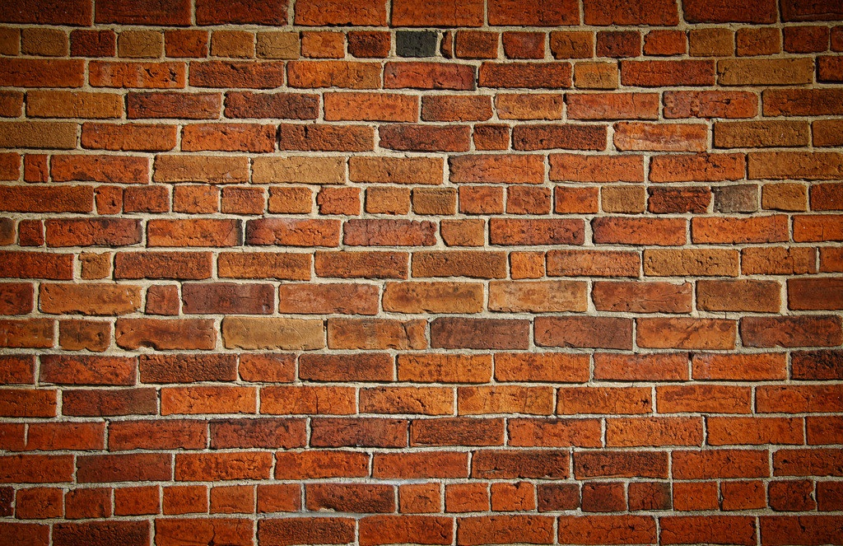
BARRIERS
TO
COMMUNICATION
LECTURE 4

Slide 2
BARRIERS
Anything that hinders the process of communication at any of these levels is a barrier to communication
Barriers to communication can be defined as the aspects or conditions that interfere with effective exchange of ideas or thoughts.

Slide 3
CLASSIFICATION OF BARRIERS
PHYSICAL BARRIERS
SEMANTIC AND LANGUAGE BARRIERS
SOCIO-PSYCHOLOGICAL BARRIERS
ORGANIZATIONAL BARRIERS
CROSS-CULTURAL BARRIERS

Slide 4
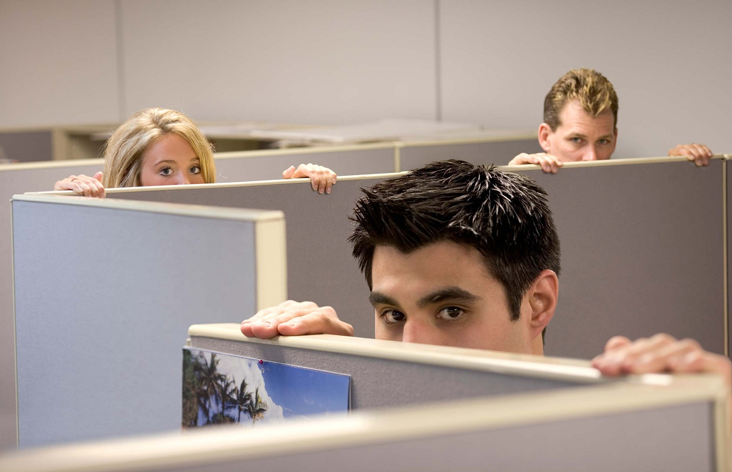
PHYSICAL BARRIERS

Slide 5
Physical barrier is the environmental and natural condition that act as a barrier in communication in sending message from sender to receiver. Organizational environment or interior workspace design problems, technological problems and noise are the parts of physical barriers.
When messages are sent by the sender, physical barriers like doors, walls, distance, etc. do not let the communication become effective. The barriers are less if the proximity of the sender and the receiver is high and less technologies are required.
Disturbance in hearing due to thunders, telephone call disconnection, problems in television reception, message not being sent in chat, etc. are some examples of physical barriers of communication

Slide 6
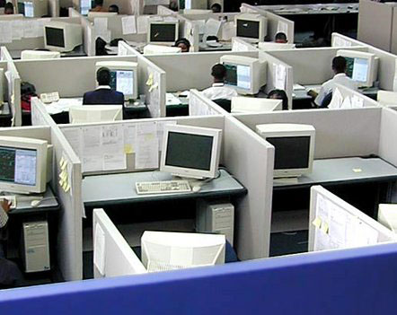
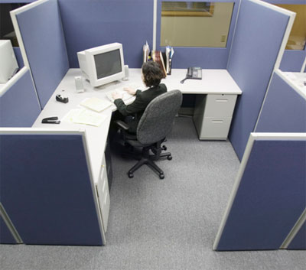
Faulty Organizational Structure
Large working area
Closed office doors
Separate areas for people of different status
It forbids team member from effective interaction with each other.

Slide 7
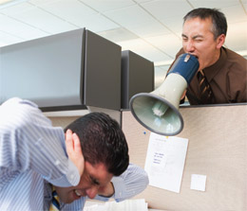
Noise
Physical noise (outside disturbance)
Psychological noise (inattentiveness)
Written noise (bad handwriting/typing)
Visual noise (late arrival of employees)

Slide 8
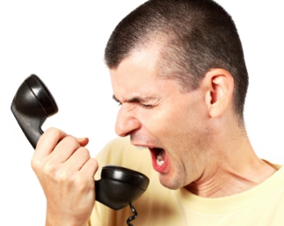
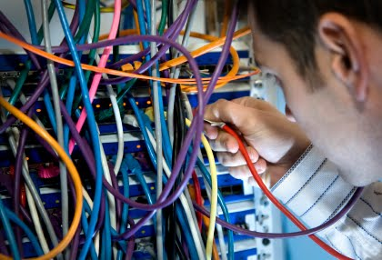
Time and Distance
Improper Time
Defects in Medium of communication
Network Facilities
Mechanical Breakdowns

Slide 9
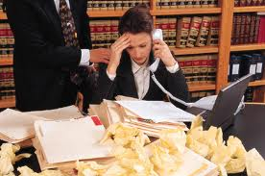
Information Overload
Piling up of tasks due to improper time management.
Excess number of people assigned for same task
Work overload/Information duplication.

Slide 10
ENVIORNMENT AND CLIMATE
Thunder, rain, wind and other environmental factors create noise which cannot be stopped and disturb the message flow. Natural noise is present in the environment which disturbs the communication.
Likewise, unstable temperature makes people unfocused on creating the message. If temperature of a place is too high or low, people cannot concentrate on the information they are sending. It promotes uncomfortable feelings which leads to environmental and physical barrier to communication. Similar is the case of improper lightening which impairs proper visual communication.

Slide 11
SEMANTIC & LANGUAGE
BARRIERS
Those who speak do not know
Those who know do not speak
- Random Japanese Guy

Slide 12
SEMANTICS
What do you mean by SEMANTICS?
Semantic is the study of meaning, signs and symbols used for communication. The word is derived from “sema”, a Greek word meaning signs. Semantic barriers to communication are the symbolic obstacles that distorts the sent message in some other way than intended, making the message difficult to understand.
The meaning of words, signs and symbols might be different from one person to another and the same word might have hundreds of meanings. So, when a message is sent by a sender to a receiver, it might be interpreted wrongly in a communication process causing misunderstandings between them

Slide 13
CAUSES OF SEMANTIC BARRIER
3 main causes
HOMOPHONES
HOMONYMS
HOMOGRAPHS

Slide 14
SIMILAR SOUNDING WORDS
These words are known as Homophones
Pronunciation
Spelling
Meaning
Examples:
pale/pail
alter/altar
buy/bye/by
rain/reign

Slide 15
WORDS HAVE MULTIPLE PRONUNCIATIONS
These words are known as Homographs
Spelling
Pronunciation
Meaning
Examples
The bandage was wound around the wound.
We must polish the Polish furniture.
He could lead if he would get the lead out.

Slide 16
WORDS HAVE MULTIPLE MEANING
These Words are also known as homonyms
Spelling
Pronunciation
Meaning
Examples
Never desert your friends in the desert.
Close the window before the bee gets too close

Slide 17
DENOTATIONS AND CONNOTATIONS
TYPES OF SEMANTIC BARRIER:
Denotation: The literal meaning of a word
For example, the meaning of braces which is used to define the metallic structure to adjust teeth in American English whereas it means a part of clothing in British English.
Connotations: The emotions and associations connected to a word
For example, the word astonish can be used to describe surprise as well as startle. The words, when used by someone, can have any of the meaning. The context in which it is used will only let the receiver know what the sender means. Another example is the word god, which is used differently by people following different religions.
Examples:
They gave us cheap stuff.
At this shop, they sell things cheap

Slide 18
LANGUAGE BARRIERS
Language is needed for any kind of communication even people with speech impairments communicate with sign language and brail. Communication becomes difficult in situations where people don’t understand each others’ language. The inability to communicate using a language is known as language barrier to communication.

Slide 19
Causes of Language Barriers
Difference in Language
Difference in language is the most obvious barrier to communication as two people speaking two different languages cannot communicate with each other. For example, an American goes to China. The person does not understand Chinese and most people in China do not understand English. So, when the person speaks, the communication is worthless as the other Chinese person doesn’t understand it.
No Clear Speech
People who speak soft or in a small voice cannot be understood. The sender might be saying something whereas the receiver might understand something else. Though speaking common language, people might have difficulty understanding the meaning of the message and the feedbacks. This might also be a cause of obstacle in communication.

Slide 20
Use of Jargons and Slang
Jargons are the technical words used in communication. It might be different according to different professions, specialty and technical field of a person.
For example, technical words used by doctors and lawyers are extremely different. If they start talking, both of them will not get what the other is talking about.
Similarly, the use of slang also makes communication ineffective. For example, the use of word “grass” to describe marijuana can act as a barrier for the people who do not know the slang meaning.
Word Choice
The choice of word used in describing anything must be considered before communicating. The words used by a particular person to show their agreement on something can be taken as sarcasm which is negative in nature.

Slide 21
GRAMMAR AND SPELLING
Grammar and spelling becomes a barrier in communication as people from different parts of the world can be using it differently even in a particular word. Similarly, grammar and spelling mistakes create a huge communication barrier in written communication.
or example, a person makes a mistake of typing done as don. The spelling and grammar checker of the computer does not label it as wrong as don is also a correct word. But, the word can change the whole meaning of the sentence or make the sentence not understandable.

Slide 22
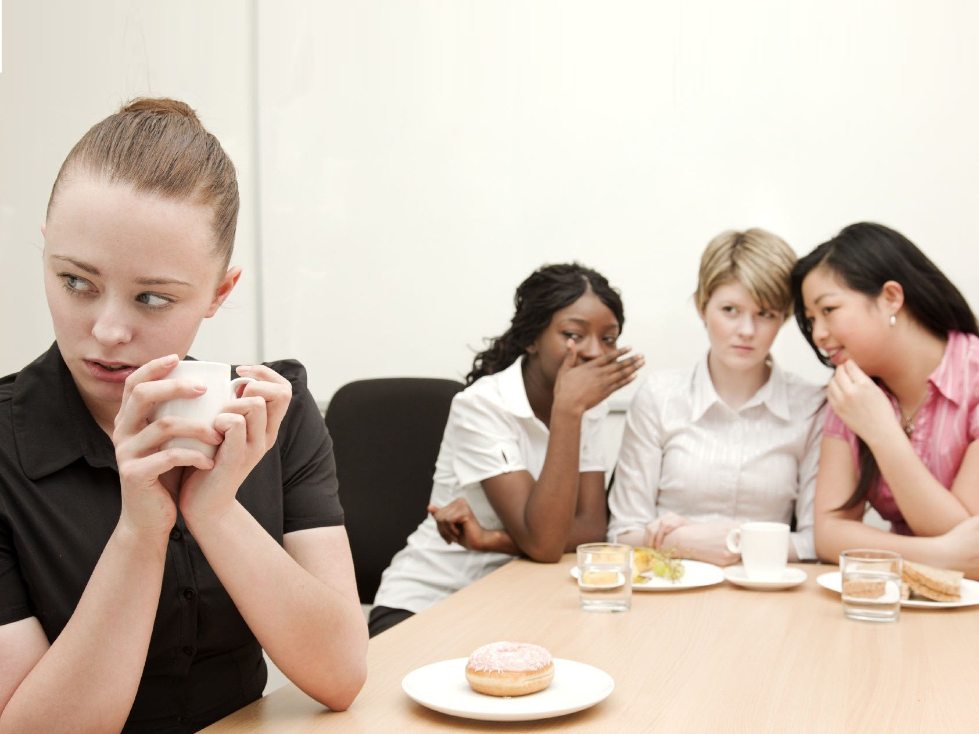
SOCIO-PSYCHOLOGICAL BARRIERS

Slide 23
What is Psychological barrier?
Psychological barriers can be described as the cause of distorted communication because of human psychology problems.
Communication is highly influenced by the mental condition that the communicators are in and is disturbed by mental disturbance. If the people involved in communication are not emotionally well, they won’t be able to communicate properly.

Slide 24
Lack of Attention
When a person’s mind is distracted or preoccupied with other things, the person is not able to form proper message, listen to what others tell him/her, interpret the message as required and give proper feedback. The communication will face problems and becomes ineffective
Poor Retention
Retention of information is the capacity of the memory of the brain to store information and the way brain stores information in memory. Brain does not store all the information it comes across, but only the ones it deems useful for future. So, half the information is lost in the retention process.

Slide 25
For example, you were told about a friend coming to meet you before a month and had been given the person’s name, address, phone number, etc. Now, you have to communicate the information to somebody else. At the time, you only remember the name and address and forget the phone number. The truth can change or distort due to poor retention which acts as barrier to communication.

Slide 26
Distrust and Defensiveness
Communication is successful when the communicators trust each other.
Lack of trust makes them derive negative meaning of the message and they ignore the message. When a person tries to force his/her own ideas and opinions, then receiver does not listen. If the receiver does not agree to the message provided or thinks of it as a threat, he/she will not listen to it.
Similarly, when the message is not transferred across to the receiver, the communication fails. For example, I don’t trust a friend, I will only give the details, of what is happening in my personal life which I think are harmless.

Slide 27
Perception, Viewpoint, Attitudes and Opinions
Perception is the mindset using which people judge, understand and interpret everything. Each person has his/he own perception of reality which is shaped from mental and sensory experiences.
Likewise, viewpoint is also a mindset to look at the world. Sender might have a particular viewpoint that is not shared by the receiver. The sender does not explain the viewpoint but takes the viewpoint as granted. The message is not understood by the receiver as must have been understood, creating a barrier to effective communication.

Slide 28
Attitude is the established way in which we think and feel about things and ideas which also creates a psychological communication barrier.
For example, a person takes females to be weak which is the person’s perception. He/she tells that to someone who does not think so. This causes a misunderstanding between the two. Everything they communicate after that becomes unsuccessful that the view of the person is already set.

Slide 29
Closed Mind and Filtering
Man is selfish by nature and put his own needs and problems above all else. This sometimes leads people to filter information that someone is trying to convey to them. This might be due to mistrust, competition, jealousy, or the view that the message is insignificant.
For example, a senior in a company does not want the junior to do better at work, the person filters the information and does not provide crucial information that could help the junior. The junior therefore will not be able to complete the work properly and progress in ranks. Similarly, when a person is close minded, the person will have fixed opinions on many things which the person believes resolutely. The person will interpret any information in a negative way.

Slide 30
For example, a sexist person does not accept the suggestions of a female colleague in a meeting that affects the communication flow in the meeting. It is difficult to argue with such close minded people and give proper information.

Slide 31
CROSS-CULTURAL BARRIERS

Slide 33
Cross Culture Communication
Culture is all socially transmitted behavior, arts, architectures, languages, signs, symbols, ideas, beliefs, norms, traditions, rituals, etc. which is learnt and shared in a particular social group of the same nationality, ethnicity, religion, etc.
Cross-cultural communication barriers such as anxiety, uncertainty, stereotyping, and ethnocentrism are caused by inadequate cultural knowledge and the lack of intercultural communicative skills.
In America, people communicate freely and that is a part of their culture. In Germany, an Indian who is used to being very indirect with his communication might find their direct way of speaking rude. Being direct is part of the German culture and it is reflected in the way they communicate. Communication shapes culture and culture shapes communication.

Slide 34
Different Cross Cultural Barrier
Language
Different cultures have developed their own language as a part of their heritage. People are comfortable communicating in their own language whereas have to work hard to learn new languages. For example, separation of East and West Germany for 40 years caused the language to differ a lot. The dialect became very different as people of East Germany had an influence of Russian language whereas West Germany had influence of English.
Signs and Symbols (Semantics)
Non-verbal communication cannot be relied upon in communication between people from different cultures as that is also different like language. Signs, symbols and gestures varies in different cultures.
For example, the sign “thumbs up” is taken as a sign of approval and wishing luck in most of the cultures but is taken as an insult in Bangladesh. Similarly, the “V” hand gesture with palm faced outside or inside means victory and peace in US, but back of hand facing someone showing the sign is taken as insulting in many cultures

Slide 35
Stereotypes and Prejudices
Stereotyping is the process of creating a picture of a whole culture, overgeneralizing all people belonging to the same culture as having similar characteristics and categorizing people accordingly. It is a belief about a certain group and is mostly negative.
Stereotyping can be done on the basis of many things like nationality, gender, race, religion, ethnicity, age, etc. For example, Asian students are stereotyped to be good at Math which is a positive stereotype. But, there is also cultural stereotype of all people following a particular religion as being violent like Islam and is negative stereotyping

Slide 36
Behavior and Beliefs
Cultural differences causes behavior and personality differences like body language, thinking, communication, manners, norms, etc. which leads to miscommunication. For example, in some cultures eye contact is important whereas in some it is rude and disrespectful. Culture also sets a specific norms which dictates behavior as they have guidelines for accepted behavior. It explains what is right and wrong. Every action is influenced by culture like ambitions, careers, interests, values, etc. Beliefs are also another cause for cultural barrier.
For instance, mostly, people who believe in god can cope with their lows of life easily than atheists but atheists are more hardworking at all times which relates to their behavior and communication

Slide 37
Ethnocentrism
Ethnocentrism is the process of dividing cultures as “us” and “them”.
The people of someone’s own culture are categorized as in-group and the other culture is out-group. There is always greater preference to in-group. There is an illusion of out-group as evil and inferior. This evaluation is mostly negative.
If the culture is similar to us, then it is good and if is dissimilar, it is bad. Other’s culture is evaluated and assessed with the standard being their own culture. Ethnocentrism affects the understanding of message, and encourages hostility. For example, the books in schools use reference of their own culture to describe other cultures by either showing common things or differences.

Slide 38
Religion
Similar to ethnocentrism and stereotyping, religion also disrupts communication as it creates a specific image of people who follow other religions. People find it difficult to talk to people who follow different religions. Religious views influence how people think about others. It creates differences in opinions.
For example, in Pakistan, the Christians have to speak up for their rights as the majority is of Islam and the Christians are discriminated. There is also a lack of communication between these religious groups.

Slide 39
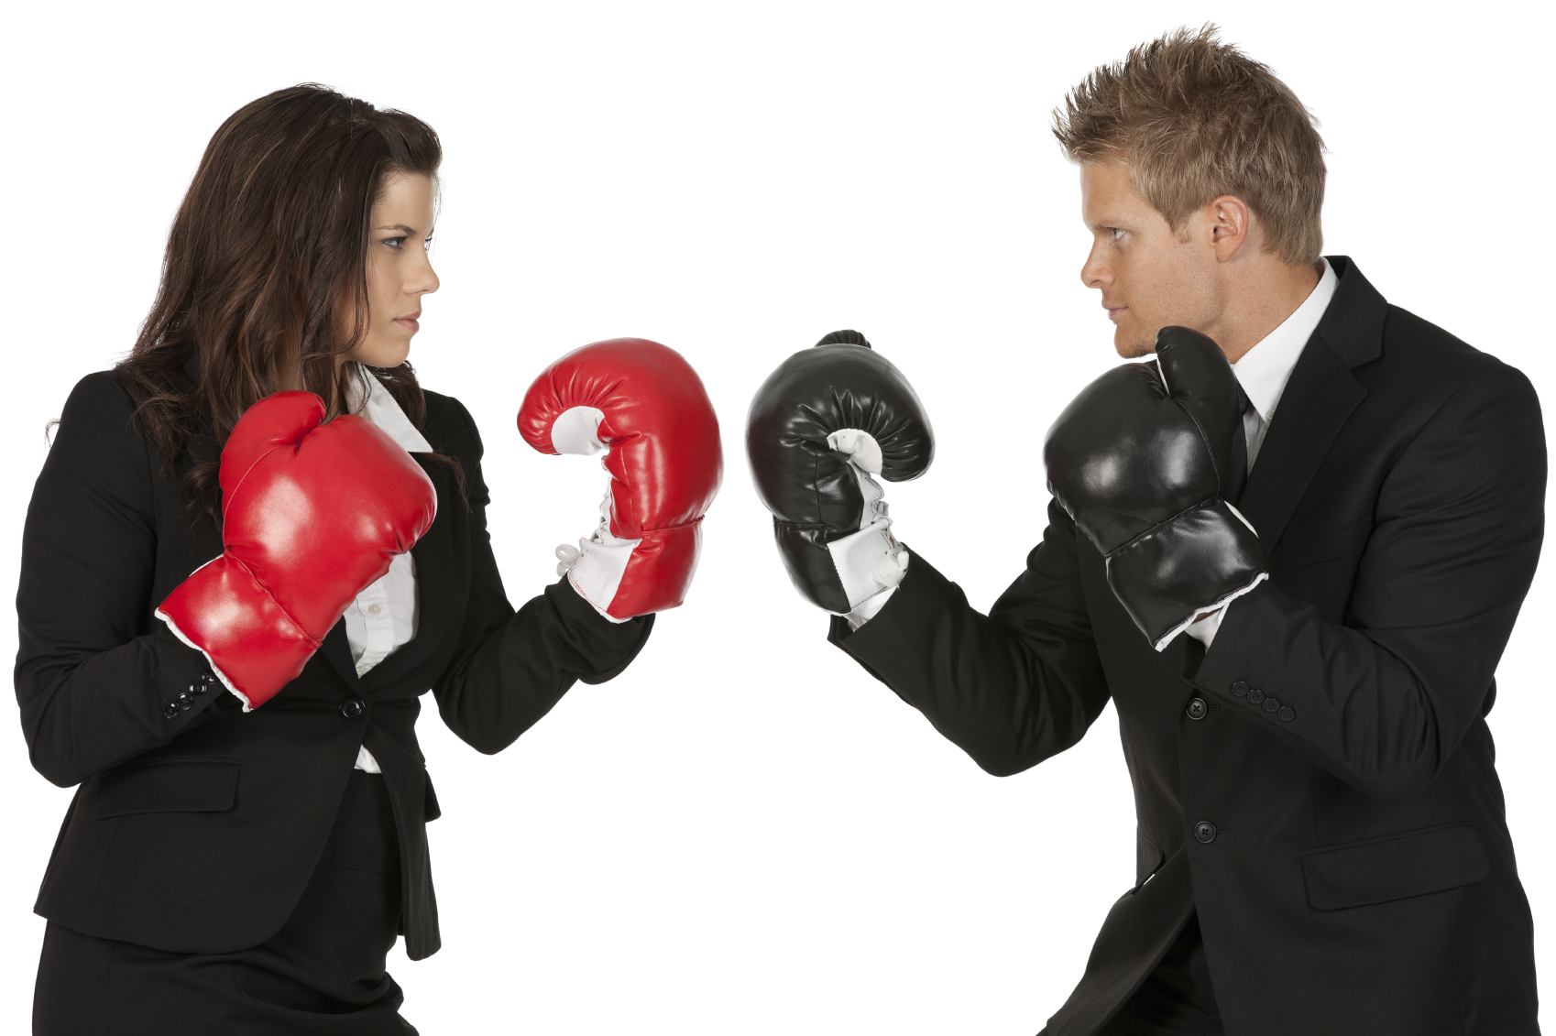
ORGANISATIONAL BARRIERS

Slide 40
Organizational barriers
Organizational barriers come up when characteristics of the client system itself conflict with the demands of change. There are several examples of these types of barriers. They are threat to power and influence, organizational structure, behavior of top-level administrators, climate for change in the organization and technological barriers of resistance.
Notes:
rate

Slide 41
….cont
Lack of communication policy
Authoritarian attitude of management
Poorly Defined Authority and Responsibility
Too Many Levels in Organization Structure
Insufficient Communication Training

Slide 42
Examples include filtering(Filtering is the distortion or withholding of information to manage a person’s reactions.), selective perception(Selective perception refers to filtering what we see and hear to suit our own needs. This process is often unconscious.), information overload, emotional disconnects(A sender or receiver who is emotionally upset may be unable to present ideas or feelings effectively.), workplace gossip, gender differences, and semantics.

Slide 43
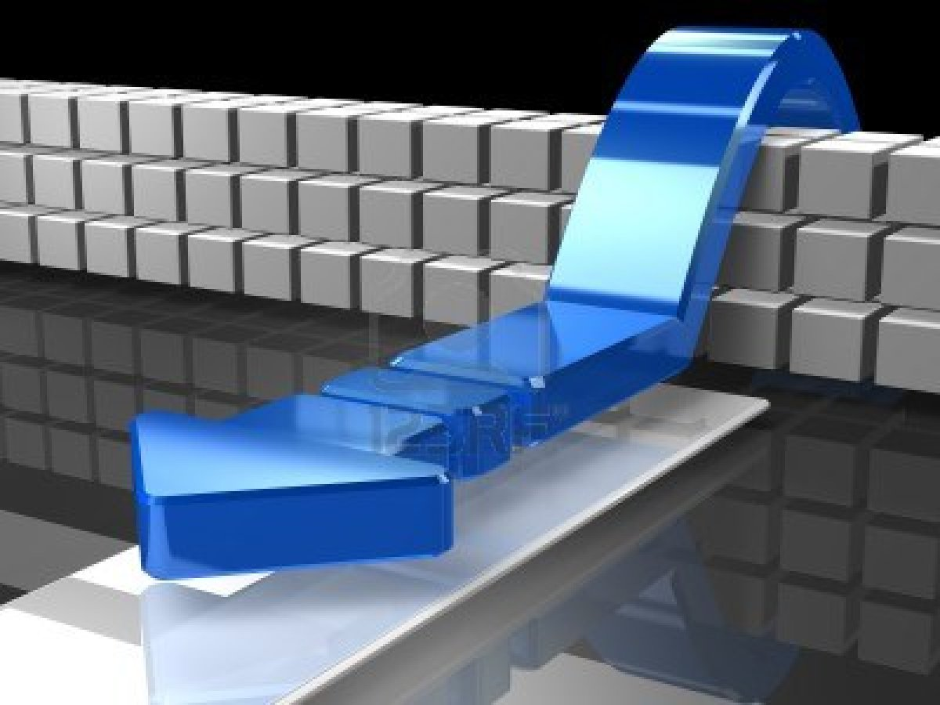
CONCLUSION

Slide 44
Ways To Overcome Barriers to Communication-
For Physical Barriers-
Appropriate Seating Arrangement
Ensure Visibility & Audibility
Environmental Comfort
Minimise Visual/Oral Distractions
For Semantic Barriers-
Use of Simple Language
Symbols & Charts
Active Listening/ Constructive feedback

Slide 45
Contd..
For Socio-Psychological Barriers-
Calling Attention & Motivation
Assistance & Sympathy
For Cross Cultural Barriers-
Understanding of Traditions & Customs
Information of all Sides of Culture

Slide 46
Contd..
For Organisational Barriers-
Simple Organisational Structure
Avoiding Information Overload
Flexibility in Meeting Targets

