Slide 2
ASSINGMENT Principle Of Organic Farming

Slide 3
Organic Farming
Definition
The farming including the exclusion of synthetic chemicals
The farming free of synthetic chemicals

Slide 4
History
It is being practiced from several years. When we study history we will come to know that Charles Drawin firstly observe break down of ingested matter by worm resulting in provision of nutrients to plant.

Slide 5
PRINCIPLES OF ORGANIC FARMING
Organic foods set the standard for top quality freshness, texture, flavor, and variety. These foods are produced without the standard array of modern toxic and persistent chemicals commonly used on conventional food products since the 1950s. Yet organic farming isn't primitive, it's actually farming with our future at heart.

Slide 6
Basic Conventional Farming
To help understand the differences, here is a quick look at conventional farming practices. Conventional growers use an assortment of synthetic pesticides, fertilizers, genetically engineered organisms and growth enhancers to stimulate their soil and crops. Their focus is on short-term yield increases rather than long term soil health. When the soil is found lacking in various nutrients, they are added through the use of synthetic fertilizers. Crops may be grown from genetically engineered seeds. Pesticides or fungicides may be used to control insects in crop storage and transportation. Conventional farmers can use manure without restrictions and are not required to keep records of their production practices.

Slide 7
Basic Organic Farming
Organic farmers manage their crops using proactive practices to prevent problems. They strive to:
Replenish and maintain soil fertility.
Eliminate the use of toxic and persistent chemical pesticides and fertilizers.
Restore, maintain, and enhance ecological harmony.
Build and support biologically diverse agriculture.
To be certified as organic, all organic farmers must keep records verifying their practices and products used.

Slide 8
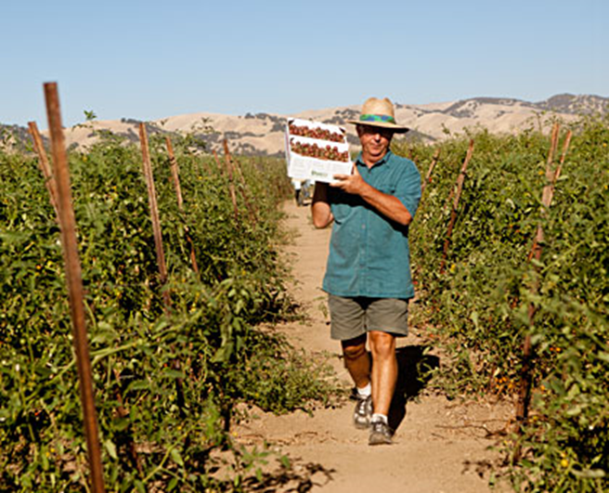
Organic Farming Practices
Organic farmers select the most environmentally friendly solutions to the pests and disease problems that affect their crops. These strategies include

Slide 9
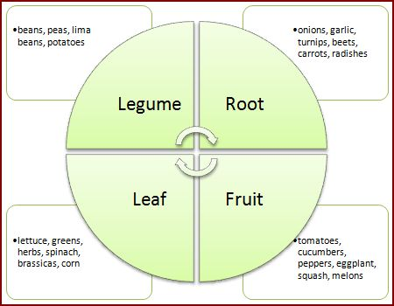
Crop Rotation
This means alternating the crops grown in each field, rather than growing the same crop year after year (mono-cropping). Different plants contribute varying nutrients to the soil. By rotating crops, the soil is naturally replenished. This time-honored practice can eliminate the need for insecticides in many crops since the insect's life cycle and habitat are interrupted and destroyed.

Slide 10
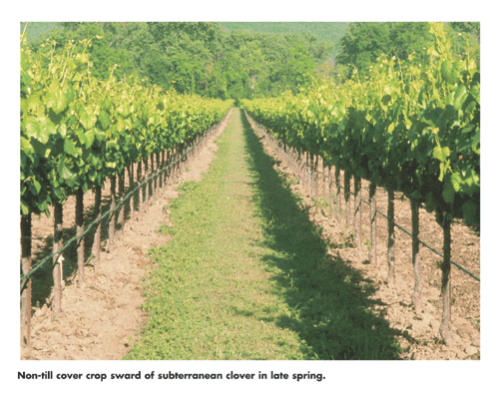
Cover Crops
Cover crops can protect the soil, add nutrients, prevent weed growth, aerate the soil with deep root systems, and fertilize the soil by building organic matter when plowed under. Sometimes referred to as "green manure crops," cover crops also conserve soil moisture and feed the soil's micro flora and fauna, such as earthworms. By encouraging the lifecycles of beneficial soil organisms, problematic bacteria, fungi, nematodes, diseases and insects are prevented from proliferating.

Slide 11
Release beneficial insects
Organic farmers utilize natural predators to control pests that destroy their crops, which eliminates the need for chemical insecticides that remains in the soil for years.

Slide 12
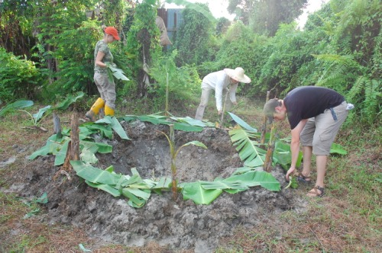
Add compost and plant wastes
Use of manure in organic production (including raw animal manure) is highly regulated, unlike the animal manures and fertilizers used in conventional farming. The continuous cycling of naturally occurring materials helps the soil retain moisture and nutrients. Correctly made compost kills pathogens and weed seeds, producing a fertilizer that encourages soil life and healthy crops

Slide 13
Mulching
Mulching means covering the ground with a layer of loose material such as compost, manure, straw, dry grass, leaves or crop residues. Green vegetation is not normally used as it can take a long time to decompose and can attract pests and fungal diseases. Mulches have several effects on the soil which help to improve plant growth:
Decreasing water loss due to evaporation
Reducing weed growth by reducing the amount of light reaching the soil
Preventing soil erosion
Increasing the number of micro-organisms in the top soil
Adding nutrients to the soil and improving soil structure
Adding organic matter to the soil Alternative mulching materials include black plastic sheeting or cardboard. However these materials do not add nutrients to the soil or improve its structure.

Slide 14
Weed control
In organic farming systems, the aim is not necessarily the elimination of weeds but their control. Weed control means reducing the effects of weeds on crop growth and yield. Organic farming avoids the use of herbicides which, like pesticides, leave harmful residues in the environment. Beneficial plant life such as host plants for useful insects may also be destroyed by herbicides.
On an organic farm, weeds are controlled using a number of methods:
Crop rotation
Hoeing
Mulches, which cover the soil and stop weed seeds from germinating

Slide 15
Green manures or cover crops to outcompete weeds
Animals as weeders to graze on weeds
Hand-weeding or the use of mechanical weeders
Planting crops close together within each bed, to prevent space for weeds
to emerge

Slide 16
Principle of organic faming
The principle of organic farming are listed below
Ensure quality of food
Ensure quantity of food
Adoption of environment friendly practices
Interacting with natural ecosystem
Ensure the quality of water
Using of renewable resources
Ensure plant and animal health
Practices that helpful in decreasing pollution
Increasing use of flora, fana and microorganism

Slide 17
Use and develop appropriate technologies based upon an understanding of biological systems.
Achieve and maintain soil fertility for optimum production by relying primarily on renewable resources.
Use diversification to pursue optimum production.
Aim for optimum nutritional value of staple food.
Use decentralized structures for processing, distributing and marketing of products.
Strive for equitable relationship between those who work and live on the land.
Maintain and preserve wildlife and their habitat

Slide 18
conclusion
For a country to be independent of other in matter of fiber , food and shelter agriculture play an important role. The use of fertilizers in recent years increase to make the country self sufficient, due to which toxic effect increases that leads towards the disturbance of ecosystem. In a true sense if agriculture effect the environment system and have draw back of economic problems for farmer it can't be sustainable. The organic farming practices like green manuring , FYM etc. should be adopted to eradicate such problems. Now , after so much discussion it is clear that organic farming could be helpful for agriculture sustainability if adequate concentration paid on this.

Slide 19
References
Arora, C.L., Nayaar V.K. and Randhuwa S.S., 1975. Note on Secondary and Micro Nutrient Content of Fertilizers and Manures, Indian J. Agric. S. 45: 085.
Asmed, S., 1993. Agriculture-Fertilizer Interference in Asia. Issue of Growth and Sustainability, Oxford and IBH Publishers, New Delhi, India.
Bhattarai, D.K. and Bathla J.C., 1997. Nitrate Pollution of Underground Water, Ilaryana, Ilaryana Farming (Aug. 1997), CCSIIAU, Ilisar, India.
Bould, C., 1994. Diagnosis of Mineral Disorders in Plants, Vol. 1,2, 3 Principles. Chemical Publishing, New Delhi, India.

