Slide 1
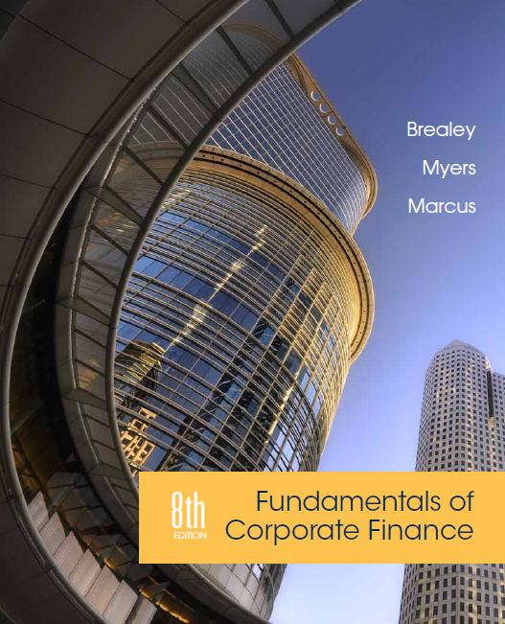
Chapter 18
Long-Term Financial Planning
Copyright © 2015 by The McGraw-Hill Companies, Inc. All rights reserved

Slide 2
Topics Covered
18.1 What is Financial Planning?
18.2 Financial Planning Models
Example: Executive Cheese
Example: Executive Fruit
18.3 Planners Beware
18.4 External Financing and Growth
Notes:
2

Slide 3
Financial Planning
The Financial Planning Process
Analyzing the investment and financing choices open to the firm
Projecting the future consequences of current decisions
Deciding which alternatives to undertake
Measuring subsequent performance against the goals set forth in the financial plan
Notes:
3

Slide 4
Financial Planning
Planning Horizon - Time horizon for a financial plan
Departments are often asked to submit 3 alternatives
Optimistic case = best case
Expected case = normal growth
Pessimistic case = retrenchment
Financial plans help managers ensure that their financial strategies are consistent with their capital budgets. They highlight the financial decisions necessary to support the firm’s production and investment goals.
Notes:
8

Slide 5
Financial Planning
Why Build Financial Plans?
Contingency planning
Considering options
Forcing consistency
Notes:
9

Slide 6
Financial Planning Models
Inputs
Planning Model
Outputs
Inputs - Current financial statements. Forecasts of key variables (such as sales or interest rates).
Planning Model - Equations specifying key relationships.
Outputs - Projected financial statements (pro forma). Financial ratios. Sources and uses of funds.
Notes:
12

Slide 7
Financial Planning Models
Pro Formas - Projected or forecasted financial statements
Percentage of Sales Model - Planning model in which sales forecasts are the driving variable and most other variables are proportional to sales
Balancing Item - Variable that adjusts to maintain the consistency of a financial plan
Also called a plug
Notes:
13

Slide 8
Financial Planning Models
Net Income
Retained Earnings
Dividends
New Assets
Retained Earnings
External Financing
New Equity
New Debt
External Financing
By entering data provided for each variable, the remaining variable is the “plug”
Data is determined by “policy” or “rules” established by the company
Notes:
13

Slide 9
Executive Cheese
Current Income Statement and Balance Sheet
Income Statement
Sales | $1,200
Costs | 1,000
Net income | $200
Balance Sheet (YTD)
Assets | $2,000 | Debt | $800
 |  | Equity | 1,200
Total | $2,000 | Total | $2,000
Notes:
14

Slide 10
Executive Cheese
Pro forma Income Statement and Balance Sheet
Income Statement
Sales | $1,320
Costs | 1,100
Net income | $220
Balance Sheet (YTD)
Assets | $2,200 | Debt | $880
 |  | Equity | 1,320
Total | $2,200 | Total | $2,200
Rule: Dividend is fixed at $100
Notes:
15

Slide 11
Executive Cheese
Policy: Pro forma balance sheet with dividends fixed at $180 and debt used as the balance item
Policy: Pro forma balance sheet with dividends fixed at $180 and new debt limited to $100. Equity is the balancing item
Panel A
Panel B
Balance Sheet (YTD)
Assets | $2,200 | Debt | $960
 |  | Equity | 1,240
Total | $2,200 | Total | $2,200
Balance Sheet (YTD)
Assets | $2,200 | Debt | $900
 |  | Equity | 1,300
Total | $2,200 | Total | $2,200
Notes:
16

Slide 12
Executive Fruit
2014 Financial Statements
Balance Sheet
Assets
Net working capital | $200 | 10% of sales
Fixed assets | 800 | 40% of sales
Total assets | $1,000 | 50% of sales
Liabilities and shareholders' equity
Long-term debt | $400
Shareholders' equity | 600
Total liability + equity | $1,000 | Equals total assets
Income Statement
Revenue | $2,000
COGS | 1,800 | 90% of sales
EBIT | $200 | Difference = 10% of sales
Interest | 40 | 10% of debt at start of year
Earnings before taxes | $160 | EBIT – interest
State and federal tax | 64 | 40% of (EBIT –interest)
Net income | $96 | EBIT – interest – taxes
Dividends | 64 | Payout ratio = 2/3
Retained earnings | $32 | Net income – dividends

Slide 13
Executive Fruit
2015 Pro Forma Statements
Balance Sheet
Assets
Net working capital | $220 | 10% higher
Fixed assets | 880 | 10% higher
Total assets | $1,100 | 10% higher
Liabilities and shareholders' equity
Long term debt | $400 | Temp held fixed
Shareholders' equity | 636 | Increased by RE
Total liability + equity | $1,036 | Debt + equity
Required external financing | 64
Income Statement
Revenue | $2,200 | 10% higher
COGS | 1,980 | 10% higher
EBIT | $220 | 10% higher
Interest | 40 | unchanged
Earnings before taxes | $180 | EBIT – interest
State and federal tax | 72 | 40% of (EBIT –interest)
Net income | $108 | EBIT – interest – taxes
Dividends | 72 | Payout ratio = 2/3
Retained earnings | $36 | Net income – dividends

Slide 14
Executive Fruit
Second Stage Pro Forma Balance Sheet 2015
Balance Sheet
Assets
Net working capital | $220 | 10% higher
Fixed assets | 880 | 10% higher
Total assets | $1,100 | 10% higher
Liabilities and shareholders' equity
Long term debt | $464 | 16% higher (new borrowing = $64; this is the balancing item)
Shareholders' equity | 636 | Increased by retained earnings
Total liability + equity | $1,100 | Equals total assets

Slide 15
Executive Fruit
Sources and Uses of Funds 2015
Sources |  | Uses
Retained earnings | $36 | Investment in working capital | $20
New borrowing | 64 | Investment in fixed assets | 80
Total sources | $100 | Total uses | $100

Slide 16
Executive Fruit
Growth Rate, % | Required External Finance, $ thousands
0.00 | -32.00
2.00 | -12.80
3.33 | 0.00
5.00 | 16.00
10.00 | 64.00
15.00 | 112.00
20.00 | 160.00
Required external financing
= (net assets/sales) × increase in sales – retained earnings
= (.50 × 200,000) – 36,000 = $64,000

Slide 17
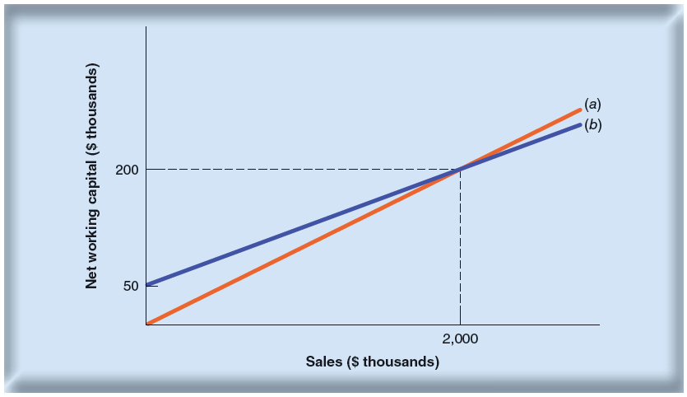
Planners Beware
Net Working Capital as a Function of Sales

Slide 18
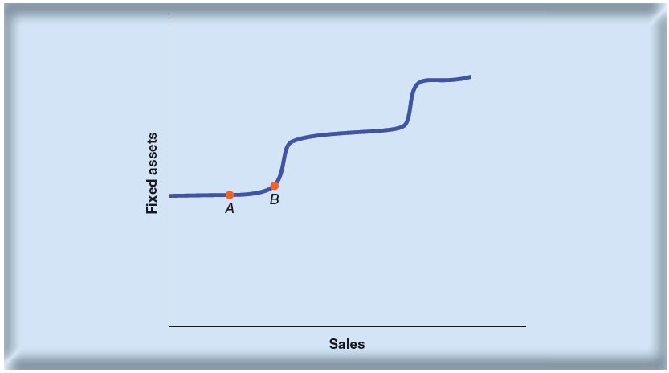
Planners Beware
If factories are operating below full capacity, sales can increase without investment in fixed assets (point A)
Beyond some sales level (point B), new capacity must be added.

Slide 19
Planners Beware
Many models ignore realities such as depreciation, taxes, etc.
Percent of sales methods are not realistic because fixed costs exist
Most models generate accounting numbers not financial cash flows
Adjustments must be made to consider these and other factors
Notes:
17

Slide 20
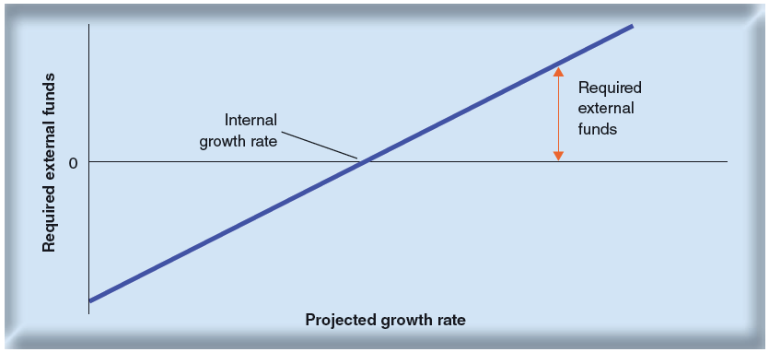
External Financing & Growth
Where the sloping line crosses the horizontal axis, external financing is zero
The firm is growing as fast as possible without resorting to new security issues
Called the internal growth rate

Slide 21
External Financing & Growth
Sustainable growth rate - Steady rate at which a firm can grow without changing leverage
Sustainable growth rate = plowback ratio × return on equity
$$Internal growth rate= \frac{retained earnings}{assets}$$
$$=\frac{retained earnings}{net income}×\frac{net income}{equity}×\frac{equity}{assets}$$
$$Required external financing=\frac{new assets}{sales}×\begin{matrix}\begin{aligned}increase \\ in sales\end{aligned} & − & \begin{aligned}reinvested \\ earnings\end{aligned}\end{matrix}$$
Notes:
20

