Slide 2
CONTENTS
Sanitation
Thermal sanitation
Chemical sanitation
Chlorine releasing compound
Quats
Iodophores
Irradiation

Slide 3
PLANT SANITATION…
Definition
Reduction of microorganisms to a level considered safe from a public health point of view
According to Association of Official Analytical Chemists
sanitizing of food product contact surfaces is a process which reduces contamination level by 99.999% in 30sec
The standard test organisms used are Staphylococcus aureus and Escherichia coli

Slide 4
PLANT SANITATION
Thermal sanitation
Chemical sanitation
Irradiation
Sanitation could be employed in the form of

Slide 5
THERMAL SANITATION
It is the use of hot water or steam at a specific temperature for precise length of contact time
Dry heat( hot air) is less effective than wet heat( steam or hot water)
Hot water is useful for sanitizing food plants because appreciable quantities of bacteria are also removed by this action
Steam is used for sanitizing storage tanks, pipelines and vessels
Steam jets are used both interior and exterior sanitizing of plants

Slide 6
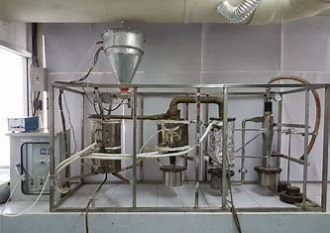
THERMAL SANITATION…
Thorough cleaning of equipment before heat sanitation is essential, otherwise food soils on contaminated surfaces can be baked on to plant surfaces

Slide 7
CHEMICAL SANITATION
The use of an approved chemical agent at a particular concentration for a specific time period
It is very convenient to use for cleaning in place systems
They can be used in cold dilute solutions in order to prevent the corrosion of food plant material

Slide 8
CHEMICAL SANITATION…
Most commonly used chemical sanitizers are
Chlorine releasing compounds
The quanternary ammonium compounds
Iodophores
Amphoteric or acid anionic santizers

Slide 9
IRRADIATION…
The use of ionic radiations of specific wavelength for precised length of time
UV rays having wavelength from 13.6 to 400nm are used to disinfect surfaces of equipment
UV rays having wavelength of 200 to 280nm are used in food processing plants to inactivate microoagnisms

Slide 10
Thank You ☺

