Slide 1
Cardiac output and venous return
Cardiac Output
It is vol. of blood pumped by heart into aorta each minute.
Value
5 (range 5-6) lit./min at rest.
Venous Return
It is vol. of blood flowing from veins into right .itrium each min.
Value
VR = Cardiac output

Slide 2
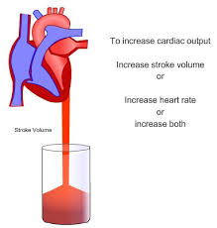
Cardiac output and venous return

Slide 3
Cardiac output and venous return
Cardiac Index
Cardiac output per square meter of body surface is called cardiac index.
Value
5/1.7 = 3 lit./min../m²

Slide 4
Cardiac output and venous return
Regulation of Cardiac Output
Different factors that partake in regulation of cardiac output are
Heart
Heart plays permissive role in cardiac output regulation.
That is, it is capable of pumping 10-13 lit. of blood per min.
It permits cardiac output to be regulated at any value below this given permitted level.

Slide 5
Cardiac output and venous return
Venous Return
Inc. Venous return Inc.cardiac output in accordance with Frank-Stariling Law of heart.
Local Tissue Metabolism
Local tissue metabolism (ie inc. O₂ consumption) inc. venous return inc. cardiac output.

Slide 6
Cardiac output and venous return
Aterio-Venous(AV) Fistuia
AV fistula (i.e direct opening of artery into vein) Inc.venous return Inc.cardiac output.
Blood Volume
Inc. blood vol. Inc. mean systemic filling pressure Inc. venous return Inc. Cardiac output.

Slide 7
Cardiac output and venous return
Mean Systemic Filling pressure
Inc. MSFP Inc. venous return Inc. cardiac output.
Exercise
Cardiac ouput inc. in exercise due to:
Just thinking about exercise Psychic effect Sympathetic stimulation Inc. heart rate and strength and peripheral vasoconstriction Inc. cardiac output

Slide 8
Cardiac output and venous return
When signals from motor cortex go to muscles, collateral signals go to vasomotor center Sympathetic Stimulation Peripheral vasoconstriction but vasodilation of muscle blood vessels Inc. cardiac output.

Slide 9
Cardiac output and venous return
Muscle metabolism during exercise Vasodilator substances formed Muscle Vasodilation Inc. cardiac output.
Abdominal contraction during exercise Compression of venous reservoirs in abdomen Inc.MSFP Inc. venous return Inc. cardiac output.

Slide 10
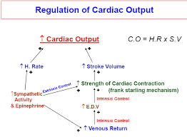
Cardiac output and venous return

Slide 11
Pathological Causes of Low Cardiac Output
Cardiac Causes
Myocardial infarction
Myocarditis
Valvular heart disease
Cardiac Temponade
Peripheral Causes
Dec. blood vol. e.g, hemorrhage
Acute venous dilation
Obstruction of veins

