Slide 1
Spill response protocols Accident Investigation Recording and Analysis

Slide 2
Basics of spill response
Spill response is an emergency response that will be guided by the Emergency Management Plan for All Hazards & Incident Command System

Slide 3
Laboratory, Studio, or Shop employees
are responsible for minor or incidental
spills of hazardous materials utilized
Clean-up of incidental
or simple spills is part of managing lab, studio, or shop chemicals properly.
All labs, studios, shops, and other campus facilities where hazardous materials are used or stored must maintain spill kits .

Slide 4
Simple Spill Clean Up .The following steps should be taken during simple spill clean-up.
1. Prevent the spread of dusts and vapors.
2. Control the spread of liquid.
3. Neutralize acids and bases, if possible.
4. Absorb the liquid.
5. Collect and contain the clean-up residue.
6. Label container, store appropriately and call EHS team for dispose of the wastes.
7. Clean up the area and affected equipment.

Slide 5
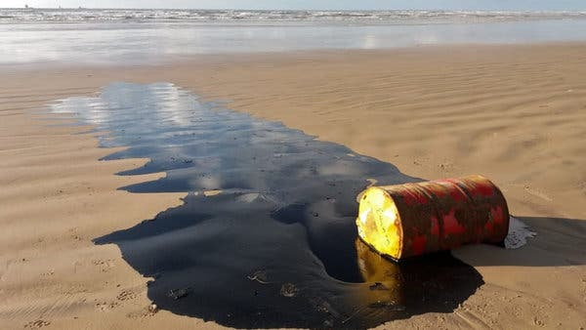
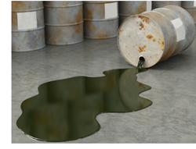
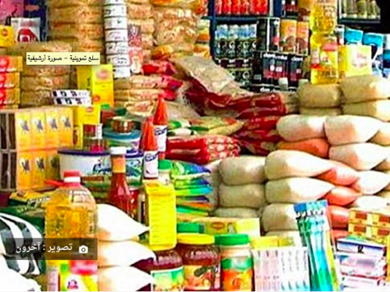
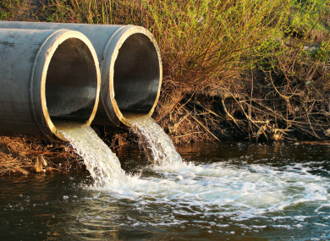
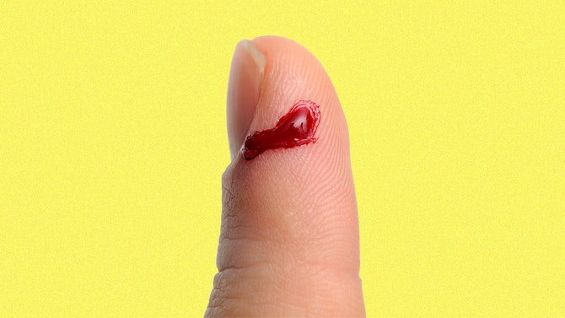
Potential Pollutants
Oils
Chemicals
Foodstuffs
Sewage/Bodily Fluids

Slide 6
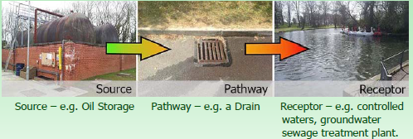
As with everything prevention is always better
than cure and every effort should be made to
engineer out the possibility of spills.
Using the source – pathway - receptor model your risk assessment should help you to prepare properly and reduce the likelihood and impact any spill could have.

Slide 7
Spill Hierarchy – Personal Safety

Slide 8
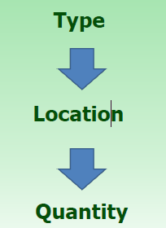
Identify & Assess Spill

Slide 9
If the worst happens and pollution leaves site the spill must be reported to the necessary bodies.
Negative Impacts of a Spill
Endanger human health (Both Staff and Public)
•Damage the environment
•Damage property
•Heavy fines from the regulators
•Bad public image
•Disrupt site operations
•Impact profits

Slide 10
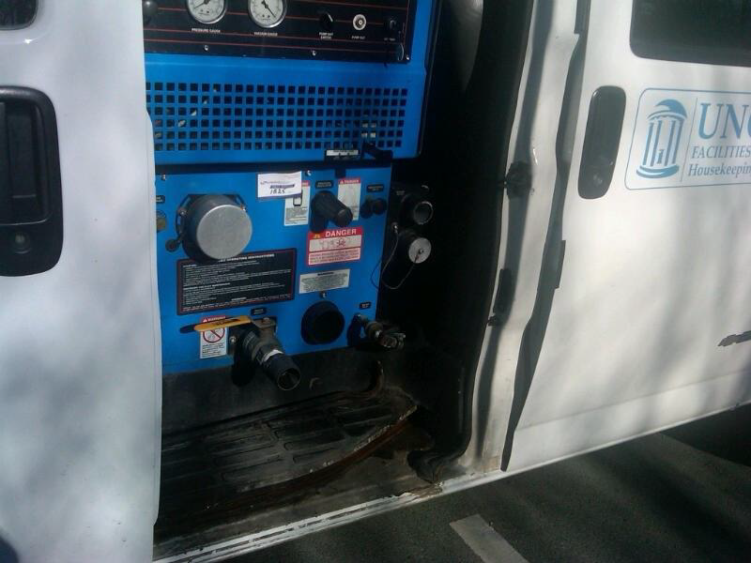
Prior to clean up, a designated area outside of the dirty area should be set up to allow employee(s) to put on necessary PPE.
(PPE should readily available for quick response.)

Slide 11
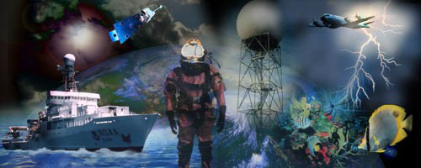
ACCIDENT INVESTIGATION
What is your definition of an “Accident”?
an unplanned event, an unplanned incident
involving injury or fatal accident
- a series of events culminating in an unplanned and unforeseen event

Slide 12
How do Accidents occur?
Accidents (with or without injuries) occur when a series of unrelated events happen together at a certain time and space.
-This can be from a few events to a series of a dozen or more (Because the accident of the series of events is a matter of luck, actual accidents only happen seldom)

Slide 13
Unsafe Acts
An unsafe act occurs in approx 85%-
95% of all analyzed accidents with injuries
- An unsafe act is usually the last of a
series of events before the accident
occurs (it could occur at any step of the
event) - By stopping or eliminating the unsafe act, we can stop the accident from occurring

Slide 14
Why Investigate Accidents?
Prevent a recurrence with corrective action
Determine the cause
Document your Line Office’s version of
the incident
Complete OSHA-required reporting

Slide 15
What is an Accident Investigation?
A systematic approach to the identification
of causal factors and implementation of
corrective actions without placing
blame on or finding personal fault.
The information collected during an
investigation is essential to determine
trends and taking appropriate steps to
prevent future accidents.

Slide 16
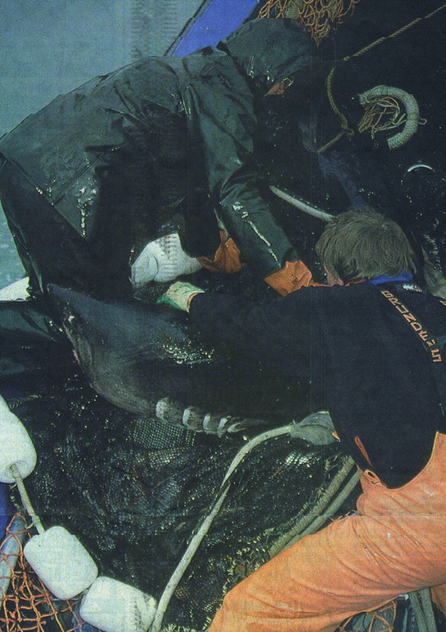
ALL accidents (including illnesses) shall be recorded and reported through the established procedures and guidance as provided by Safety Division

Slide 17
Why Investigate Accidents?
Determine the cause
Develop and implement corrective actions
Document the events
Meet legal requirements
Primary Focus:
PREVENT REOCCURENCE!!!
PREVENT REOCCURENCE!!!
PREVENT REOCCURENCE!!!

Slide 18
Who Investigates?
Minor accident/incident
— Supervisor
— Safety committee member
Major accident/incident
— Supervisor
— Safety committee member
— Occupational Health & Safety Manager’s

Slide 19
When to Investigate?
Immediately after incident
—Witness memories fade
—Equipment and clues
are moved
Finish investigation quickly

Slide 21
Accident Causes
Unsafe Act
- an act by the injured person or
another person (or both) which caused the accident,
and/or
Unsafe Condition
- some environmental or hazardous
situation which caused the accident
independent of the employee .

Slide 22
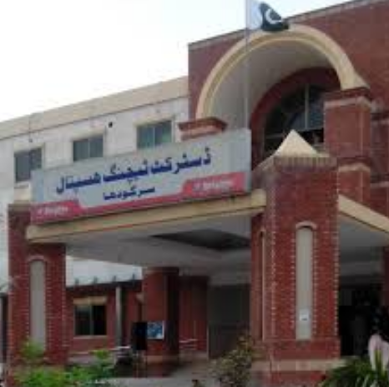
Results of the Accident
Physical Harm
- disastrous (multiple deaths)
- single death
- disability
- serious
- minor
■ Property Damage
- terrible damage
- major
- serious
- minor

Slide 23
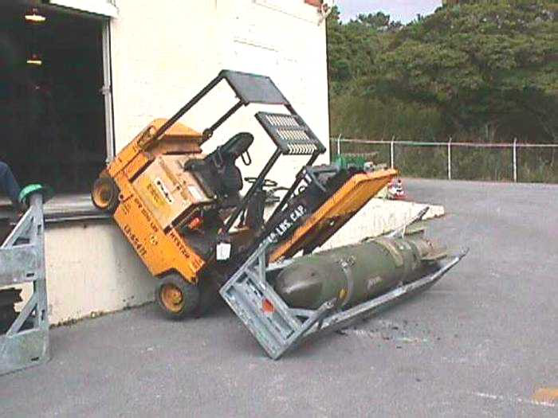
Immediate Causes
Practices
- operating without authority
- use equipment improperly
- not using PPE when required
- correct lifting procedures not
established
- drinking or drug use horseplay
- equipment not
properly secured

Slide 24
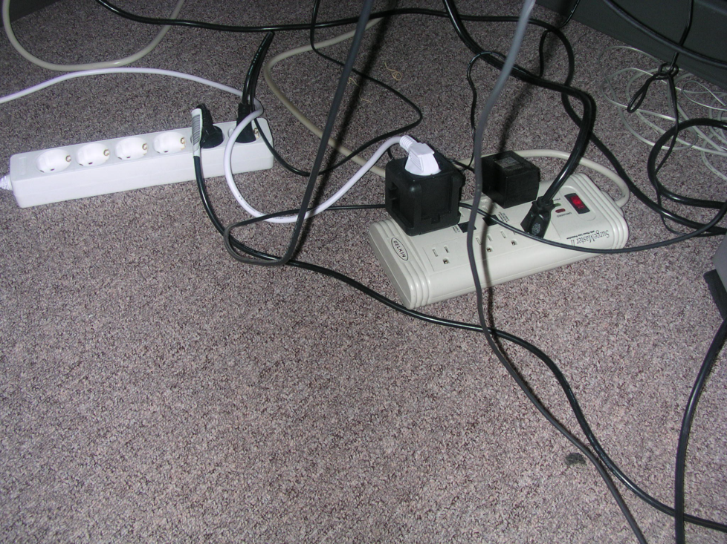
Conditions
- ineffective guards
- unserviceable tools and equipment
- inadequate warning systems
- bad housekeeping practices
- poor work space
illumination
- unhealthy work
environment

Slide 25
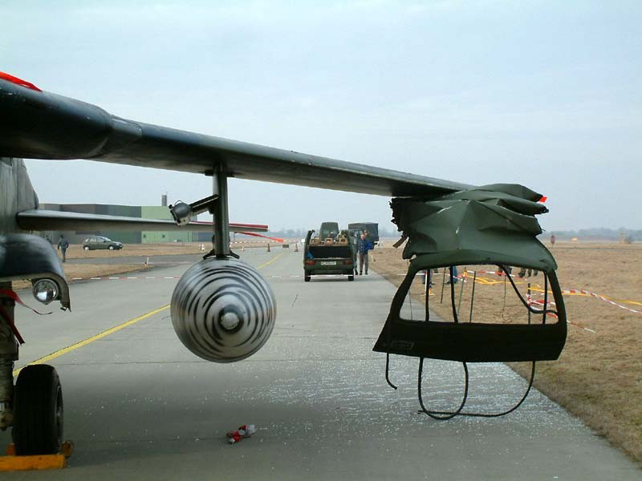
Basic Causes
Personal Factors
lack of knowledge or skill
improper motivation
physical or mental condition
Literacy or ability
Job Factors
Physical environment
sub-standard equipment
Abnormal usage
Design and maintenance

Slide 26
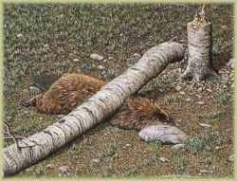
Basic Causes
Supervisory Performance
inadequate instructions
failure of SOPs
rules not enforced
hazards not corrected
devices not provided

Slide 27
Investigator’s Qualifications
Technical knowledge
Objectivity
Analytical approach
Familiarity with the job, process or operation
Tact in communicating
Intellectual honesty
Curiosity / interest

Slide 28
Beginning the Investigation
Gather investigation team and kit
Report to the scene
Look at the big picture
Record initial observations
Take pictures

Slide 29
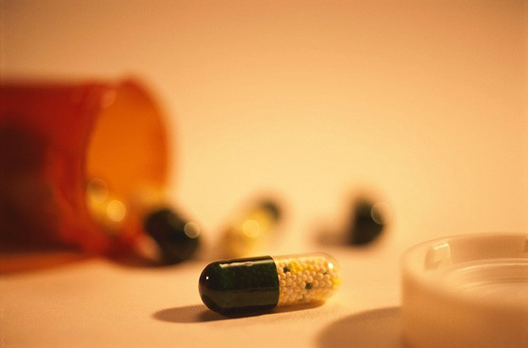
What’s Involved?
Who was injured?
Medication, drugs, or alcohol?
Was employee ill?
Double shift or
rotating shifts?

Slide 30
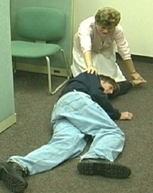
Witnesses
Who witnessed the incident?
Was a supervisor or
lead person nearby?
Where were other employees?
Why didn’t anyone
witness the incident?

Slide 31
Interviewing Tips
Discuss what happened leading up to and after the accident
Encourage witnesses to describe the accident in their own words
Don’t be defensive or judgmental
Use open-ended questions

Slide 32
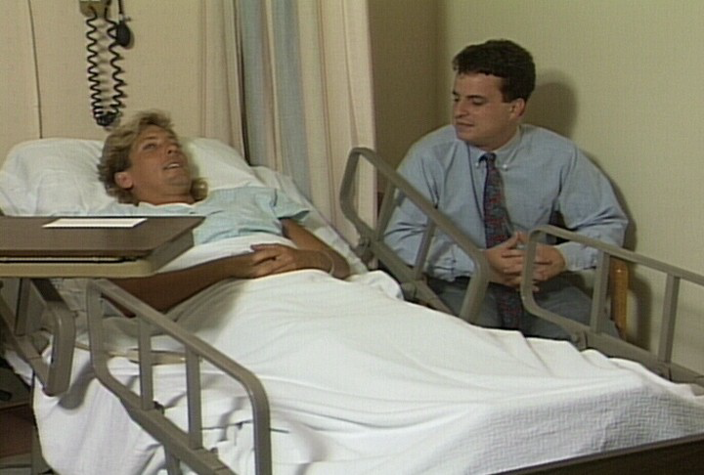
What Was Involved?
Machine, tool, or equipment
Chemicals
Environmental conditions
Production schedule

Slide 33
Accident Investigation Kit
May Include:
Digital Camera
Report forms, clipboard, pens
Barricade tape
Flashlight
Tape measure
Tape recorder
Personal Protective Equipment (as appropriate)

Slide 34
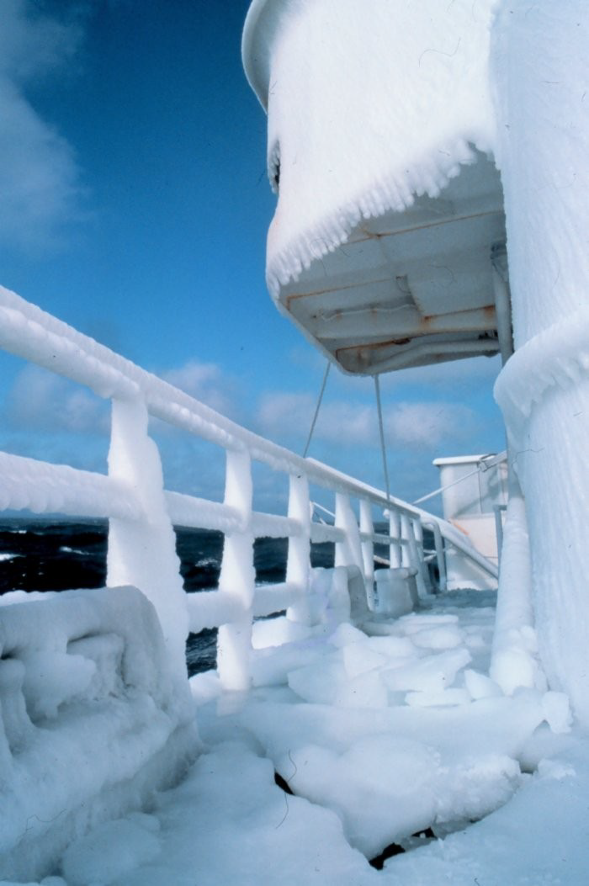
Accident Location
Work area
On, under, in, near
Off-site address
Doing normal job
Duties
Performing non routine
or routine
tasks (i.e., properly
trained)

Slide 35
Corrective Actions Taken
Include immediate temporary controls
implemented at the time of accident
Recommended corrective actions
Employee training
Preventive maintenance activities
Better operating procedures
Hazard recognition
Management awareness of risks involved

Slide 36
Summary
Investigate accidents immediately
Determine who was involved and
who witnessed it
Ascertain what items or equipment
were involved
Record detailed description
Determine causal factors
Conduct corrective actions

