Slide 1
TOPIC METHODES OF LOCOMOTION IN BACTERIA

Slide 2
Bacterial Locomotion
Locomotion or motality is important characteristic of bacteria Bacterial locomotion is of three types. 1. Flagellar 2. Spirochaetal 3. Gliding

Slide 3
1.FLAGELLAR MOVEMENT
Most motile bacteria move by use of flagella,threadlike locomotor appendages extending from the plasma membrane and cell wall.They are slender, rigid structure, about 20nm across and upto 15 or 20 meo meter long

Slide 4
STRUCTURE OF FLAGELLA
Bacteria flagellum is composed of three parts FILAMENT The longest and most obvious portion is the filament ,which extend from the cell surface to the tip . BASAL BODY A basal body is embedded in the cell.The basal body attaches the flagellum to the cell wall and plasma membrane. It is composed of a small rod instead into a series of ring .

Slide 5
Hook A short, curved segmented, the hook is present outside the cell wall and connects filament to the basal body . The hook and basal body are quite different from the filament .Slightly wider than the filament , the hook is made of different protein subunit.

Slide 6
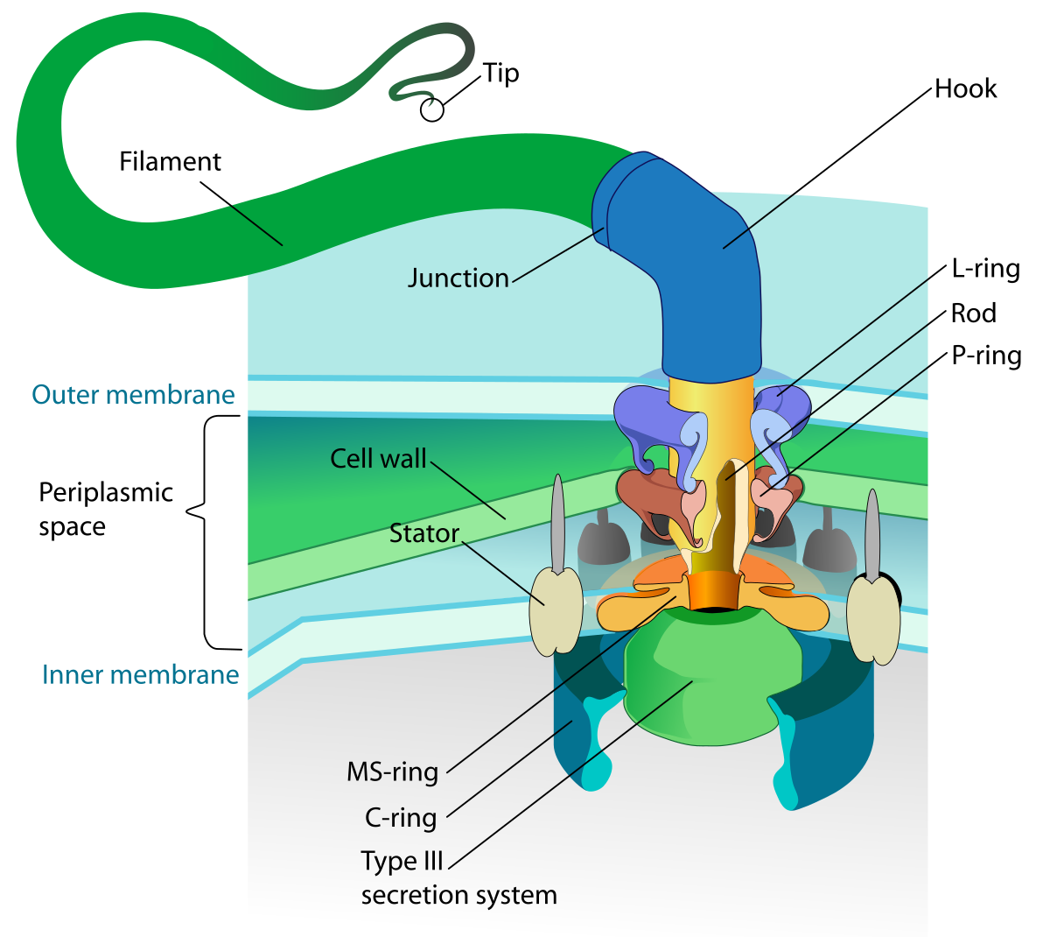
DIAGRAM OF FLAGELLA STRUCTURE

Slide 7
MECHANISM OF FLAGELLAR MOVEMENT
The filament is in the shape of a rigid helix, and the bacterium moves when the helix rotates .
The basal body act as motor and cause rotation .
Flagellar rotation determines the nature of bacterial movement.

Slide 8
CLASSIFICATION OF BACTERIA ON THE BASIS OF NUMBER OF FLAGELLA
Atrichos
These bacteria has no flagella i.e Corynebacterium diptherae
Monotrichous
One flagellum is attached to the one end of bacterial cell .i.e. Vibro cholerae.

Slide 9
Lophotrichous
Bunch of flagella is attached to one end of the bacteria cell i.e Pseudomonas
Amphitrichous
Bunch of flagella arising from both end of the bacteria cell i.e Rhodospirillum

Slide 10
Peritrichous
The flagella are evenly distributed surrounding the entire bacterial cell i.e Bacillus

Slide 11
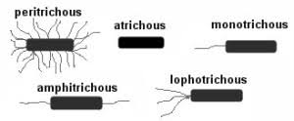
Diagram

Slide 12
SPIROCHETE
Bacteria can move by mechanism other than flagellar rotation called as spirochetes
Spirochete shows several types of movement such as
Flexing
Spinning
Free swimming
Creeping
As they are flexible and helical bacteria and lack flagella.

Slide 13
Just within the cell envelop they have flagella like structure which are known as periplasmic flagella or axial fibrils.
The axial fibrils are present in the space between inner and outer membrane of cell envelope .

Slide 14
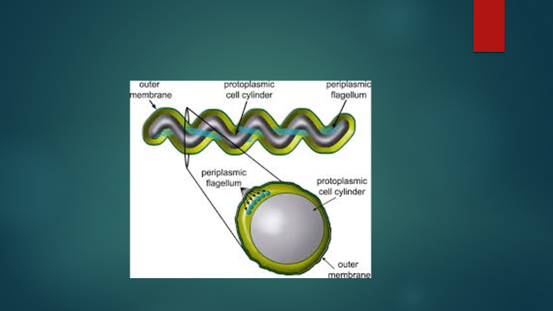
Spirochete structure

Slide 15
GLIDING MOVEMENT
Some bacteria such as the species of cyanobacteria and mycoplasma show gliding movement .When come in contact with to a solid surface .
However no organelles are associated with the movement .
They do not have flagellar structures either internally or externally but they secrete slimy substance like snails during locomotion .

Slide 16
The exact mechanism of gliding locomotion is still unknown but some scientists have suggested presence of fimbriae like appendages at the poles of glider cell.
The generation of contractile waves or surface tension or pushing by secreted slime was also proposed as possible mechanism of gliding .

Slide 17
GLIDING BACTERIA

Slide 18
TAXIS
Bacteria also show movement in response to certain stimulus that is called as taxis .
There are three types of movement .
Chemotactic : Movement due to chemical stimulus.
Phototactic :Movement due to light stimulus .
Magnetotactic :Movement by detecting magnetic field of earth.

Slide 19
Reference.
Prescott ,L.M Microbiology

Slide 20
/ THANK YOU /

