Slide 1
Carbohydrates classification,structures and functions:

Slide 2
Carbohydates :
Carbohydrates are the sugars, starches and fibers found in fruits, grains, vegetables and milk products. Though often maligned in trendy diets, carbohydrates — one of the basic food groups — are important to a healthy diet.
All carbohydrates are made of carbon, hydrogen, and oxygen with the general formula of Cm(H2O)n.

Slide 3
Examples of Carbohydrates:
Sugars
Starches
Fibers etc.
The building blocks of all carbohydrates are simple sugars called monosaccharides. A monosaccharide can be a polyhydroxy aldehyde (aldose) or a polyhydroxy ketone (ketose)

Slide 4
Carbohydrates are the most abundant organic constituents of plants.
They serve as the major source of chemical energy for living organisms (e.g. sugars and starch), as well as important constituents of supporting tissues (e.g. cellulose).
Simple carbohydrates are known as sugars or saccharides (Latin saccharum, sugar) and the ending of the names of most sugars is –ose. For example: 1. Glucose (for the principle sugar in blood) 2. Fructose (for a sugar in fruits).

Slide 5
Classification of Carbohydrates:
Classification According to the number of sugar molecules:
Simple Carbohydrates :
Monosaccharides (1 unit)
Disaccharides (2 Units)
Complex Carbohydrates :
Oligosaccharides (3-10 Units)
Polysaccharides (More than 10 Units) e.g:Glycogen - Starches – Fibers.

Slide 6
Monosaccharides:
Monosaccharides (from Greek monos single, sacchar: sugar), also called simple sugar, are the simplest form of sugar and the most basic units of carbohydrates.
They cannot be further hydrolyzed to simpler chemical compounds. The general formula is C_{n}H_{2n}O_{n}.

Slide 7
Characteristics:
They are usually colorless, water-soluble, and crystalline solids.
Some monosaccharides have a sweet taste.
Examples of monosaccharides include glucose, fructose and galactose.
Monosaccharides are the building blocks of disaccharides (such as sucrose and lactose) and polysaccharides (such as cellulose and starch).

Slide 8
The monosaccharide glucose plays vital role in metabolism, where the chemical energy is extracted through glycolysis and the citric acid cycle to provide energy to living organisms.
Some other monosaccharides can be converted in the living organism to glucose.

Slide 9
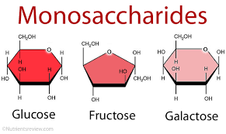

Slide 10
Disaccharides :
A disaccharide (also called a double sugar) is the sugar formed when two monosaccharides (simple sugars) are joined by glycosidic linkage.
Like monosaccharides, disaccharides are soluble in water.
Three common examples are sucrose, lactose, and maltose.

Slide 11
General formula of disaccharide is C₁₂H₂₂O₁₁.
The joining of simple sugars into a double sugar happens by a condensation reaction, which involves the elimination of a water molecule from the functional groups only.
Breaking apart a double sugar into its two simple sugars is accomplished by hydrolysis with the help of a type of enzyme called a disaccharidase.

Slide 12
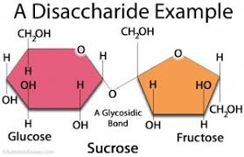
Structuresof Disaccharide:

Slide 13
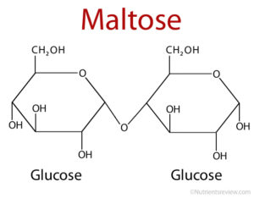

Slide 14
Polysaccharides :
Polysaccharides are long chains of carbohydrate molecules,specifically polymeric carbohydrates composed of monosaccharide units bound together by glycosidic linkages.
This carbohydrate can react with water (hydrolysis) using amylase enzymes at catalyst, which produces constituent sugars (monosaccharides, or oligosaccharides).
They range in structure from linear to highly branched.

Slide 15
Examples include storage polysaccharides such as starch and glycogen, and structural polysaccharides such as cellulose and chitin.
Polysaccharides are often quite heterogeneous, containing slight modifications of the repeating unit.
Depending on the structure, these macromolecules can have distinct properties from their monosaccharide building blocks.
They may be amorphous or even insoluble in water

Slide 16
Starch:
Starch is a glucose polymer in which glucopyranose units are bonded by alpha-linkages.
It is made up of a mixture of amylose (15–20%) and amylopectin (80–85%).
Amylose consists of a linear chain of several hundred glucose molecules, and Amylopectin is a branched molecule made of several thousand glucose units (every chain of 24–30 glucose units is one unit of Amylopectin).

Slide 17
Starches are insoluble in water.
They can be digested by breaking the alpha-linkages (glycosidic bonds).
Both humans and other animals have amylases, so they can digest starches. Potato, rice, wheat, and maize are major sources of starch in the human diet.
The formations of starches are the ways that plants store glucose.

Slide 18
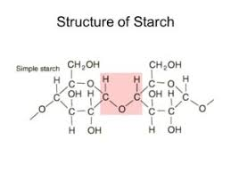

Slide 19
Glycogen:
Glycogen serves as the secondary long-term energy storage in animal and fungal cells, with the primary energy stores being held in adipose tissue.
Glycogen is made primarily by the liver and the muscles, but can also be made by glycogenesis within the brain and stomach.
Glycogen is analogous to starch, a glucose polymer in plants, and is sometimes referred to as animal starch.

Slide 20
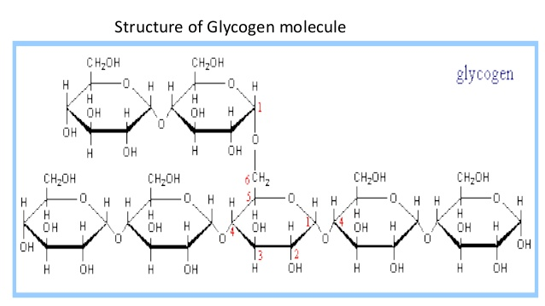

Slide 21
Cellulose:
The structural components of plants are formed primarily from cellulose.
Wood is largely cellulose and lignin, while paper and cotton are nearly pure cellulose.
Cellulose is a polymer made with repeated glucose units bonded together by beta-linkages.

Slide 22
Humans and many animals lack an enzyme to break the beta-linkages, so they do not digest cellulose.
Certain animals such as termites can digest cellulose, because bacteria possessing the enzyme are present in their gut.
Cellulose is insoluble in water.
It does not change color when mixed with iodine.
On hydrolysis, it yields glucose. It is the most abundant carbohydrate in nature.

Slide 23
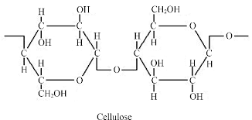

Slide 24
Functions of carbohydrates:
Carbohydrates have six major functions in the body:
Providing energy.
Regulating blood glucose.
Sparing the use of proteins for energy.
Breaking down fatty acids.
Providing dietary fiber.

Slide 25
Natural sweetener for foods.
All the cells and tissues in the human body need carbs, especially the brain.

Slide 26
THANK YOU

