Slide 1
Myocarditis

Slide 3
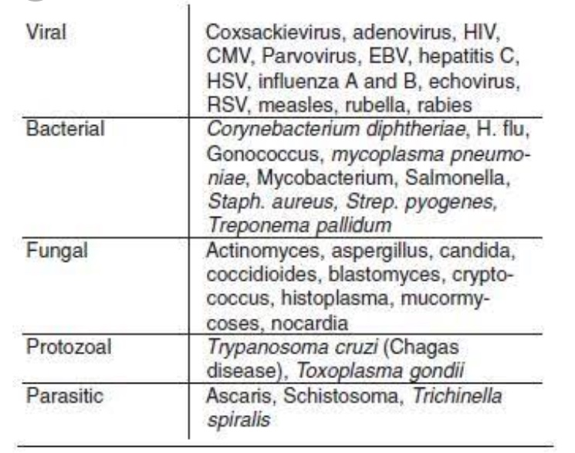
Etiology

Slide 5
Clinical manifestations
Range from asymptomatic and non specific to cardiogenic shock and sudden death.
Infants and young children have fulminant presentation with respiratory distress,tachycardia,hypotension,gallop rhythm.
Assosciated with rash or end organ involvement like hepatitis,meningitis etc

Slide 9
Treatment
Primary management for acute myocarditis is supportive.
ACE inhibitors,ARBs,Diuretics are useful in patients with compensated CCF but may be contra indicated in those with fulminant heart failure,collapse.
In patients with arythmias anti arrythmics are helpful
IVIG and STEROIDS may have role in improving cardiac function

Slide 11
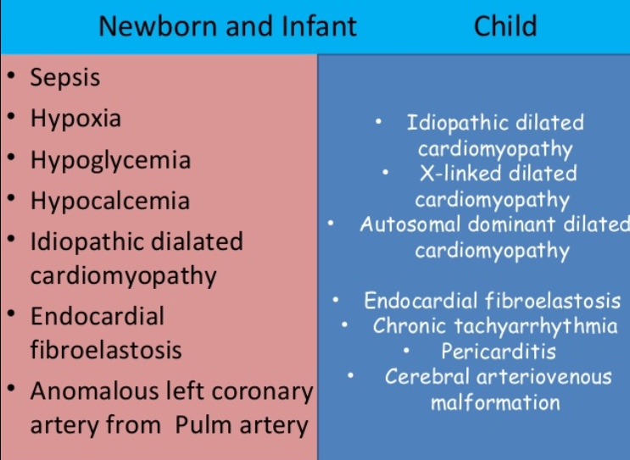
Differential diagnosis

