Slide 1
Adverbs
By
Tanveer Gul

Slide 2
What is an Adverb?
Adverb is a word that modifies a verb, adjective, determiner, clause, preposition, or sentence.
Adverbs can tell you how something is done, for example, speak nicely or work hard.
Adverbs can also tell you how much or how many of something you have.
An adverb can answer questions like:
How? What? When? Where? How much? And others.

Slide 3
What is an Adverb?
Adverbs can always be used to modify verbs. Notice that the second of these two sentences is much more interesting simply because it contains an adverb:
The dog ran. (You can picture a dog running, but you don’t really know much more about the scene.)
The dog ran excitedly. (You can picture a dog running, wagging its tail, panting happily, and looking glad to see its owner. You can paint a much more interesting picture in your head when you know how or why the dog is running.)

Slide 4
Adverbs are often formed by adding the letters “-ly” to adjectives. This makes it very easy to identify adverbs in sentences. (but not always)
An adverb can be used to modify an adjective and intensify the meaning it conveys. For example:
He plays tennis well. (He knows how to play tennis and sometimes he wins.)
He plays tennis extremely well. (He knows how to play tennis so well that he wins often.)

Slide 5
Types of adverbs
The 5 Basic Types of Adverbs
Adverbs of time
Adverbs of place
Adverbs of frequency
Adverbs of manner
Adverbs of degree

Slide 6
Adverbs of Time
An adverb of time provides more information about when a verb (action) takes place.
Adverbs of time are usually placed at the beginning or end of a sentence. When it is of particular importance to express the moment something happened we’ll put it at the start of a sentence.

Slide 7
Examples
Examples of adverbs of time: never, lately, just, always, recently, during, yet, soon, sometimes, usually, so far
So far, we have found twelve grammar mistakes.
I haven’t been going to the gym lately.
We recently bought a new car.
Last year was the worst year of my life.
Tomorrow our fate will be sealed.
Yesterday my troubles seemed so far away.

Slide 8
Adverbs of Place
An adverb of place, sometimes called spatial adverbs, will help explain where an action happens.
Adverbs of place will be associated with the action of the verb in a sentence, providing context for direction, distance and position: southeast, everywhere, up, left, close by, back, inside, around.

Slide 9
Directions
New York is located north of Philadelphia.
They travelled down the mountainside.
First, I looked here, and then I looked there, but I can’t find them anywhere.
Distance
Jane is moving far away.
Sara is sitting close to me.

Slide 10
Position
The treasure lies underneath the box.
The cat is sleeping on the bed.
Why are you standing in the middle of the Hall?

Slide 11
Adverbs of Frequency
Adverbs of frequency are used to express time or how often something occurs.
Adverbs of frequency can be split two main groups:
adverbs of indefinite frequency
adverbs of definite frequency
The first, adverbs of indefinite frequency, are terms that have an unclear meaning as to how long or how often something occurs: never, always, rarely, sometimes, normally, seldom, usually, again
These adverbs will usually be placed after the main verb or between the auxiliary verb and infinitive.

Slide 12
Example
Adverbs of frequency examples in the following sentences are in bold for easy identification.
The adverb is usually placed before the main verb.
I can normally cook good food.
I will always love.

Slide 13
Adverbs of definite frequency will usually be placed at the end of the sentence.
We get paid hourly.
The situation seems to change monthly.
The newspaper is bought daily.

Slide 14
Adverbs of Manner
An adverb of manner will explain how an action is carried out.
Very often adverbs of manner are adjectives with -ly added to the end, but this is certainly not always the case.
In fact, some adverbs of manner will have the same spelling as the adjective form.
Some examples of adverbs of manner include:
Slowly
Rapidly
Clumsily
Badly
Diligently
Sweetly
Warmly
Sadly

Slide 15
Example
Adverb of manner examples in the following sentences are in bold for easy identification.
She passed the exam easily.
They walk quickly to catch the train.
The dinner party went badly.
Ahmad answered the question correctly.
Notice how the adverbs are formed by adding -ly to the adjectives bad, correct and quick

Slide 16
As mentioned, some adverbs of manner take the same spelling as the adjective and never add an -ly to the end:
The boys had worked hard.
Julia dances well.

Slide 17
Adverbs of Degree
Adverbs of degree explain the level or intensity of a verb, adjective, or even another adverb.
Example of adverbs of degree: almost, quite, nearly, too, enough, just, hardly, simply, so
Can I come to the movies too?
Aren’t you hungry? You’ve hardly touched your dinner.
I’m so excited to see the new James Bond movie!

Slide 18
Adverbs of Purpose
Adverbs of purpose, sometimes called adverbs of reason, help to describe why something happened.
They can come in the form of individual words – so, since, thus, because – but also clauses – so that, in order to.
Notice in the examples (on next slide) that the adverbs of purpose are used to connect sentences that wouldn’t make sense if they were formed alone.

Slide 19
Example
Adverbs of purpose examples in the following sentences are in bold for easy identification.
I was sick, thus didn’t go to work today.
I started jogging so that I wouldn’t be late.
Because I was late, I jogged a little faster.
Since it’s your birthday, I will buy you a gift.

Slide 20
Positions of Adverbs
The positions of adverbs are not a fixed or set thing.
As you have seen, adverbs can appear in different position in a sentence.
However, there are some rules that help us decide where an adverb should be positioned.
The rules will be different depending on whether the adverb is acting to modify an adjective or another adverb, a verb or what type of adverb it is.

Slide 21
Adverb position with adjectives and other adverbs
These adverbs will usually be placed before the adjective or adverb being modified:
We gave them a really tough match.
(The adverb really modifies the adjective tough.)
It was quite windy that night.
(The adverb quite modifies the adjective windy.)
We don’t go to the movies terribly often.
(The adverb terribly modifies the adverb often.)

Slide 22
Adverb position with verbs
This can be a bit trickier because, it will depend on the type of adverb – place, position, time etc. – and there are many exceptions to the rules. However, a basic set of guidelines is shown below:
Adverbs of manner or place are usually positioned at the end of the sentence:
She laughed timidly.
I stroked the cat gently.
Noor lived here.
There are flies everywhere.

Slide 23
If the adverb is of definite time it will be placed at the end of the sentence.
I did it yesterday.
We can discuss it tomorrow.
Let’s go to Paris next week.
However, if it is an indefinite period of time, it will go between the subject and main verb.
We often go to Paris in the springtime.
Ibrahim regularly swims here.
Suzan and William always loved fishing by the lake.

Slide 24
Conjunctive Adverb
A conjunctive adverb is a type of adverb that joins two independent sentences or clauses of any kind. This type of adverb is used to connect two parts into one longer sentence.
These parts can be whole sentences that need to be connected into one longer sentence or smaller clauses that need to be connected as well.

Slide 25
Conjunctive Adverb
Adverbs usually modify one verb, but conjunctive adverbs modify entire sentences because they connect larger parts than just one word.
Conjunctive adverbs are used to join together parts in order to form a larger thought.
This means that the final sentence explains more than the two smaller ones would if they were still divided.

Slide 26
Conjunctive adverbs serve different functions, such as: addition, comparison, concession, contrast, emphasis, summarize, illustrate a point, or signify time.
Conjunctive adverbs are used to connect ideas, and to form larger thoughts with longer sentences. These sentences are divided by a semicolon (;).

Slide 27
Examples
I wanted to go have ice cream after work; however, my friend wanted something else.
He had studies all day and night; nevertheless, it wasn’t enough to pass the test.
It was never going to work between us; therefore, we decided to go our separate ways.
I had to work the whole weekend; in addition, there was also another contract from a month ago I had to deal with.
If you decide to start a diet you will see the improvement in your life soon; for instance, you’ll have more energy during the day.
She was driving home from her friend’s place; meanwhile, her husband was busy preparing her a surprise.

Slide 28
Adverb Clause
Usually, an adverb is just one word which modifies or describes, a verb.
An adverb clause, on the other hand, is an entire clause which functions as an adverb.
This clause is a group of words, or an entire sentence, which modifies a verb.

Slide 29
Adverb Clause
One adverb adds some detail to the verb.
An adverb clause adds more detail to the verb and describes precisely. An adverb clause can answer questions like:
How? What? When? Where? How much? And others.

Slide 30
Like any clause, an adverb clause has to have a subject and predicate in order to be complete.
An adverb clause can appear in the beginning, middle, or end of the sentence.
The adverb clause is always divided by a comma if it’s in the beginning or middle of the sentence.

Slide 31
Example
Since I work from home, I don’t have to eat in restaurants often.
The adverb phrase is in the first sentence. The subject is “I” and the predicate “work,” so the clause is complete. This adverb clause answers the question: where?

Slide 32
Example
Whales, although they are large, don’t eat anything but plankton.
This adverb phrase is in the middle of the sentence, and it’s divided by commas. The subject is “they” and the predicate is “are large.” This adverb clause answers the question: how? (big are they / do they look)

Slide 33
Example
Because he missed the first bus he ran like his life depended on it.
Since the adverb phrase is at the end of the sentence is does not always need to be divided with a comma. The subject is “he” and the predicate “ran.” This adverb clause answers the questions: how? and why?

Slide 34
Example
I’m going to look for a new job when I get back from my trip.
Here the subject is “I” and the predicate is “get back.” This adverb clause answers the question: when?

Slide 35
Adverb Phrase
An adverb phrase is a group of words that function as an adverb.
Unlike the adverb clause, an adverb phrase does not need a subject and predicate.
An adverb phrase is two or more words that modify the verb.

Slide 36
Adverb Phrase
Adverb phrases are used to describe the verb in more detail than just one adverb would.
Since they are composed of more than one word they can answer a different set of questions.
Adverb phrases often answer the questions:
How? Where? Why? and When?

Slide 37
Adverb Phrase
How? Where? Why? and When?
These questions need more than one adverb to be answered completely.
An adverb phrase can appear anywhere in the sentence, and they don’t need to be divided by commas.
They are, however, mostly at the end of the sentence, and sometimes the beginning.

Slide 38
Example
Because the boss is late the meeting will start later than usual.
This adverb phrase is used to answer the question: when?
It is at the end of the sentence and gives more details about why the meeting is not happening when it usually does.

Slide 39
Example
Like in every fairy tale they must kiss before sunset to break the curse.
This adverb phrase also answers the question: when?
Here it describes the exact time when something must happen.

Slide 40
Example
Put the flowers on the kitchen table.
This adverb phrase answers the question: where?
The person speaking wants the flowers to be put at a specific place.

Slide 41
Example
She always completes her tasks without care.
The question answered is: how?
It describes how careless the person is when completing her tasks.

Slide 42
Adverb vs Adjective
ADJECTIVES describe THINGS
Beyoncé is so ambitious.
John was an affectionate man.
Her sunglasses are insane.
My upstairs neighbours are really energetic.
Your iPad is so old-fashioned.
My flip-flops are cute.
I met a magical girl in English class.
That wasn’t a very good idea.

Slide 43
Adverb vs Adjective
ADVERBS describe EVERYTHING ELSE
Beyoncé sings really loudly.
She can sing incredibly beautifully.
In Dracula’s castle, people disappeared surprisingly quickly.

Slide 46
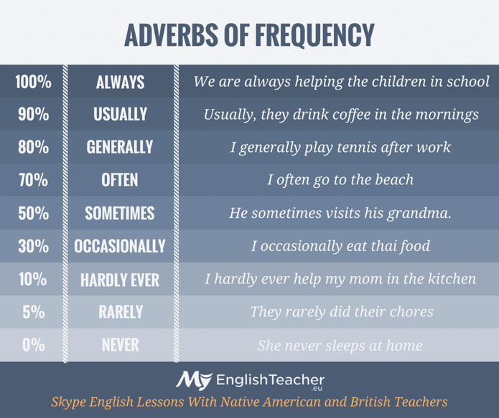

Slide 47
Adverbs of time

