Slide 1
ICT Defined
By Tariq Saleem Ghayyur
Lecturer
Department of education
University of sargodha

Slide 2
Information
Information means facts or knowledge provided or learned. Meaningful data which is obtained after processing data is known as information.
Information is also defined as process form of data.
We can get information by so many mediums. For example :- T.V., Radio, Net, Newspaper, etc.

Slide 3
Communication
Latin word ‘communis’ means common experience. So communication means : to send any idea to another. In communication a person gives some instructions & the other reacts or gives response.
Communication means transfer of information or content. Communication is carried through expression signs, pictures, diagrams & facial expression.

Slide 4
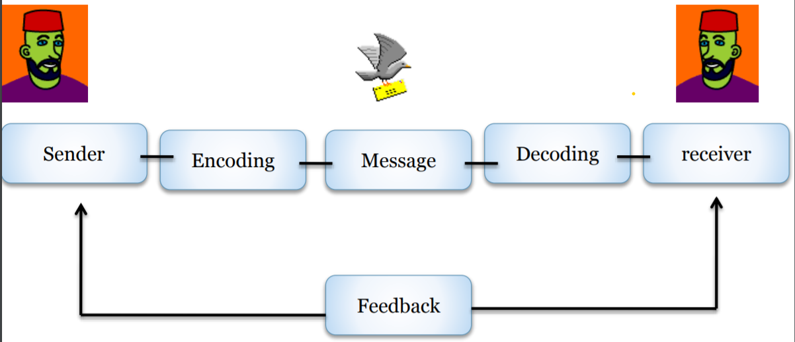
Model of communication

Slide 5
Types of communication

Slide 6
Formal communication
There are some specific objectives are expected to be fulfilled. In this type of communication some definite rules & systems are arranged.
For example :- lecture, Interview, communication with senior authorities, speech etc.

Slide 7
Informal communication
• It is called unexpected & sudden communication. There is no formality for this type of communication. • For example:- talking with friends, chatting etc.

Slide 8
Nonverbal communication
Nonverbal communication between people is communication through sending and receiving wordless clues. • It includes the use of visual cues such as body language (kinesics), distance (proxemics) and physical environments/appearance, of voice (paralanguage) and of touch (haptics).[1] It can also include chronemics (the use of time) and oculesics (eye contact and the actions of looking while talking and listening, frequency of glances, patterns of fixation, pupil dilation, and blink rate).

Slide 9
Verbal Communication
The sharing of information between individuals by using speech. Individuals working within a business need to effectively use verbal communication that employs readily understood spoken words, as well as ensuring that the enunciation, stress and tone of voice with which the words are expressed is appropriate.

Slide 10
Information Technology
In the broadest sense, information technology refers to both the hardware and software that are used to store, retrieve, and manipulate information. At the lowest level you have the servers with an operating system. Installed on these servers are things like database and web serving software. The servers are connected to each other and to users via a network infrastructure. And the users accessing these servers have their own hardware, operating system, and software tools.

Slide 11
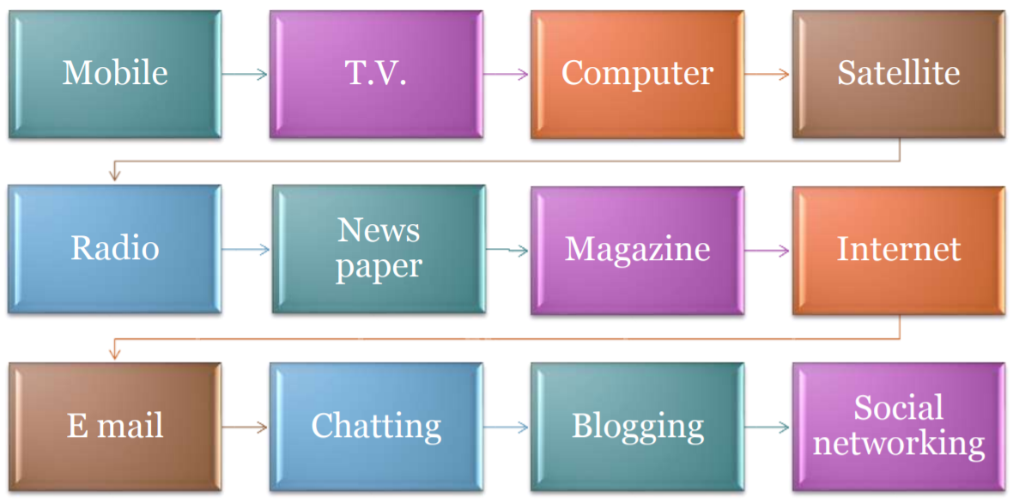
Technology

Slide 12
Synchronous Communication
The word synchronous means working together at the same time, and in the online learning world, chat rooms and online conferences are good examples of synchronous communication. In a chat room, people's comments to each other are relayed immediately, enabling a real-time discourse. Similarly, online conferencing with the benefit of voice over Internet protocol (VOIP) tools enable real-time conversations to take place online. Learning from synchronous communication is enhanced because real-time conversations allow people to explore, through writing or talking, the class concepts. The act of verbalizing helps students build bridges between different ideas and concepts, thus helping them retain information more effectively.

Slide 13
In general, synchronous (pronounced SIHN-kro-nuhs, from Greek syn-, meaning "with," and chronos, meaning "time") is an adjective describing objects or events that are coordinated in time. In information technology, the term has several different usages. 1) In telecommunication signaling within a network or between networks, synchronous signals are those that occur at the same clock rate when all clocks are based on a single reference clock. (Plesiochronous signals are almost but not quite in synchronization and asynchronous signals are those that run from different clocks or at a different transition rate.)

Slide 14
Definitions of Information Technology
The branch of engineering that deals with the use of computers and telecommunications to retrieve and store and transmit information
The term "IT" encompasses the methods and techniques used in information handling and retrieval by automatic means. The means include computers, telecommunications and office systems or any combination of these elements.
A broad term used to refer to any form of technology used to create, transfer, or store information in all it's various forms (text, images, sound, multimedia files).

Slide 15
Communication Technology
a process to store or deliver information using electronic and graphic means; Processes include encoding, transmitting, receiving, storing, retrieving and decoding.
Electronic systems used for communication between individuals or groups. Communication technology facilitates communication between individuals or groups who are not physically present at the same location. Systems such as telephones, telex, fax, radio, television, and video are included, as well as more recent computer-based technologies, including electronic data interchange and e-mail.
communications technology - the activity of designing and constructing and maintaining communication systems

Slide 16
Information and communication technology (ICT) Definitions
ICT is an umbrella term that includes any communication device are application, encompassing radio television cellular, phone computer and network hardware and software, satellite system and so on, as well as various services and application associated with them.
Information and communication technology (ICT) is defined by Berce, Lanfranco and Vehovar (2008) as “a mixture of hardware (equipment), software (operating system, applications, etc.) and communication facilities (Local area Networks, wide area and backbone Networks, communication protocols, etc.)” (p, 190).
Notes:
In this contemporary era, a lot of interventions are being made for effective learning of the students and a variety of concepts are used to describe these interventions for digitization of education in forms of investment, adoption, and use of newer Information and Communication Technology in educational practices and research. These concepts may include programmed instructions, Computer Assisted Instructions (CAI), Computer Assisted Learning (CAL), Computer Assisted Language Learning (CALL), Computer Assisted Teaching (CAT), Information and Communication Technology, Information Technology (IT), Information and Communication Technology (ICT), Instructional Technology, Teaching Learning Technology and Educational Technology etc. Many of these concepts are used interchangeably in general because of close understanding they have.

Slide 17
ICT Defined-Continued
Bates (2015) defines Information and Communication Technology to include all those tools and equipment used to support teaching and learning in the form of computers, software programs, or e-materials. Therefore, for current study, the concept Information and Communication Technology is being used to refer to newer technologies used in the digitalization of educational institutions as well as teachers’ everyday practices to implement these technologies. Further, Information and Communication Technology may include various information (assignment, projects, reports), communication (e-mails, websites, online storage) and administration (LMS, CMS, databases) technologies and software (courseware, tutorial, databases, websites), as well as to devices such as cell phone, tablets, computers, and laptops as well as e-boards and projectors with or without interactivity or internet.

Slide 18
Asynchronous communication
Asynchronous communication is the relay of information with a time lag. Discussion forums and email are two examples of how asynchronous communication is employed in online learning. It is very helpful to communicate in this way, because students have plenty of time to formulate thoughts. By communicating via email, students are able to respond in detail to a question or topic that they might have answered incompletely in a real-time conversation. This time lag in communication helps students internalize information by giving them time to research certain ideas or merely extra time for contemplation. The main disadvantage to asynchronous communication is time lost waiting for a response.

Slide 19
Wang and Woo (2007) also defined ICT as a tool. They stated that “ICT can be hardware (such as computers, digital cameras), software (such as Excel, discussion forums) or both. In the educational context, it mainly refers to various resources and tools (software) presented on the computer” (p. 149).

Slide 20
Finger et al. (2007) stated that the term ICT is usually used to refer to computer-based and computer-related devices. However it also includes a variety of other devices that can be used for information and communication purposes. They describe ICT as a range of new devices such as the internet, mobile phones, digital cameras, plasma screens, digital video recorders, interactive whiteboards, and wireless technologies and networking.

Slide 21
Betrus, Branch, Doughty, & Molenda, (2008) who provide a broad definition of ICT in a learning context as: ―the study and ethical practice of facilitating learning and improving performance by creating, using, and managing appropriate technological processes and resources‖ (p. 1).

Slide 22
ICT is an acronym for Information and Communication Technology. It includes digital tools and hardware such as smartphones, laptops, pads or tablets, and other technologies such as audio visual equipment, projectors, smartboards and various technologies for use in education, development, information, travel and business. It also includes internet, blended learning, online learning, social media, cloud computing, flipped classrooms, learningmanagement systems, email, and online learning opportunities. (NMC Horizon Project, 2013)

