Slide 1
Geometric Mean

Slide 2
Introduction: The geometric mean G, of a set of n positive values $x_{1 }$, $x_{2 }$…. $x_{\begin{aligned}n \\ \end{aligned}}$ is defined as the positive nth root of their product, G = $\sqrt[n]{x_{1 }\text{, }x_{2 }\text{…. }x_{\begin{aligned}n \\ \end{aligned}}}$, where x > 0 The geometric mean is appropriate to average ratios and rates of change.

Slide 3

Formulas: G.M = Antilog $\left(\frac{\text{Ʃ}\text{log} x_{i}}{n}\right)$ (For Ungrouped data) G.M = Antilog$\left(\frac{\text{Ʃ}f_{i} \text{log} x_{i}}{\text{Ʃ}f_{i}} \right)$ (Group data)

Slide 4
Example: (Ungrouped data) Find the geometric mean 8, 40, 175, 1209, 2000 Solution: The geometric mean, G, is calculated as G =$\sqrt[5]{8×40×175×1209×2000}$ Taking log, we have G.M =$\sum{\left(\frac{log8+log40+log175+log1209+log2000}{5}\right)}$

Slide 5
G.M = 2.22632 G .M = Antilog (2.22632) = 168.39

Slide 6
Example: (Grouped data) Given the following frequency distribution of weights, calculate the geometric mean. Weight frequency 65-84 9 85-104 10 105-124 17 125-144 10 145-164 5 165-184 4 185-204 5

Slide 7
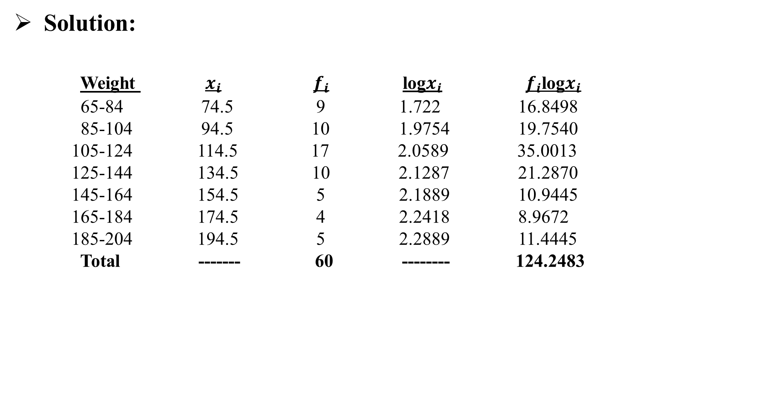
Solution: Weight $x_{i}$ $f_{i}$ log$x_{i}$ $f_{i}$log$x_{i}$ 65-84 74.5 9 1.722 16.8498 85-104 94.5 10 1.9754 19.7540 105-124 114.5 17 2.0589 35.0013 125-144 134.5 10 2.1287 21.2870 145-164 154.5 5 2.1889 10.9445 165-184 174.5 4 2.2418 8.9672 185-204 194.5 5 2.2889 11.4445 Total ------- 60 -------- 124.2483

Slide 8

G.M =Antilog $\frac{\text{Ʃ}f_{i} \text{log} x_{i}}{\text{Ʃ}f_{i}}$ = $\frac{\text{124.2483}}{60}$ = 2.0708 G.M = Antilog (2.0708) G .M = 17.7 grams

Slide 9
Merits of Geometric Mean:
It is based on observed value.
It is amenable to mathematical treatment .
It gives equal weightage to all observations.
It is an appropriate type of average to be used in case rates of change or ratios are to be averaged.

Slide 10
Demerits of Geometric Mean
It is neither easy to calculate nor to understand.
It vanishes if any observation is zero.
In case of negative values, it cannot be computed at all.

Slide 11
Assignment Questions: Question 01: Calculate the geometric mean for the following data: (a) 0.35, 3, 30, 300, 3000, 0.3, 0.03, 0.0362, 0.00482, 58642 (b) 6.5, 169.0, 11.0, 112.5, 14.2, 75.0, 35.5, 215.0 Question 02: (a)For the following data find the geometric mean. Weights 60-80 80-100 100-120 120-140 140-160 160-180 180-200 (No.of apples) 5 14 17 10 1 0 2

Slide 12
(b) Find the geometric mean for the following data . Marks in percentage No. of Students 31- 40 28 41-50 31 51-60 12 61-70 9 71-80 5

