Slide 1
Surveying Instruments
Lecture No.2

Slide 2
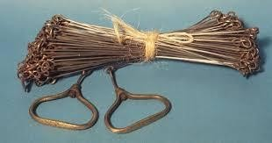
Surveying Instruments
Different type of instruments used in surveying are
Chain
Chain is an instrument used to measure linear distance in surveying.

Slide 3
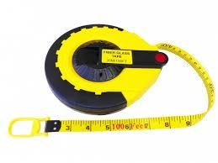
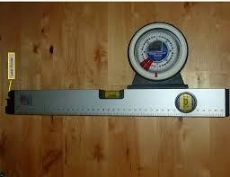
Tape
Accurate measurements are carried out through tape in survey.
Clinometer
Used to measure angle for inclined distance.

Slide 4
Compass
A compass is an instrument used for navigation and orientation that shows direction relative to the geographic "cardinal directions
i.e. (North, South, East and West)", or "points".
Compass are of different types.
1. Trough Compass

Slide 5
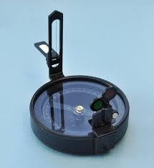
2. Prismatic Compass
This Prismatic Compass is used for the purpose of measuring
magnetic bearings.

Slide 6
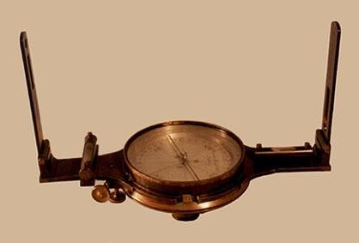
Surveyor Compass
This compass is also used fro measuring bearing with the North and south poles. The bearing are shown in quadrants.

Slide 7
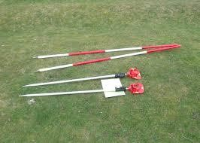
Ranging Rods
These rods are used in surveying for stationing and ranging of lines.
Reflector/Prism
Used in total station Surveying as shown in figure

Slide 8
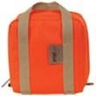
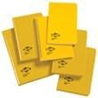
Bags
Used for keeping the instruments like prism etc. safe.
Field Book
Used for entering the
field data (measurements).

Slide 9
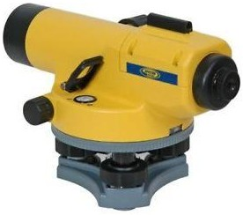
Auto level
Used in levelling process of survey.

Slide 10
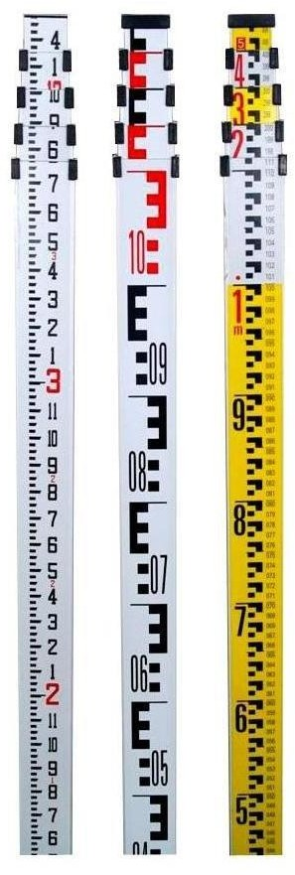
Staff rod/ Levelling rods
Used with auto level in measuring the levels of different points or objects.

Slide 11
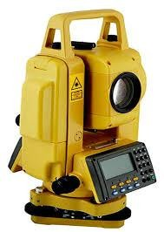
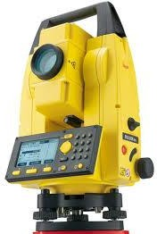
Theodolite
Used for measuring horizontal and vertical angles.
Total Station
Used for measuring angles,
Coordinates, levelling etc.

Slide 12
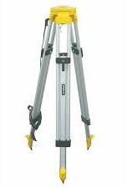
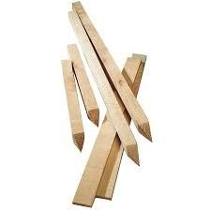
Tripod
Used for setting out of Instruments like Auto level, theodolite,
total stations etc.
Pegs
Used for stations point or used in setting of curves.

Slide 13
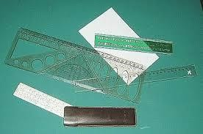
Scales
Used in plotting of surveying works

Slide 14
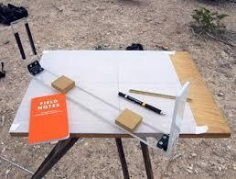
Plan Table
Used in plan table surveying

Slide 15
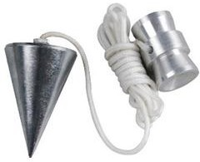
Plumb bob
Used for verticality and point centering.

