Slide 1
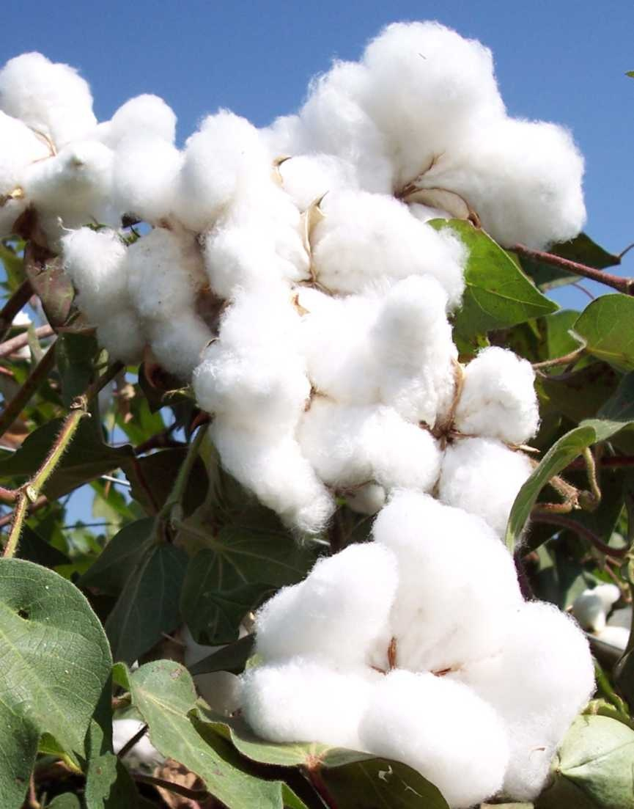
Major Insect Pests of Cotton Crop in Pakistan
Sucking pest complex
Bollworms complex

Slide 2
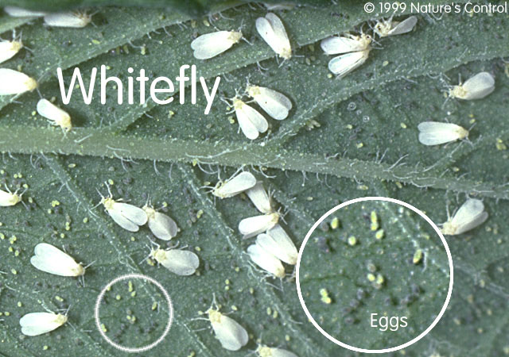
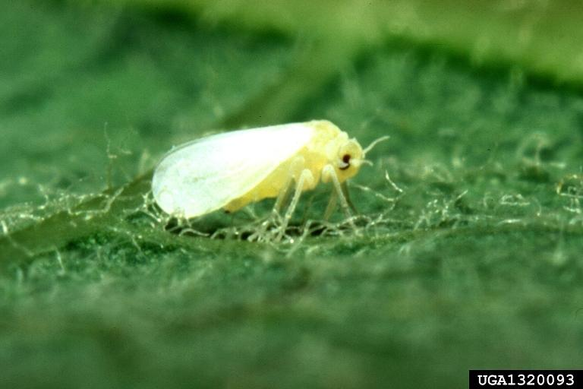
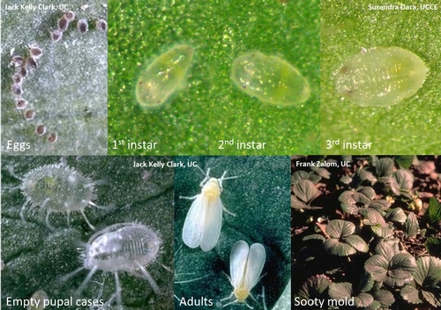
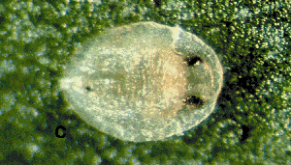
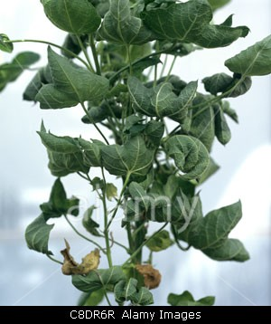
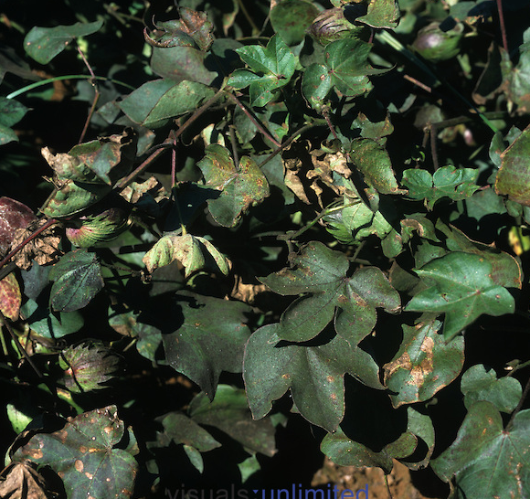
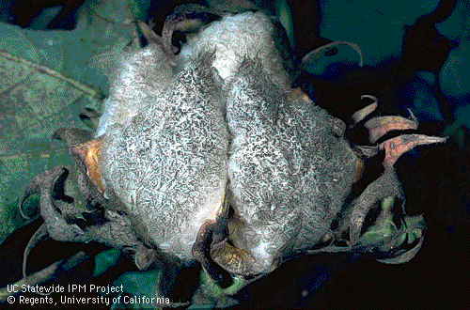
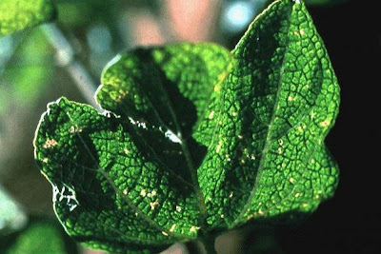
Insect pests of cotton Whitefly (Bemisia tabaci ; Aleyrodidae, Homoptera)
Sooty mold on lint
CLCV symptoms
Notes:
Bemisia tabaci
Remains active throughout year
No hibernation
Desaping_yellowiing and then falling of leaves
Toxic saliva_abnormaling plant physiological processes_disorders
Blackish and sickly appearance due to sooty mould growith on honeydew_photosynthesis interruption
B. tabaci_transmits 38 viral diseases in more than 70 different plant species.
Bemisia argentifoli_more fecundiy and honeydew prodcution than B. tabaci

Slide 3
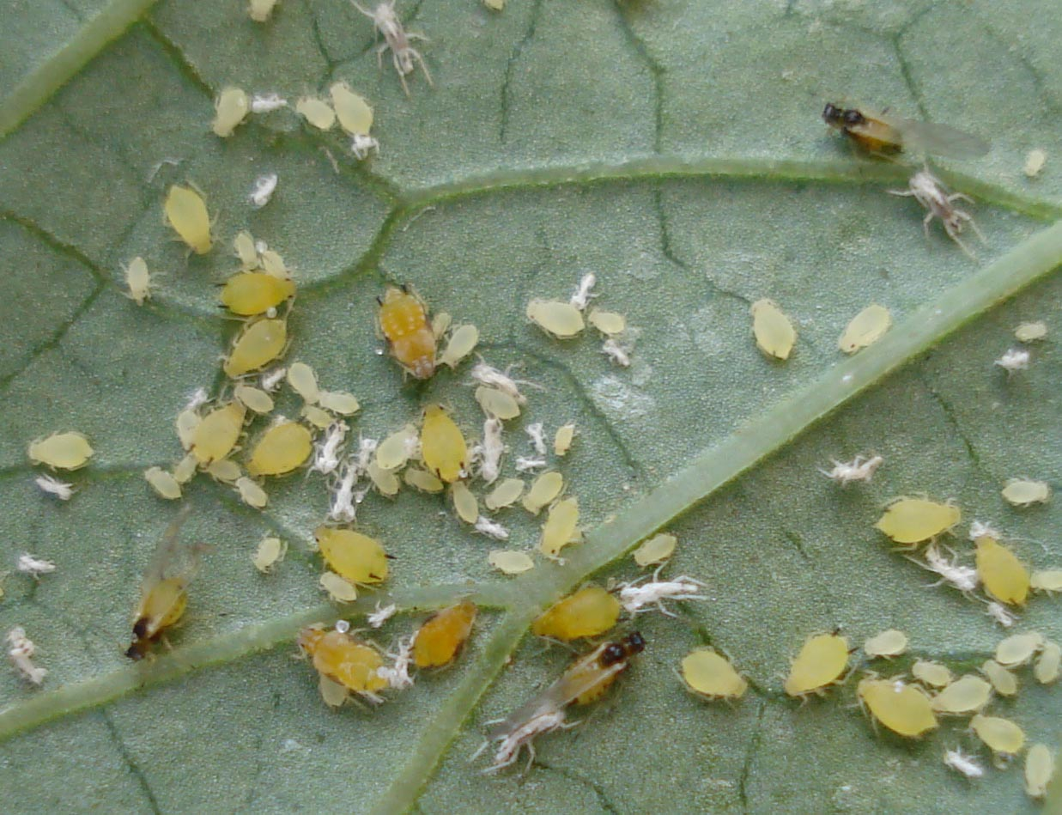
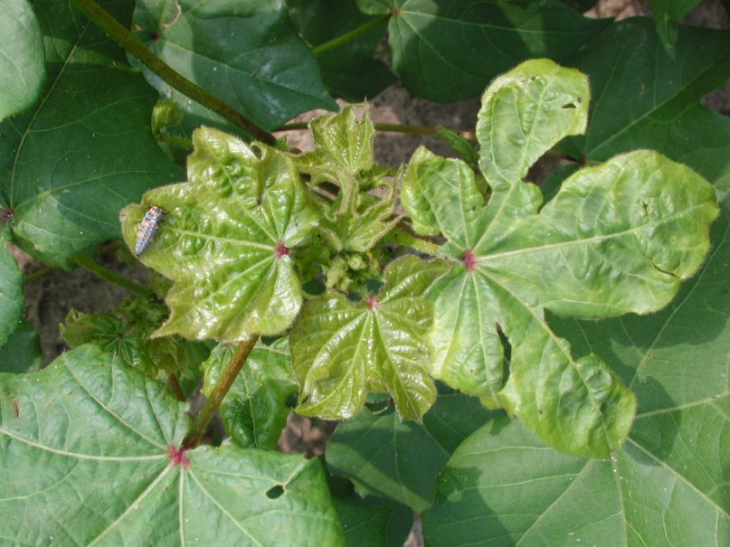
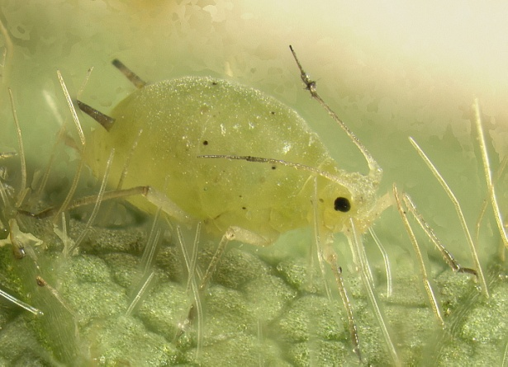
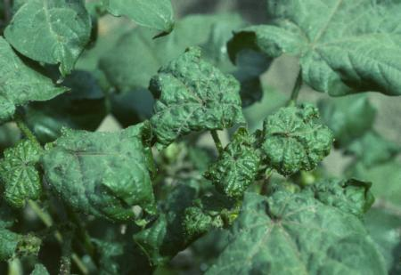
Insect pests of cotton Aphid (Aphis gossypii ; Aphidae, Homoptera)
Stunted growth with shriveling/withering
Notes:
Aphis gossypii
Desaping_decline in plant vitality and fruting capacity
Alatae/apterae, polymorphism (season, growth, host-changing, overcrowding)

Slide 4
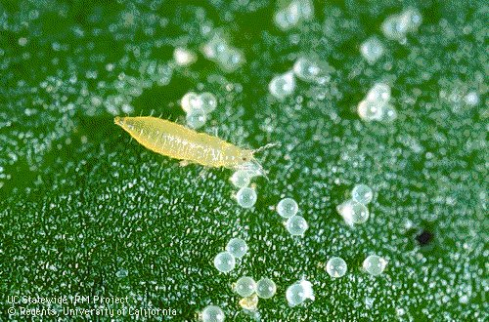
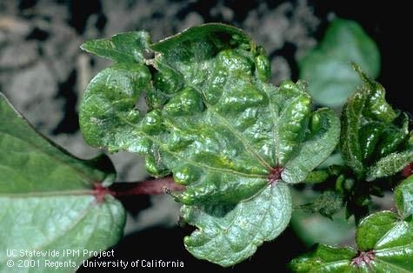
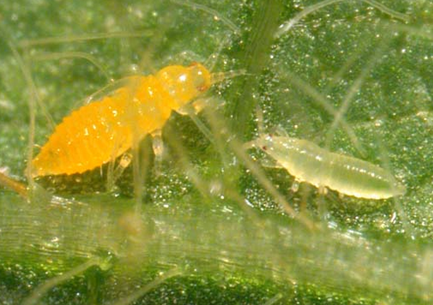
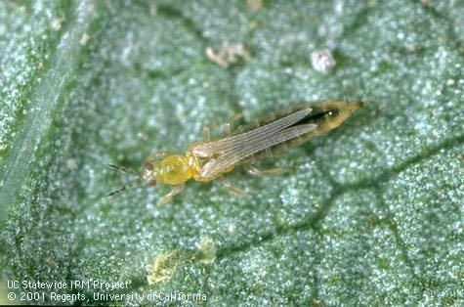
Insect pests of cotton Thrips (Thrips tabaci ; Thripidae, Thysanoptera)
Rasping/withering
Silvery white crumple shaped leaves
Premature boll opening
Notes:
Thrips tabaci (Severe pest in hot and dry conditions)
Early seedlings (and usually lower leaves) are more attacked by thrips.
Rasping_feeding on exuded secretions
Infested leaves silvery white, then dirty white and then become crumpled shaped. And curuves up-ward.

Slide 5
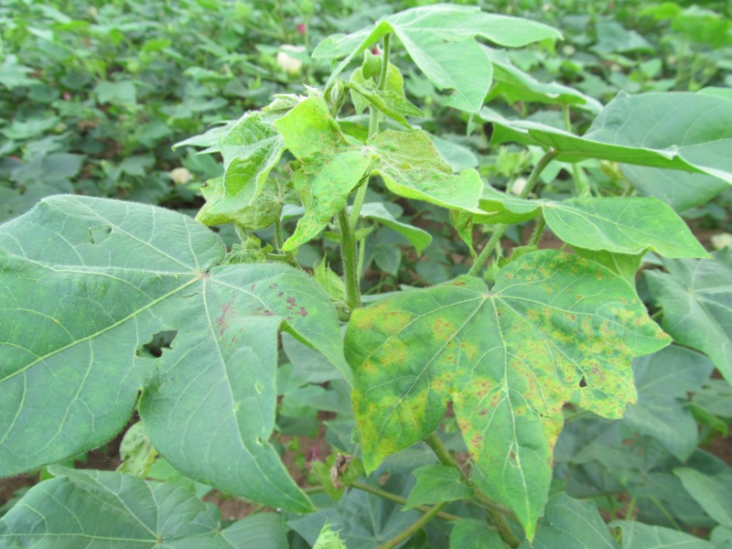
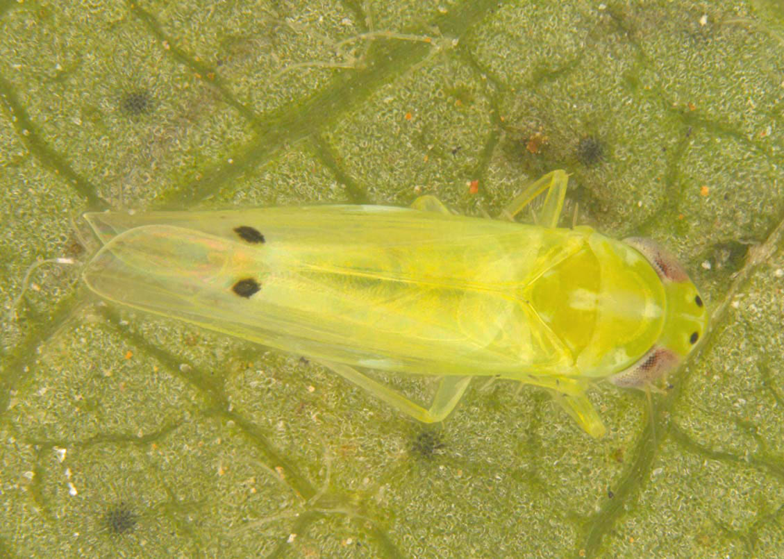
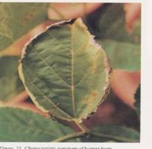
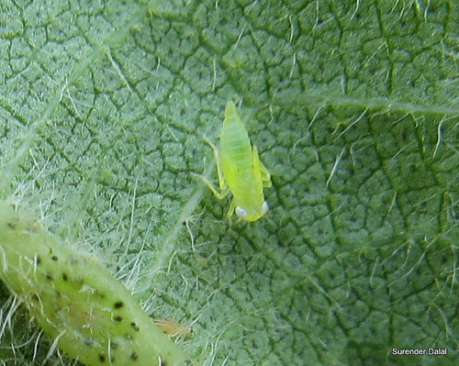
Insect pests of cotton Jassid (Amrasca bigutella ; Cicadellidae, Homoptera)
Cup-shaped leaves of brick red color (Hopper-burn)
Notes:
Amrasca bigutella bigutella (in hot and humid conditions)
Yellowishing , then cup-shaping, then brick red marginal color (hopper burn appearance)
Cotton leaves downwards by jassid desaping (attack).
Attack is more consipecous on middle aged leaves than older or new ones.

Slide 6
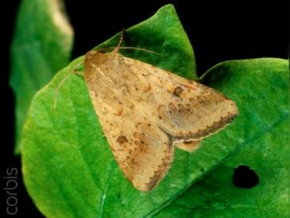
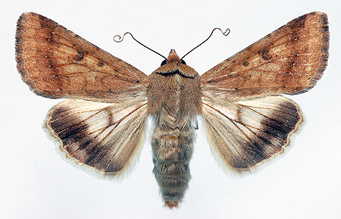
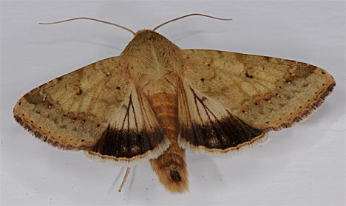
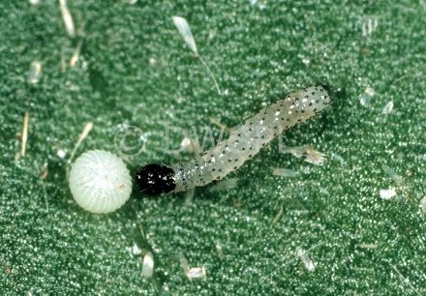
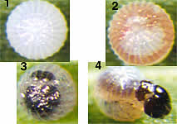
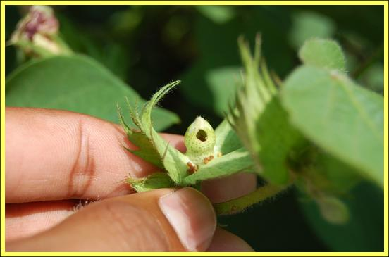
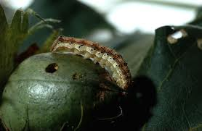
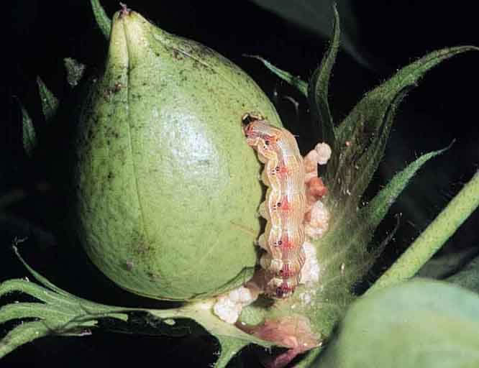
Insect pests of Cotton American bollworm (Helicoverpa armigera ; Noctuidae, Lepid.)
Notes:
Helicoverpa armigera
Voracious feeders of all fruiting bodies
Prominent hole on boll or square
5th and 6th instar more damaging and difficult to control

Slide 7
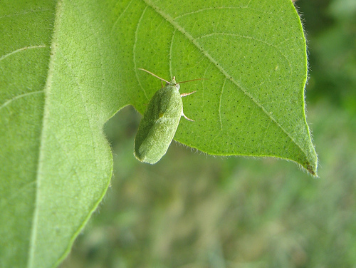
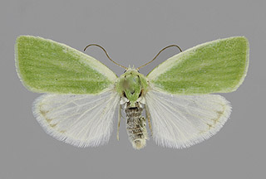
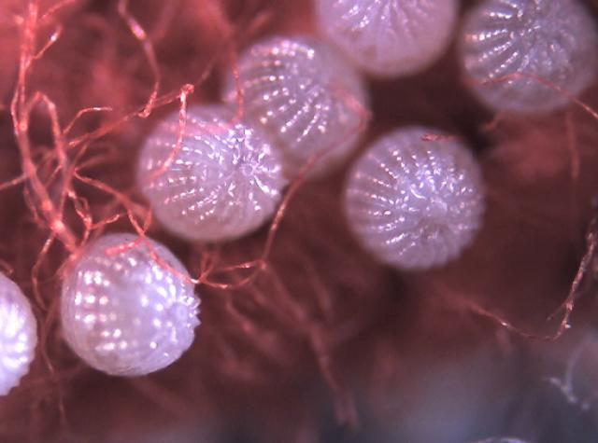
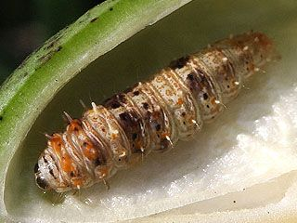
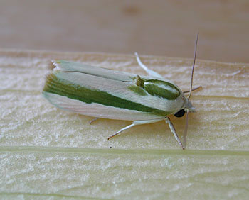
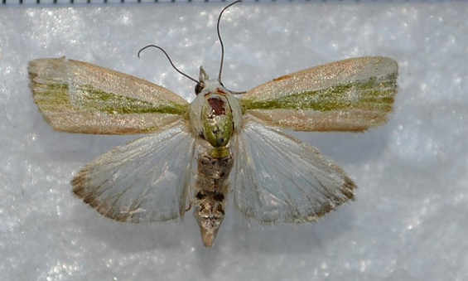
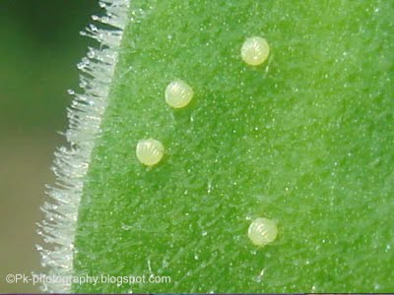
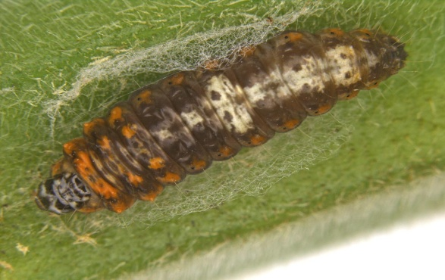
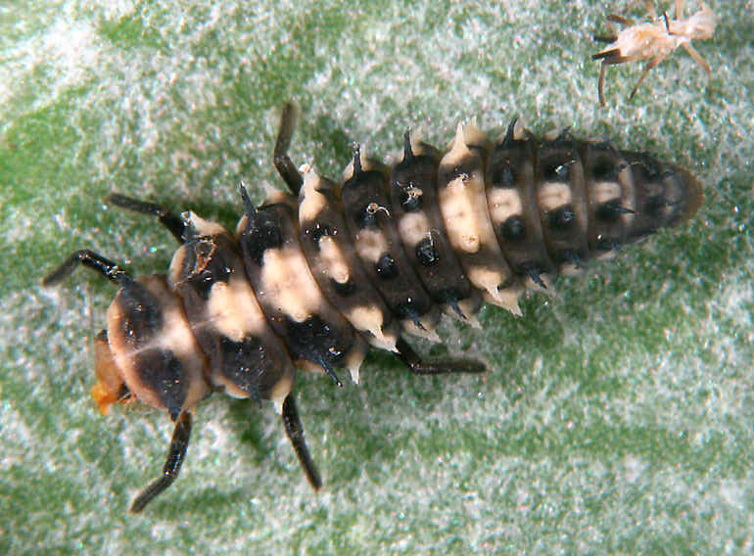
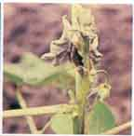
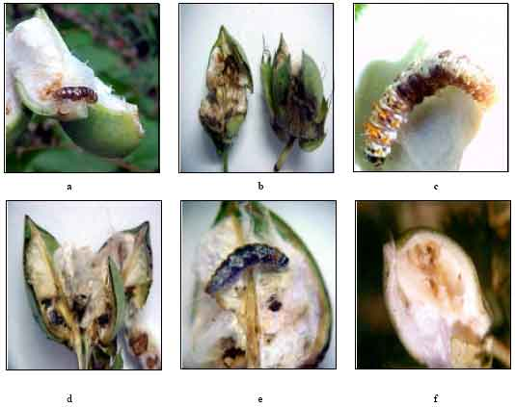
Insect pests of Cotton Spotted bollworm (Noctuidae, Lepidoptera)
Earias insulana
Earias vittella
Notes:
E. Insulana larvae is dull greenish white with black spots on body and orange dots on prothoracic segment.
E. Vittella larva is brownish with a median longitudinal streak on dorsal side and ventral side usually pale yellow or greenish
Stem boring,

Slide 8
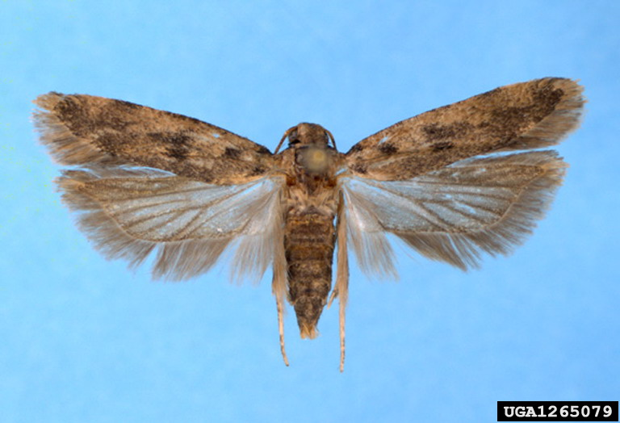
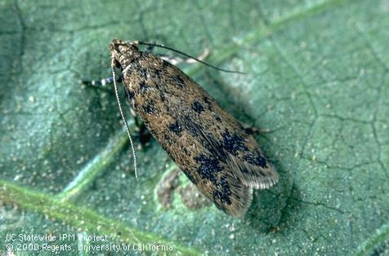
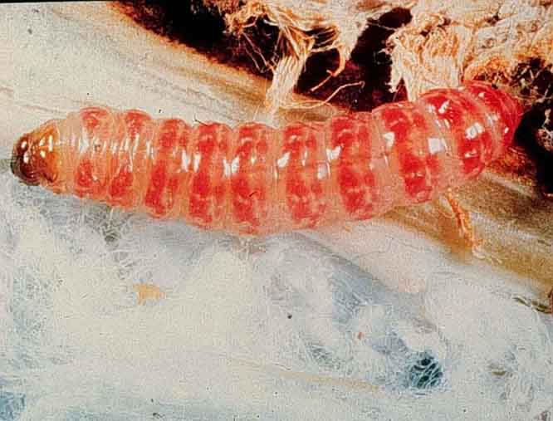
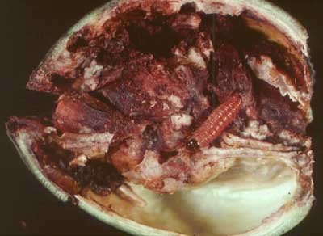
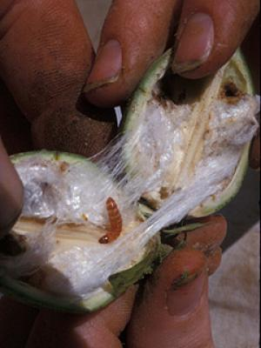
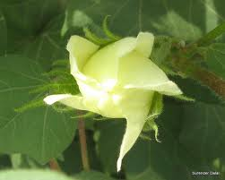
Insect pests of Cotton Pink bollworm (Pectinophora gossypiella ; Gelechiidae, Lepidoptera)
Notes:
Pectinophora gossypiella
Attack on squares and cause rossette flower
No sing of entry on boll while damagin lint inside boll

Slide 9
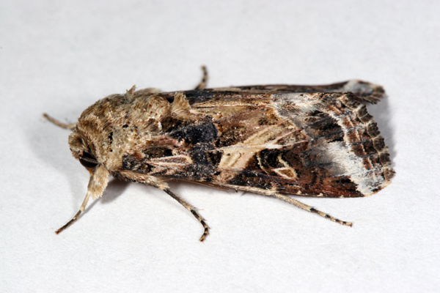
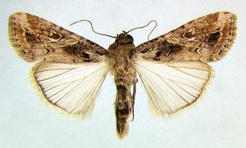
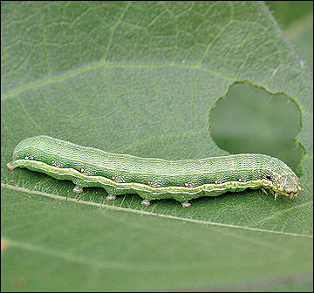
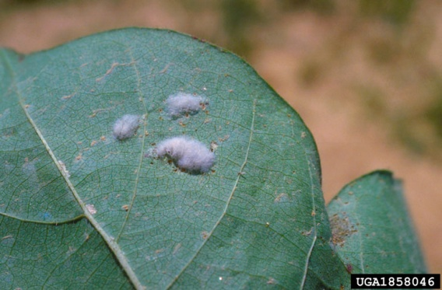
Insect pests of Cotton Armyworms
Notes:
Spodoptera litura
Egg masses on upper leaf areas
Larva feeds on fleshy green matter and leaving behind leaf veinlets or skeleton

Slide 10
Major Insect Pests of Sugarcane in Pakistan

Slide 11
Dead-heart formation
then
Bunchy top (by side shoots development)
Insect pests of Sugarcane Top borer
Notes:
Scirpophaga nivella
Egg mass covered with orange hairs of anal tuft of female moth.
Larvae bore through lower side mid rib of leaves, bores into the central core and thus unfolded shot-holes on leaves show pest attack.
Presence of the reddish mid-rib tunnel on the crown leaf indicates top-borer infestation

Slide 12
Insect pests of Sugarcane Stem borer
Notes:
Chilo infuscatellus
The larva is dirty white with five violet stripes.
The larvae bore into the plants by one or more holes and kill the growing point, resulting in the characteristic 'deadhearts' that emit a foul smell and can be easily pulled out.
the upper portion of the cane dries up completely.

Slide 13
Insect pests of Sugarcane Root borer
Notes:
Emmalocera depressella
Larvae have creamy white body with yellowish brown head.
There is only one entry hole near the base of the shoot.
Dead hearts and general yellowing of the leaves. The dead hearts cannot be pulled easily and does not emit any offensive smell

Slide 14
Insect pests of Sugarcane Leaf hopper (Pyrilla)
Notes:
Pyrilla perpusilla
foliage-sucking pest
Cane yield loss is about 28% while 1.6% unit loss in sugar content.
leaves turn yellowish white and wither away.
Lateral shoots
Sooty mould on honeydew

Slide 15
Insect pests of Sugarcane Termites (Microtermes obesi, Odontotermes obesus ; Isoptera)
Notes:
Odontotermes obesus
Microtermes obesi

Slide 16
Major Insect Pests of Rice Crop in Pakistan

Slide 17
Insect pests of Rice Yellow stem borer (Scirpophaga incertulus: Pyralidae)
Notes:
Yellowish straw color adults with black spots on forewings. Larvae; Pale yellow or yellowish white with head-capsule orange-yellow in color. Eggs laid in clusters of 100s.
4-5 generations per y.
Could cause 90% of crop loss. Growing shoots dries up (dead-heart). Upon attack at flowering stage, whitish ears stands erect in field with no grain formation particularly in August-September.

Slide 18
Insect pests of Rice White stem borer (Scirpophaga innotata: Pyralidae)
Notes:
Selender whitish adult with black spot on each fore wing. Female with orange anal tuft. Larvae; Pale or yellowish white. 5-7 generations per y.
Damage same as yellow Stem Borer.

Slide 19
Insect pests of Rice Damage of Stem Borers
Dead-hearts formation
Milky or White-ears formation
Notes:
Cultural Control: Nursery after 20th May, Transplaning essentially in August Light traps, clean-cultivation, stubbles removal, picking and destroying egg-masses and dead-hearts
Chemical control: Carbofuran (Furadan 3G) @14kg/acre, Chlorpyriphos or Cartap (Padan 4G) @10Kg/acre, Diazinon (Basudin 10G) @ 9Kg/acre

Slide 20
Insect pests of Rice White-backed plant hopper (Sogatella furcifera: Delphacidae)
Hopper burn
Notes:
Widely distributed in Kallar tract of Pakistan (Sialkaot, Gujranwala, Sheikhupura etc). Host plants: Rice and wild grasses.
Adults: Greyish straw colored with white back, mass egg-laying (cylindrical) in leaf-sheaths, Nymph: greyish white then turns dark grey
Life cycle: 3-4 weeks, active period: March to November, overwinters as egg or nymph, several generations per y.
Congregate near plant base around leaf sheaths, desaping gives yellowish color and then dries up and gives burnt appearcence to the whole crop. Lower rice yeild

Slide 21
Insect Pests of Maize and Sorghum

Slide 22
Insect pests of Maize & Sorghum Stem borer (Chilo partellus: Pyralidae: Lepidoptera)
Host plants: wild and cultivated grass species, including maize, sorghum, millets and rice
Identification (Spotted stem borer)
Adult: Forewings are yellowish grey
Eggs: Clusters of 10-70 oval shaped eggs laid on leaves near midribs.
Larvae: Creamy-white to yellowish-brown in colour with purple strips on dorsal side
Conspicuous dark-brown spots on dorsal side
Life history:
Life cycle: 3-4 weeks
Larvae: 1-2 weeks (diapause as larva)
Pupation: 1-1.5 weeks (inside stems)
No. Og generations: 5-7
Damage:
Active period: April to October
Early stage crop is more susceptible.
Young larvae feed inside the leaf whorl (leaving shot holes on leaves)
Stem boring and feeding on growing tissues
Producing ‘deadhearts’ and weakening stem with holes on them on internodal region.
Control:
Destruction of crop stubbles.
Granular/dust insecticide to plant whorls.
Biological control by Cotesia flavipes, Bracon spp.
Carbofuran / Cypermethrin / Deltamethrin

Slide 23
Insect pests of Maize & Sorghum Shoot fly (Atherigona soccata: Muscidae: Diptera)
Host plants: Sorghum, corn, millets, wheat, other grasses
Identification:
Adult: small dark flies like house flies
Eggs: elongated whitish in color laid singly on leave lowersides (30-40 eggs /female)
Larvae: yellowish brown in color
Pupae: Pale white (turns brown later on)
Life history:
Life cycle:
Adult: 1 month
Egg hatching: 3-5 days
Larva (maggot): 6-10 days
Pupation: 7 days (in-side stems)
Damage:
Active period: Feburary to October
Maggots bore into the shoot of young plants, Central shoot dries (dead-heart).
Side tillers formation (which may be further attacked).
Control:
Pull-out and discard the infested plants
Higer seed rate than normal to ensure optimum plant density in the field
Folier spray of Deltamethrin, Cypermethrin, Chlorpyrifos etc.
Notes:
small dark fly; whitish eggs singly laid on leaf middle area.
Larvae yellow in color, make a clean cut at the base of the leaf inside the leaf whorls.
The maggots bore into the shoot of young plants, central shoot dries (dead-heart).
Side tillers (which may be further attacked).

Slide 24
Insect Pests of Vegetable Crops in Pakistan

Slide 25
Hadda beetle (Henosepilachna chrysomelina: Coccinellidae: Coleoptera)
Host plants: All plants of cucurbitaceae family
A serious pest of these plants
Identification
Adult: Reddish brown forewings with many black prominent spots on dorsal side (6-8 on each forewing)
Eggs: Singly laid eggs (in clusters of 20-30), Yellowsih in color on leave upper sides. (about 300 eggs per adult female)
Larva (grub): Yellowish in color with spines.
Life history:
Life cycle: 1.5 to 2 months (male short lived than females)
Adult: 2-3 weeks
Larva: 10 days
Pupat: 4-5 days
No. of generations per annum: 5-7
Overwinters as adult in crop stubbles or in soil structures
Damage:
Active period: March to November (max. damage June/July)
Larval feeding on lower leaf sides making them sieved-like
and ultimately drying and falling of leaves.
Control:
Destruction of crop stubbles.
Biological control by Pediobius foveolatus; P. epilachnae (larval/pupal parasitioid wasp as shown in photo right)
Folier spray of Cypermethrin/ Lambda-cyhalothrin/ Bifenthrin

Slide 26
Red pumpkin beetle (Aulacophora foveicollis: Chrysomelidae: Coleoptera
Host plants: Major pest of pumpkin crop and other cucurbitaceous plants
Identification
Adult: Red orange colored body
Eggs: Initially yellow, later turns on orange brown (50-300 eggs laid singly or in batches)
Larva (grub): Creamy white or yellowish
with dark black ends
Pupa: Creamy white
Life history:
Life cycle: About 1.5 to 2.5 months
Adult: 1 month
Larvae: 2-3 weeks
Pupation: 1-2 weeks
No. of generations per annum: 5
Damage:
Active period: March to November (max. damage April/May)
Adult and larvae feed on germinating young cucurbit seedlings in spring season.
Grubs attack on roots, stems and fruits as well.
At early stage, severe infestation cause complete crop eradication, so re-sowing becomes necessary.
Control:
Destruction of crop stubbles.
Foliar spray of Cypermethrin/ Lambda-cyhalothrin/ Abamectin

Slide 27
Brinjal fruit borer (Leucinodes orbonalis: Crambidae: Lepidoptera)
Host plants: Brinjal, Okra etc.
Most destructive pest of eggplant crop
Identification
Adult: Milky white forewings with brown irregular spots
Eggs: Laid singly on leaf, stem, shoot or fruit ventral surface (under-side)
Larvae: Pink in color with brown head capsule
Life history:
Life cycle: 2.5 to 3.5 months
Adult: 3 weeks
Larvae: 1 month
No. of generations: many overlapping generations per annum
Damage:
Active period: March to Nov. (maxi. Damage June/July)
Boring of tender shoots and stems (drying of central terminal shoots)
Shedding of flowers and premature fruits
Buds and fruit boring and infestation (entry holes clogged with excreta)
Vectors of brinjal bacterial wilt
Control:
Removal of crop stubbles
Sowing of resistant varities
Manual removal of infested plants (dead shoot removal)
Biological control (by Ichneumonid wasps: larval parasitoids)
Chemical control (Foliar spray with Cypermethrin, Spinosad etc.)

Slide 28
Insect Pests of Fruit Crops in Pakistan

Slide 29
Insect pests of Fruit Crops Citrus caterpillar (Papilio demoleus: Papilionidae, Lepidoptera)
Also called Citrus swallowtail butterfly
Host plants: Major pest of Rutacae (citrus family) and also of Fabacae.
Identification
Adult: Bluish green wings with irregular black and whitish-yellow patches.
Red tornal spot with blue edging on forewing
Eggs: Smally creamy and round eggs laid singly on tender plant shoots or twigs.
Larvae: First instar larvae-bird dropping look, stays in the leaf middle portion on upper side
Full grown larvae green in color with oblique brownish strips on abdomen.
Pupa: Rugose, dimorphic
Life history:
Life cycle: 1 – 1.5 month
Adult: 1 week / Larvae: 2 to 4 weeks / Pupa: 1 – 3 weeks
No. of generations: 6 – 8 per annum
Damage:
Active period: April to Nov. (maxi. Damage July/ August)
Vigoruosly eating leaves from edge to midrib.
Devaste tender shoots and young sprouts.
Complete defoliation of citrus nursery or no fruiting on trees.
Control:
Mannual picking and destruction of larvae
Biological control (larval paristoids like Apanteles, Bracon hebetor)
Pupal parasitods like Brachymeria (Chalicidae)
Chemical control (Foliar spray with Imida, Cypermethrin, Spinosad etc.)

Slide 30
Insect pests of Fruit Crops Citrus Leafminer (Phyllocnistis citrella : Gracillariidae , Lepidopt.)
Host plants: Major pest of citrus plants and widely distributed in citrus growing areas of Pakistan.
Identification
Adult: Silvery white tiny (2 mm long) moth with hair-fringes on fore- and hind-wings.
Eggs: Minute round eggs (looks like tingy water droplets in mines) laid singly under side of plant tender sprouts and leaves. (50 eggs / female)
Larvae: Pale greenish in color
Pupa: Tiny brownish in color, pupate in mine near rolled-leaf edge.
Life history:
Life cycle: 3 – 10 weeks
Adult: 2 – 8 weeks/ Larvae: 1 to 4 weeks / Pupa: 1 – 2 weeks
No. of generations: 12 plus
Damage:
Active period: March to Nov. (maxi. Damage July/ August)
Zigzag galleries on young foliage silvery when on young leaves
turns into brown patches on older leaves
Leaves and sprouts twisting and retarded growth occurs later on on attacked portion
Rarely infest the stems and fruits.
Control:
Horticultural oil sprays (to reduce egg laying)
Fertilization in late winger/ Limited irrigation in late summer
Biological control: Chrysoperla carnea (lacewings)*
Cirrospilus coachellae (Eulophid wasps) larval parasitiod
Chemical control difficult (low efficiency).

Slide 31
Insect pests of Fruit Crops Citrus psylla (Diaphorina citri : Psyllidae, Homoptera
Also called Asian Citrus Psyllid
Host plants: Major pest of citrus.
Identification
Adult: Small (4 mm long) hoppter with brown and white patches (moteled body)
Aphids are sedentry and psyllids are active.
Egg: Pale yellow small eggs laid on young foliage
Nymph: Five nymphal instars with light yellow color of full grown nymph
Life history:
Life cycle: 2- 7 weeks
Damage:
Active period: March to October
(maxi. Damage March-April)
De-saping of young foliage
Withering , deformation and yellowing of plant leaves and twigs
Pre-mature fruit dropping and defoliation
Sooty mold on sugary secretions produced by Psyllids
Vector of citrus greening disease
Control:
Biological control (Tamarixia radiata hoverflies, lacewings, several species of ladybird

Slide 32
Insect pests of Fruit Crops Mango leafhopper (Amritodus atkinsoni ; Cicadellidae, Homoptera)
Host plants: Mango
A destructive pest of Mango plant, widely distribute in mango orchards
Identification
Adult: Pale brown in color
Eggs: 200 , laid singly in panicle tissues, unopened
flowers, and your foliage.
Nymph: Pale yellowish in color
Life history:
Life cycle: One month
Eggs: about 200 eggs per female (hatching in one week)
Nymph: One to three weeks
No. of generations: 2 per year (Feb. And in June)
Damage:
Active period: Throughout the year
(Maxi. population in May, June)
Maximum damage caused in February-March (to inflorescence and young sprouts).
De-saping of young foliage and sprouts, and tender leaves and twigs.
Withering , deformation and yellowing of plant leaves and twigs
Pre-mature fruit dropping and poor-quality fruits
Control:
Chemical control (Acetamiprid, Imidacloprid, Bifenthrin, Lamda-cyhalothrin)
Biological contorl by releasing lacewings, coccinallid beetles etc.

Slide 33
Insect pests of Fruit Crops Mango mealybug (Drosicha stebbingi ; Monophlebidae, Homoptera)
Host plants: Mango, Mulberry, Peaches, guava, fig, rose etc.
A destructive pest of Mango plant/ widely distribute in mango orchards in Pakistan.
Identification
Adult: Females are wingless, oval, flattend body covered with a white mealy powder
Males are dipterous with black forewings and hindwings modified as halteres and with crimson colored body.
Eggs: Pink clored minute egg (masses), which later on turns pale near maturity.
Pupa: Only occurs in Male lifespan.
Life history:
Life cycle: One year
Eggs: about 200 eggs/ female laid singly which hatch in1-2 weeks.
Nymph: 3 – 6 months
Pupa: 4 – 7 months (in soil near trunk)
No. Of generations per annum: One
Damage:
Active period: Jan. to June (Maxi. Population in Jan. to April)
After egg-laying adults die in June
Egg hatching in 2nd fortnight of December and nymphs
crawl up on the tree trunk in January and cluster around
twigs, shoots, leaves, inflorescence, young fruits etc.
De-saping of young foliage and sprouts, and tender leaves and twigs.
Retarded plant growth and pre-mature fruit falling
Control:
Regular ploughing of soil under tree trunk from May to November
Collection and desctruction of egg masses
Mealybug sticky traps on tree trunks
Chemical control (Imidacloprid, Deltamethrin, Lamda-cyhalothrin)

Slide 34
Insect pests of Fruit Crops Mango fruit fly (Ceratitis cosyra ; Tephritidae, Diptera)
Host plants: Mango, guava, ber, peach
A destructive pest of Mango plant/ fairly distributed in mango orchards
Identification
Adult: Brownish yellow with shinny black spots
Eggs: Whitish yellow elongated eggs laid inside the mature green fruits.
Larvae: Apodous, creamy white maggots
Pupa: Yellowish brown in color (in 5-10 cm upper soil layer)
Life history:
Life cycle: 1 – 1.5 month
Adult: 4 – 5 days
Eggs: Hatching takes place in 2 – 3 days.
Larvae: One to two weeks
Pupa: 2-3 weeks
No. Of generations: 2 per year
Damage:
Active period: March to November
(Pupal hibernation: November to Feburary)
Maximum damage caused in August to November
Egg-laying in fruits by puncturing with ovipositors
Attacked fruit skin got rotten, giving strong smell
and contain several maggots later on.
Fruit quality deterioration
Control:
Plouging of soi under tree trunk
Regular removal and destruction of rottened and fallen fruits
Pheromone traps (methyl eugenol oil)
Chemical control (Acetamiprid, Imidacloprid, Bifenthrin, Lamda-cyhalothrin)
Notes:
Mango Fruit fly (Ceratitis cosyra). The body and wing colour is yellowish, with black spots. Adult mediterrenean fruit flies are 4-6 mm long,The wings are spotted or banded with yellow and brown margins.
Fruit flies lay eggs under the skin of mature green and ripening fruit. Some fruit flies such as Bactrocera invadens, a new species recently introduced into East Africa, also lay eggs on small fruit. The eggs hatch into whitish maggots within 1 to 2 days. The maggots feed on the fruit flesh and the fruit starts to rot. After 4 to 17 days, the maggots leave the fruit, making holes in the skin. Adult fruit flies are about 4-7 mm long.

Slide 35
Storage / Stored Grain Insect Pests

Slide 36
Stored grain insect pests
Red flour beetle_susri (Tribolium castaneum ; Tenebrionidae, Coleoptera)
Identification
Adult: Reddish brown with 11 segmented antennae (body length 4-5 mm)
Larva/grub: Yellowish white with light brown head (10 mm long)
Damage:
Larvae feed on broken kernels and grain dust (flour particles)
Active period: March to November
Overwintering as adult
Infestation in wheat flour and other stored grain products produces disagreeable odor and flavor through production of benzoquinones from pest’s abdominal glands
High rate of dispersal (flying adults) and reproduction under optimum temperature and conditions

Slide 37
Stored grain insect pests Rice weevil (Sitophilus oryzae; Curculionidae, Coleoptera)
Identification
Adult: Reddish brown to black with a developed rostrum , elytra with 4 brownish orange spots
(adult body length 2.5 –3.5 mm)
Larva/grub: dirty white found inside rice grains (10 mm long)
Damage:
Active period: March to October-November
Overwintering as larva inside grains
Female oviposits inside grains (egg-site) where grubs begin to feed on germ material,
leaving only intact grain shells.
Single weevil grub may consume one third of a grain during its development.
Notes:
Below 9% moisture conditions, rice weevil unable to breed. So keeping stored products dry.
Bag-trapping of adult weevils and destruction aferwards.

Slide 38
Stored grain insect pests Khapra beetle(Trogoderma granarium ; Dermestidae, Coleoptera)
Identification
Adult: Dark brown beetles with 11 segmented clubbed-shape antennae (body length 1.5 – 3.5 mm)
Larva/grub: Dark reddish brown (4 – 6 mm long) with long spicisetae hair tuft on 9th abdominal segment.
Damage:
Active period: March to November
Overwintering as larva
Adults rarely eat or drink and do not fly.
Development is more high in warm and humid conditions inside the grain godowns.
The pest is resistant to low humidity, temperature conditions, insecticides etc. but sensitive to oxygen supply inside the grain heap. Therefore it is a surface feeder and not infest beyond a certain depth.

Slide 39
Hide or leather beetle - Dermestes maculatus

Slide 40
Stored grain insect pests Lesser grain borer(Rhyzopertha dominica; Bostrichidae, Coleoptera)
Identification
Adult: Dark brown beetles (body length up to 5 mm)
Larva/grub: Creamy white cylindrical (2.5 – 3.5 mm long), found inside grains
Damage:
Active period: March to November
Overwintering as larva
Both adults and larvae bore into the grains and feed on grain contents including germplasm.
Infestation of Lesser grain borer develops more frequently on milled rice and flour than highly polished rice.

Slide 41
Stored grain insect pests
Dhora _ Pulse bettle(Callosobruchus chinensis/maculatus; Bruchidae, Coleoptera)
Identification
Adult: Reddish brown body with usually brownish elytra and pectinate antennae (body length up to 3-4 mm)
Larva/grub: Pale yellowish (2-3 mm long), usually lie inside the grains
Damage:
Active period: March to November
Overwintering as larva
Major pest of chick pea and other pulses and lentils.
Grubs bore and fees on the internal seed cotyledons and excavate a growth chamber inside the grain.

Slide 42
General Instructions for the Storage of Cereals/ Pulse Grains in order to reduce spoilage and pest infestation
Cleaning/Grading/Sieving of Grains
Sun drying/ Heat treatment
Treatment of grains with different plant extracts (such as neem seed oil or extract)
Treatment of storage structures/stores
Superheating of stores
Cleaning of stores and plugging of crevices.
Maintaining the unfavorable/non-conducive conditions for the pest development
Fumigation with Aluminum-phosphide (Phosphine) tablets (@ 1 tablet / m³)
Regular monitoring/pest-scouting of stores

Slide 43
Household Insect Pests

Slide 44
House fly (Musca domestica; Muscidae: Diptera)
Mechanical transmission of organisms on its hairs, mouthparts, vomitus and feces:
Parasitic diseases: cysts of protozoa e.g. Entamoeba histolytica (dysentry), Giardia lamblia (diarrhea)
Eggs of helminths, e.g., Ascaris lumbricoides ,Trichuris trichiura, Hymenolepis nana, Enterobius vermicularis. (all causes stomach diseases),
Bacterial diseases: typhoid, cholera, dysentery, pyogenic cocci, etc. House flies have been demonstrated to be vectors of E. Coli
Viruses: enteroviruses: poliomyelitis, viral hepatitis (A & E)..etc.
Management:
Dispose of manures, garbage, sewage, food waste, human exrement and dead animals
Use Sticky papers
Use Fly-flappers
Use of electric trap
Use Poison baits (coding with dichlorvos etc)
Spray insecticides inside homes (Trichlorphon 0.5%)

Slide 45
Mosquito (Aedes spp., Culex spp., Anopheles spp.; Culicidae: Diptera)
Disease transmission: malaria, dengue fever virus, yellow fever virus, japanese encephalitis virus, filariasis (disease due to Nematodes)
Management:
Destroy the mosquito breeding places (e.g., old tyres, water storage tank, room coller, flower vase etc to avoid dengue fever)
Remove the stagnant water (to avoid malaria)
Use of insecticide treated nets (ITN)
Screening of doors and windows
Vaccinate the children against malaria
Use of mosquito repellent (e.g., mospal, mos free etc)
Grasses around the house should be cut and sprayed with permethrin (0.25 %)
Spray on Vegetation around house against mosquito permethrin (0.25 %)
Use temephos to kill the larvae of mosquito

Slide 46
Cockroaches(Periplaneta americana; Blattidae: Dictyoptera)
vectors and/or reservoirs of antibiotic resistant microbes (enterococci)
move freely from building to building or from drains, gardens, sewers and latrines to human habitations.
feed on old damp books and leather articles, human faeces as well as human food they can spread germs that cause disease
They are proven or suspected carriers of the organisms causing:
— diarrhoea
— dysentery
— cholera
— leprosy
— plague
— typhoid fever
— viral diseases such as poliomyelitis.
may cause allergic reactions, including dermatitis, itching, swelling of the eyelids and more serious respiratory conditions (asthma)
Sugary and starchy substances in the houses are destroyed by their excreta and produce offensive smell
Common in unclean kitchens, restaurants and old musty buildings and other filthy places
Management:
Close all cracks and crevices to control the entry of cockroaches
Keep the kitchen clean
Keep the drains sealed
Use of sticky traps
Spray rooms with chlorpyriphos (0.5 %)
Spray dichlorvos ( 0.5 %)
Fipronils in poison baits
Flufenoxuron (0.001 %) as IGR in baits

Slide 47
Ent-306 Agricultural insect pests and their management 4(3-1)
Termites (Odontotermes obesus/Microtermes obesi)
(Termitidae, Isoptera)
Notes:
Macrotermes spp.
Odontotermes guptai
Setts are infested by termies. So pre-sowing treatement with some insecticide is effective against termites.
Add well rotten FYM in field.
Remove deeply crop stubbles after harvest to ensure eradication of termite infestation and flood irrigate with some insecitcide or kerosine oil dripped after deep soil ploughing.

Slide 48
House Crickets (Acheta domestica; Gryllidae: Orthoptera)

Slide 49
Insecticides Formulation
And
Their Application

Slide 50
A pesticide/insecticide formulation is a mixture of chemicals which effectively controls a pest. Formulating a pesticide involves processing it to improve its storage, handling, safety, application, or effectiveness.

Slide 51
The pesticide formulation is a mixture of active and inert ingredients. An active ingredient is a substance that prevents, kills, or repels a pest
Synergists are a type of active ingredient that enhance another active ingredient's ability to kill the pest. For example, insecticides containing the active ingredient pyrethrins often contain piperonyl butoxide as a synergist.
Inert ingredients may aid in the application of the active ingredient and include solvents, carriers, adjuvants etc.

Slide 53
Insecticide Application Equipment
Common Sprayer Types
Hydraulic sprayer
Hand atomizer sprayer
Knapsack sprayer
Wheelbarrow sprayer

Slide 54
Insecticide Application Equipment
Common dusters
Hand Rotary Duster
Manual Powder Duster and Shaker Applicator
Viller’s power rotary duster
Backpack Granule Spreader

Slide 55
Insecticide Application Equipment
Common Nozzle Types

Slide 56
Insecticide Application Equipment
Nozzle Selection

Slide 57
Numerical Calculations for Preparing Insecticide Solutions
$TQP=\frac{Dose}{Formulation}+$100
$TQSM=\frac{Dose}{Concentration}+$100
Calculate the dose (per acre) of Imidacloprid 25WP with a concentration of 0.8 % and TQSM of 50 liters. What would be the TQP used for one acre?

