Slide 1
Spinal Cord Injury Management

Slide 2
Outlines
Pressure ulcer
Vasomotor
Postural sense
Muscle length

Slide 3
Pressure ulcers
Sacrum
Trochneters
Ischial tuberosities
Knees
Fibula
Heel
5th MT
Scapula, occipital in cervical lesion
Under splint where sensation compromise

Slide 4
Contribution factor
Loss of sensation
Loss of voluntary movement
Loss of vasomotor control

Slide 5
30 classification
Stirling scale described 4 stages
Stage 0 pre ulcer stage
Normal intact skin
Erythematic
48 hours resolve inflammation
Stage 1
Permanent without damage to superficial layers
Congestion not disappear on digital pressure
Skin color change
Stage 2
Abrasion of skin and formation of blisters
Shallow ulcer without underming adjacent tissue

Slide 6
Stage 3
Full thickness skin loss
Not extending to bone , tendon, joint capsule
Stage 4
Full thickness
Up to bone and deep structure
Osteomylitis
Ectopic bone formation
Septicemia and death

Slide 7
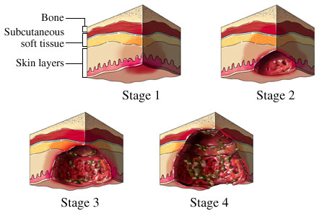
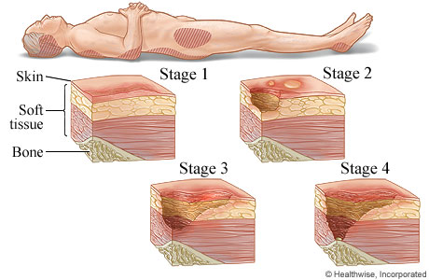

Slide 8
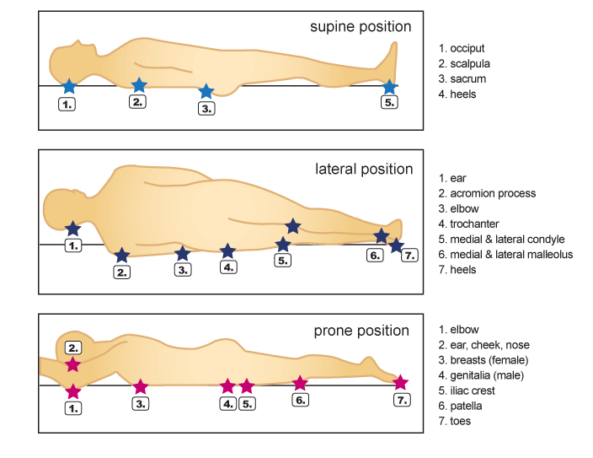

Slide 9
Prevention of ulcer
Sir Ludwing Guttmann used to say
” Where there is no pressure, there will be no sore”
Relief with correct positioning
Age, gender, body build, level of injury, degree of incontinence and general health
Smoking
Anemia
Diabetes

Slide 10
Turning the patient
2-3hour
Improve renal function
If side lying not possible adopt hip flick position
Not in lower thoracic and lumbar fracture
Each turn inspect the skin
Redness that not fade on pressure, bruising , swelling warning sign
Electrical turning and tilting bed
Prone in non acute lesion if sacrum pressure ulcer
Ripple Mattress

Slide 11
Intact skin should be kept clean with soap and water
Dead epithelium collect at feet and palm due to disuse
Remove and Emollient into skin

Slide 12
Do’s and don’ts
The patient is taught the following list of simple do’s and don’ts when he first gets out of bed:
Do relieve pressure in the chair for 1.5–2 minutes every half-hour.
Do lift the paralysed limbs when transferring.
Do little lifts when using a transfer board or use a sliding sheet to reduce friction.
Do cover the tyre of the rear wheel when transferring whilst undressed.
Do use a mirror to detect marks, abrasions, blisters and redness on buttocks, back of legs and malleoli
Do protect the limbs against excessive cold.
Do have the bath water ready and not too hot.

Slide 13
Do’s and don’ts
Don’t force the transfer board under the bottom, lean over to the side before placing it.
Don’t allow the clothes to be pulled to be repositioned.
Don’t open the hot tap when having a bath in case hot water drips on the toes.
Don’t have a hot water bottle in bed.
Don’t expose the body to strong sunlight; tetraplegic patients must wear a hat.
Don’t knock the limbs against any hard object.
Don’t carry hot drinks on the lap.
Don’t rest the paralysed limbs on hot water pipes or radiators.
Don’t sit too close to the fire.
Don’t leave the legs, particularly the feet, unprotected against car heaters.

Slide 14
Physical proportion of the patient
Ease and speed
Height, weight, arm length
Below C6
Intrepid or daring patient have good independence
Study on physical ability complete below C6
Extensor carpi radialis present, triceps absent
Monkey syndrome…..no result
Long arms and a short trunk
Its only subjective impression
Lean further have transfer ability
Broader hips…..mechanical disadvantages
Females have narrow shoulder and broader hips so difficult in transfer

Slide 15
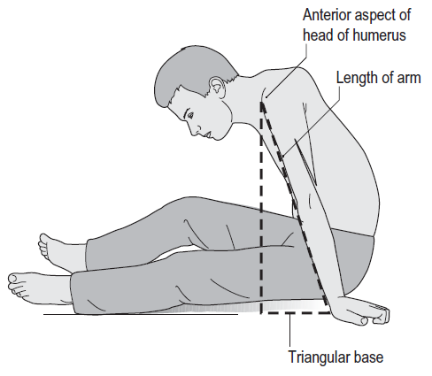

Slide 16
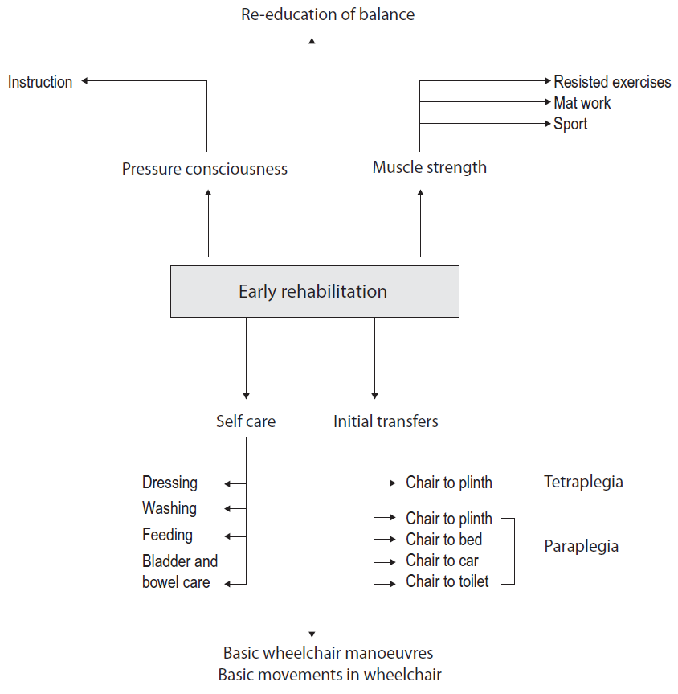

Slide 18
Aim of treatment
Highest level of fitness, independence, balance and control that the patient’s lesion permit

Slide 19
Re-adjustment of vasomotor control
Postural Hypotension
Splanchnic loss….unable to constrict
Deep breathing
Tilting exercises in bed
Frequent changes in positioning
Graduated balance exercise in sitting and standing
First 30degree than 90 degree.

Slide 20
10-15mint to 3 hour tilted position
Functional electrical stimulation to leg muscles
Active rehabilitation start when patient tolerate 1.5hour on wheelchair
Legs elevated in case of fainting
Deep breathing and arm movements

Slide 21
Postural sense
Loss of kinesthetic and proprioception
T12 hip joint sensory loss
Balance issue in unsupported sitting
LD with high innervations and large muscles maintain balance in below C7 lesion
Visual control
Visual motor feedback
Mirror
Later without mirror

Slide 22
Balance exercises in sitting position
Mirror
Progression
Self supported
Single arm
Bilateral arm
Without mirror
5-10mints to 30mints

Slide 23
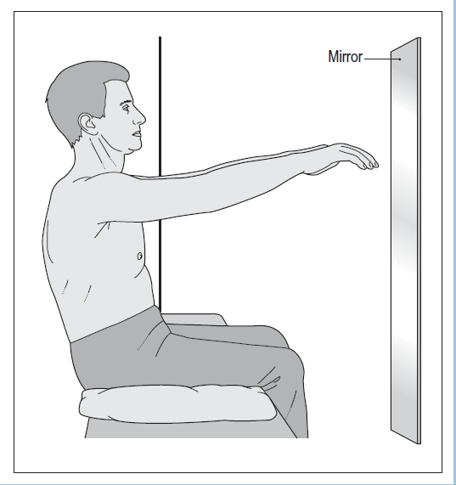

Slide 24
Muscle re education
LD
Shoulder adductors
Arm muscles
Abdominal muscles
PNF in little spasticity….incomplete….trunk and arm muscles
Spring
Weights ..wrist or ankle cuffs
Pulleys
Multi gym
Sports
Bilateral activities

Slide 25
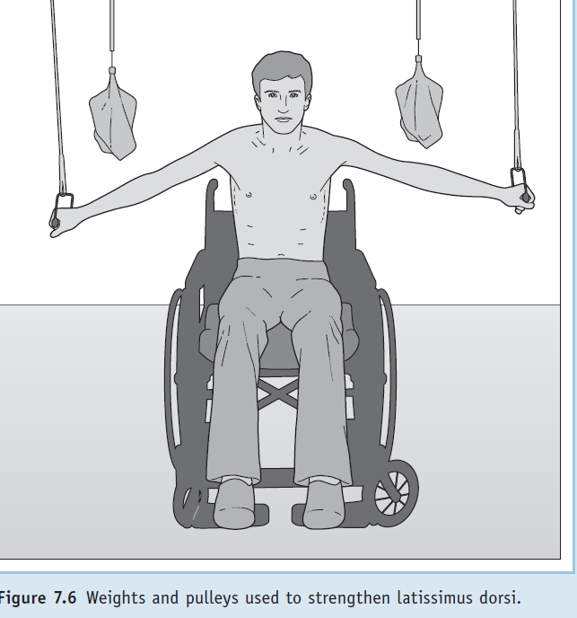
If flex elbow ??????? will strengthen

Slide 26
Muscle length

Slide 27
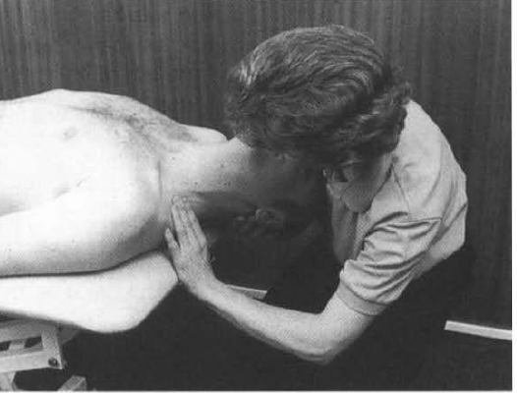
Scalenes
The clinician extends the head and laterally
flexes away and rotates towards the side of testing for
anterior scalene; neutral rotation tests the middle fibers and
Contra lateral rotation tests the posterior scalene muscle

Slide 28
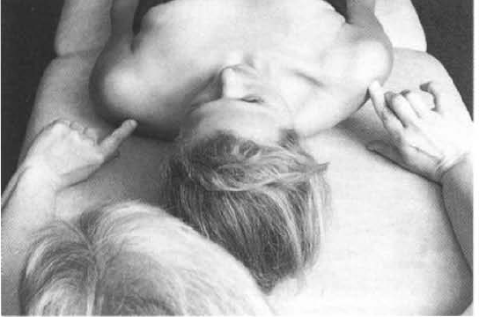
Pect minor

Slide 29
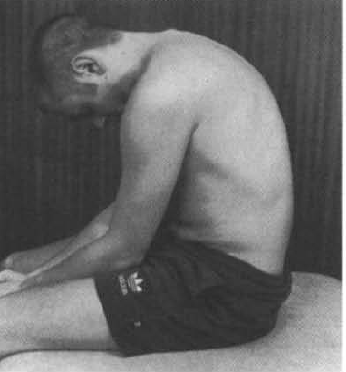
Erector spinae

