Slide 1
Forest Resources

Slide 2
Forest:
Latin word, foris= outside
Include all uncultivated and uninhabited land.
Jungle=collection of trees, shrubs etc.
It is natural ecosystem having multi species and multi aged trees as dominant community.
1/3rd of the earth total area is covered by forest.
In the words of Allen and Shorpe, “Forest is a community of trees and associated organism covering a considerable area, utilizing air, water and minerals to attain maturity and to reproduce and capable of furnishing mankind with indispensable products and services”

Slide 3
What are resources?
he term resources was taken to mean only the natural factors or things like mountains, mineral deposit, forests, animal life, soil, water, air etc „Resource‟ was used to refer to only natural resources.
This term was taken to mean all natural phenomenon or factors, whether they are useful to man or not.

Slide 4
Today resources is taken to mean only those natural, human and cultural factors which satisfy human wants and contribute to human welfare
The modern meaning of the term “resources” is given Prof.Zimmermann as “A means of attaining given ends, the ends being satisfaction of human wants and attainment of social objectives”.
According to B.S.Negi, “Resources are those aspects of mans environment which facilitate the satisfaction of human wants and the attainment of social objectives”

Slide 5
What are forests?
Forest resources play an important role in the economy of any country. It is highly complex, changing environment made up of a living and non living things. Living things include trees, shrubs, wildlife etc. and non-living things include water, nutrients, rocks, sunlight and air. Forest vary a great deal in composition and density and are distinct from meadows and pastures. Forest are important to humans and the natural world. For humans, they have many aesthetics, recreational, economic, historical, cultural and religious values. Forest provide fuel, wood, timber, wildlife, habitat, industrial, forest products, climate regulations, medicinal etc.

Slide 6
Functions of forests:
Protective functions: protective role against soil erosion, drought, floods,etc.
Productive functions: forests are source of wood and products like gums, fibers, medicines, honey, paper etc.
Regulative functions: like storage, absorption, release of gases, water, minerals, regulate floods, drought, and many gaseous cycles. Improve atmospheric conditions.
Accessory functions: recreation, aesthetics etc.

Slide 7
Protective functions:

Slide 8
Productive Functions
•
Forest Provide various products like, gum resins, medicines, Katha, honey, pulp, bamboo, timber, and fruits

Slide 9
Regulative Functions
The Forest regulates the level of Oxygen and carbon dioxide in atmosphere. The forests also help in regulating temperature conditions

Slide 11
Accessory Function
•
Forest provides aesthetics, habitat to various flora and fauna besides that it also has an recreational value.

Slide 12
Ecological Importance or uses of Forests
1. Regulation of global climate and temperature
Forest play a crucial role in regulation of global climate and temperature as forest cover absorb the solar radiations that would otherwise be reflected back into the atmosphere by bare surface of the earth.
Transpiration of plants increases the atmosphere humidity which affects the rainfall, cools the atmosphere and thus regulate the hydrological cycle
•
The main green house gas co₂ is used by forests for photosynthesis process the forest act as a sink for co₂ there by reducing the green house effect due to co₂

Slide 13
3. Production of Oxygen
•
During Photosynthesis process forest releases oxygen a very important gas for human survival thereby are called as lungs of earth.

Slide 14
4. Conservation of Soil
•
They prevent soil erosion by binding the soil particles tightly in their roots. They also reduce the velocity of wind and rain which are chief agents causing erosion

Slide 15
5. Improvement in fertility of Soil
•
The fertility of soil increases due to humans formed by the decay of forest litter

Slide 16
5. Control of water flow
•
The forest act as a giant sponge they slow down runoff, absorbing and holding water that recharges springs, streams, and ground water.
6. Habitat to wild life
They provide the habitat for high wild life species

Slide 17
7.Absorption of Noise
•
Forest cover absorbs the noise and helps in preventing noise pollution

Slide 18
Absorption of air pollutants
•
Forest absorbs many toxic gasses and air pollutants and can help in keeping air pure.

Slide 19
Economical Importance of Forest
•
Timber: Wood used for commercial purposes like for making furniture and other items like boats, bridges and other day to day uses.
•
Fuel Wood: The wood is used as fuel for cooking and other purposes by poor people.
•
Raw material for wood based industries: forest provide raw material for various wood based industries like paper and pulp, sports goods, furniture, match boxes etc.
Food: Fruits, roots, leaves of plants and trees along with the meat of forest animals provide the food to the tribal people.
Miscellaneous Products: Miscellaneous products like, resin, gums, oils, medicines, Katha, honey are provided by forests

Slide 20
Deforestation
•
Forest are exploited since early times for humans to meet human demand
The permanent destruction of forest is called deforestation.
Deforestation: Cutting of forest trees of commercial use without planting new tree in return is called deforestation
•

Slide 21
Causes of Deforestation
•
1.Population explosion: Population
explosion is the root cause of all the environmental problems, vast area of forests are cleared for human settlement
•
2. Shifting
traditional
Cultivation:
agroforestry
It is a
system
widely practiced
in north eastern
region of country in which felling and burning of forests followed by cultivation of crop for few years and abandon of cultivation allow forests for re-growth cause extreme damage to forest.

Slide 22
3.Growing food demand: To meet the food demand of rapidly growing population more and more forests are cleared off for agricultural purpose.
4.Fire wood: Increasing demand of wood for fuel increases pressure on forests.
5. Raw material for wood based industry:
Increasing demand of wood for making furniture, plywood, match box etc results into tremendous pressure on forests.

Slide 23
6.Infrastructure development: Massive destruction of forest occurs for various infrastructure development like, big dams, highways projects etc.
•
7.Forest fires: Forest fires may be natural or man made cause a huge loss of forest
•
•
8.Over grazing: Overgrazing of land by
cattle result into soil erosion, desertification.
9. Natural forces: Floods, storms, heavy winds, snow, lightening are some of the natural forces

Slide 24
Effects of Deforestation
•
Deforestation adversely affects and damages the environment
•
The adverse effect of deforestation are discussed below:
Soil erosion: The soil gets washed away with rain water on sloppy areas in the absence of trees leading to soil erosion.
Expansion of deserts: Due to strong winds laden by rock dust, land mass gradually gets converted in atmosphere.
•
•

Slide 25
Decrease in rainfall : In the absence of forest, rainfall declines considerably because forest bring rains due to high rate
of transpiration. It maintains humidity in atmosphere
Loss of fertile land: Less rainfall results into loss of fertile land owing to less natural vegetation growth.
Effect on climate: Deforestation induces global climate change. Climate becomes
•
•
warmer due to lack of humidity in deforested areas, also pattern of rainfall changes

Slide 26
Lowering
recharging
of Water table: Lack of of underground reservoir,
results into lowering of water table
Economic Losses: Deforestation will cause loss of industrial timber and non timber products
Loss of biodiversity: Loss of flora and fauna result into loss of bio-diversity leading to disturbance in ecological balance world wide.
•
Environmental changes: It will lead to increase in carbon dioxide concentration
and other pollutants which results in Global warming.

Slide 27
Afforestation
•
The conservation measure against the
deforestation development
is afforestation. The of forest
by planting is called
trees on waste
land
afforestation
•
•
•
•
The main objective of afforestation To control the deforestation
To prevent soil erosion
To regulate rainfall and maintain temperature

Slide 28
To control atmospheric condition by keeping it clean
To promote planned uses of wasteland
To Protect forest ecosystem and to get benefits of forest products.

Slide 29
Forest conservation:
Production from fires:
Use of fire breaker, use of back firing, aeoro spraying of fire, use of high capacity strong air blowers to change direction of winds etc.
Maintenance of forest trees:
Cutting of unwanted trees, removal of abnormally grown branches, removal of weeds, promote growth of useful trees.
Protection from grazing
Protection from insects and pests(spray chemical and
fungicides)
Protection of wild life(from hunters and fisher mans)

Slide 30
Forest in Pakistan

Slide 31
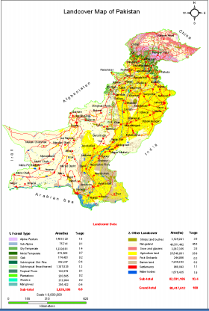

Slide 32
1. Alpine Forests:
These forest are called alpine because they grow in conditions similar to those in the Alps, a mountain range in Europe.
Alpine forests are found on the mountains of Gilgit-Baltistan. In the region of high mountains there is snow, so little or no vegetation is found here.
Due to the very cold climate above a height of 4000 metres, trees do not grow properly. Some dwarfed trees of silver fir, juniper, and birch grow here.
Alpine forests are found in a limited area in Chitral, Dir, Swat, and Gilgit.
They normally have upward branches to attain more sunlight.
They are used as fuel wood only. Pinus walichiana ( Blue pine), Juniperous macropoda (Snober), Betula utilis (Birch)

Slide 33
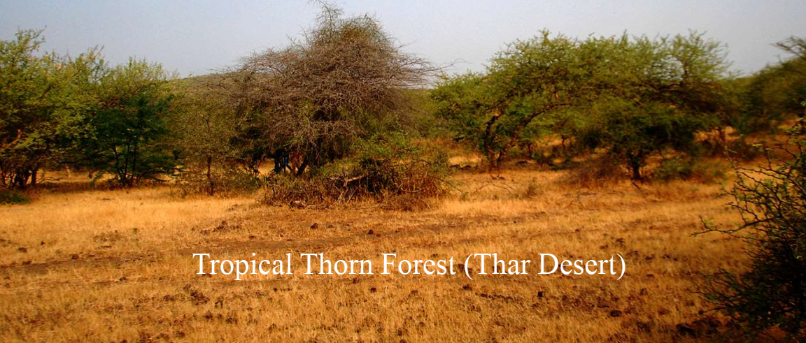
2. Tropical Thorn Forests:
The tropical thorn forests are dominated by xerophytic scrubs. They are most widespread in the Punjab plains but also occupy small areas in southern Sindh and western Balochistan. They are mainly used for grazing purposes, watershed protection and fuelwood. The usual height is 6-9 m.
This is the natural vegetation over the whole of the Indus Plains except for the driest parts. It merges into the subtropical dry evergreen type of the lower hills to the north and West generally.
They have deep roots to search for water

Slide 34
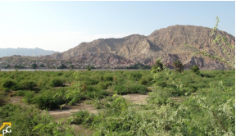
Area: 1,73000 ha Elevation : 20-1200 feet rainfall: 30 inches or 750 mm ( vary year to year) MAT: 420C ( 50o C in Summer) Wind : Hot wind blows during April- July each year Spp: Acacia niltotica, (Kikar), Prosopis cineraria (Jhand), Zizyphus mauritiana (Ber) Fauna: Ibex, Lizards, Snakes, Falcons, Hobara Baster etc

Slide 35
3. Coniferous Forests:
The coniferous forests occur from 1,000 to 4,000 m in altitude. Chitral, Swat, Upper and Lower Dir, Malakand, Mansehra and Abbottabad, districts of Khyber Pakhtunkhwa, Azad Kashmir, Rawalpindi and districts of the Punjab are the main areas covered with coniferous forests.
Coniferous forests are evergreen which survive in low temperature. They are important source of timber for making furniture and boxes.
They are conical in shape and have sloping branches which prevent snow accumulation.
These type of forests are good breeding and conserving centres for birds and wildlife.
Coniferous forests add to the scenic beauty of the area, attract tourists and promote tourism industry

Slide 36
4. Sub-Tropical Scrub Forest:
Commonly these are known as scrub forests. These forest consist of branchy trees forming a canopy if complete closure or scattered trees with a shrub growth.
these trees and shrubs are mostly thorny and evergreen, but some ,like olive and pomegranate are not thorny.
These scrub forest occurs at height of 1500-5000 feet. These forests found in Gujrat, Margalla Hills, Attock and Malakand.
Actually broadly speaking, these forests occur throughout the country at suitable elevation merging downwards with the sub-tropical pine forest.
They are used for grazing purposes and for supplying firewood.

Slide 37
5.Mangrove Forests:
Mangroves are slat tolerant bush type trees which grow in inter-tidal zones of tropical and subtropical areas, river deltas and along the coasts.
Mangroves forests of Pakistan in Indus delta and along Arabian Sea coastal areas, as per estimates, are some 129,000 hectors in the Indus delta and over 3,000 hectors in Gwadar bay areas.
They are natural habitat to a large number of insects, micro organisms, birds, different mammals aswell as snakes. Mangrove areas act as physical breeding grounds and nurseries for fish, shrimp and crabs. During winters, many guest birds from north also come to breed here.
The mangrove forests protect the coasts from dangerous cyclones and hurricanes. Mangroves slow the water’s flow, helping to protect the coastline and preventing erosion.
They have broad leaves and leathery texture to minimize transpiration. In better water areas the trees rise to 6-8 metres but their general height is 3 metres.
Mangroves are suppliers of firewood and timber for local communities

Slide 38
6. Riverain Forest:
The riverine forests occur in the province of Sindh along both banks of the IndusRiver. They rely on inundation by the River for irrigation and therefore their existence is heavily dependent on the intensity, duration and frequency of river water flow.
They provide Shishum and Babul, two valuable species which are used for making furniture.

Slide 39
7. Irrigated Forests:
These are man made forests. They include plantation along roads, in parks andalong railway lines.
Their main function is to protect the soil and to prevent it from eroding.
They keep the environment pleasant by lowering the temperature and providing shade.
They are important source of timber and firewood. Eucalyptus is mainly preferred as they reduce waterlogging and salinity.
They also add to the scenic beauty of the area and promote tourism.
Leaves of trees provide food for animals.
Forests absorb carbon dioxide and release oxygen into air

Slide 40
Changa Manga, Wan Bachran in the Thal Area, Chicha Watni in the Sahiwal district and Guddu barrages and Ghulam Muhammed district  Economically important species are planted in large blocks. Shisham, Babul and Eucalyptus are normally preferred.

Slide 41
8. Tropical Dry Deciduous Forest
Elevation : 1500-3000 feet ,
Rainfall:21-27 0 C ,
Humidity: 50-60% Wind : wind is not present but occurs in summer,
Topography & Soil: Small hills and undulating planes and soil is light sandy,
Spp: Acacia catechu, Bombax ceiba, Adhatoda vesica Fauna: Goral, Chinkara

