Slide 1
Soil Plant Animal Relationship

Slide 2
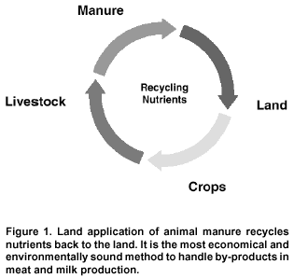
Soil – Plant – Animal continuum

Slide 3
Introduction
Soil - Soul Of Infinite Life
“All flesh is forage”
Mineral status of soil, plant and animal - interrelated (Sharma et al. 2002)
Deficiency/excess affect the status of other
Mineral content of soils and forage - influence the health & production of livestock
Mineral deficiency diseases - common.

Slide 4
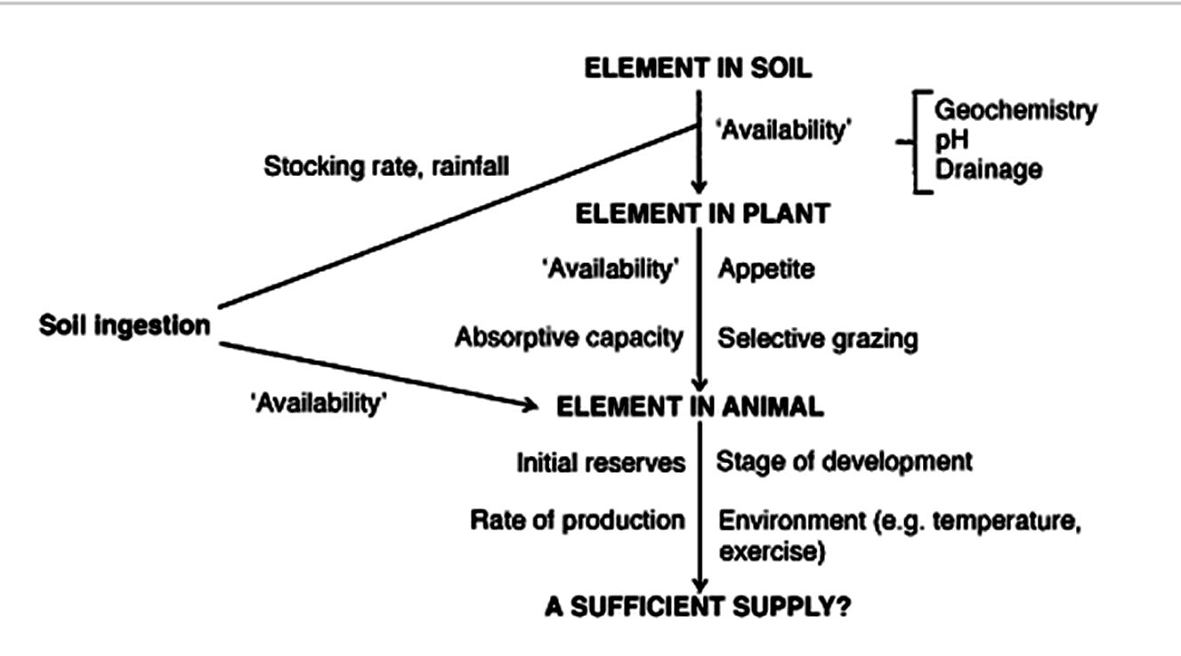
Soil Plant Animal Relationship

Slide 5
Importance
Powerful basis for sound management practices.
Allows producer experience and research knowledge obtained in one environment to be used in other locations
Allows objective predictions of future outcomes based on past climatic experience

Slide 6
Mineral content of soil depend upon
Parent material
Pedogenic factors: laterisation, calcification, salinization
Translocation: surface erosion, leaching, evaporation & redeposition of minerals on the surface
Effective concentration in the soil solution

Slide 7
Pedogenetic factors
Soils developed from | Acid igneous rocks | Basic igneous rocks
Amounts of essential trace elements
Trace element (Cu & Co) status in grazing livestock | Deficiency | Excess

Slide 8
Pedogenetic factors
Wind/water borne soils – No relationship between animal health and soil
Soils solely from underlying strata, animal problems coincide
Contamination from industrial sources: alters mineral profile
Cu deficiency in soils containing large amount of organic matter & in sandy soils

Slide 9
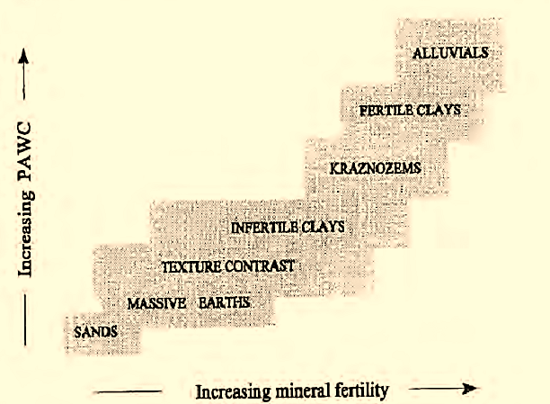
Soil avail. water & Mineral fertility

Slide 10
Mineral uptake of plants from soil
Plant genotype
Soil pH
Moisture
Temperature
Fertilization
Organic matter and microbial activity of soil

Slide 11
Influence of Plant Genotype
Legumes rich in macro minerals than grasses.
Ca concentrations of 14.2 and 10.1 g/kg DM in legumes vs 3.7 and 3.8 g/kg DM in grasses.
In saline soils, accumulation of salts in roots :NaCl 80–140 vs 1 g/kg DM in common soils.
Astragalus contain >5000 PPM Se compared to <20 PPM DM in common herbage in same soils
Strontium-accumulating species

Slide 12
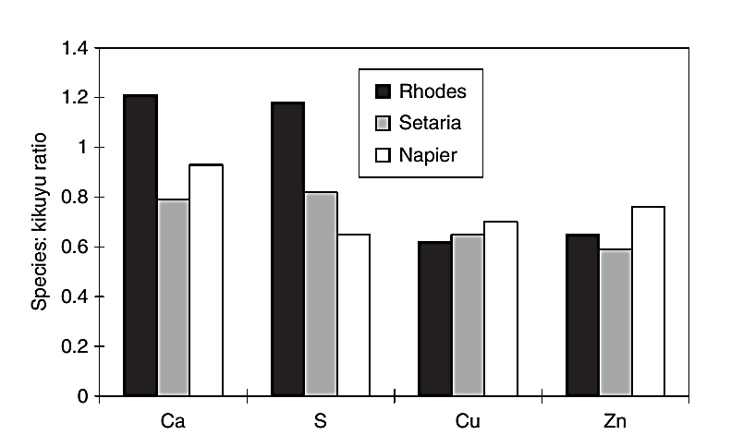
Species differences in mineral composition
Notes:
Species differences in macro- and trace mineral composition amongst four grasses

Slide 13
Variation among grasses and forages
Accumulation of salts in roots - natrophilic & natrophobic
Herbs - higher mineral conc. than cultivated plants (Wilman and Derrick, 1994).
Seeds of legumes and oilseeds are rich in most minerals
Seeds of grasses and cereals, low in Ca & Na.
Variation amongst grains and seeds

Slide 14
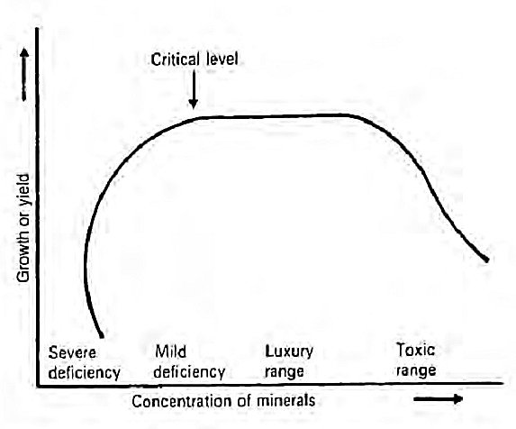
Plant growth & Conc. Of mineral in plant

Slide 15
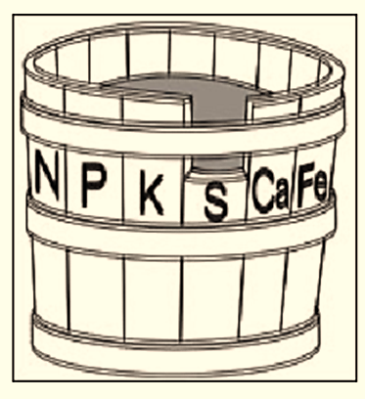
Wooden bucket - Short stave

Slide 16
Concept of most limiting nutrient
Capacity of a wooden bucket - short stave
Crop yields - soil nutrient in shortest supply
Increasing the height of N – No increase in bucket ’s capacity.
Unless sulfur fertility is improved, the value of other fertilizer nutrients is reduced.
Soil testing discovers the limiting nutrient: maximizes fertilizer returns
Most limiting ​ nutrient in a soil determines the growth and reproduction of plants.

Slide 17
Soil fertilizers
Soil, plant and livestock don’t respond equally to top dressing of soil
Soil enhanced with Mg by Epsom or Ca by Gypsum may not increase Mg/ Ca level in animals.
Plants do not need I or Co, and soil treatment to meet the req. of livestock.
Applications of Mg:
To raise the pasture Mg to meet the needs of cows
No increase in fodder yield.

Slide 18
Application of N & K fertilizers
Increases the risk of mineral def. in grazing livestock
Mg, Na & Zn conc.
Mn, Mo, Ca & S
K, Cu & Co - no change
Availability of Cu & Mg - risk of def. by pasture improvement.
Heavy N fertilizers: legume growth, Ca content of a legume/grass
Heavy K fertilizers yields and K contents, herbage Mg and Na

Slide 19
Application of other fertilizers
Superphosphate applications over and above:
herbage palatability & digestibility
Greater weight gains in sheep and cattle, wool yields and lamb and calf crops (Winks, 1990)
Small applications of Mo: legume yields & Mo and protein levels in forage.
Increases in Mo - no value, except where copper intakes are high.
Zn and Se conc. in grains and pastures reflect the soil status and fertilizer usage.

Slide 20
Influence of Maturity and Season
P conc. of forage decline with advancing maturity.
Decline is less in legumes than in grasses
Cu, Co, Fe, K, Mg, Mn & Zn also decline.
Seasonal fluctuations in Ca, P, Mg, Mn, Cu & Se.
Rainy season, forage higher in K, P & Mg by 110%, 60% & 75%, respectively (Kiatoko et al., 1982).
Negative correlation on rainfall & Se conc. in wheat grain (White et al., 1981)

Slide 21
Influence of Maturity and Season
Concentration of Cu increases and Se decreases with increasing altitude.
Se conc. in sugarcane are much higher in the tops than in the cane.
Ca stable & Si increase as the plant matures and concentrations of both elements are higher in straw than in grain.
Low soil temp. mineral uptake is slow - low root extension and membrane permeability

Slide 22
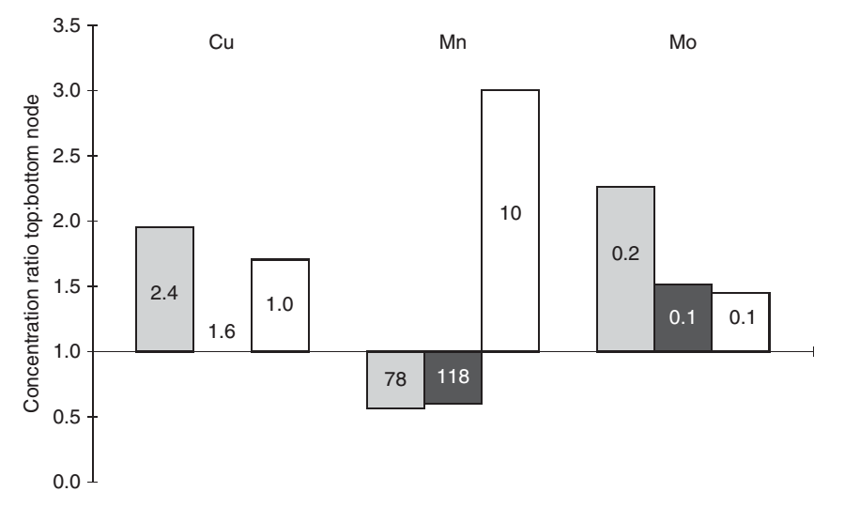
Conc. of minerals vary from part to part
Leaf
stem
sheath
Notes:
Concentrations of minerals in plants vary from part to part and with state of maturity. Values for leaf (grey), sheath (black) and stem (white) are given in different columns. The height of the column indicates the proportionate difference between the parts from the top (youngest) and bottom (oldest) nodes of wheat plants (actual values for bottom node are given within columns in mg kg−1DM) Burridge et al., 1983)

Slide 23
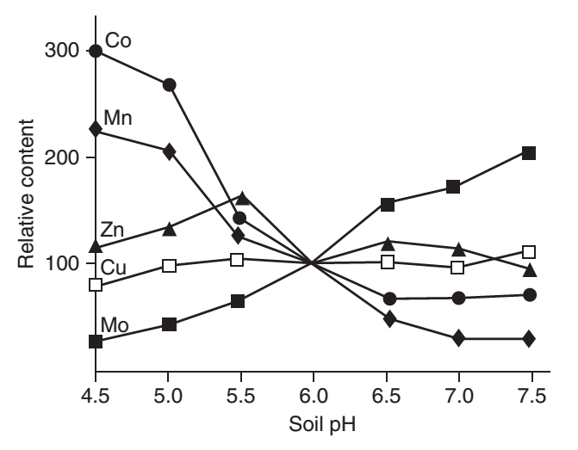
Mineral uptake in plants influenced by soil pH
Notes:
Concentrations of cobalt and manganese in plants decrease markedly as soil pH increases, while those of molybdenum increase and those of copper and zinc show little change

Slide 24
Mineral uptake in plants influenced by soil pH
More striking in legumes.
Pasture Mo can rise on alkaline soils to induce Cu responsive disorders
Application of lime and sulfur can raise/lower soil pH, respectively
Liming - improves soil fertility & increase in pasture Mo – Cu deficiency in sheep
Co, Mo & Mn conc. in pasture - increased by soil waterlogging.

Slide 25
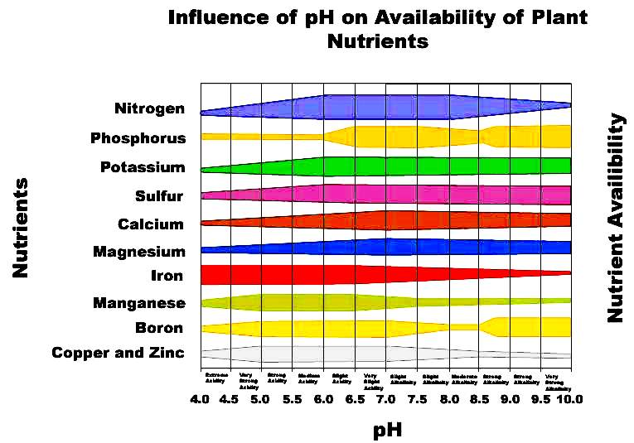
Influence of pH on available plant nutrients
Notes:
soil ph affects nutrient availability to plants. the width of the band indicates the relative availability of each plant nutrient at various ph levels.

Slide 26
Other factors
P, Na, Co, Se & Zn def. - due to soils low in minerals
Plant needs for K & Mn > animals
Applications of K & Mn - boost pasture yield
Soil leaching, erosion and long duration crops -depletion of trace minerals.
Crop management and climatic conditions - influence trace mineral level in feeds
Heavy rainfall - lush greens – dilution of minerals

Slide 27
Soil animal relation
Cattle fed with fodder and concentrate grown in calcareous soil ( Mn)
Low blood serum Mn
Infertility and low productivity.
Fodders and feeds need mineral fortification
At field level keeping in view the soil fertility status
At feeding stall.

Slide 28
Plant animal relationship
Level of Cu, Zn, Mn, Fe and Co in crops sufficient for optimum yield - not adequate to livestock
Se not required by crops – max. crop yield on soil with traces of Se.
If livestock are fed with the low Se - muscular disorders etc.
White muscle disease most common and serious

Slide 29
Soil Ingestion
Grazing intensity is high/ Pasture avail. low
10–25% of DM intake by sheep & cattle
Co, I & Se occur in soils – conc. higher than plants, soil ingestion beneficial to the animal
Cu antagonists Fe, Mo & Zn : biol. active in soils
Ingestion from soil contamination of herbage - hypocuprosis in cattle and ‘swayback’ in sheep
Route for toxic elements (Pb, Cd & F) - accumulate in the tissues of grazing livestock.

Slide 30
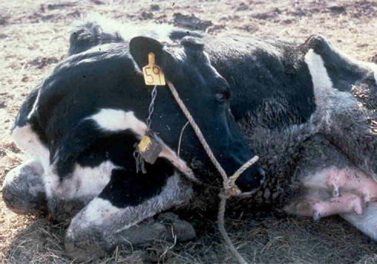
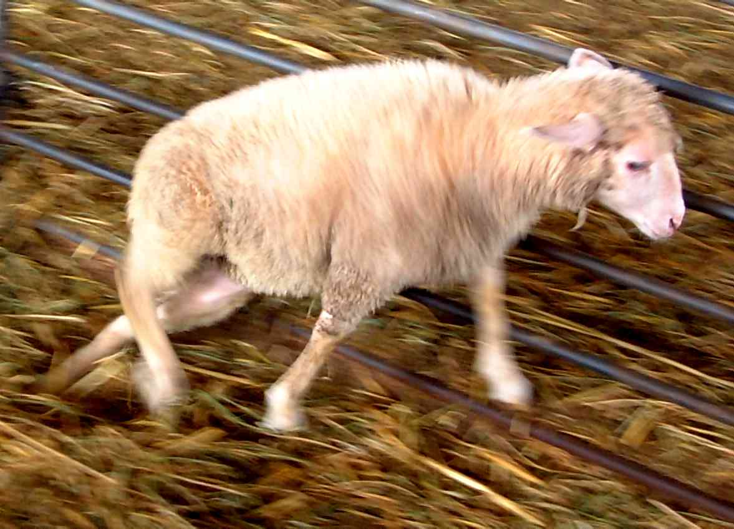
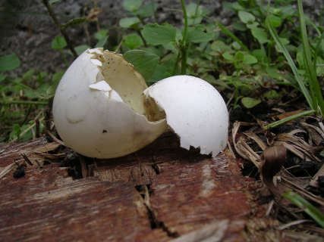
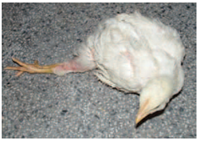
Mineral deficiencies

Slide 31
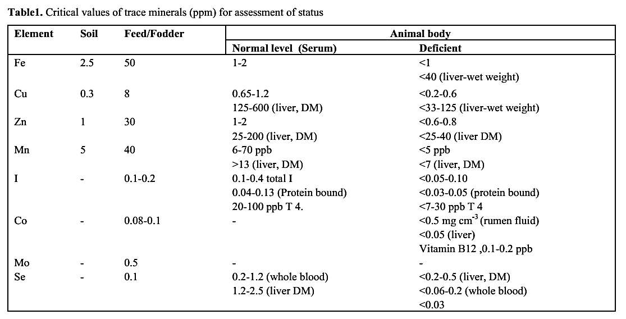
Critical values for assessment of status

Slide 32
Mineral deficiencies in India
REGIONS | Minerals deficient in feeds
Northern | Ca , P , Cu, Zn, Mg, Mn, I
Western | Ca, P, Cu, Zn, S.
Southern | Ca, P, Cu, Zn, Mg
Eastern | Ca, P,, Cu, Zn, Mg, Mn, Co.
Mineral deficiencies in AP for animals
Rain fed zone | Ca, P, Cu, Zn, Mn
Coastal | Ca, P, Cu, Zn
Arid zone | Cu, Zn, Mn
Mineral nutrient deficiencies in Andhra Pradesh for normal animal nutrition
i) Rainfed zone Ca, P, Cu, Zn, Mn
ii) Coastal zone Ca, P, Cu, Zn
iii) Arid zone Cu, Zn, Mn

Slide 33
Area specific mineral mixture (ASMM)
Prepared after mineral
Minerals are provided to meet the mineral deficient state
Efficacy validated by rigorous field trials.
Technology is sustainable due to low input and high return
Cost advantages
Fortified with vitamins and probiotics
No common Salt

Slide 34
ASMM – A.P.

Slide 35
Implications on human nutrition
Bio-fortification of micronutrients in staple food crops
Since soils have enough Fe, Cu & Mn reserves, identifying crops capable of higher absorption and translocation into seed are highly desired.
Mechanisms of uptake and translocation among crop species - tool for identifying efficient plants.
Agronomic interventions influencing bio fortification for improving bioavailability of trace elements in animal model

Slide 36
Conclusions
Endemic diseases resulting from the def. of I, Zn, Cu, Fe, Se and F with the characteristics of geographic distribution has increased
Overcoming the deficiency or imbalances of minerals improved in the productive efficiency
Minerals not received much attention neither in soil nor in the formulating diets, yet their long term practical impact on production, reproduction and immunity should not be ignored.

