Slide 1
“BACTERIOLOGY AND VIROLOGY”

Slide 2
BACTERIOLOGY AND VIROLOGY
TOPIC :
“HISTORY
AND
MECHANISM
OF
CONJUGATION”

Slide 3
BACTERIOLOGY AND VIROLOGY

Slide 4
BACTERIOLOGY AND VIROLOGY

Slide 5
BACTERIOLOGY AND VIROLOGY

Slide 6
BACTERIOLOGY AND VIROLOGY

Slide 7
BACTERIOLOGY AND VIROLOGY

Slide 8
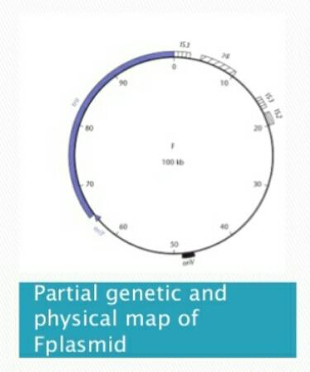
BACTERIOLOGY AND VIROLOGY

Slide 9
BACTERIOLOGY AND VIROLOGY

Slide 10
BACTERIOLOGY AND VIROLOGY

Slide 11
BACTERIOLOGY AND VIROLOGY

Slide 12
BACTERIOLOGY AND VIROLOGY

Slide 13
BACTERIOLOGY AND VIROLOGY

Slide 14
BACTERIOLOGY AND VIROLOGY

Slide 15
BACTERIOLOGY AND VIROLOGY

Slide 16
BACTERIOLOGY AND VIROLOGY

Slide 17
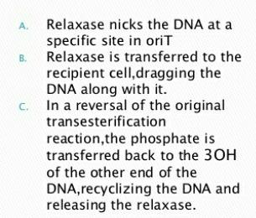
BACTERIOLOGY AND VIROLOGY

Slide 18
BACTERIOLOGY AND VIROLOGY

Slide 19
BACTERIOLOGY AND VIROLOGY

Slide 20
BACTERIOLOGY AND VIROLOGY

Slide 21
BACTERIOLOGY AND VIROLOGY

Slide 22
BACTERIOLOGY AND VIROLOGY

Slide 23
BACTERIOLOGY AND VIROLOGY

Slide 24
BACTERIOLOGY AND VIROLOGY

Slide 25
BACTERIOLOGY AND VIROLOGY

Slide 26
BACTERIOLOGY AND VIROLOGY

Slide 27
BACTERIOLOGY AND VIROLOGY

Slide 28
BACTERIOLOGY AND VIROLOGY

Slide 29
BACTERIOLOGY AND VIROLOGY
THANK YOU😄

