Slide 1
Spinal Cord Injury Management

Slide 2
Outlines
Strength training

Slide 3
Strength training
Strength
Endurance
Power
Motor control
06 weeks for strengthening
Motor learning
Thousands repetition
Training protocol
Maximum Repetition minimum weight??
Maximum weight minimum Repetition??

Slide 4
Two clients came to your department and both want to increase strength of upper limb
One person is Furqan Ahmad
Other person is Arshad Nawaz
What will be your protocol
Will the protocol be same for both or different
Explain with logic

Slide 5
Two client came to your Gym and both have almost same age, height and weight.
One of them said he wants to increase strength of his limbs while other said I want to increase my endurance of upper limb
So what would be your appropriate protocol for both???

Slide 6
Strength
Mobility
Independence
Lattismus dorsi and triceps
Normal strength not sufficient to lift

Slide 7
C6 partial paralysis of Pect Major
Function of pect major
Help in Rolling
Weak dorsi flexors ??
C5 shoulder flexor strength will improve???
C6 wrist extensors strength will increase ??

Slide 8
Strength assessment
MMT
1RM
Hand held myometer
Isokinetic dynamometers

Slide 9
Strength assessment
Individual or group muscles
6 point or 11 point scale
Isometric strength for higher grades
SCI
06 point scale uses
Only 10 muscles assess
C5-T1 and L2 –S1
Daily or after some days

Slide 10
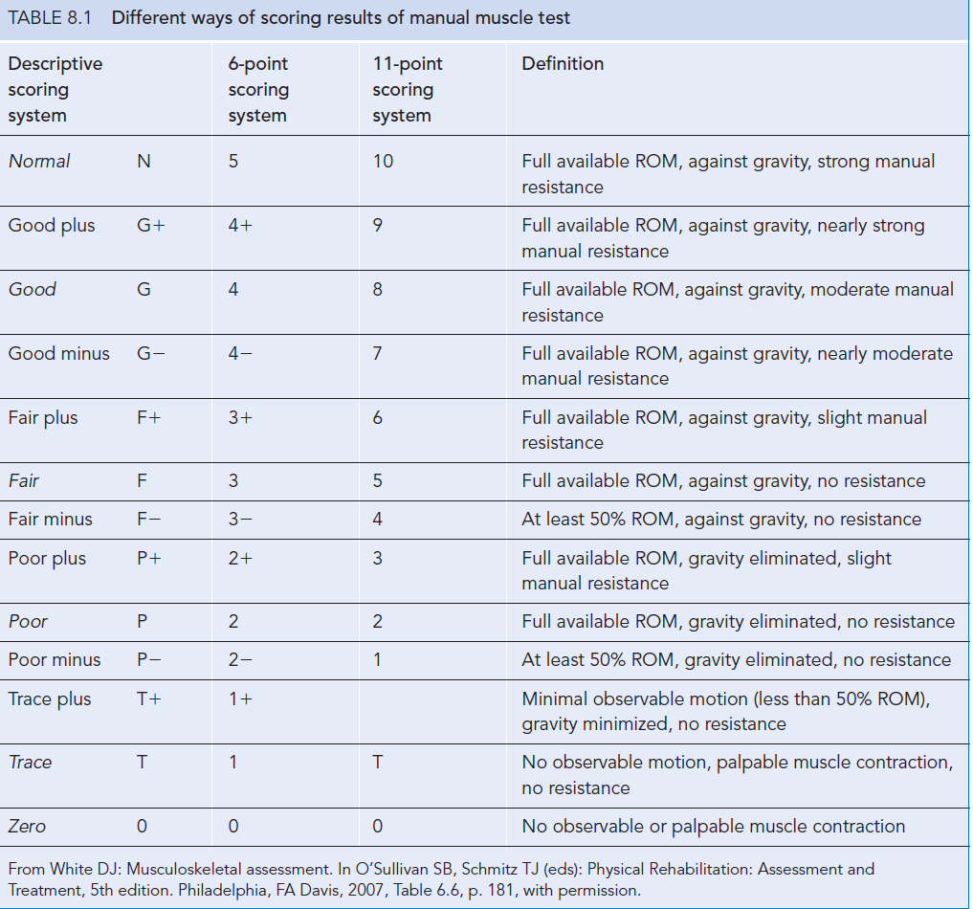

Slide 11
1RM
Repetition maximum
4 or 5 grade
Weight lift one time or 10time
Wrist or ankle velcro weight
Modified 1RM for 3 grade

Slide 12
How to measure 1RM
http://www.exrx.net/Calculators/OneRepMax.html
http://www.exrx.net/index.html

Slide 13
Hand held myometer
Isometric strength
Measure force not torque
Stability is difficult
Not healthy patient
Bed confined patient
Hip extensors in bed ridden patient ??

Slide 14
Isokinetic dynamometers
Torque in concentric or eccentric
Same velocity
Not in SCI
Profound weakness and bed ridden

Slide 16
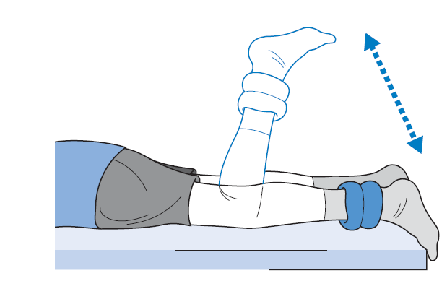
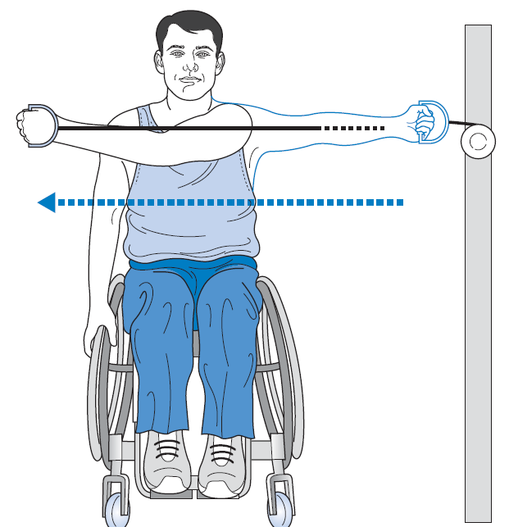
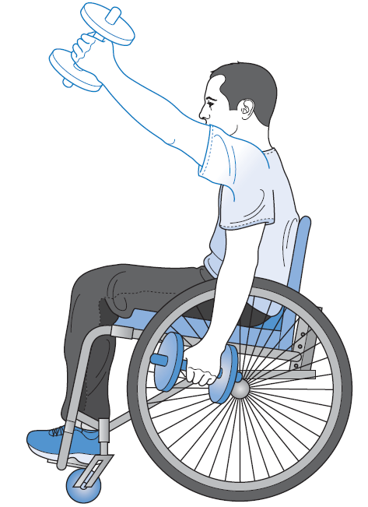

Slide 17
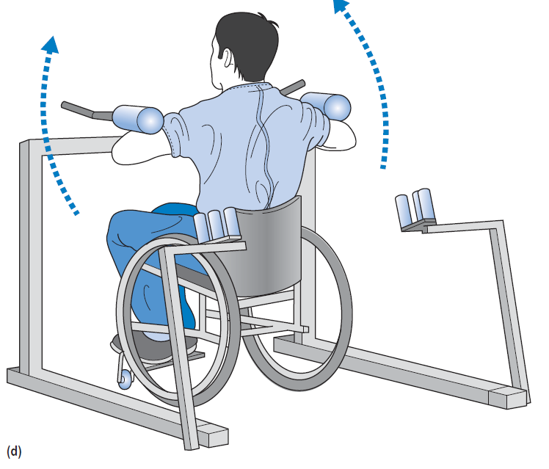

Slide 18
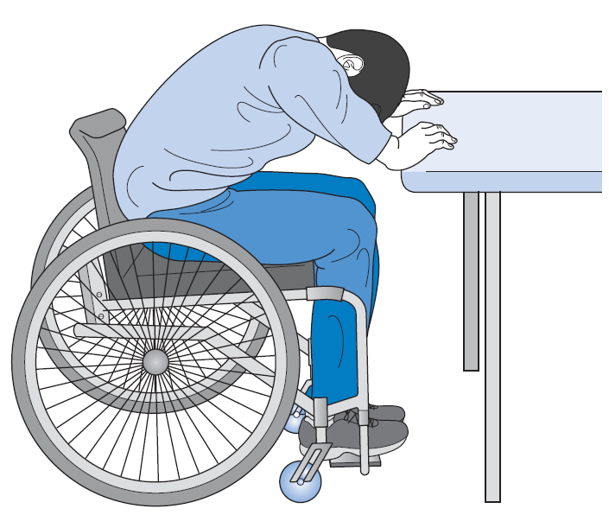

Slide 19
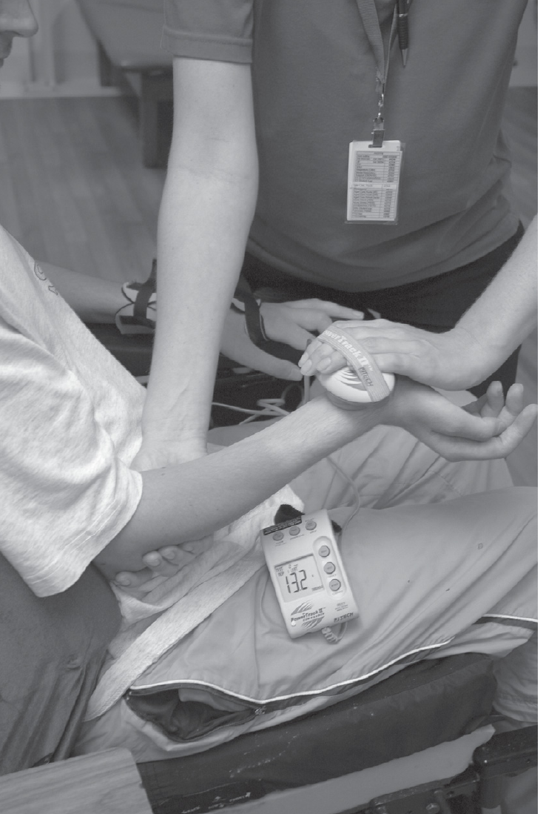

Slide 20
Strength training
Strength increase 2 % per week
Early stages or deconditioned patient more strength increase
Male and female of any age same effect
Cross sectional area, protein content, increase capillary density, hypertrophy
Hyperplasia?
Motor unit synchronization, firing and recruitment
Short term strength training …hypertrophy…..motor unit synchronization

Slide 21
PRE
Best regimen
8-12 RM
60-80% of a 1RM
1-3 second rest than second and third time
Two to three per week
8-12 times not increase
Longer rest 3minutes superior to shorter 40 seconds
Eccentric strengthening superior to concentric
Variation in load in session better than fixation

Slide 22
Specificity of training
Co contraction
Position of joint
Type eccentric concentric isometric
Speed
Functional task
Floor and wheel chair
8-12 RM

Slide 23
Training muscle power and endurance
For power
Speed
30-60% of 1RM
Endurance
20 or more repetition
Rest time is less than 1 minutes in 10-15 repetition
1-3mints in 15-20repitition
High velocities 180per second
Endurance effective when exercise closely resemble with task

Slide 24
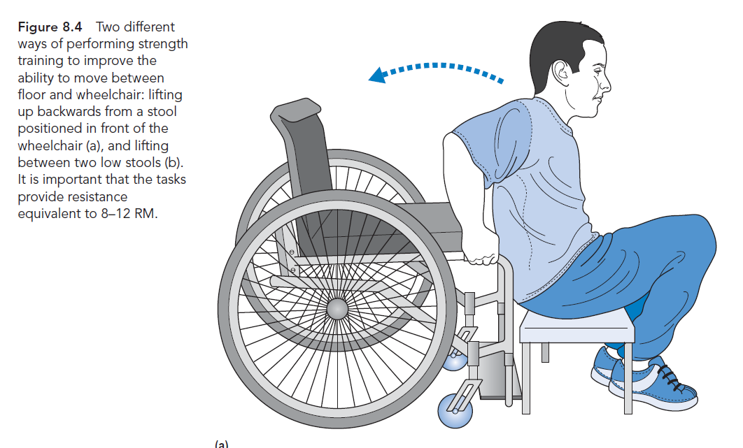

Slide 25
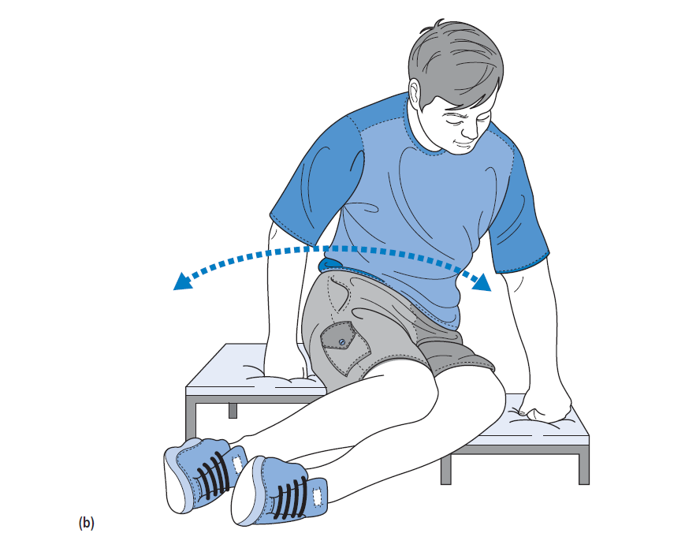

Slide 26
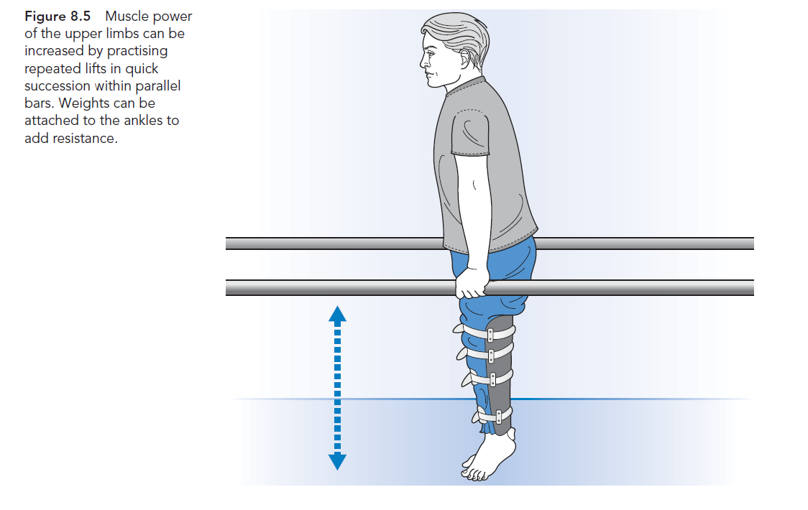

Slide 27
Strength training for paralyzed muscles
Same principal
Biceps in grade 2
Hamstring in grade 2
8-12 repetition than change grade

Slide 28
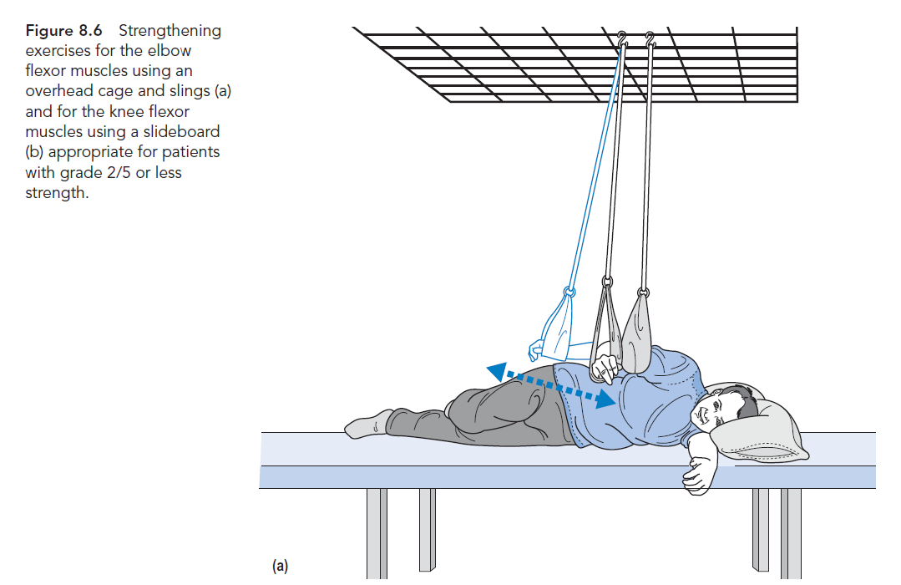

Slide 29
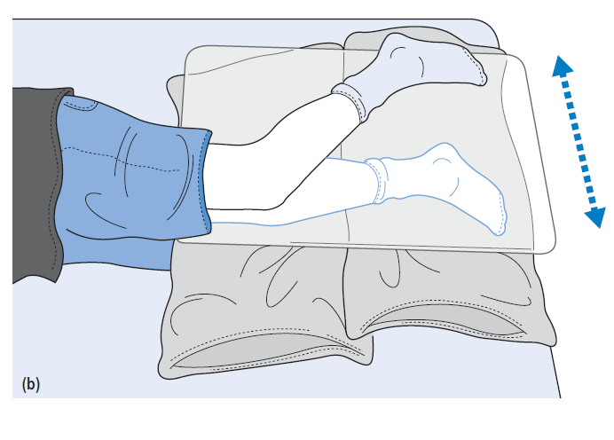

Slide 30
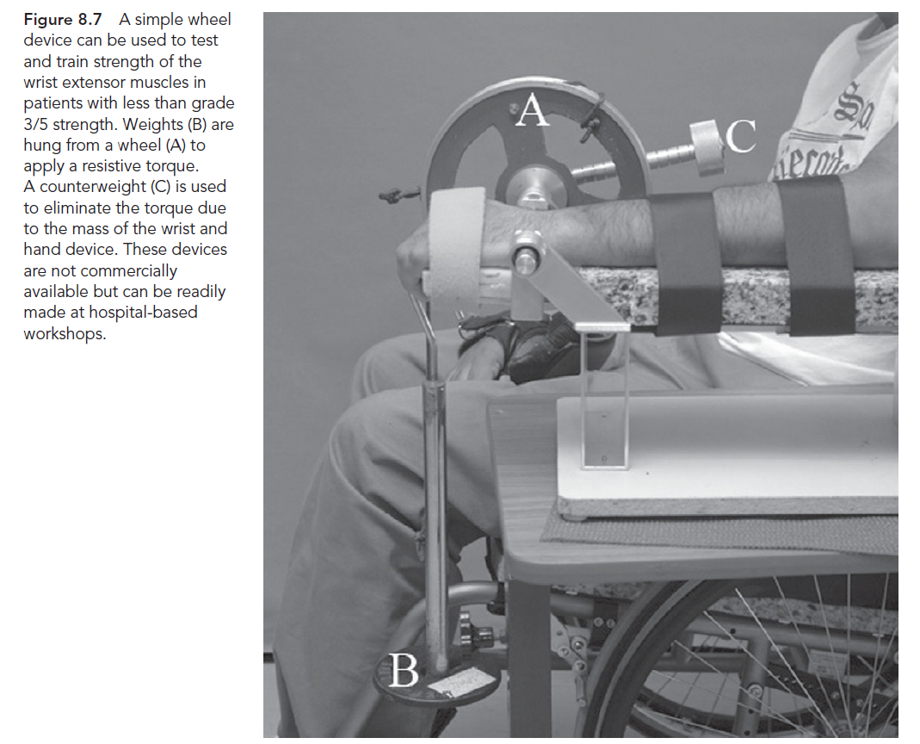

Slide 31
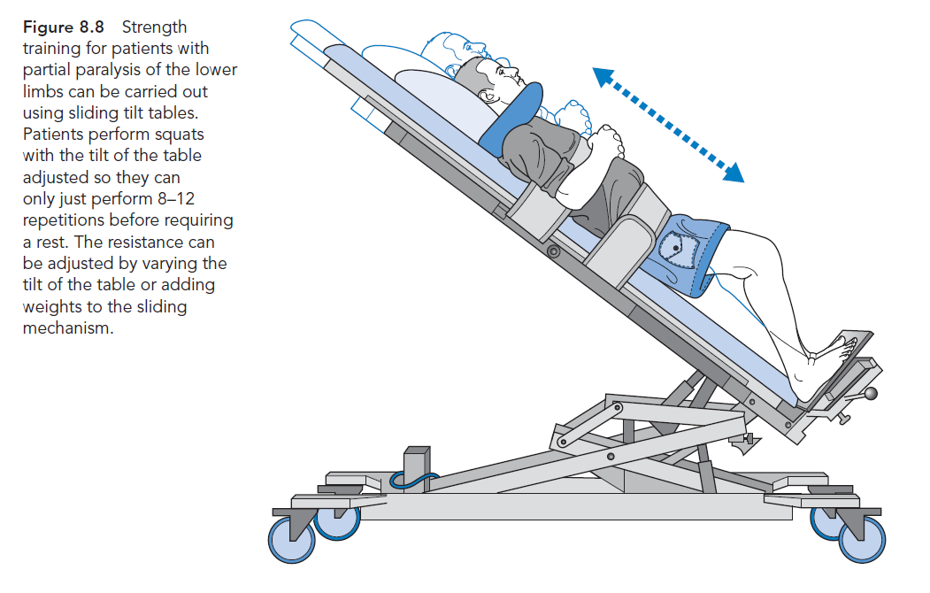

Slide 32
Flicker movement
EMG feed back
Mental practice
Motor imaginary
Repeated cognitive practice without movement

Slide 33
Electrical stimulation
Crude grip
Increase blood circulation
Gltueal area so pressure sore
No literature

Slide 34
Resistance training increase spasticity
Bobath believed that resistance exercises reinforced abnormal movement pattern in stroke
In stroke Not in SCI
Modified plan with gradually increasing
Eccentric more DOMS
Mood, QOL, pain, satisfaction
Barriers

Slide 35
Muscle length

Slide 36
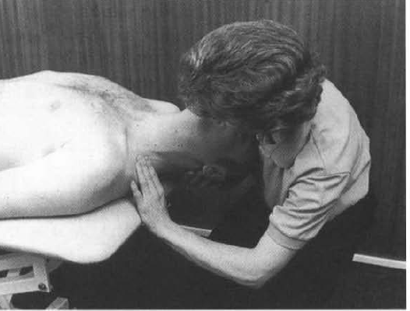
Scalenes
The clinician extends the head and laterally
flexes away and rotates towards the side of testing for
anterior scalene; neutral rotation tests the middle fibers and
Contra lateral rotation tests the posterior scalene muscle

Slide 37
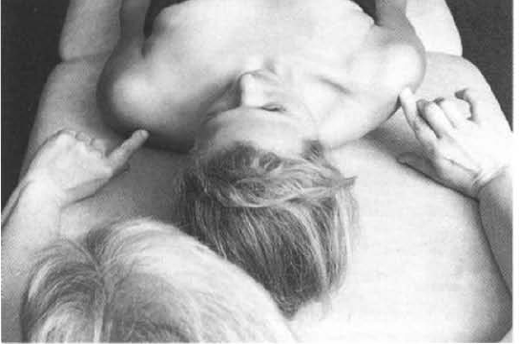
Pect minor

Slide 38
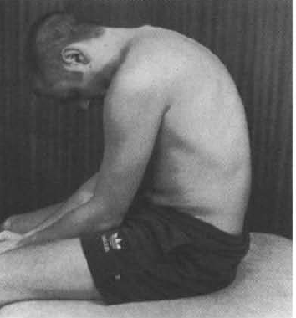
Erector spinae

Slide 39
Test
SCIM
Barthel index
Lawton index

Slide 40
Assignment
Summary
Feedback
Anything missing ???

Slide 41
MCQs

Slide 42
A 12moth old child got infection in L4 vertebrae , there were no specific family history of any pathology.
During examination you noted the neurological deficit in lower limbs.
Which of the following description is MOST appropriate for explaining the clinical picture of lesion
Cauda equina flaccid lesion
Spastic paraplegia
Peripheral nerve entrapment
Spinal stenosis

Slide 43
A 50year old male with history of road traffic accident admitted through emergency,
before reading the file of patient you observed the b/L lower limb flexed posture of patient.
On the basis of this information, what would be the possible location of trauma
Cerebral cortex
Hind brain
Spinal cord
Hip fracture

Slide 44
A patient comes to the physical therapy department with history of a spinal trauma at the level of T10 vertebrae ,
the symptoms were loss of sensory sensation in right leg , while the motor loss in the left leg .
During neurological examination you observed the positive babinski sign and exaggerated reflexes,
on the basis of above symptoms which type of injury comes in your mind
Right hemi section of spinal cord
Right anterior damage of spinal cord
Left hemi section of spinal cord
Complete damage of spinal cord

Slide 45
If you are working in spinal cord injury unit, you should know the concept of level of decussating of different ascending and descending tracts of spinal cord.
Which of the following tract is/are decussating at the level of spinal cord segment
Anterior spinothalamic tract
Posterior spinocerebellar tract
Lateral spinocerebellar tract
A & C

Slide 46
In spinal cord Injury unit , you assess a patient through different movement and sensation ,
you observed that the thumb sensation are preserved but the little finger has impaired sensation , what will be the diagnosis
C6 incomplete
C6 complete
C7 incomplete
C5 incomplete

Slide 47
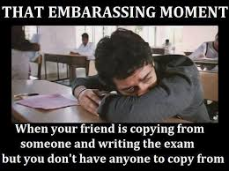

Slide 48
If a patient get fractured C7 spine and all the sensory and motor sensation are absolutely finished.
The C8 spinal segment is last segment which is preserved and all below segments get damaged ,
the patient is declared the spastic paraplegic, in which segment flaccid symptoms will be observed
C7
C8
T1
None of above

Slide 49
You are treating a patient with T4 paraplegia who begins to demonstrate signs and symptoms of autonomic dysreflexia.
Which of the following vital signs are the indicators of this
Pulse rate
Respiratory rate
Blood pressure
Body temperature

Slide 50
In hand function , the power grip of hand mainly on the ……………side and skill activity mainly on the………side
Ulnar , radial
Radial , ulnar
Radial , thumb
Thumb , wrist

Slide 51
You are about to discharge a patient with a C7 spinal cord injury. Which of the following would be challenging but obtainable goals for this patient?
Independent w/ all ADLs; may need adaptive aids for bowel care
Independent pressure relief
May have limited walking with bracing
Independent slide board transfer

Slide 52
A patient of spinal cord injury presents with independent breathing but no other motor activities were possible.
He can operate his motorized wheelchair through breathing and puff , what would be the level of injury
C3
C4
C5
C6

Slide 53
A patient of spinal cord injury presented with independent in self care & basic activities , which highest level of injury you suspect in such patient
C5
C6
C7
C8

Slide 54
Your patient looks flushed and is complaining of a pounding headache.
You suspect these symptoms may be indicative of autonomic dysreflexia.
In this case all of the following would be appropriate responses EXCEPT
lie the patient down immediately.
check the patient's catheter and if it is clamped, release it.
check for irritating stimuli such as tight clothing or abdominal binder and remove source of irritation.
seek medical attention if symptoms do not resolve.

Slide 55
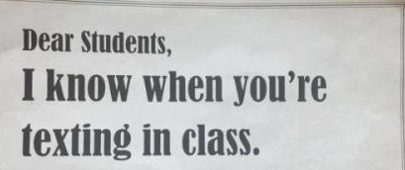

Slide 56
A patient with a C7 complete SCI would most likely
require a power wheelchair for mobility.
require a lightweight manual wheelchair for mobility.
require a power wheelchair for community mobility but use a manual wheelchair for short distances.
require a lightweight manual wheelchair for community distances but ambulate for short distances.

