Slide 2
Vegetation
Vegetation is an assemblage of plant species and the ground cover they provide. It is a general term, without specific reference to particular taxa, life forms, structure, spatial extent, or any other specific botanical or geographic characteristics.

Slide 3
Significance of Vegetation
Vegetation serves several critical functions in the biosphere, at all possible spatial scales.
First, vegetation regulates the flow of numerous biogeochemical cycles, most critically those of water, carbon, and nitrogen; it is also of great importance in local and global energy balances.
Such cycles are important not only for global patterns of vegetation but also for those of climate.

Slide 4
Significance of Vegetation
Second, vegetation strongly affects soil characteristics, including soil volume, chemistry and texture, which feed back to affect various vegetational characteristics, including productivity and structure.
Third, vegetation serves as wildlife habitat and the energy source for the vast array of animal species on the planet (and, ultimately, to those that feed on these).
Vegetation is also critically important to the world economy, particularly in the use of fossil fuels as an energy source, but also in the global production of food, wood, fuel and other materials.

Slide 5
Significance of Vegetation
Perhaps most importantly, global vegetation (including algal communities) has been the primary source of oxygen in the atmosphere, enabling the aerobic metabolism systems to evolve and persist.
Lastly, vegetation is psychologically important to humans, who evolved in direct contact with, and dependence on, vegetation, for food, shelter, and medicines.

Slide 6
Depending upon the variations in the climate and the soil the vegetation of Pakistan change from one region to another. On the basis of certain common features the forests of Pakistan can be divided into following categories
Tropical evergreen forests
Tropical deciduous forests
Tropical dry forests
Arid or desert forests
Tidal or mangrove forests
Mountain forests

Slide 12
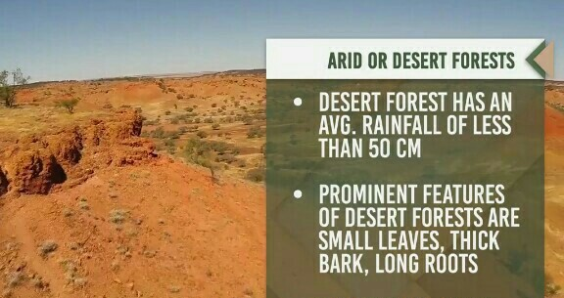

Slide 13
Factors affecting the global pattern of vegetation

