Slide 1
Enzymes
Fundamentals of Biochemistry

Slide 2
There are two fundamental conditions for life;
First, the living entity must be able to self-replicate.
Second, the organism must be able to catalyze chemical reactions efficiently and selectively.

Slide 3
Reaction catalysts of biological systems:
The enzymes, are the most remarkable and highly specialized proteins.
Enzymes have extraordinary catalytic power, often far greater than that of synthetic or inorganic catalysts.
They have a high degree of specificity for their substrates.
They accelerate chemical reactions tremendously, and they function in aqueous solutions under very mild conditions of temperature and pH.

Slide 4
Enzymes are central to every biochemical process
Acting in organized sequences, enzymes catalyze the hundreds of stepwise reactions.
Degrade nutrient molecules, conserve and transform chemical energy, and make biological macromolecules from simple precursors.
Through the action of regulatory enzymes, different metabolic pathways are highly coordinated to sustain life.

Slide 5
Practical importance of enzymes
In some diseases, especially inheritable genetic disorders, there may be a deficiency or even a total absence of one or more enzymes.
For other disease conditions, excessive activity of an enzyme may be the cause.
Measurements of the activities of enzymes in blood plasma, erythrocytes, or tissue samples are important in diagnosing certain illnesses.
Many drugs exert their biological effects through interactions with enzymes.
Enzymes are important practical tools, not only in medicine but in the chemical industry, food processing, and agriculture.

Slide 6
An Introduction to Enzymes
Eduard Buchner in 1897; discovered;
That yeast extracts could ferment sugar to alcohol, proving that fermentation was promoted by molecules that continued to function when removed from cells.
Frederick W. Kühne called these molecules as “enzymes”.
The isolation of new enzymes and the investigation of their properties advanced the science of biochemistry.

Slide 7
Sumner in 1926, found that urease crystals were consisted entirely of protein.
He postulated that “all enzymes are proteins”.
Although the molecular nature of enzymes was not yet fully appreciated.
Haldane, made the remarkable suggestion that weak bonding interactions between an enzyme and its substrate might be used to catalyze a reaction (the basis of catalysis).

Slide 8
With the exception of a small group of catalytic RNA molecules, all enzymes are proteins.
Their catalytic activity depends on the integrity of their native protein conformation.
If an enzyme is denatured or dissociated into its subunits, catalytic activity is usually lost.
Thus the primary, secondary, tertiary, and quaternary structures of protein enzymes are essential to their catalytic activity.

Slide 9
Enzymes, like other proteins, have molecular weights ranging from about 12,000 to more than 1 million.
Some enzymes require no chemical groups for activity other than their amino acid residues.
Others require an additional chemical component called a cofactor—either one or more inorganic ions, such as Fe²⁺, Mg²⁺, Mn²⁺, or Zn²⁺ (Table 6–1), or a complex organic or metalloorganic molecule called a coenzyme (Table 6–2).
Some enzymes require both a coenzyme and one or more metal ions for activity.

Slide 10
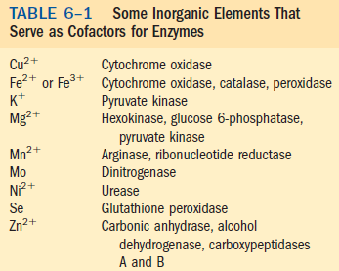

Slide 11
Prosthetic group: A coenzyme or metal ion that is very tightly or even covalently bound to the enzyme protein.
Holoenzyme: A complete, catalytically active enzyme together with its bound coenzyme and/or metal ions is called a holoenzyme.
Apoenzyme: The protein part of such an enzyme is called the apoenzyme or apoprotein.
Coenzymes: act as transient carriers of specific functional groups.
Most are derived from vitamins, organic nutrients required in small amounts in the diet.

Slide 12
Enzymes Are Classified by the Reactions They Catalyze
Many enzymes have been named by adding the suffix “-ase” to the name of their substrate or to a word or phrase describing their activity.
For example; urease catalyzes hydrolysis of urea, and DNA polymerase catalyzes the polymerization of nucleotides to form DNA.
Other enzymes were named for a broad function they perform.
For example, an enzyme known to act in the digestion of foods was named pepsin, from the Greek pepsis, “digestion,” and lysozyme was named for its ability to lyse bacterial cell walls.
Still others were named for their source: trypsin, named in part from the Greek tryein, “to wear down,” was obtained by rubbing pancreatic tissue with glycerin.

Slide 13
Classification of Enzymes
Because of such ambiguities, and the ever increasing number of newly discovered enzymes, biochemists, by international agreement, have adopted a system for naming and classifying enzymes.
This system divides enzymes into six classes, each with subclasses, based on the type of reaction catalyzed (Table 6–3).
Each enzyme is assigned a four-part classification number and a systematic name, which identifies the reaction it catalyzes.
As an example, the formal systematic name of the enzyme catalyzing the reaction
is ATP:glucose phosphotransferase.
This indicates that it catalyzes the transfer of a phosphoryl group from ATP to glucose.

Slide 14
Its Enzyme Commission number (E.C. number) is 2.7.1.1.
The first number (2) denotes the class name (transferase);
The second number (7), the subclass (phosphotransferase);
The third number (1), a phosphotransferase with a hydroxyl group as acceptor;
And the fourth number (1), D-glucose as the phosphoryl group acceptor.
For many enzymes, a trivial name is more commonly used—in this case hexokinase.

Slide 16
PROPERTIES OF ENZYMES
Enzymes are protein catalysts that increase the rate of a chemical reaction, and are not consumed during the reaction.
Some RNAs can act like enzymes, usually catalyzing the cleavage and synthesis of phosphodiester bonds.
Ribozymes: RNAs with catalytic activity are called ribozymes

Slide 17
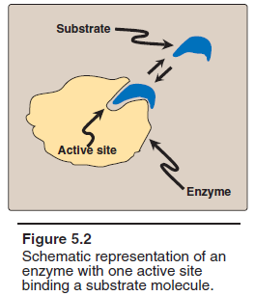
A. Active sites: A special pocket or cleft within the enzyme molecules, that is the center for catalysis.
The active site contains amino acid side chains that participate in substrate binding and catalysis (Figur).
Substrate: The molecule that is bound in the active site and acted upon by the enzyme is called the substrate.
Enzyme–substrate (ES) complex: The substrate binds the enzyme, forming an enzyme–substrate (ES) complex.
Induced fit: Binding is thought to cause a conformational change in the enzyme (induced fit) that allows catalysis.
Enzyme-product complex: ES is converted to an enzyme–product (EP) complex that subsequently dissociates to enzyme and product.

Slide 18
B. Catalytic efficiency Enzyme-catalyzed reactions are highly efficient, proceeding from 10³–10⁸ times faster than uncatalyzed reactions.
Turnover number: it is the the number of molecules of substrate converted to product per enzyme molecule per second. It is represented by ‘kcat’ and typically is 10²–10⁴s⁻¹.
C. Specificity: Enzymes are highly specific, interacting with one or a few substrates and catalyzing only one type of chemical reaction.
E. Regulation: Enzyme activity can be regulated, that is, increased or decreased, so that the rate of product formation responds to cellular need.
F. Location within the cell: Many enzymes are localized in specific organelles within the cell (Figure 5.3) for;
Compartmentalization and;
To provides a favorable environment for the reaction so that the thousands of enzymes present in the cell may be gathered into purposeful pathways.

Slide 20
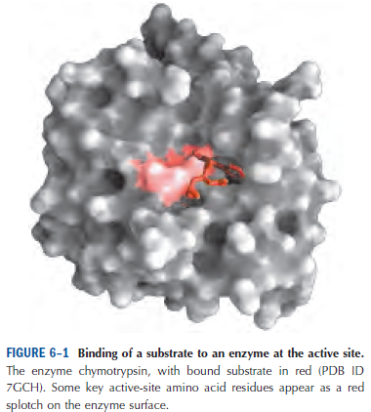
Enzymes Affect Reaction Rates, Not Equilibria
A simple enzymatic reaction might be written
where E, S, and P represent the enzyme, substrate, and product;
ES and EP are transient complexes of the enzyme with the substrate and with the product.

Slide 21
The energy in biological systems is described in terms of free energy, “∆G”.
The free-energy changes for reactions: Chemists define a standard set of conditions (temperature 298 K; partial pressure of each gas 1 atm, or 101.3 kPa; concentration of each solute 1 M) and express the free-energy change for this reacting system as “∆G^{0”}, the standard free energy change.
Because biochemical systems commonly involve H⁺concentrations far below 1 M, biochemists define a biochemical standard free-energy change, ∆G^{/0}, the standard free-energy change at pH 7.0.

Slide 22
The mechanism of enzyme action can be viewed from two different perspectives;
The first treats catalysis in terms of energy changes that occur during the reaction, that is, enzymes provide an alternate, energetically favorable reaction pathway different from the uncatalyzed reaction.
The second perspective describes how the active site chemically facilitates catalysis.

Slide 23
Virtually all chemical reactions have an energy barrier separating the reactants and the products.
The free energy of activation: This barrier, is the energy difference between that of the reactants and a high-energy intermediate that occurs during the formation of product.
For example, Figure 5.4 shows the changes in energy during the conversion of a molecule of reactant A to product B as it proceeds through the transition state (high-energy intermediate), T*:

Slide 24
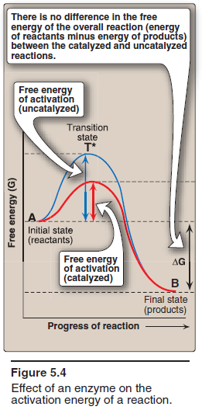
Free energy of activation: The peak of energy in Figure 5.4 represents the difference in free energy between the reactant and T*.
The high-energy intermediate is formed during the conversion of reactant to product.
Because of the high free energy of activation, the rates of uncatalyzed chemical reactions are often slow.
Rate of reaction:
For molecules to react, they must contain sufficient energy to overcome the energy barrier of the transition state.
In the absence of an enzyme, only a small proportion of a population of molecules may possess enough energy to achieve the transition state between reactant and product.
The rate of reaction is determined by the number of such energized molecules.

Slide 25
In general, the lower the free energy of activation, the more molecules have sufficient energy to pass through the transition state, and, thus, the faster the rate of the reaction.
3. Alternate reaction pathway:
An enzyme allows a reaction to proceed rapidly under conditions prevailing in the cell by providing an alternate reaction pathway with a lower free energy of activation (Figure 5.4).
The enzyme does not change the free energies of the reactants or products and, therefore, does not change the equilibrium of the reaction (see p. 71).
It does, however, accelerate the rate with which equilibrium is reached.

Slide 26
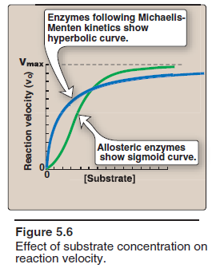
FACTORS AFFECTING REACTION VELOCITY
A. Substrate concentration
1. Maximal velocity: The rate or velocity of a reaction (v) is the number of substrate molecules converted to product per unit time.
Units of rate of reaction: Velocity is usually expressed as μmol of product formed per minute.
The rate of an enzyme-catalyzed reaction increases with substrate concentration until a maximal velocity (Vmax) is reached (Figure 5.6).
The leveling off of the reaction rate at high substrate concentrations reflects the saturation with substrate of all available binding sites on the enzyme molecules present.

Slide 27
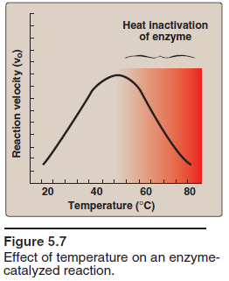
B. Temperature
1. Increase of velocity with temperature: The reaction velocity increases with temperature until a peak velocity is reached (Figure 5.7).
This increase is the result of the increased number of molecules having sufficient energy to pass over the energy barrier and form the products of the reaction.
2. Decrease of velocity with higher temperature:
Further elevation of the temperature results in a decrease in reaction velocity as a result of temperature-induced denaturation of the enzyme (see Figure 5.7).

Slide 28
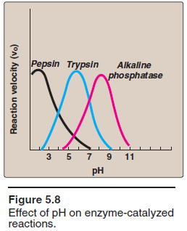
C. pH
1. Effect of pH on the ionization of the active site: The concentration of H⁺ affects reaction velocity in several ways.
First; the catalytic process usually requires that the enzyme and substrate have specific chemical groups in either an ionized or un-ionized state in order to interact.
For example, catalytic activity may require that an amino group of the enzyme be in the protonated form (–NH₃⁺).
At alkaline pH, this group is eprotonated, and the rate of the reaction, therefore, declines.
2. Effect of pH on enzyme denaturation: Extremes of pH can also lead to denaturation of the enzyme, because the structure of the catalytically active protein molecule depends on the ionic character of the amino acid side chains.

