Slide 1
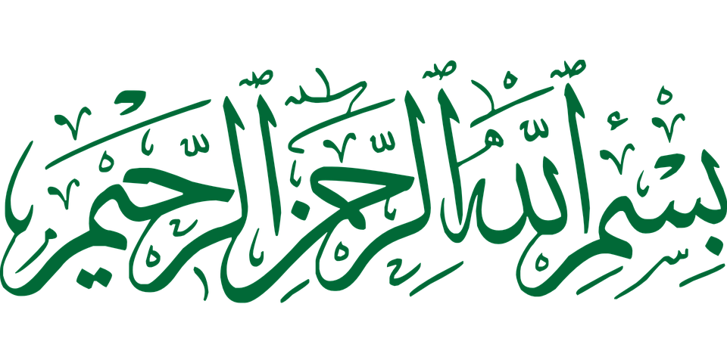

Slide 2
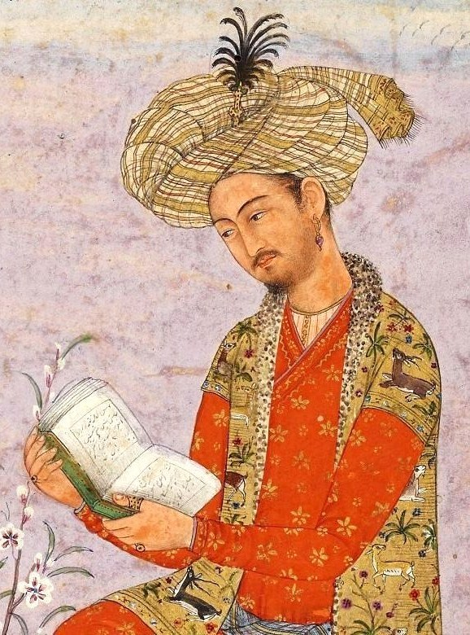
Topic
INDO-PAK ON THE EVE OF BABUR’S INVASION

Slide 3
political condition
Social and culture condition
Economic condition
Military condition

Slide 4
Political Condition

Slide 5
1. No Political Unity
Since the death of Firuz Traghluq, the disintegration of the Delhi Sultanate had set in and a large number of independent States had sprung up in this country.
Of the important independent states of Northern India the names of Delhi, Gujarat, Malwa Bengal, Mewar, Khandesh, Punjab, Sind and Kashmir may be mentioned here

Slide 6
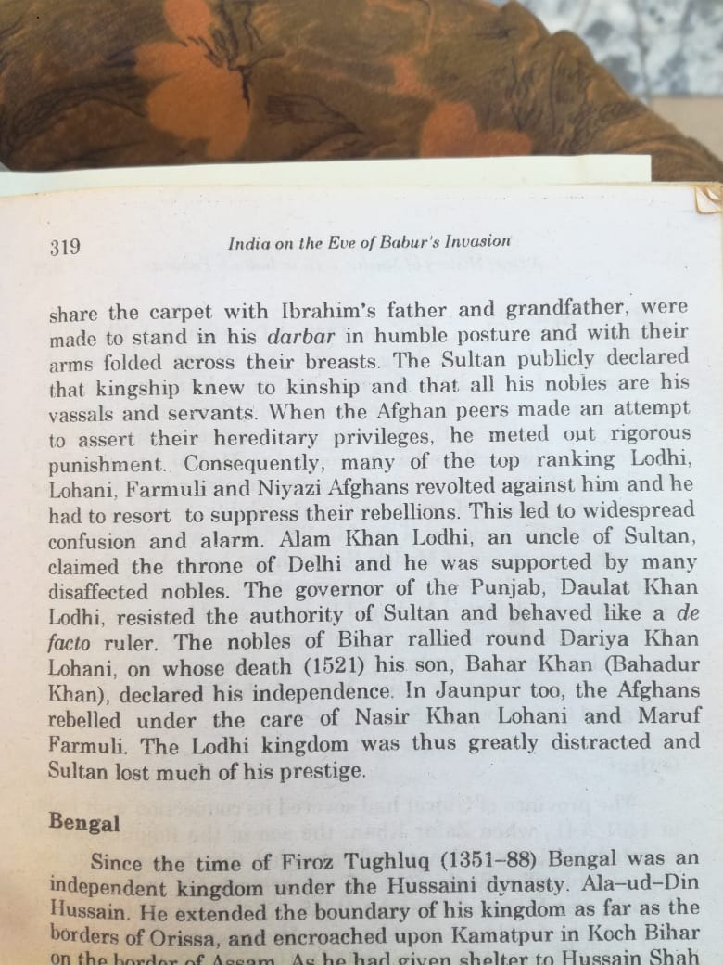
2. The Kingdom of Delhi

Slide 7
Bengal

Slide 8
Malwa

Slide 9
Gujrat

Slide 10
Mewar

Slide 11
Sind

Slide 12
Punjab

Slide 13
Kashmir

Slide 14
Orissa

Slide 15
Khandesh

Slide 16
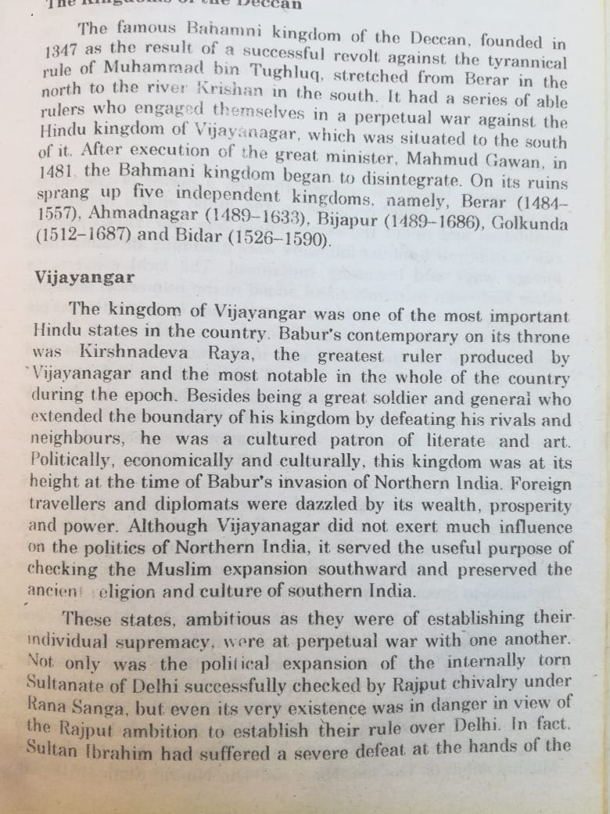
Vijayangar

Slide 17
Vijayangar

Slide 18
Social
&
Cultural Condition

Slide 19
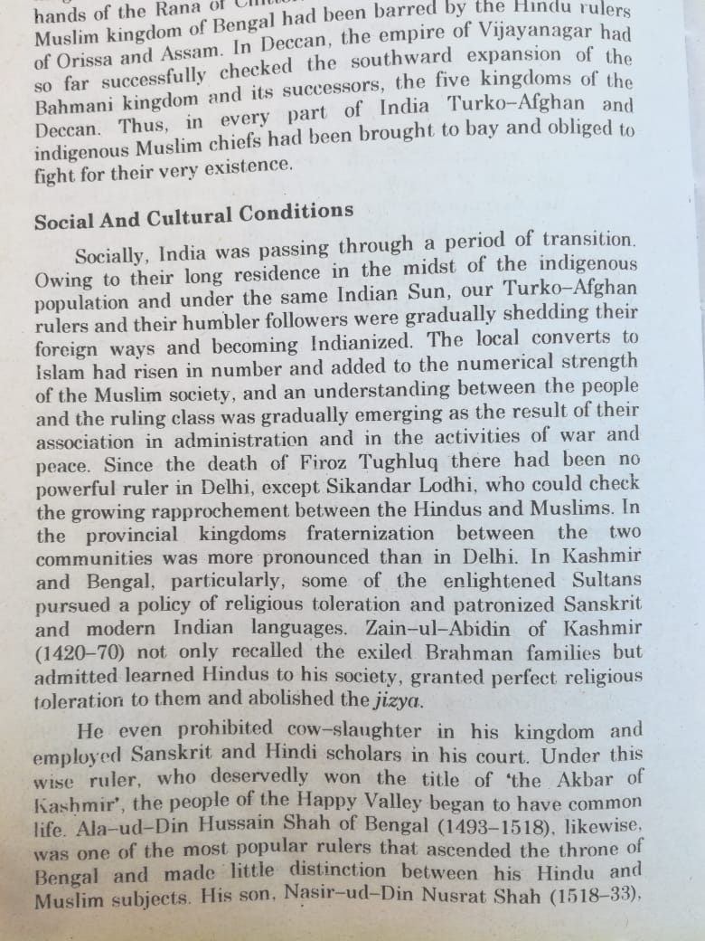

Slide 22
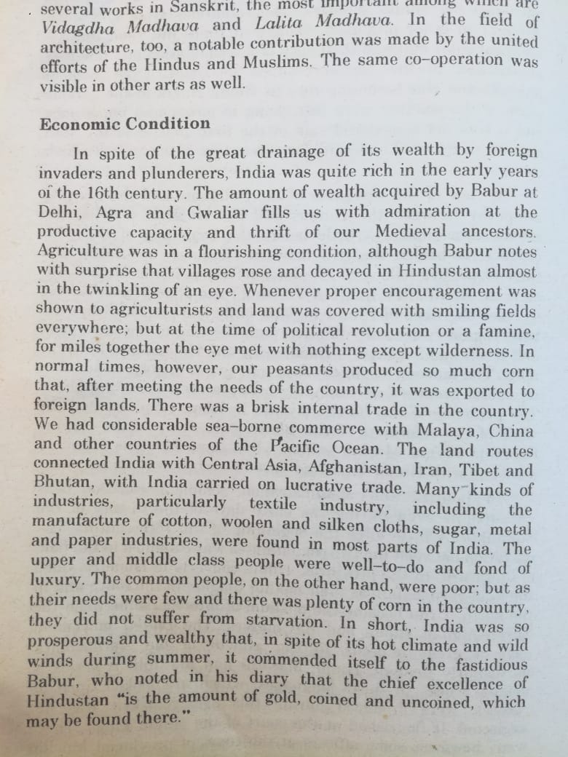
Economic Condition

Slide 23
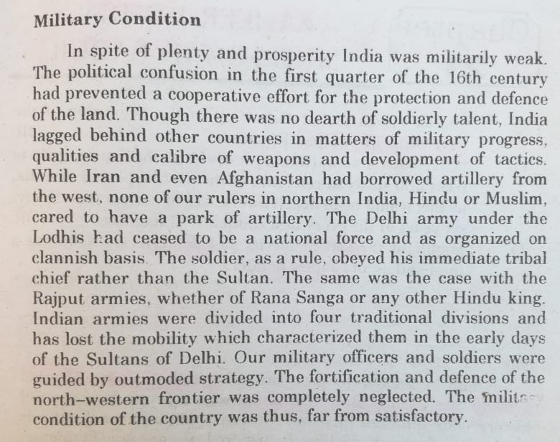
Military Condition

Slide 24
T
A
H
K
N
y
o

