Slide 1
Citrus Canker

Slide 2
History and Importance:
Occur in all citrus growing areas.
Originated in China & spread to Europe and USA in 1910.
In 1919 & 1984 all citrus destroyed in Florida, USA.

Slide 3
Etiology
Xanthomonas axonopodis pv. citri

Slide 4
Symptoms
First raised watery spots appear on leaves.
Later spots become thickened, brown and corky.
Infection to midrib and petiole causes premature defoliation.

Slide 5
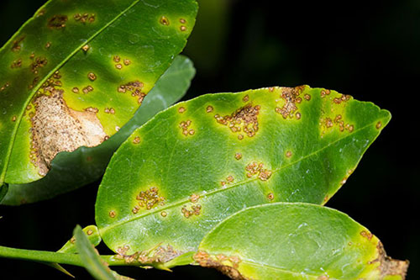
Symptoms
Raised, thick, corky brown cankers on leaves

Slide 6
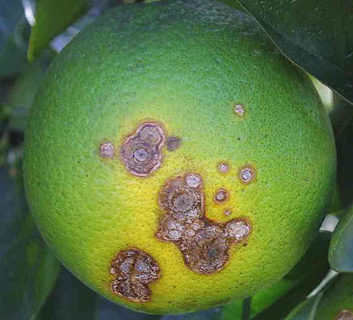
Symptoms
Raised, thick, corky brown cankers on fruits

Slide 7
Disease cycle
Primary source are old lesions on standing trees.
Wind driven rain helps in secondary infection.
Enter through stomata or wounds.
Bacteria induce surrounding cells to swell up and divide abnormally.
Tissue disruption and enzymes begin to degrade tissues, kill cells.
Plant cell contents leak out to nourish bacteria.

Slide 8
Epidemiology
Leaf miner
20-30°C

Slide 9
Management:
Streptomycin 100-1000 ppm at 15 days interval.
Garlic extract.

