Slide 2
Ecology
Water as an Environmental Factor

Slide 3
Water Cycle
Water exhibits cyclic flow between atmosphere , land and sea , and between living organisms and their environment referred as water cycle or hydrological cycle. Without cycling of water ecosystem could not function , and life could not maintained. Water cycle is characterized by :
Precipitation
Interception
Infilteration
Evaporation.

Slide 4
Stages of Water Cycle
Precipitation:
It results from condensation of water vapours derived from surface of oceans. It is the major source of soil moisture and driving force of the water cycle.
Precipitation begins as water vapour in atmosphere . When the air rises it is cooled and when it rises above the temperature level at which condensation take place ,clouds form.
The condensing moisture aggregate to droplets , when diameter reach about 1mm ,they fall as rain.

Slide 5
Cont….
Interception:
As the precipitation reach earth , some water reaches ground directly , some is intercepted by vegetation and by building etc.
Because of interception various amount of water evaporates into atmosphere without reaching the soil surface.
Infilterartion:
The precipitation that reaches the soil moves in to ground by infilterartion. More intense the rain, greater would be the infiltration.

Slide 6
Cont…
Water seeps down and called gravitational water
A great amount of water is used by humans and for domestic purposes.
A part of water is held in soil by capillary forces between the soil particles called capillary water.
4.Evaporation:
Water on the surface of ground, on the surface of vegetation, and in stream, lakes and oceans return to atmosphere by evaporation.
Some water is lost by roots of plants .
The total loss of water from the surface of ground is called as evapotranspiration.

Slide 7
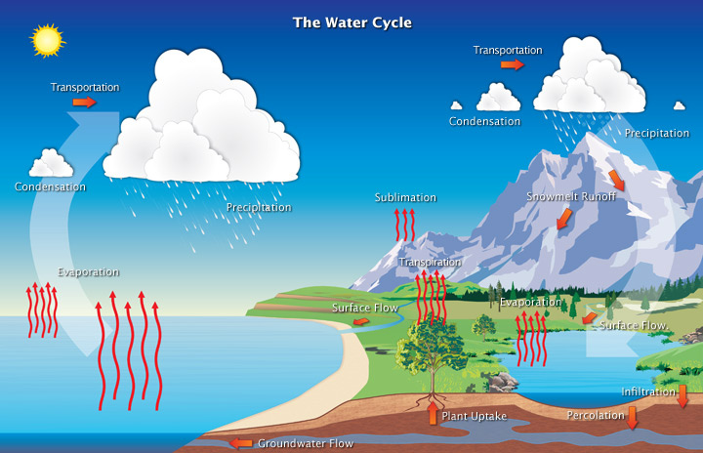

Slide 8
Atmospheric Moisture
Water exist as :
Invisible vapour (humidity).
Visible vapour (cloud and fog).
1. Humidity:
The actual amount of water vapours in atmosphere is known as absolute humidity.
It is measured in ounces per cubic yard or grains per cubic foot of air. iii. It differs from place to place.

Slide 9
Cont…
It declines if we move from equator (20mm) towards pole (1mm).
The percentage of moisture present in atmosphere as compared to its full capacity is called relative humidity It is defined as “percentage of maximum quantity that the air can hold at a temperature “.
Temperature governs humidity .warm air can hold more water than cold air. The capacity of air carrying vapours become double with increase of 11°c.
Relative humidity is low during day and high in night.
In rain forests low relative humidity is 80% and in desert it may be below 10%.

Slide 10
2. Cloud and Fog :
It consist of water droplets or some sometime ice crystals formed from cooling of air to a temperature below its dew point.
They differ in their locations.
Clouds are separated from earth while fog is present near the earth. When further cooled both converted to droplets.
Clouds are formed when air moves upward from land surface into colder regions of atmosphere.

Slide 11
Cont…
Fog is formed by warm air passing over cold water currents in the sea , by warm air rising up a sloping land surface to high elevations , and by rapid cooling of land surface during night.

Slide 12
Importance of Moisture to plants
1. Effect on intensity of solar radiations:
Vapour in atmosphere intercept with solar radiations, before it reaches the earth hence less energy is available for photosynthesis and respiration. E.g. slow growing dwarfed trees.
2. Effects on evaporation and transpiration:
With the increase in relative humidity ,reduces the rate of evaporation and transpiration and vice versa.

Slide 13
Cont…
3. Source of soil moisture :
When fog moves horizontally, or clouds come in contact with earth , minute water droplets deposits as they pass through foliage and absorbed by soil.
4. Direct use by plants :
Mosses and lichens absorb moisture from humid atmosphere without waiting for condensation. When relative humidity rises above 85%, epiphytes and xerophytes absorb water directly.

Slide 14
Precipitation
Precipitation is condensation of water vapours in the form of rain ,hail and snow etc.
It is source of soil moisture.
It is major driving force of water cycle as well.
Precipitation directly or indirectly affects the plant life through humidity and water content of the soil , therefore important ecological factor.

Slide 15
Importance of precipitation to plants
Snow:
It may be injurious or beneficial.
Snow that melt is a source of water.
By wind and by rain break off tree branches.
At high altitude and latitude it damage vegetation.
Snow press seedlings down-may attacked by fungus easily.

Slide 16
Cont…
2. Rainfall:
Source of moisture for soil.
Helps to crack open thin skinned fruits e.g. cherries and tomatoes and release seeds.
The amount of rain determine vegetational zones e.g. Subtropical forests ,rain forest etc
3. Hail and steel:
Cause damage to aerial parts of plants.

Slide 17
Water as an Environmental Factor
A vital biotic factor
Important for existance of organisams
Variety of adaptations

Slide 18
Animal adaptations to water
Water obtain
Water loss
Water retention
Groups of animals depending on their adaptations for maintaining water balance

Slide 19
Water as a physical environment of life
The main characteristics of water as a physical environment are:
Transparency
Salt content
Gas content
Temperature regime and current

Slide 20
Human impact on water resources of earth
Industrial and domestic waste
Radioactive pollution
Little fresh water on earth

