Slide 1
What is Islamic Illumination?
Illuminate
Illuminate means adding light, shine or shimmer.
Illumination
Illumination is the art of applying gold or adding light. The term “illumination” is also present in the Arabic, Turkish and Persian languages, but the word in all of those three languages is Tezhip/Tathhib/ تذهيب.

Slide 2
What is Islamic Illumination?
Islamic illumination is the use of gold to paint geometric and/or biomorphic patterns (organic and floral forms and motifs) to decorate the pages of Quran and books of poetry. Biomorphic patterns have a geometric grid that is usually hidden with the painting and illuminating.

Slide 3
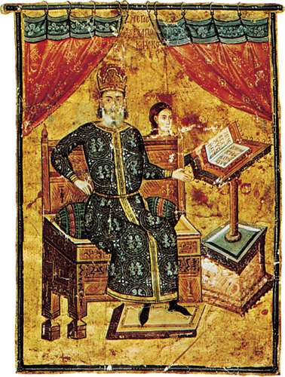
Illuminated manuscript, handwritten book that has been decorated with gold or silver, brilliant colours, or elaborate designs or miniature pictures. Though various Islamic societies also practiced this art, Europe had one of the longest and most cultivated traditions of illuminating manuscripts. In the great era of the illuminated manuscript, the art of the illuminator often played an important role in the development of art.
Portrait of the high admiral Alexius Apocaucos, illuminated manuscript page from the Hippocrates Manuscript, c. 1342; in the Bibliothèque Nationale, Paris.

Slide 4
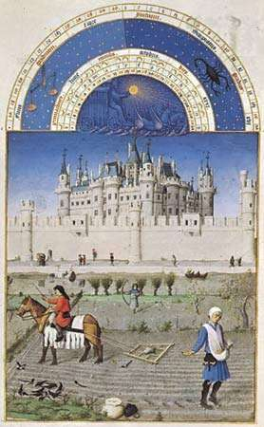
Illuminated manuscript page by Giovannino de’ Grassi, c. 1385, in the Biblioteca Nazionale Centrale, Florance
Illuminated manuscript page from Les Très Riches Heures du duc de Berry by the Limburg brothers, c. 1416; in the Condé Museum, Chantilly, France.

Slide 5
Islamic Art of Illumination presents an amazing mixture of classical Turkish illumination patterns and their contemporary interpretations. It illustrates how illumination was applied to various articles during the Ottoman period, including pictures, royal edicts and insignia, tiles, chests, gun holsters, shields, and even costumes prepared for the Sultan and his family. It also shows how today illumination has extensively been applied on architectural surfaces, book covers, manuscripts, carpets, textiles, ceramics, glass and wood panels, and metal works. In richly illuminated designs using motifs such as buds and roses, as well as stylized and naturalistic flowers, she exhibits all of the geometrical, foliate, and floral patterns used in the art. She also takes a closer look at making illumination designs.

Slide 6
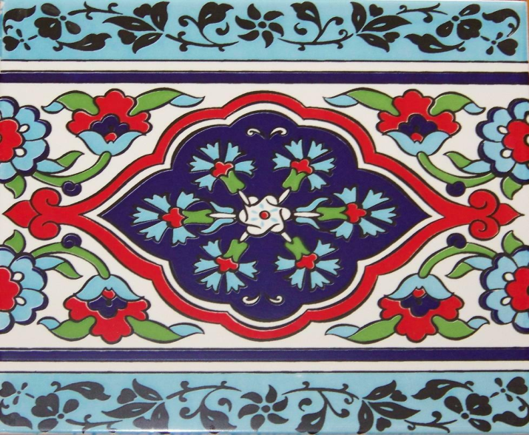
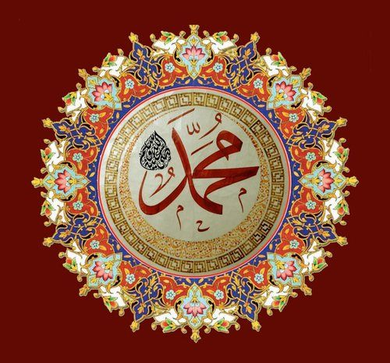
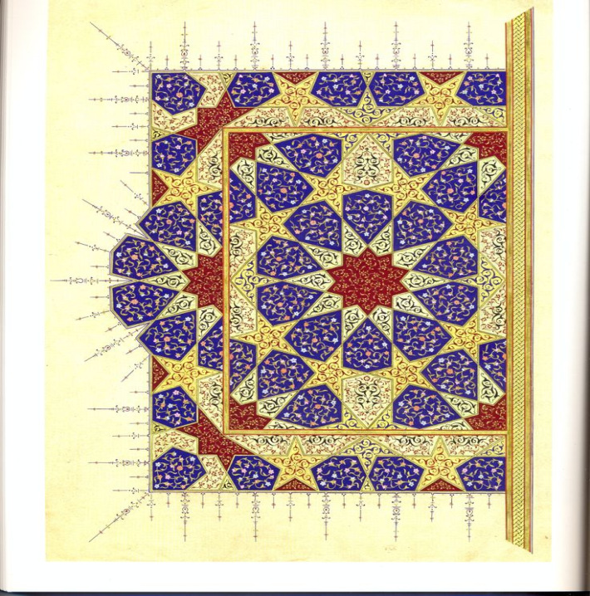
Mixture of classical Turkish illumination patterns
TURKISH ART OF ILLUMINATION
Turkish & Islamic

Slide 7
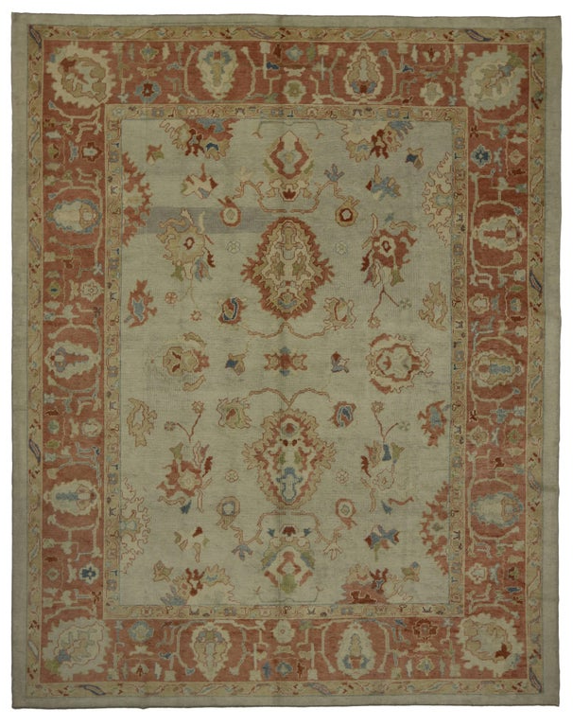
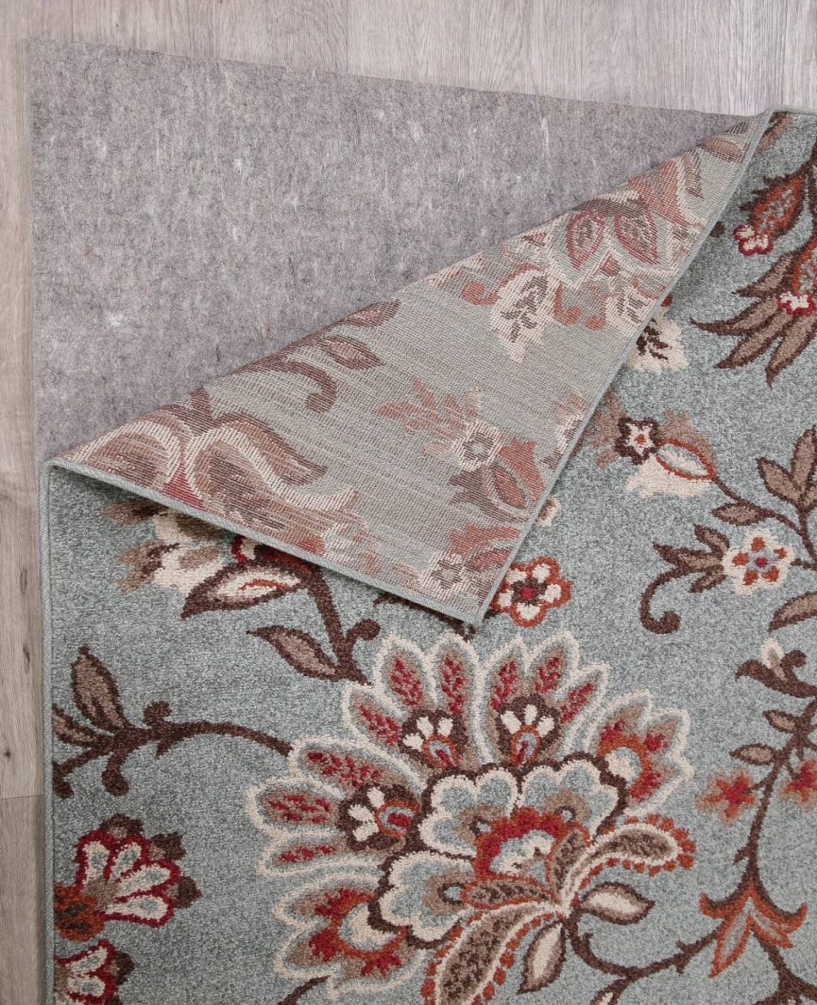
Contemporary Turkish illumination
Contemporary Modern Turkish Oushak Rug with Transitional Style in Light Colors
Light Blue Floral Modern Turkish Oriental Area Rug

Slide 8
Illuminating the Quran
The Quran is the main source of Islam. It was recorded using Arabic calligraphy. The first calligrapher is the prophet's cousin and son-in-law Imam Ali Ibn Talib (Nasr, 1987). The writing of the Quran was regarded highly since it was the visual representation of the word of God. From that point, the writing and the presentation of the book became an art.
As art developed in the Muslim world, calligraphy was not enough, so artists started adding a little gold to decorate the Quran to physically represent the enlightenment that comes from the word of God.
Usually, the cover and the frontal pieces are very elaborate, but the rest of the pages are decorated less. Later on, "Art of the book" extended to other books such as poetry and story books.

