Slide 1
Introduction to Computer (Comp-201)

Slide 2
Input & Output Devices
What is Input and Input devices?
Input is any data and instructions entered into the memory of a computer. An input device is any hardware component that allows users to enter data and instructions into a computer.

Slide 3
Input Devices
Keyboard
Pointing Devices
Touch Screen
Audio Input Devices
Sensors Input Devices

Slide 4
Key Board
A keyboard is an input device that contains keys users press to enter data and instructions into a computer.
All desktop computer keyboards have a typing area that includes the letters of the alphabet, numbers, punctuation marks, and other basic keys.
Many desktop computer keyboards also have a numeric keypad on the right side of the keyboard.
Most of today’s desktop computer key boards are enhanced keyboards. An enhanced keyboard has 12 or more function keys along the top and a set of arrow and additional keys between the typing area and the numeric keys.

Slide 5
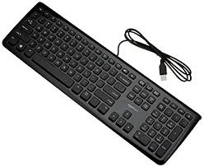
Continue..
Desktop computer keyboards often attach via a cable to a USB port on the system unit. Some keyboards, however, do not have any wires connecting the keyboard to the system unit.
A wireless keyboard, or cordless keyboard, is a battery-powered device that transmits data to the system unit using wireless technology, such as radio waves (Bluetooth) or infrared light waves (IrDA).

Slide 6
Pointing Devices
An input device used to control a pointer on the screen is called a pointing device.
A pointer is a small symbol that appears on the screen in GUI.
A pointing device can be used to select text, graphics and other objects such as buttons, icons and menu commands.

Slide 7
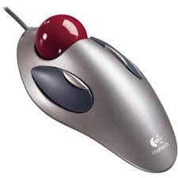
Pointing Devices
Some pointing devices are
Mouse
Trackball
Touchpad / Trackpad

Slide 8
Mouse
Mouse is the most popular pointing device.
It is used to input instructions with a pointer on the screen.
It is moved on a flat surface to control the movement of pointer on the screen.
A mouse usually has two buttons that are used to perform different tasks such as selecting an object or opening a program.

Slide 9
Mouse
A mouse may also include a wheel that can be rolled with the finger to scroll the screen.
Mouse typically connects to the computer through USB port or wireless connection.
Different types of mouse are available in market, some of these types are mechanical mouse, optical mouse, wireless mouse and touch mouse.

Slide 10
Mouse
Mechanical mouse contains a rubber or metal ball inside it.
The movement of cursor depends on the movement of ball.
This mouse is normally used on a mouse pad, which is a small pad of rubber or foam to provide easy movement of the mouse.

Slide 11
Mouse
Optical mouse contains no ball inside it, it uses a device that emits light to detect the mouse movement.
Optical sensor and laser is used in these types of mouse.
It is more expensive than mechanical mouse and is the most widely used mouse.
Wireless mouse is a type of mouse that does not require a wire for working.
It transmits data using wireless technology like radio waves or infrared light waves

Slide 12
Mouse
Touch mouse is a touch sensitive mouse that recognizes touch gestures.
It can also detect the movement of the mouse and traditional click and scroll operations for example the user
can press a location on a touch mouse to click
can sweep thumb on the mouse to scroll pages
Can slide multiple fingers across the mouse to zoom.

Slide 13
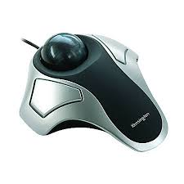
Trackball
A trackball can be used as an alternative to a mouse.
It has buttons similar to those on mouse, and has a large rotating ball on the top.
The body of the trackball is not moved, instead the ball is rolled with fingers.
Position of cursor on the screen is controlled by rotating the ball.
Advantage of trackball over mouse is that it takes less space to move.

Slide 14
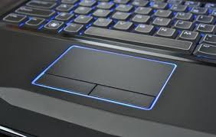
Touchpad
A touchpad is a small and flat surface over which the user moves his finger.
Movement of the finger moves the cursor on the screen.
Touchpad also has one or two buttons near it and these buttons work like mouse buttons.
Touchpads are built in in laptop computers.
An external wireless touchpad can also be used with desktop computers.

Slide 15
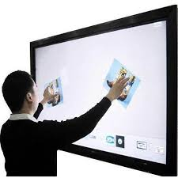
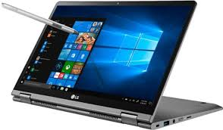
Touch Screen
A touchscreen is a touch sensitive device.
The user can touch different parts of the screen with the finger or stylus to input data and issue commands.
Most of the touch screens now a days are multi touch and can recognize input from more than one finger at a time.
For example the user can use two fingers to enlarge and rotate an image on the screen.

Slide 16
Touch Screen
Touch screens are commonly used in tablets, mobile devices and ATMs.
Some models of laptops also have touch screens.
Touch screens are very popular because user can interact with the computer easily without an external input device.

Slide 17
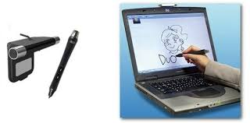
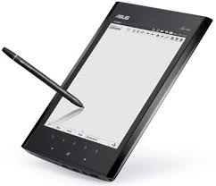
Pen Input
With pen input, you touch a stylus or digital pen on a flat surface to write, draw, or make selections.
The flat surface may be a screen on a monitor or mobile device, a signature capture pad, or a graphics tablet .
A stylus is a small metal or plastic device that looks like a tiny ink pen but uses pressure instead of ink.
A digital pen, which is slightly larger than a stylus, typically provides more functionality than a stylus, featuring electronic erasers and programmable buttons. Most digital pens, often simply called pens, are pressure-sensitive.

Slide 18
Audio Input Devices
The process of entering any sound into the computer is called audio input.
It may include speech, music or any other sound effects.
Audio can be entered through different devices such as microphone, tape players, CD/DVD player or radio.
Audio devices convert sounds into a form that can be processed by computer. Common audio devices are microphone and MIDI devices.

Slide 19
Audio Input Devices
Microphone
It is an input device that digitally record audio data such as human voice.
It can be plugged into a computer or recorder.
It enables users to input text and issue commands orally.
The software in the computer converts the sound waves into digital form, which is then stored in memory for future use.

Slide 20
Audio Input Devices
MIDI Devices
MIDI stands for musical instrument digital interface.
MIDI devices are used to enter music and other sound effects in computer.
These devices connect to sound card in the computer.
The user can compose and edit music and many other sounds using software.
Electronic piano keyboard is an example of MIDI device.

Slide 21
Sensors Input Devices
Sensor is an input device that inputs data directly from the environment and stores it in the computer.
It is usually used to detect speed, movement, weight, pressure, temperature, humidity, wind and images.
Sensors can be used to sense weather conditions and earthquakes.

Slide 22
Other types of Input devices
Game Controllers
Game Pads
Light Guns
Digital Cameras
Video Input
Web cams
Scanners and reading Devices
An optical scanner, usually called a scanner, is a light-sensing input device that reads printed text and graphics and then translates the results into a form the computer can process.

Slide 23
Optical Readers An optical reader is a device that uses a light source to read characters, marks, and codes and then converts them into digital data that a computer can process. Two technologies used by optical readers are optical character recognition and optical mark recognition.
Optical character recognition (OCR) involves reading typewritten, computer-printed, or hand printed characters from ordinary documents and translating the images into a form the computer can process.
Optical mark recognition (OMR) devices read hand-drawn marks such as small circles or rectangles. A person places these marks on a form, such as a test, survey, or questionnaire answer sheet.
Barcode Reader

