Slide 2
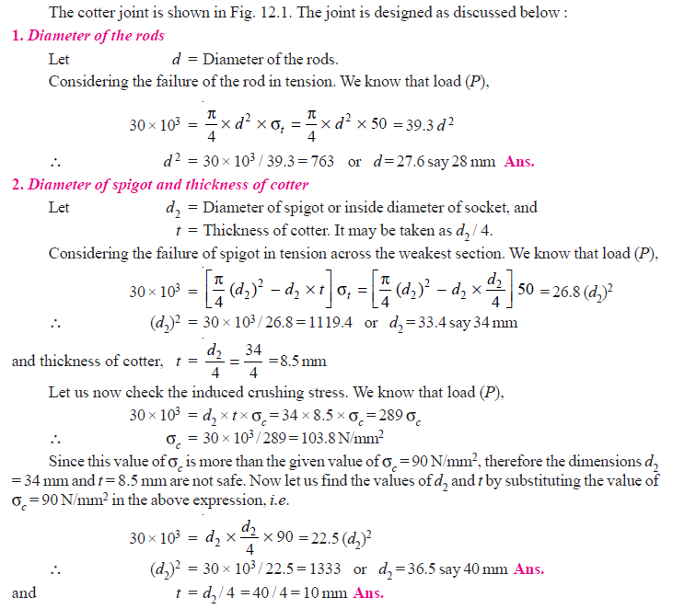

Slide 4
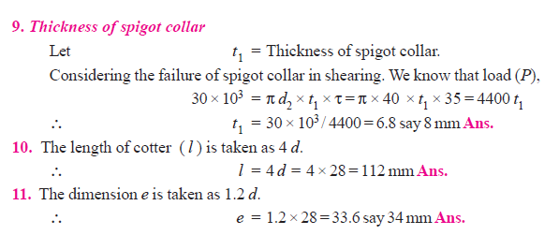

Slide 5
Coupling
In mechanical system coupling can be defined as kind of linkage between two rotating shafts which joins driving and driven shafts together.
The joint between two shafts may be permanent or temporary

Slide 6
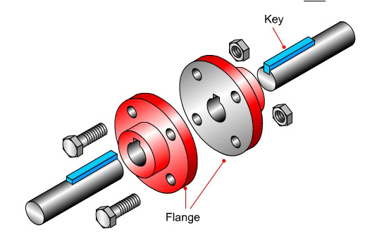
What is Coupling?
In simple words we can say that coupling is used to join input and output shafts in any power transmissions system such as machine tools gear box shaft is connected to the input engine shat by means of coupling, engine shaft with pump or compressor shafts etc

Slide 7
Requirements of a Good Shaft Coupling
1.Easy to assemble & disengage: It should be easy to connect or disconnect.
2. Power Transmission: It should transmit the full power from one shaft to the other shaft without losses.
3.Join Misaligned Shaft: It should hold the shafts in perfect alignment.
4.Reduce Shocks & vibration(power transmitting from one shaft to other but time gap): It should reduce the transmission of shock loads from one shaft to another shaft.

Slide 8
Types of Shafts Couplings
1. Rigid coupling 2. Flexible coupling
1. Rigid coupling : It is used to connect two shafts which are perfectly aligned. It is simple & less costly. It cannot tolerate any kind of Misalignment.
a)Sleeve or muff coupling.
b)Clamp or split-muff or compression coupling,
c)Flange coupling

Slide 9
2.Flexible coupling : It is used to connect two shafts having both lateral and angular misalignment.
Types of flexible coupling are
a)Bushed pin type coupling,
b)Universal coupling, and
c)Oldham coupling

Slide 10
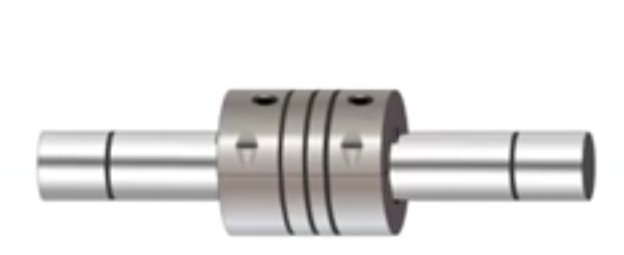
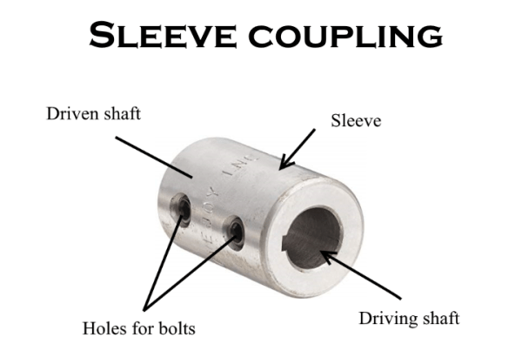
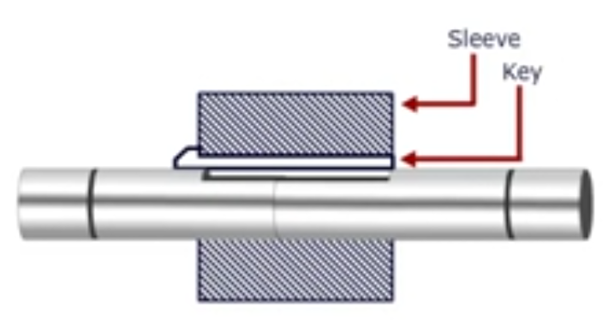
SLEEVE OR MUFF COUPLING

Slide 11
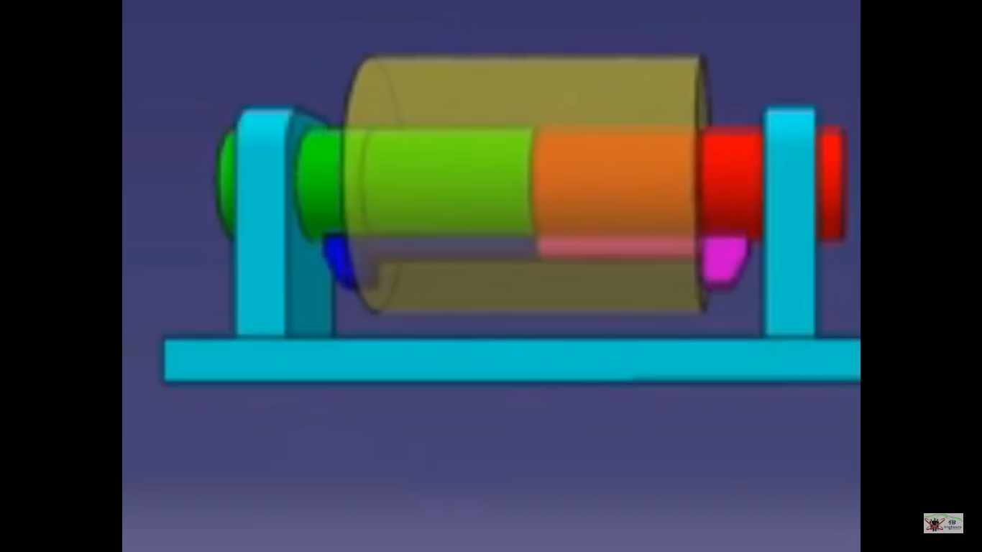

Slide 14
SHAFT - (d, T)
d = diameter of the shaft , T= torque
SLEEVE – (D, L)
D= Outer diameter of the sleeve
KEY-
l= length, w= width, t=thickness

Slide 15
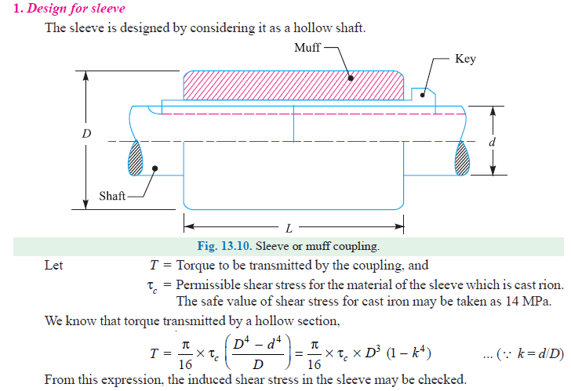

Slide 20
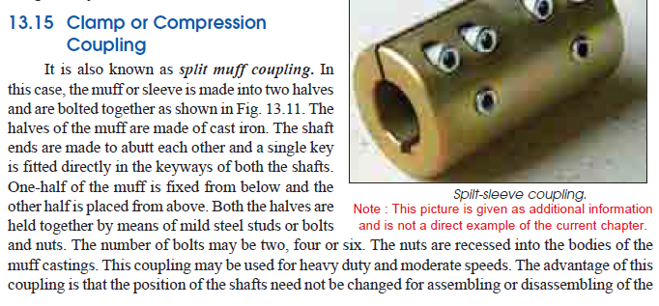

Slide 26
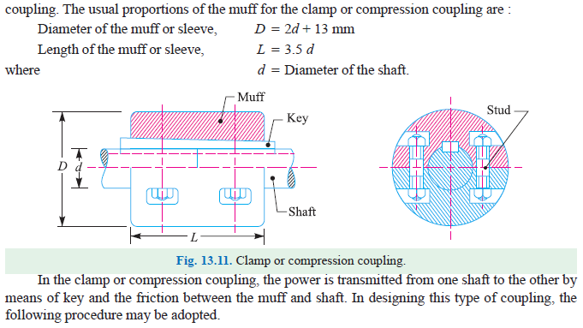

Slide 29
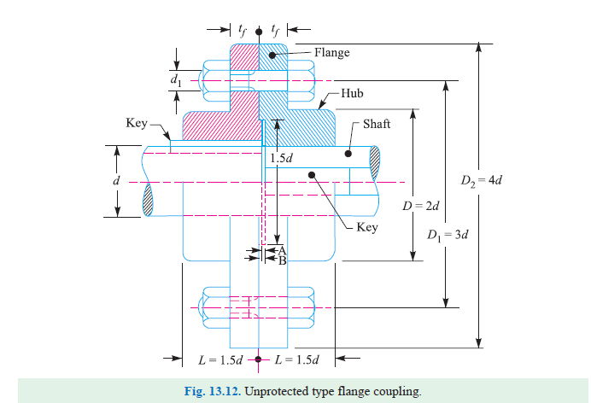

Slide 32
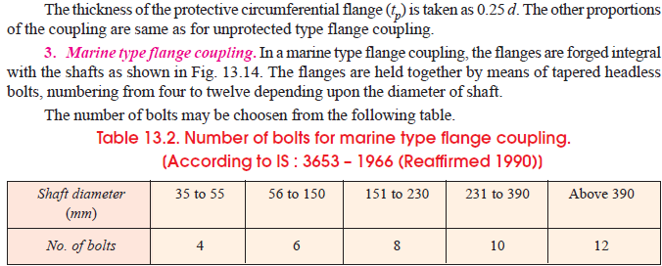

Slide 35
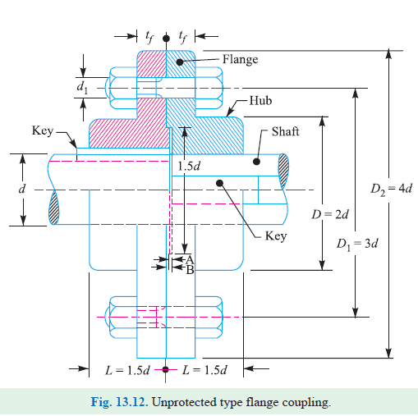

Slide 43
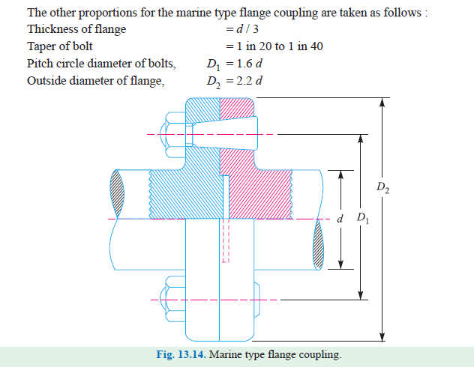

Slide 44
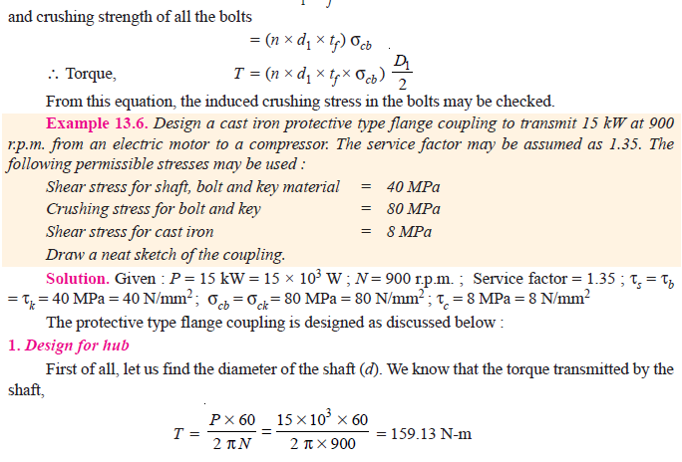

Slide 64
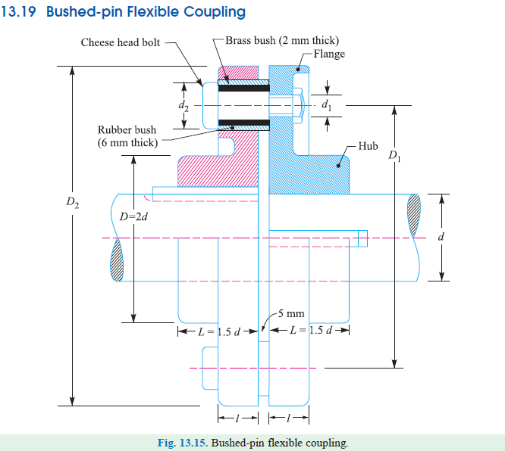

Slide 65
Bushed-pin Flexible Coupling
In this coupling bushes are used for absorbing the shocks & vibrations. The bushes are made up of flexible elements. The construction of Bush pin coupling is same as flange coupling. The bushes are mounted between flanges & shaft. Bushes are no able to compensate the eccentricity between two mating shafts as well as provide connection between flange & shaft.It is used for high torque transmission.0.1-0.5mm distance is easily adjusted.

Slide 66
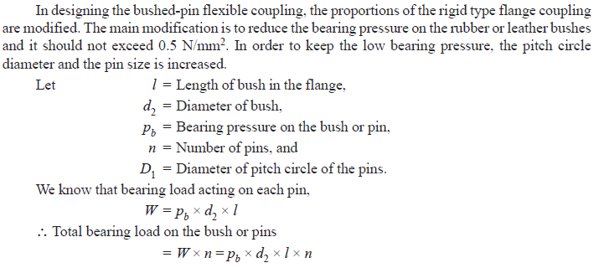

Slide 67
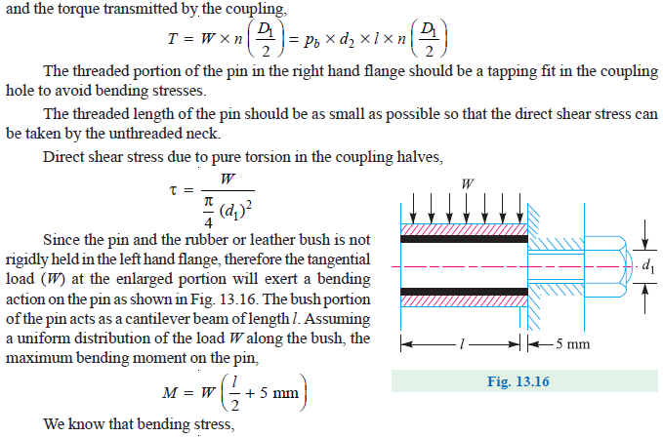

Slide 70
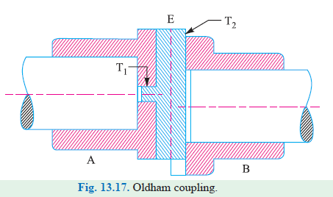
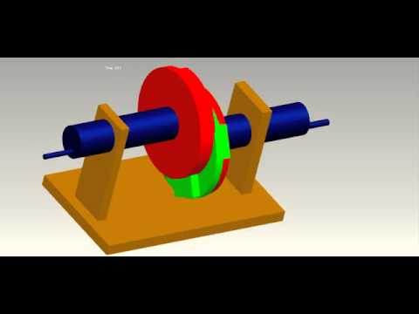
Oldham Coupling
It is used to connect the two parallel shafts when some eccentricity is present between two rotating shafts. In this two misaligned shafts have disc shape flanges with rectangular slot at the middle. Both the flanges have slot cut which is at right angle to each Other. The middle disc rotates about it centre but both misaligned shafts rotate their own by means of sliding tongue.

Slide 71
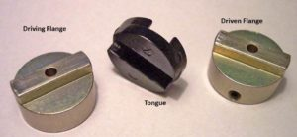
It is used to join two shafts which have lateral misalignment. It consists of two flanges A and B with slots and a central floating part E with two tongues T1 and T2 at right angles as shown in Fig. 13.17. The central floating part is held by means of a pin passing through the flanges and the floating part. The tongue T1 fits into the slot of flange A and allows for ‘to and fro’ relative motion of the shafts, while the tongue T2 fits into the slot of the flange B and allows for vertical relative motion of the parts. The resultant of these two components of motion will accommodate lateral misalignment of the shaft as they rotate.

Slide 72
Oldham coupling

Slide 73
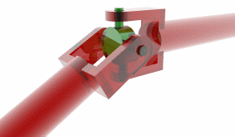
universal or Hooke’s coupling
A universal or Hooke’s coupling is used to connect two shafts having intersecting axes. It is used to joint two non-parallel & intersecting shafts which has some angular misalignment.
Yokes or Forkes
Cross

Slide 74
The input and output shafts are connected using hook’s joint. The input driving shaft rotates at a uniform angular speed while the driven shaft rotates with varying angular speed i.e. both shafts have different angular speed. Both the shafts rotate in fixed bearing and have a fork at the end. Each fork has four ends and sides which are connected by center piece.
In designing a universal coupling, the shaft diameter and the pin diameter is obtained as discussed below. The other dimensions of the coupling are fixed by proportions as shown in Fig. 13.18.
Let d = Diameter of shaft,
dp = Diameter of pin, and
τ and τ1 = Allowable shear stress for the material of the shaft and pin respectively.

Slide 75
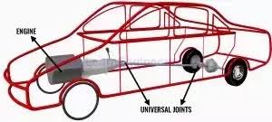
The main application of the universal or Hooke’s coupling is found in the transmission from the gear box to the differential or back axle of the automobiles. In such a case, we use two Hooke’s coupling, one at each end of the propeller shaft, connecting the gear box at one end and the differential on the other end. A Hooke’s coupling is also used for transmission of power to different spindles of multiple drilling machine.

Slide 76
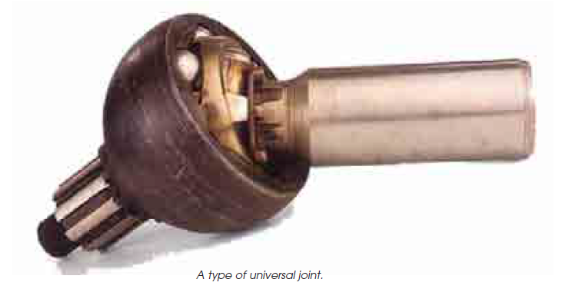

Slide 77
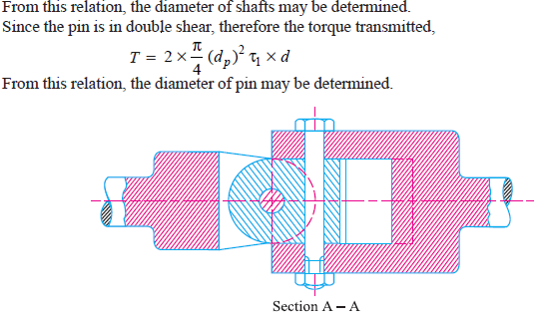

Slide 78
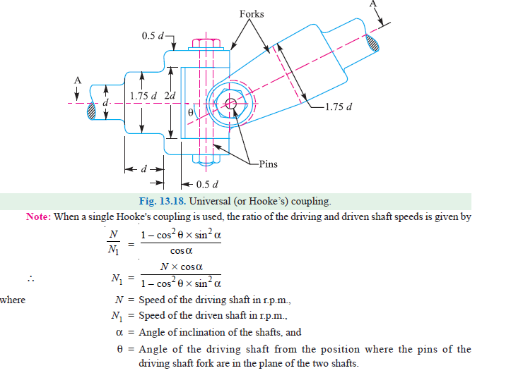

Slide 80
Referencess
https://www.youtube.com/watch?v=3JbU114al10

