Slide 1
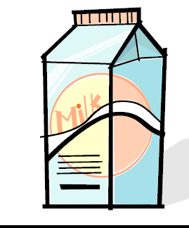
Milk
DEFINITION
INTRODUCTION
COMPOSITION OF MILK FROM DIFFERENT SPECIES
MILK PROTIENS CONCENTRATION
PRODUCTION PRACTICES
QUALITY CONTROL
PROBLEMS RELATED TO MILK PROCESSING
PROCESSING (PASTEURIZATION/ HOMOGENIZATION
NUTRITIONAL QUALITIES
MILK PRODUCTS AND BY-PRODUCTS

Slide 2
Definition
Milk may be defined as the whole, fresh, clean, lacteal secretion obtained by the complete milking of one or more healthy milch animals, excluding that obtained within 15 days before or 5 days after calving or such periods as may be necessary to render the milk practically colostrums-free, and containing the minimum prescribed percentage of milk fat and milk solid not fat.

Slide 4
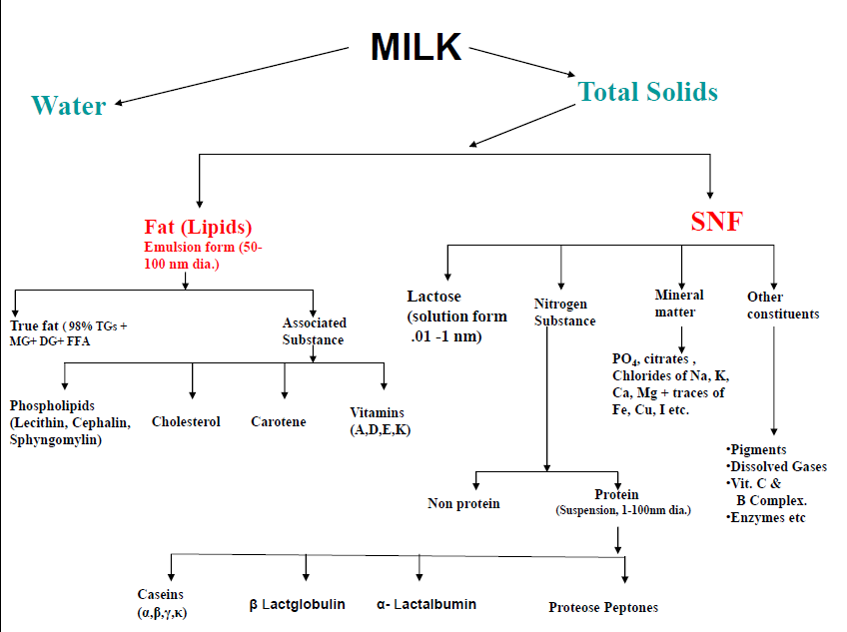

Slide 5
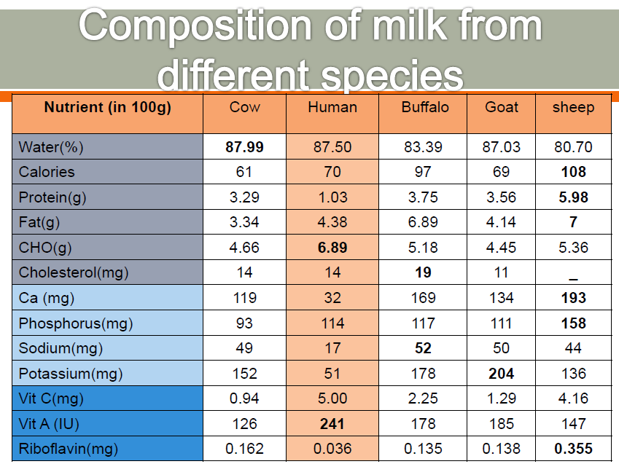

Slide 6
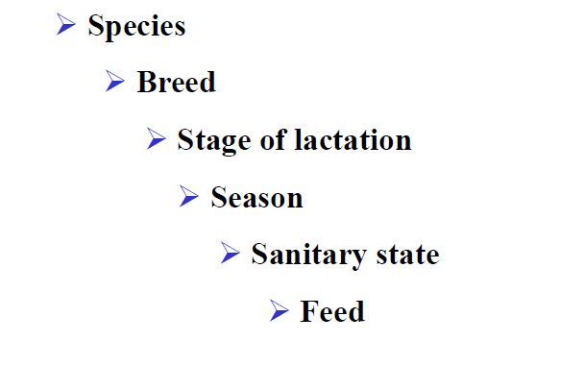
Milk: Variable composition

Slide 7
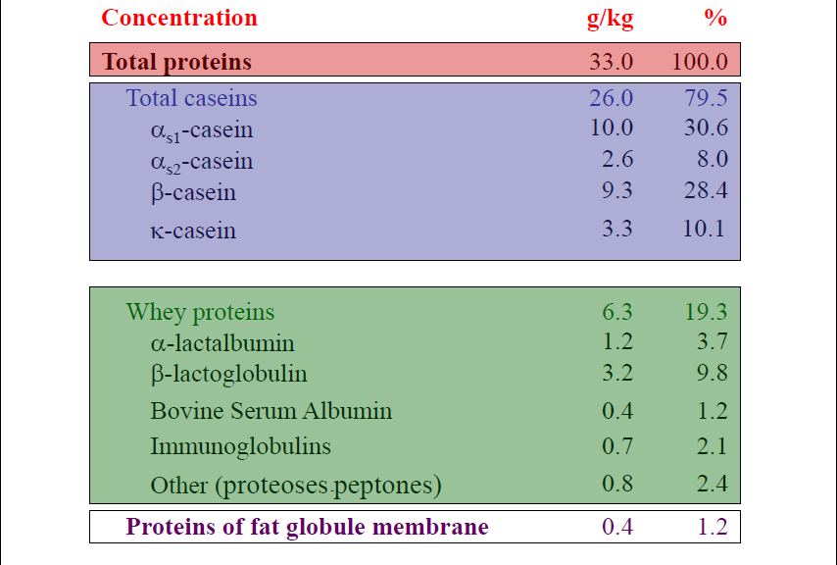
Milk proteins concentration

Slide 8
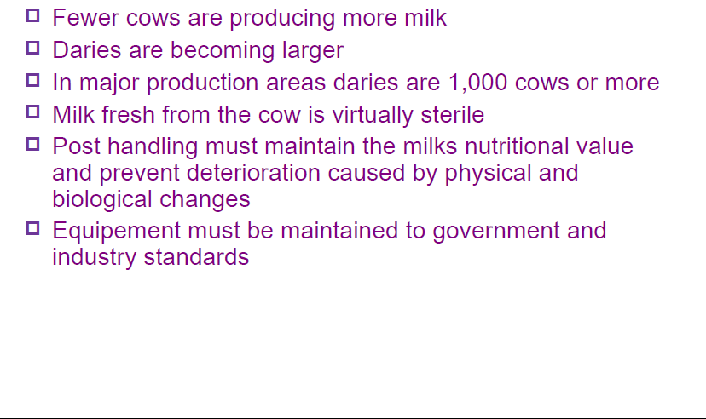
Production practices

Slide 9
Production practices

Slide 11
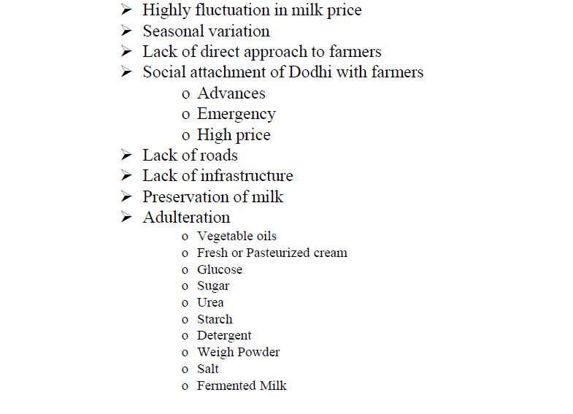
Problems related to milk processing

Slide 12
processing

Slide 13
pasteurizating

Slide 14
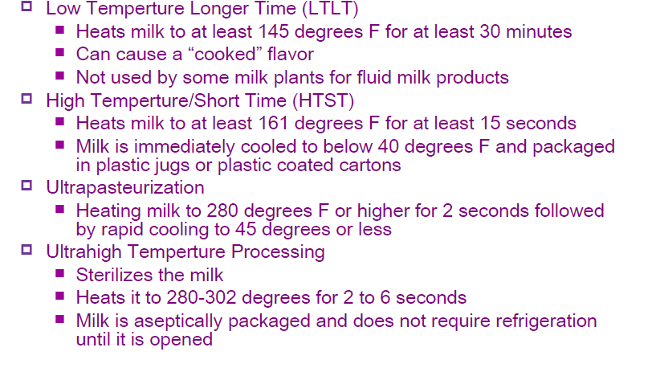
pasteurizing

Slide 15
butterfat

Slide 16
Butterfat: cream

Slide 17
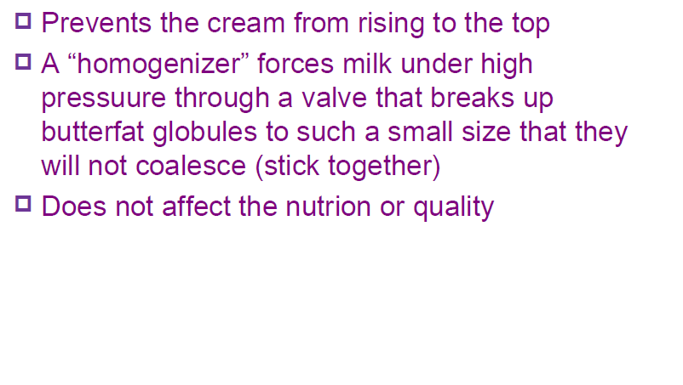
homogenization

Slide 18
Beverage milk

Slide 19
Nutritional qualities

Slide 20
Packaging

Slide 22
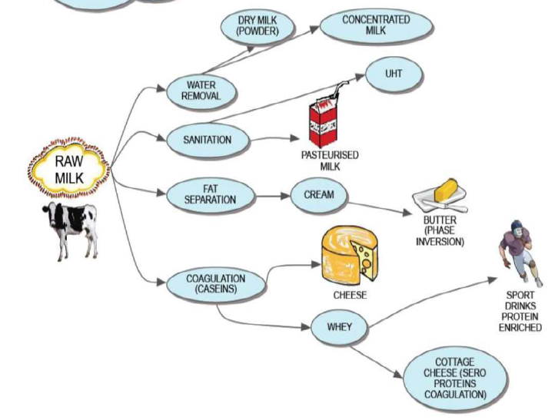

Slide 23
Milk products and by-products

Slide 24
Butter make up

Slide 26
Making butter

Slide 27
Concentrated and dried dairy products

Slide 28
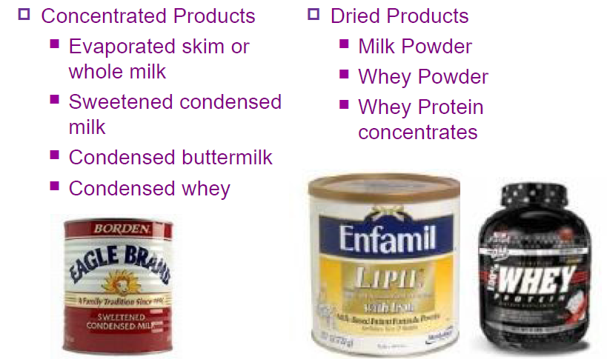
Concentrated and dried dairy products

Slide 29
cheese

Slide 30
Cheese making steps

Slide 31
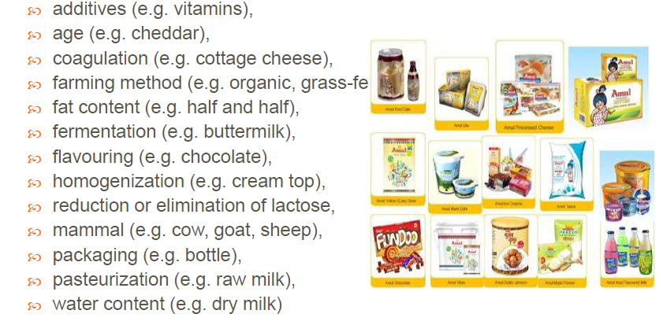
Classification of milk products

