Slide 2
Ergonomics for Children and Youth in the Educational Environment
DR.AYESHA

Slide 3
Two types of environment affects the children and youth.

Slide 4
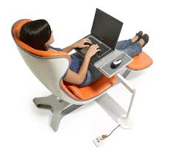
Computer Environment
Electronic media use by children has increased over the past 15 years.
American Youth in 1990 only one in 50 kids used a computer outside of class for 10 or more hours during An year,
with significant classroom computer use defined as more than 10times per subject in the school year.

Slide 5
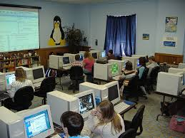
Computer environment
The most recent statistics in United States through the Current Population Survey of 56,000 households, representing 29,000 children aged 3 to 18 use computer.
These telephone interview data, reported by adult household members, indicate that 80% of kindergartners (5 years old) use computers;
by sixth grade (11 years old) almost all U.S. students use computers at home, school, or work.

Slide 6
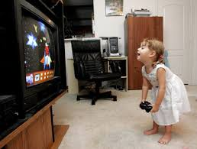
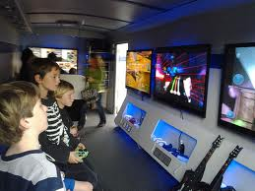
Daily use time. The average U.S. child used a computer for 34 minutes/day, the Internet for 14 minutes, and a video game for 33 minutes.
In one Australian study of notebook use, average daily use was 3.2 hours; the highest total daily use reported was 15 hours, with mean longest single period of use of 102 minutes.
Electronic or video game use is also frequent and common.
QUESTION…. whether the extensive time children spend on computers affects their health.
If it does, can the furniture and equipment they use be adjusted to their needs, or should access other activity to keep them safer?
Notes:
The question is whether the extensive time children spend on computers affects thaeir health. If it does, can the furniture and equipment they use be adjusted to their needs, or should access or other activity be adjusted to keep them safer?

Slide 7
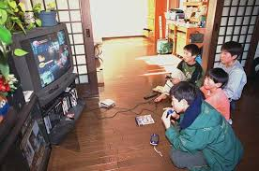
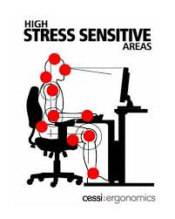
Continue………………..
children working with computers in awkward postures are considered risk factors for the musculoskeletal system.
The students reported that at home they are mostly sitting on the floor, lying prone, or sitting in a beanbag chair.
At school the postures were mostly sitting at a desk or lying on the floor.
The association between musculoskeletal discomfort and computer use is that the pain could be made worse by computer use.

Slide 8
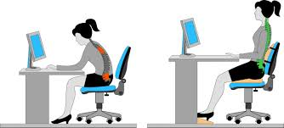
Another concern about computer use is the environmental setting, and the way the workstation is arranged and fits the user.
Increased awareness of proper positioning, proper computer workstation arrangement, and changes in work habits such as taking stretch breaks may assist
Notes:
The researchers concluded that increased awareness of proper positioning, proper computer workstation arrangement, and changes in work habits such as taking stretch breaks may assist in decreasing the degree and frequency of reported musculoskeletal discomfort and pain in children.

Slide 9
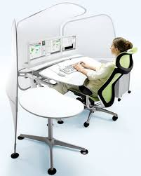

Slide 10
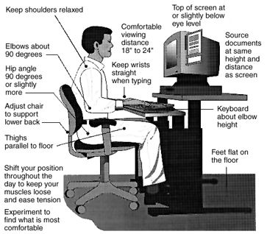
Good workstation setting

Slide 12
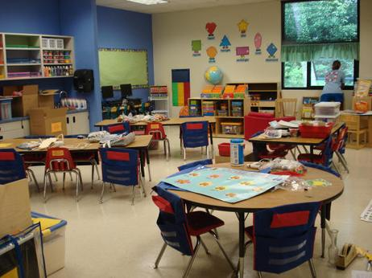
Classroom Environment
In the classroom, students do different activities……
Performance of these activities affects how children sit (e.g., writing vs. copying from the board).
Notes:
much of their work while sitting—listening to the teacher, looking at the blackboard, copying from the blackboard or free writing, doing group work, and more.

Slide 13
Continue ………………………………..
children vary in size, over the years and within the same ages,
Mismatch furniture and body size.
Ergonomic research concluded:
furniture size and design in back pain and other symptoms in children should be organized according to size not age.

Slide 14
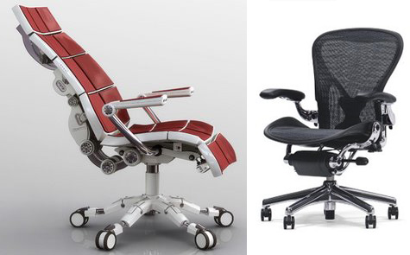
Continue ………………………………..
For Good posture in sitting…..
Furniture design……
chair be at least one third the height of the person using it and the desk at least one half the height of the person using it.
Ergonomic chair features……………..
Decreased muscle activities will result in less fatigue and stress on the spine.
Notes:
Good posture in sitting is important in the prevention of back strain in children and adults, but this is hard to achieve without the support of adjusted chairs and tables.

Slide 15
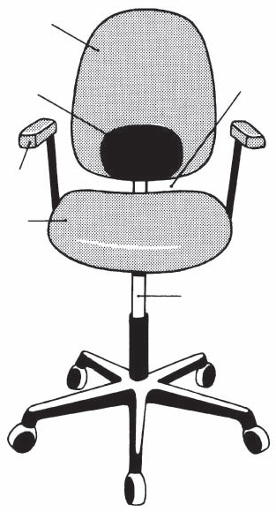
Seat pan
Height 15"-22" (range adjustable)
Width 17"-19"
Slope 0-7° (range of adjustability)
Contour Waterfall front Backrest
Height 6"-20"
Width 13"-14"
Lumbar support 4"-10"*
Up/down 7"-10"*
In/out (forward) 12"-17"*
Angle Seat pan/back 90-105°
Armrest
Height 7"-11"*
Length 6"-10"
Width 2" minimum
Support, Five star base
Angle between
seat pan and
backrest
Backrest
Lumbar
support
Armrest
Seat pan
Seat height
[Chaffin et al., 1999]

Slide 16
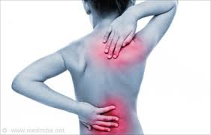
QUESTIONS TO ASK ABOUT THE SEATED LEARNING ENVIRONMENT
Questions for the Clinician
Computer work is associated with
upper back and shoulder pain:
related to raising the arms
to reach a keyboard or mouse,
Back pain: extended sitting,
Hand, wrist, and forearm disorders::::use of
the hand while rotated using mouse or key board
For Assessment risks: ask whether and where the individual has pain, discomfort, or numbness.

Slide 17
Continue………………….
The type and location of the symptoms can indicate which aspect of the environment causing the problem in children.
If a child has neck symptoms, monitor height must be assessed & seated demands, such as twisting to see the board.
If shoulder or upper back symptoms, the height of the writing surface or keyboard placement could be the cause.
shoulder symptoms, along with those in the forearm, wrist, or hand, could indicate a problem with the distance or angle of the surface or computer control devices.(mouse etc)
Back pain: chair and table mismatch, to inadequate back or foot support.
Notes:
MOUSE::How far the mouse is from the side of the user and the angle in which the keyboard or mouse places the hands, and how strongly the child holds the mouse or hits the keys will need to be assessed.

Slide 18
Suggestions:
Researchers involved in ergonomics with children and youth have suggested following:
Collect anthropometric data, and apply them to furniture…..
Conduct epidemiologic studies,.. effect of various learning environments and workstations on children’s health.
Explore ergonomic issues and risk factors for MSDs in children.
Guidelines for manufacturers.
Provide education school staff and parents in ergonomic principles and their relevance to furniture and work habits…

Slide 19
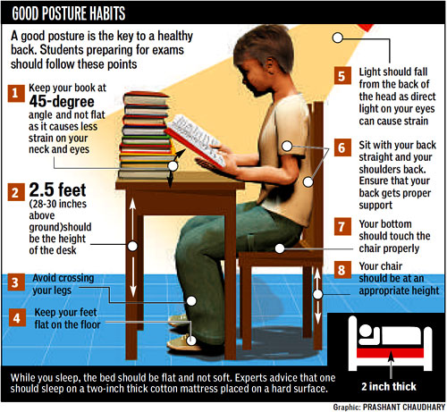

Slide 20
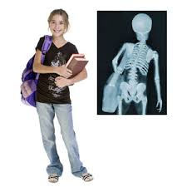
Musculoskeletal Symptoms and Complaints
References to children’s schoolbags, The American Occupational Therapy Association (AOTA), The American Physical Therapy Association (APTA) revealed a wide range of symptoms and complaints associated with backpacks.
Children report discomfort, aches, and pain in their neck, shoulders, and back.
Muscle weakness, tingling in the arms, stooped posture, and headaches have also been reported as associated with carrying a heavy schoolbag.

Slide 21
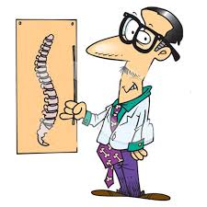
Main Concerns and Causes for the Complaints
Earlier recommendations for backpack limit weight to 10% to 15% of body weigh. But carried an average of 22% of their body weight.
There is significantly increased flexion of the trunk in relation to the pelvis and extension of the head in relation to the trunk, as well as increased anteroposterior range of COP.

Slide 22
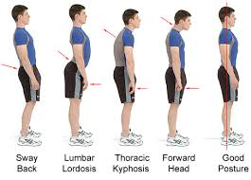
short run effects;(fatigue, irritation, injury) long-term:: postural deformities on the spine. (kyphotic, lordotic, scoliosis & Forward head deformity) affect balance in anteroposterior & medio-lateral direction,

Slide 23
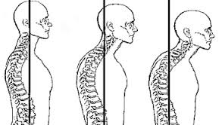
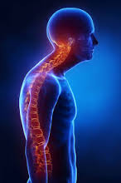
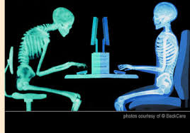

Slide 24
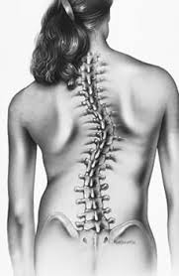
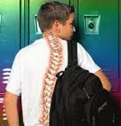
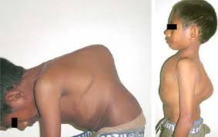

Slide 25
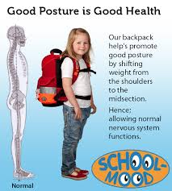
Continue…………………
The way the backpack is worn and its impact on posture reported a correlation between positioning of the bag and the posture.
Positioning the bag higher has largest negative effect on posture, & development of the spine.
Positioning the bag on the lower spine, close to the body’s center of gravity, has the least effect on posture.

Slide 26
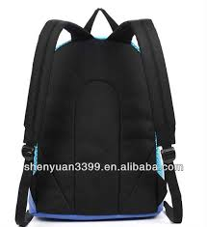
Controls
engineering, administrative, and work practice controls.
1::::::Engineering controls , are “changes to the workstation, equipment or tools” . Engineering controls are the preferred method of control,
In the case of schoolbags, the design, size, and weight of the bags themselves are engineering controls.
On examination of the schoolbag design, three components: the back of the bag, the straps, and the handles.
The back of the bag should be firm and padded……The level of the bag should be adjusted to the child’s back.

Slide 27
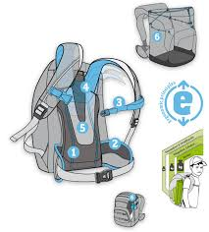
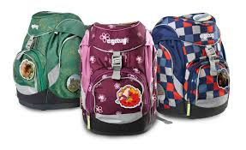
Continue………………
The straps should be padded and adjustable.
The bag handles should be smooth and comfortable for handling, without any rough edges or sharp angles.
The bag size is another element of the engineering controls.
Bag size: height: 40 ± 2 cm
width 29 ± 1 cm
The straps should be 30 mm (1.4 in) wide or more. Lightweight materials are preferred.
If there is a waist or hip belt, it should be at least 50 mm (2 in) wide..

Slide 28
Continue………………….
2:::::Administrative controls :
Reduce duration, frequency, and severity of exposure.
Requires collaboration between teachers and students.
Controlling the weight of the bag’s contents is the most obvious administrative control.
Rather than carrying large books every day, it is recommended that books and files be organized not as one unit but in subunits.
Using this approach, children will carry only what they need for that particular day.

Slide 29
Continue…………………….
Homework should be given in separate sheets, so students will bring only the papers they need.
Having books and assignments on computer disks or using websites and e-mail can reduce excess weight.
Other solutions as using drawers and lockers that will allow students to leave part of their school books, equipment, or tools at school. or
children is having two sets of books: one for home & one for school…

Slide 30
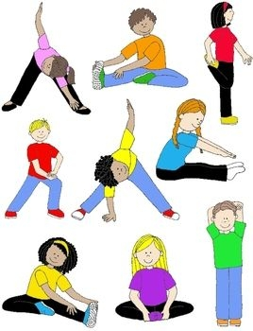
Work practice controls are (1) safe and proper work techniques and (2) fitness and flexibility.
Adequate physical activity to maintain cardiovascular and musculoskeletal strength is also important. …
Finally, educating parents, school administrators, and teachers is essential in reducing overuse syndrome caused by carrying schoolbags.

Slide 31
ERGONOMICS OF AGING

Slide 32
Introduction
The World Health Organization considers the age of 65 years to be the beginning of old age in developed countries and 60 years in developing countries
In the past, many countries imposed mandatory retirement and forced early retirement onto workers.
Thus, the knowledge base on preparing aging-friendly workplace environments is not extensive

Slide 33
Shift /change in aging criteria
Aging theories can guide therapists in planning ergonomic interventions and in creating workplaces congruent with the needs of older workers
In Canada: chronologically defined age categories often used are young-old (ages 65 to 74 years), old (75 to 84 years), and very-old (85 years and older)
These three categories define old age and place labels on the process of senescence

Slide 34
To define aging chronologically is more a convenience for political governance than it is an accurate prediction of functional ability to participate in productive work
The population aged 65 years or older in the early twenty-first century totals nearly 4 million
Maintain an injury-free, productive work environment

Slide 35
Biologic And Physiologic Theories Of Aging
There are over 70 biologic and physiologic theories of aging.
Many of these theories can be categorized into major factors responsible for decline during the aging process, such as genetic mutation or decline in cellular function through wear and tear and/or accumulation of waste

Slide 36
Biologic and physiologic levels, resulting in age-related changes
(e.g. osteoarthritis, Chondromalacia, graying of hair, reduced elasticity of skin, rigidity of the arteries, decline in kidney function, opacification of the lens of the eye, and decline in oxygen uptake and delivery of oxygen throughout the body, among others)

Slide 37
Biologic theories are linked with physiologic theories of aging through physical signs of aging.
wrinkles are the manifestation of collagen cross-linkage,
Decreased endurance is the partial result of decreased oxygen uptake, and cellular changes in metabolism
joint stiffness, and arthritis are thought to be partially a result of insulin and autoimmunity disorders.

Slide 38
Several important functional changes associated with age
These include:
Decreased strength
Decline in timed respiratory measures
Increased brittleness of bones
Increased stiffness of tendons, ligaments, and muscles
Reduced vision, and reduced hearing.

Slide 39
Biologic/ physiologic theories of aging
Antagonistic pleiotropy theory
Waste accumulation theory
Free radical damage
Insulin resistance
Advanced glycation (AGE)
Telomeres and Hayflick
The error catastrophe theory
Autoimmunity
Circadian deregulation
Evolutionary theory

Slide 40
Preparing for Changes Related to the Effects of Aging
Vision changes
Hearing changes
Skin changes
Muscle changes
Endocrine changes
Immune system changes

Slide 41
PSYCHOLOGIC THEORIES OF AGING
Functional ability and participation in productive work are directly affected by psychologic factors.
To date, psychologic theories of aging have focused mainly on postretirement ages.
Little is known about preretirement aging, with the possible exception of personality development.

Slide 42
Individuals who are motivated and active are more likely to be able to adapt and continue to participate in productive work and consequently are less likely to retire prematurely

Slide 43
Psychologic theories of aging
Longevity theory
Productivity theory
Adaptive capacity theory
Disengagement theory
Activity theory
Continuity theory

Slide 44
Psychologic theories of aging direct ergonomists and therapists to consider the older worker’s self-efficacy and personal views relevant to his or her level of activity and engagement in safe and productive work
Older workers who lack or begin to lose confidence in their ability to continue to be physically active at work may be at risk for an injury
Some older workers may be somewhat overenthusiastic in taking on new job demands and tasks, inadvertently placing them at risk for injury

Slide 45
SOCIOLOGIC THEORIES OF AGING
Sociologists have approached the study of aging and work performance through investigations of social structures such as gender, race and ethnicity, life course research, and reexamination of the concepts of ambivalence

Slide 46
Sociologic theories of aging
Age stratification
Aging and society paradigm
Political economy of aging
Ambivalence

Slide 47
ISSUES IN AGING ERGONOMICS
Issue 1: Employer Ambivalence
Issue 2: Employee Ambivalence
Issue 3: Workplace Readiness for Change
Issue 4: Physical Job Demands That Are Occasionally Untenable for Older Employees

Slide 48
Ergonomics in Disability Management
Accident prevention and disability management (DM) in the workplace are everyone’s responsibility and succeed only when there is continuous support, commitment, and a willingness to change from the employer and employees.
Creating and nurturing a culture of safety requires the employer and upper management to understand and provide the necessary financial, human, and time resources for processes to succeed

Slide 49
DISABILITY MANAGEMENT
Typically, DM is associated with the handling of workers with an injury, once an injury has been reported.
DM has been defined as the process of minimizing the impact of an impairment (resulting from work-related and non–work-related injury, illness, or disease) on a worker’s ability and capacity to engage in competitive employment

Slide 50
However, part of managing injuries is preventing them.
Rather than separating injury prevention strategies from DM, we have chosen to consider DM as part of the whole process.
Within a DM program, the use of both Macroergonomics and Microergonomics is essential

Slide 51
MACROERGONOMICS
Macroergonomics refers to employer- and upper management–directed, global, large-scale organizational solutions to ergonomic problems that, when successful, result in the existence of an effective culture of health and safety throughout the organization

Slide 52
PARTICIPATORY ERGONOMICS
The success of PE can be attributed to the involvement of workers in the entire process—from identifying the risks and hazards, to recommending solutions, to implementing the solutions and evaluating the outcomes
The therapist, as an ergonomic consultant, is not seen as the expert but rather acts as a reflective facilitator or advisor, once the team is educated on the basics of ergonomics with the employees taking the role of expert.

Slide 53
Using Participatory Ergonomics in the Workplace
It is less expensive for employers to prevent an injury than it is to make changes and corrections after an injury has occurred.
Often, making straightforward and basic ergonomic changes can reduce MSD risks significantly.
This proactive ergonomic approach has proven effective when PE is implemented.
Proactive ergonomics refers to the process of applying ergonomics in the early stages of developing work processes and tasks to avoid injuries and potentially expensive retrofitting of lines or equipment.
This forms an essential primary prevention strategy

Slide 54
RETURN TO WORK
Successful return to work depends on
(1) early injury reporting,
(2) injury intervention,
(3) continuous contact and communication among the worker, employer, and health care providers
(4) a management team and workforce educated in the importance of early and safe return to work, provision of ergonomic modifications to worksites, and specific and meaningful DM policies and procedures

Slide 55
A Written Return-to-Work Policy
Maintaining “Occupational Bond”
Job Descriptions and Physical Demands Analysis
Early Communication Between the Health Care Team and the Workplace
Creating a Return-to-Work Team
Training of the Supervisors and Employees
Offering Accommodation and Transitional Duty
Performing Ergonomic Visits (Job Coaching)
Applying Secondary and Tertiary Prevention Strategies
Evaluating the Results of the Program

Slide 56
Ergonomics of Play and Leisure

Slide 57
Ergonomics to leisure, recreation, and activities of choice
Home computers
Golfers and other athletes
Gardeners
Quilters

Slide 58
The field of kinesiology provides extensive research and information about a number of sports and activities
Performance analysis
Kinesiology combined with sports medicine also provides valuable information about the number and types of injuries associated with a variety of sports to facilitate injury prevention measures and improved treatment.

Slide 59
Gardening , quilting, and golf
These activities were selected because of their popularity and the variety of tasks involved in each activity
Quilting was chosen to represent a generally sedentary activity involving a creative process
Gardening also involves a creative process but is more physically demanding
Similar activities might include woodworking, home repair, and pottery
competitive factor in golf

Slide 60
Risk Factors For Leisure Occupations
Risk factors are associated with many leisure activities, and much of the information about the risks comes from the study of persons who engage in the performance, arts, or sports industries as professionals
There is an increase in knowledge related to ergonomics as well as an increase in the number of ergonomic products available to the general public

Slide 61
Injuries of the back and the effects of cumulative trauma and repetitive strain are most typically reported in the work environment
There are several risk factors not typically encountered in the office and work environment that may be seen in sports and leisure activities
Some leisure-time activities such as hunting, backpacking, biking, rock climbing, boating, and other challenging leisure time pursuits can generate outcomes such as ocular injuries, head injuries, injuries from lightning strikes, and even death
Gardening, photography, ceramics, and other creative outlets have resulted in health conditions and illnesses related to environmental toxins

Slide 62
Participation And Demographics
Quilting:
Quilting in America, 16.27 million households (15% of the population) have someone who participates in quilting as a hobby or a profession.
The average quilter is female and 55 to 65 years of age
Quilters report an average of 11.5 hours per week of involvement in a quilting-related task

Slide 63
Gardening
Gardening continues to be a popular activity for pleasure and leisure.
The European Commission reports 107 million gardens or garden allotments across the European Union, which includes 10 European countries.
The report further indicates that Europeans spend an average of 10 minutes per day in gardening tasks
The same survey identifies several categories of people who garden, including master gardeners, garden enthusiasts, casual gardeners, reluctant gardeners, and “just cut the grass” gardeners, indicating that there is a wide variety of participation levels in gardening

Slide 64
Golfing
There are approximately 27 million golfers in the United States, Of those 27 million golfers, 73% are male and 27% are female
Variable data

Slide 65
Common Injuries
It is important for therapists to be aware of the patterns of musculoskeletal injuries associated with various leisure activities so problems can be avoided or corrected.
In addition, it is important to understand the relationship between the work activities and the leisure activities

Slide 66
Quilting
Garment industry workers have shown that extensive time spent sewing or using poor positioning leaning forward over the sewing machine leads to musculoskeletal disorders, especially in the neck, shoulders, elbows, and hands.
Comparable problems are seen in quilters.
Quilters report discomfort and pain in the neck, shoulders, and back

Slide 67
Repetitive stress disorders, specifically carpal tunnel syndrome, tendonitis, deQuervain’s syndrome, and epicondylitis, especially when awkward positions of the body and extremities are used in the tasks
eyestrain can occur when vision is needed for a prolonged period of time in an unsuitably lighted working environment
eye soreness or fatigue, headache, blurred vision, double vision, and dry, itching, burning, or irritated eyes

Slide 68
Gardening
Surprisingly, there is very little information about injury rates among gardeners
Relatively low risk of injury in gardening and other low- to moderate-intensity activities such as home repair, hunting and fishing, swimming, and walking.
However, because of the high participation rate, the absolute number of injuries is high

Slide 69
Golfing
Common injuries seen in golfers can result from repetitive overuse, poor body mechanics, or trauma
Common injuries in the amateur golf population include low back, hand and wrist, elbow, and shoulder injuries, as well as injuries of the knee

Slide 70
Postures And Positioning
Quilting:
In quilting, there are three basic positions that can be considered: sitting at a sewing machine, standing at a cutting table or ironing board, and sitting to quilt by hand

Slide 71
Modifying the relationship between the worker and the surface that is used for cutting or ironing can alleviate back, shoulder, and neck discomforts.
By raising the work surface or lowering the worker, the task can be brought into the easy reach area, and a more effective and efficient work area can be created

Slide 72
Gardening
Gardeners use a wide range of postures and position in the multiple and varied tasks involved in gardening

Slide 73
Golfing
Body positioning, posture, and body mechanics are especially important in athletics because body position can directly affect performance as measured by accuracy, speed, or distance and therefore affect the outcome of the athletic event.
Poor body position or technique in athletics such as running, swimming, golf, baseball, and so on, can hinder performance, directly affect the outcome, and lead to injuries

Slide 74
In golf, during the set-up phase, the preferred position is to have 50% to 60% of the body weight on the back foot.
The knees are flexed approximately 20 to 25 degrees, the trunk is flexed forward at the hips 40 to 50 degrees, and the back is straight in a neutral position.
This position creates an axis of rotation at the hips
If the back is rounded there is less rotation from the hips and more rotation from the lower back, resulting in back injuries.
This is the basic position for golf swings, whether a drive or a putt

Slide 77
TOOL USE
Many leisure activities and sports require the use of specialized tools and equipment.
As seen in the work environment, proper fitting and use of tools can make the difference between comfort and discomfort or injury in leisure pursuits.

Slide 78
Quilters and other crafters have available a wide range of tools that can make a particular task easier and more efficient.
Examples of tools that have been modified in the quilting arena to improve comfort and skill in quilting include the invention of such things as the rotary cutter for cutting multiple pieces quickly and easily
Spring loaded scissors that open with a spring, making the use of scissors less resistive

Slide 79
Quilting gloves that are soft and breathable and have a slip-resistant grip on the palm used when machine quilting to control the quilt with increased ease
Tools should be lightweight, have a non slip handle, and fit the user’s hand.
Cutting tools such as garden pruners and clippers be kept sharp and free of rust or corrosion.

Slide 80
National Institute for Occupational Safety and Health (NIOSH) suggests that the use of the term “ergonomic” in defining tools can be misleading.
Padding the grip and curving a handle is not enough to make a tool ergonomic.
NIOSH recommends that for a tool to be ergonomic it needs to fit both the user and the task being performed without creating awkward postures, harmful contact pressures, or other safety and health risks

Slide 82
EVALUATION
Information about the assessment or evaluation of the ergonomic concerns of persons engaged in leisure activities is limited.
Assessment should include three components: physical performance measures, interview, and observation.
Formal testing of physical performance, such as tests of strength and range of motion, may be useful but does not address the concerns of the person in the context of the activity.

Slide 83
Furthermore, it is important to consider the person’s participation in other daily activities and routines.
A thorough interview that includes the client’s daily routine and habits helps identify problem areas.
Clinical observation of the person engaged in the leisure activity provides the best information for the individual.
If possible, an on-site assessment using the principles from work-site assessments also provides valuable information about the factors leading to the injuries or discomforts experienced by the participant.

Slide 84
Conclusion
Leisure activities are an important part of people’s lives.
People today have a myriad of crafts, sports, and leisure activities from which to choose.
Participation in leisure activities ranges from sedentary to very physically active, from casual engagement to intense involvement.
The Ergonomic Society indicates that people involved in leisure activities have a very wide range of capabilities and limitations (including people with disabilities and the elderly); therefore, human variability is greatest in leisure activities.
Ergonomics Society suggests that a key ingredient in ergonomics is the understanding of the participant.

Slide 85
Considering and understanding the individual’s engagement in leisure activities should be part of the evaluation and treatment of ergonomic concerns.

Slide 86
The End

Slide 87
The End

Slide 88
THANKS

