Slide 1
Holt’s Trend Corrected Exponential Smoothing Muhammad Wasim Amir

Slide 2
Holt’s Trend Corrected Exponential Smoothing
If a time series is increasing or decreasing approximately at a fixed rate, then it may be described by the LINEAR TREND model
If the values of the parameters β₀ and β₁ are slowly changing over time, Holt’s trend corrected exponential smoothing method can be applied to the time series observations.
Note: When neither β₀ nor β₁ is changing over time, regression can be used to forecast future values of y_{t}.
Level (or mean) at time T: β₀ + β₁T
Growth rate (or trend): β₁

Slide 3
Holt’s Trend Corrected Exponential Smoothing
A smoothing approach for forecasting such a time series that employs two smoothing constants, denoted by α and γ.
There are two estimates ℓ_{T-1} and b_{T-1}.
ℓ_{T-1} is the estimate of the level of the time series constructed in time period T–1 (This is usually called the permanent component).
b_{T-1} is the estimate of the growth rate of the time series constructed in time period T–1 (This is usually called the trend component).

Slide 4
Holt’s Trend Corrected Exponential Smoothing
Level estimate
Trend estimate
where α = smoothing constant for the level (0 ≤ α ≤ 1)
γ = smoothing constant for the trend (0 ≤ γ ≤ 1)

Slide 5
Holt’s Trend Corrected Exponential Smoothing
Point forecast made at time T for y_{T+p}
MSE and the standard error s at time T

Slide 6
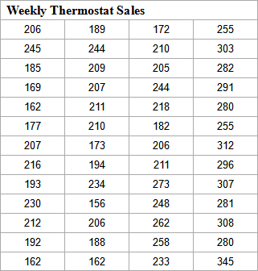
Procedures of Holt’s Trend Corrected Exponential Smoothing
Use the example of Thermostat Sales as an illustration

Slide 7
Procedures of Holt’s Trend Corrected Exponential Smoothing
Findings:
Overall an upward trend
The growth rate has been changing over the 52-week period
There is no seasonal pattern
⇒ Holt’s trend corrected exponential smoothing method can be applied

Slide 8
Procedures of Holt’s Trend Corrected Exponential Smoothing
Step 1: Obtain initial estimates ℓ₀ and b₀ by fitting a least squares trend line to HALF of the historical data.
y-intercept = ℓ₀; slope = b₀

Slide 9
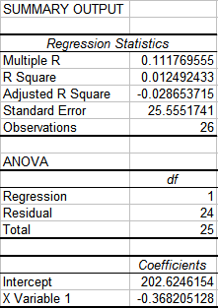
Procedures of Holt’s Trend Corrected Exponential Smoothing
Example
Fit a least squares trend line
to the first 26 observations
Trend line
ℓ₀ = 202.6246; b₀ = – 0.3682
Simple Regression

Slide 10
Procedures of Holt’s Trend Corrected Exponential Smoothing
Step 2: Calculate a point forecast of y₁ from time 0
Example

Slide 11
Procedures of Holt’s Trend Corrected Exponential Smoothing
Step 3: Update the estimates ℓ_{T} and b_{T} by using some predetermined values of smoothing constants.
Example: let α = 0.2 and γ = 0.1

Slide 12
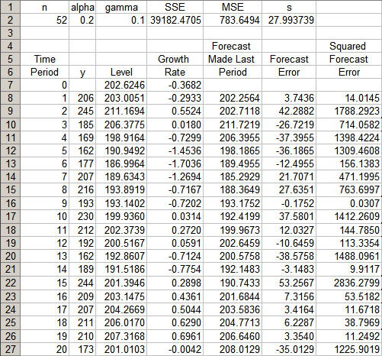
…… ……

Slide 13
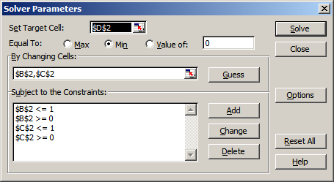
Procedures of Holt’s Trend Corrected Exponential Smoothing
Step 4: Find the best combination of α and γ that minimizes SSE (or MSE)
Example: Use Solver in Excel as an illustration
SSE
alpha
gamma

Slide 14
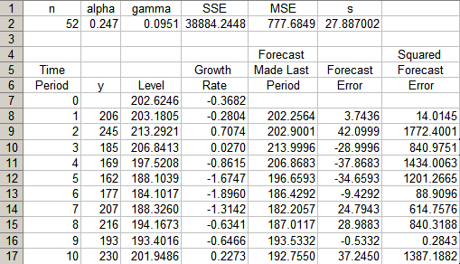
…… ……

Slide 15
Holt’s Trend Corrected Exponential Smoothing
p-step-ahead forecast made at time T
Example
- In period 52, the one-period-ahead sales forecast for period 53 is
In period 52, the three-period-ahead sales forecast for period 55 is

Slide 16
Holt’s Trend Corrected Exponential Smoothing
Example
If we observe y₅₃ = 330, we can either find a new set of (optimal) α and γ that minimize the SSE for 53 periods, or
we can simply revise the estimate for the level and growth rate and recalculate the forecasts as follows:

