Slide 1
How to draw Facial features and Portrait
Andleeb Rana

Slide 2
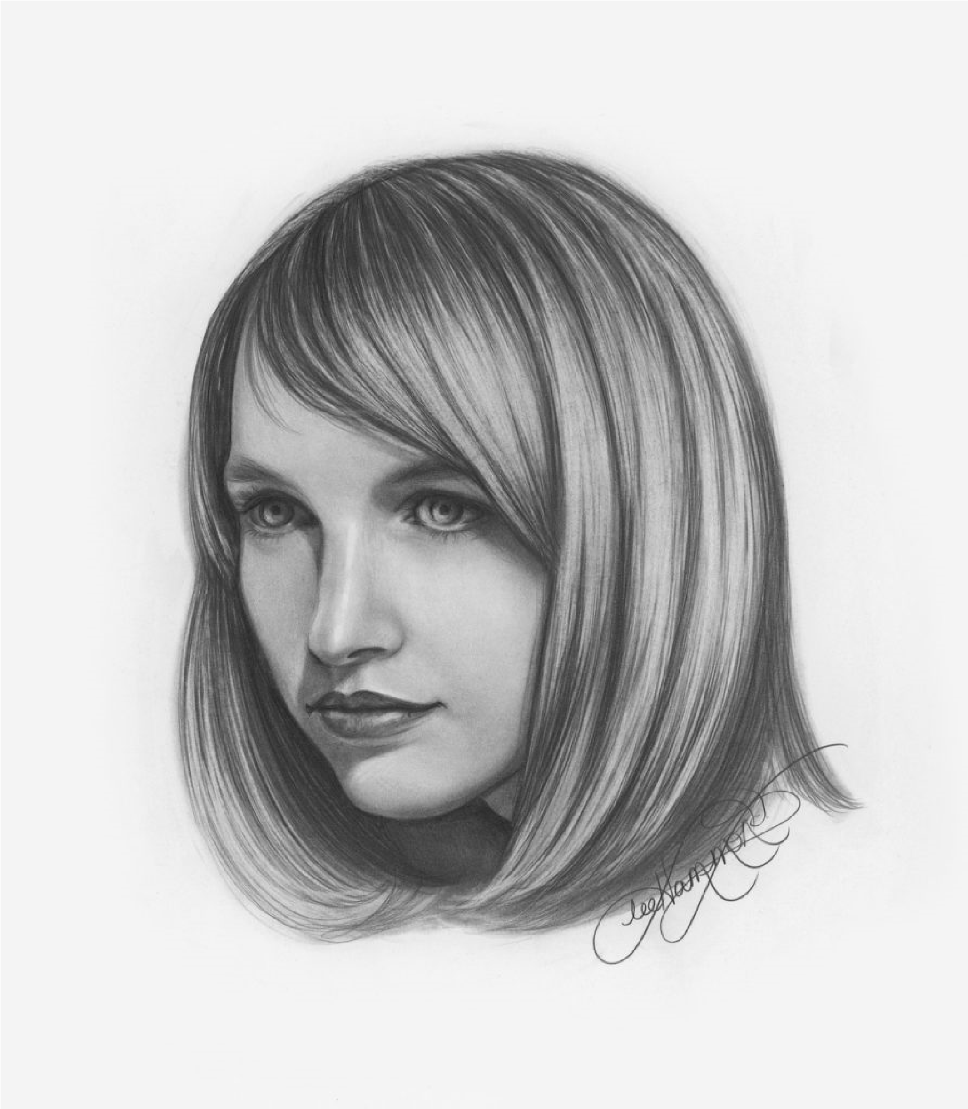
If you want to draw lifelike portraiture, knowing how to draw facial features is essential.
You will learn how to recreate every aspect of your model’s face: the eyes, nose, cheeks, and mouth.

Slide 3
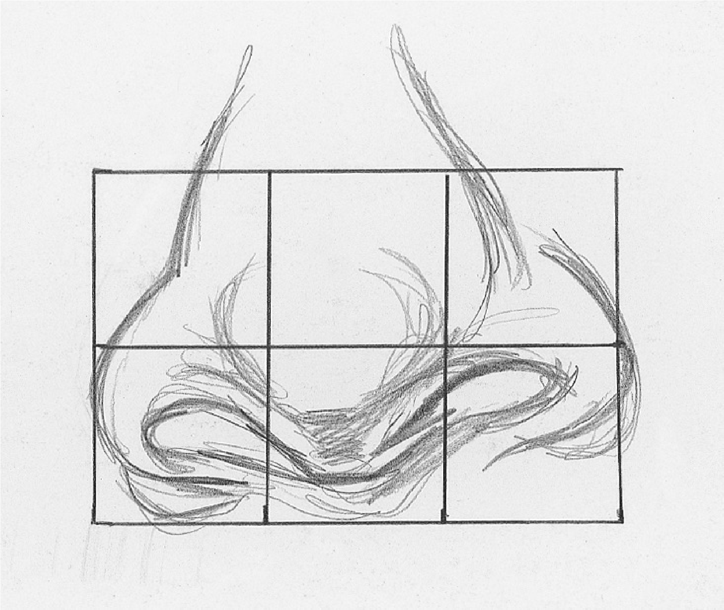
before you can draw an entire face, you must first learn to draw each of the facial features individually.
Use the grid method and a mechanical pencil to create a line drawing of a nose

Slide 4
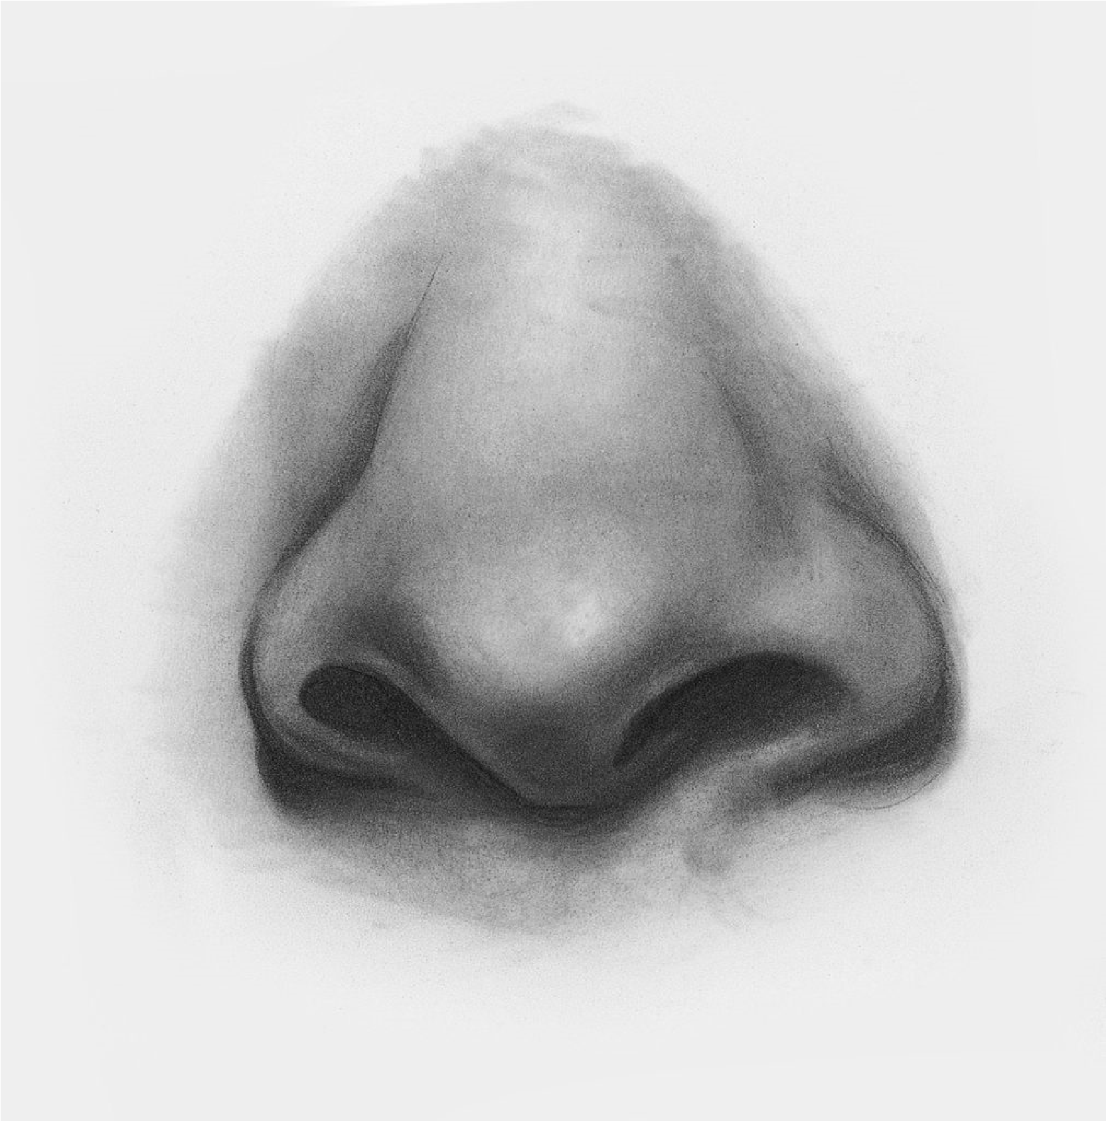
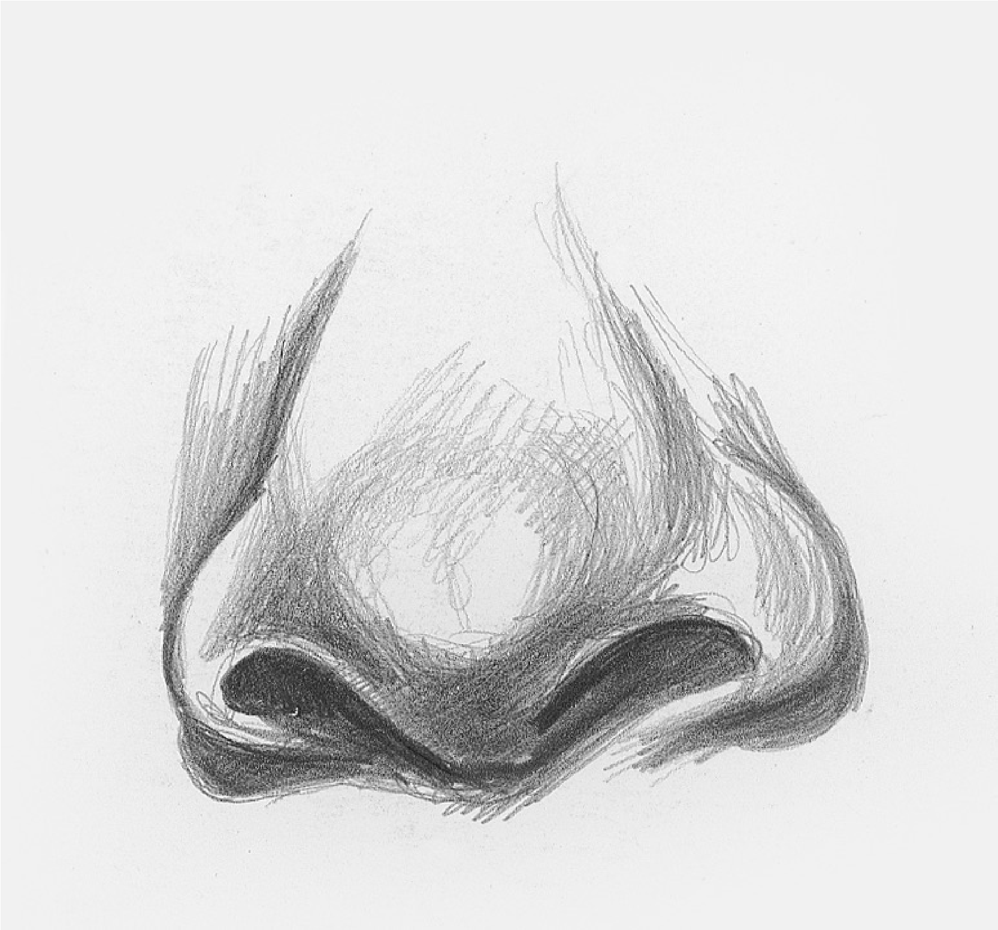
Develop the Lights and Darks
Blend

Slide 5
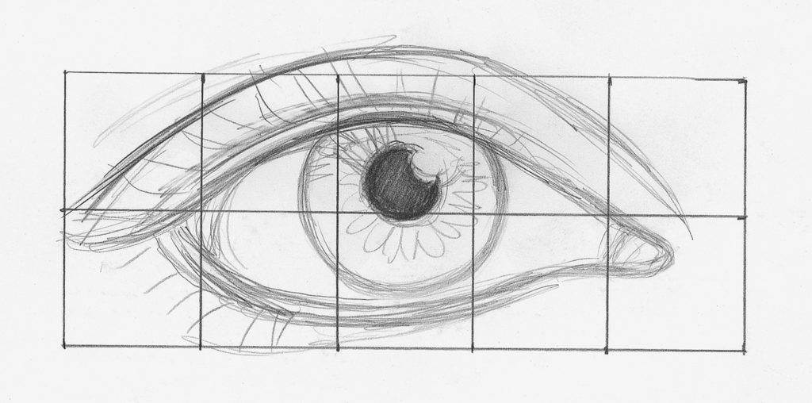
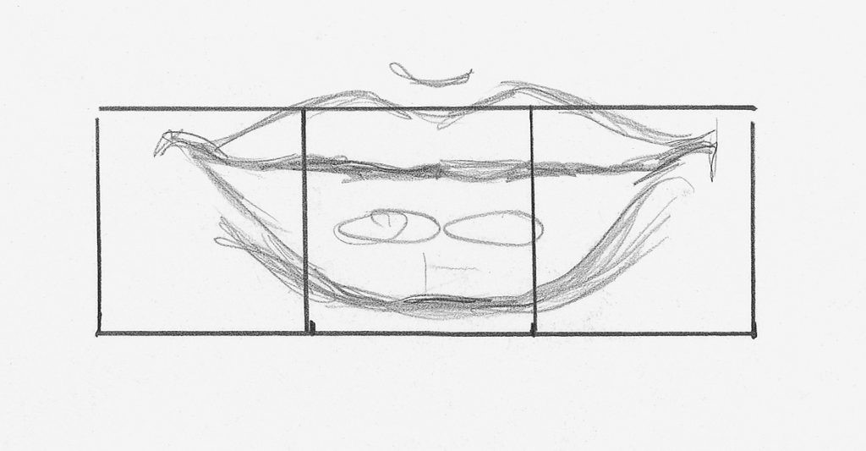
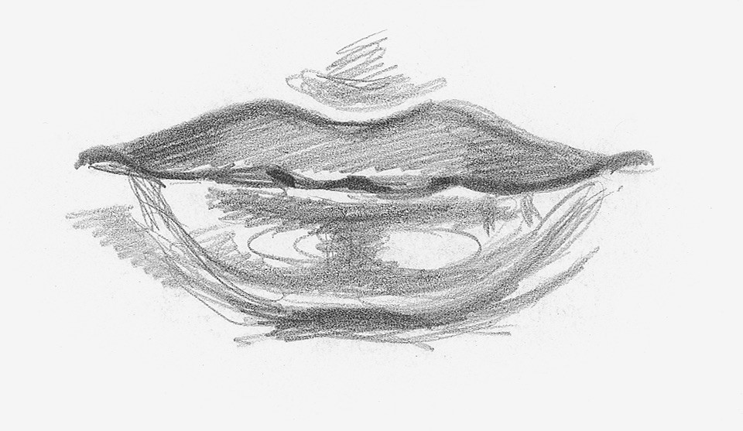
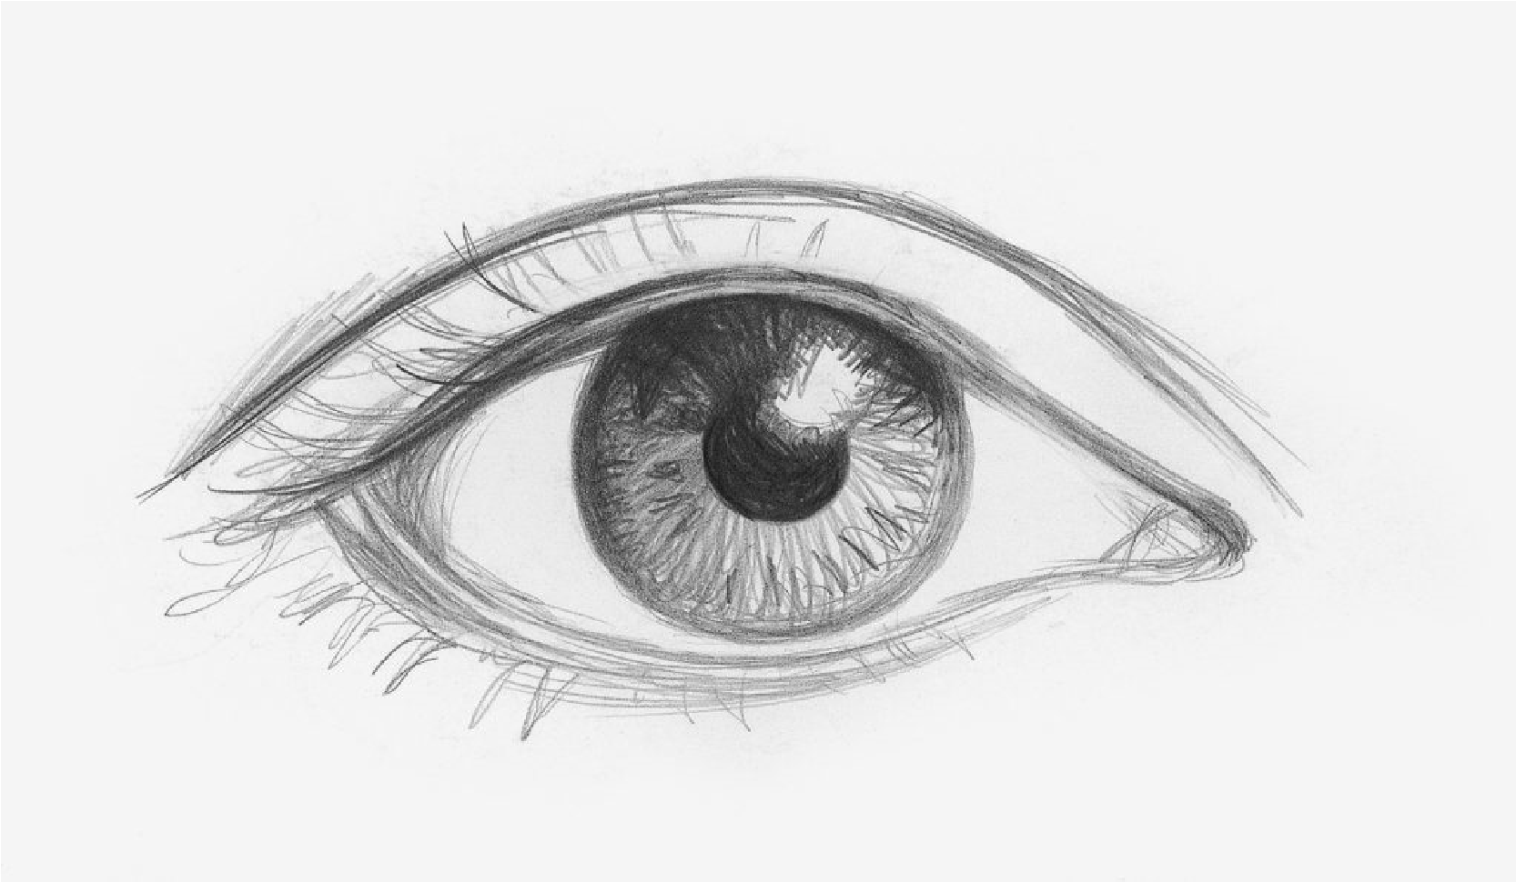
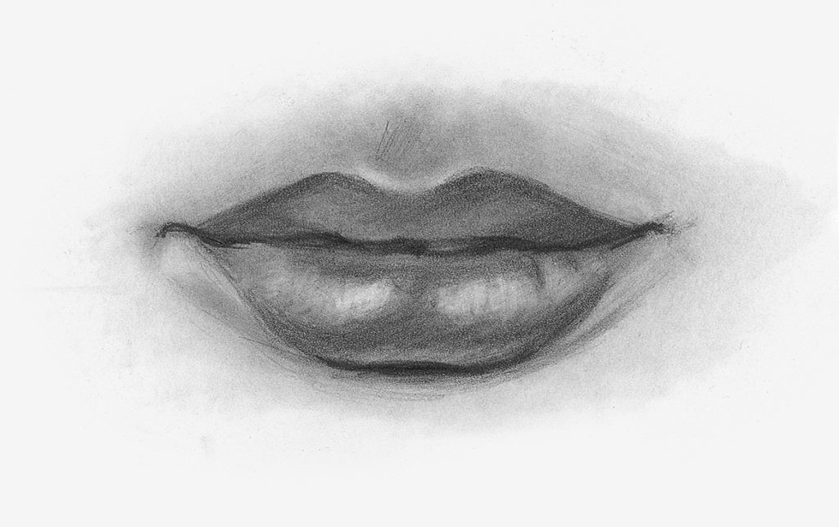
Repeat same procedure to draw ear, mouth and ears

Slide 6
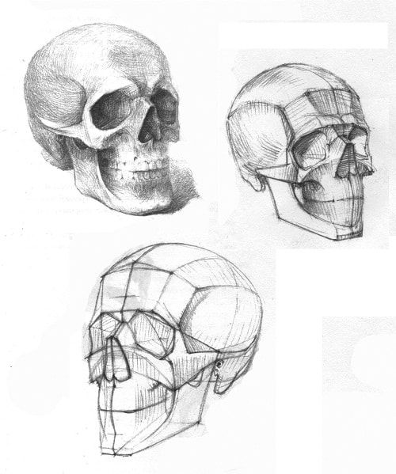
Anatomy study plays a very important role in drawing

Slide 7
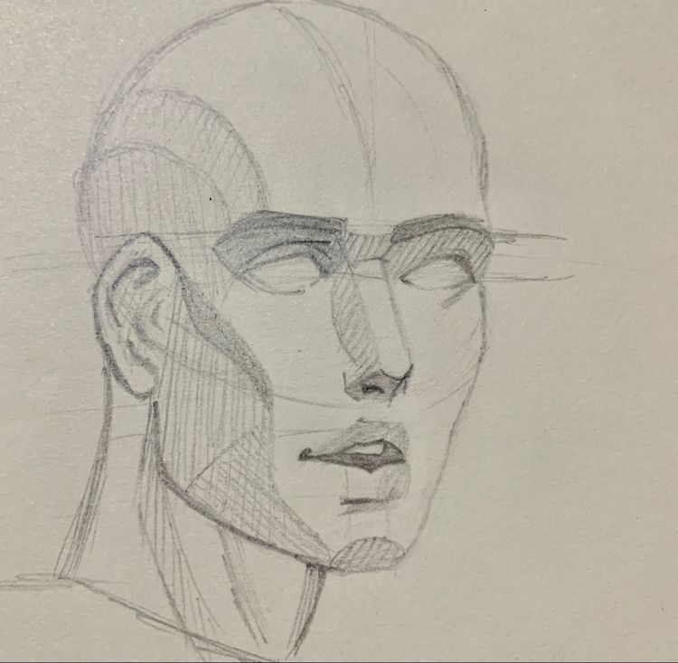
Measure and draw the basic structure

Slide 8
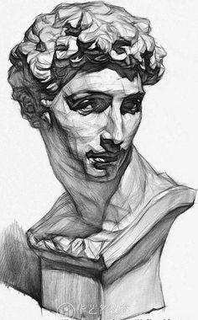
Study the model
Light and shade

Slide 9
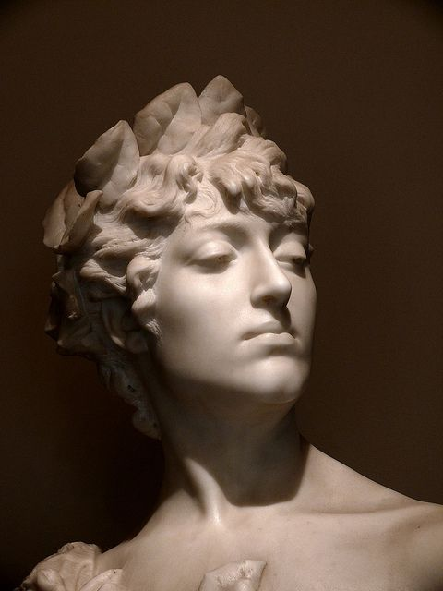

Slide 10
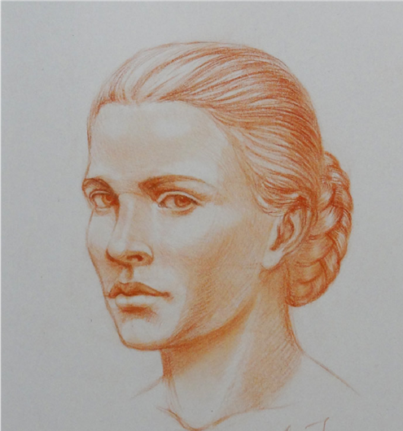
Great masters use “Sepia Colour” pastel for study

Slide 11
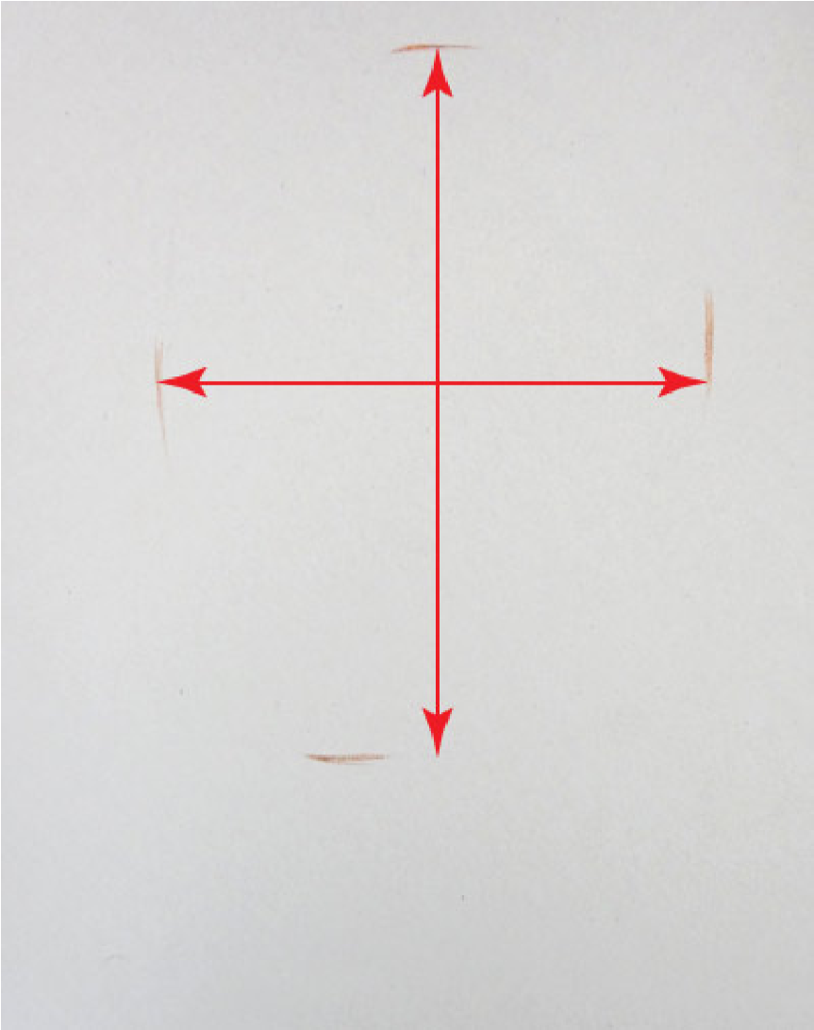
1 . First step
Begin with measuring the main proportion of the model’s head – its width-to-height ratio using a pencil or by eye.

Slide 12
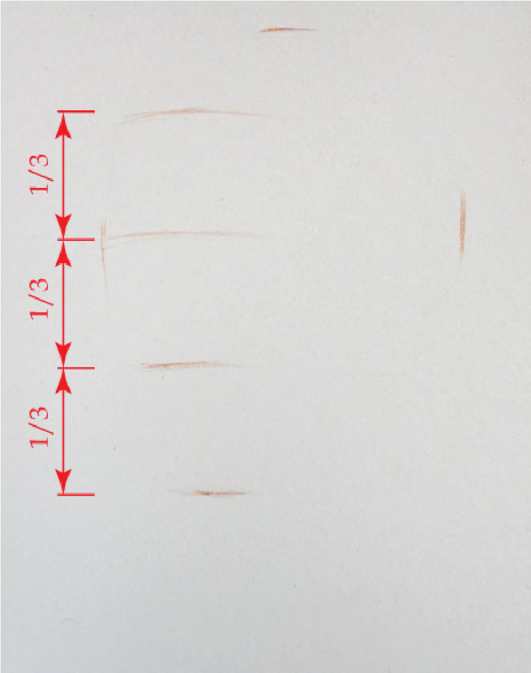
2 . Dividing the face into three parts
the distance between the hair-root line and the bottom edge of the chin can be divided in three equal parts:
From the hair-root line to the eyebrow line
From the eyebrow line to the base of the nose
From the base of the nose to the bottom of the chin

Slide 13
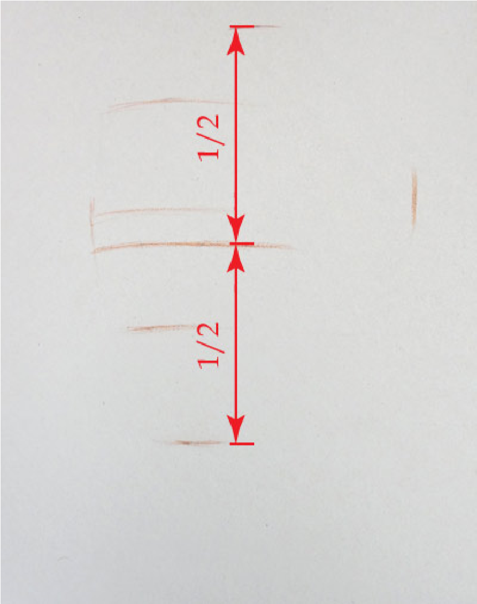
Placing the eye-line
it is universal for all portraits – the eye-line divides the height of the head in half.

Slide 14
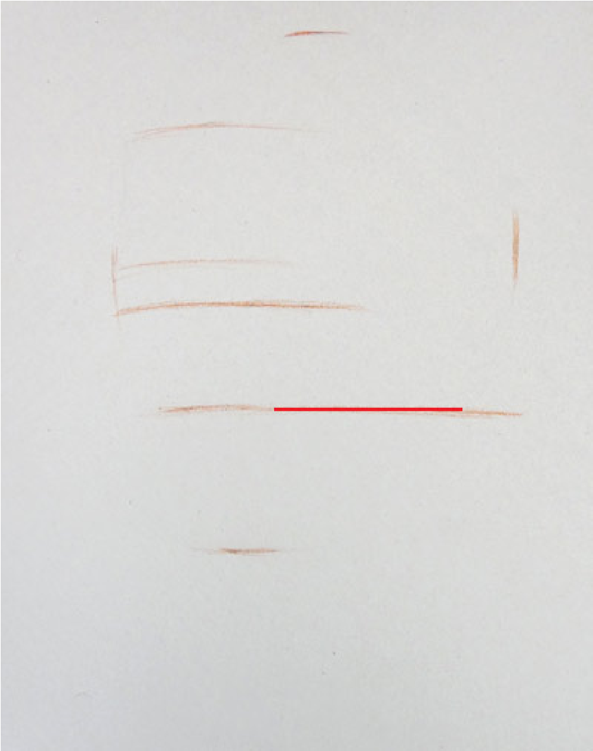
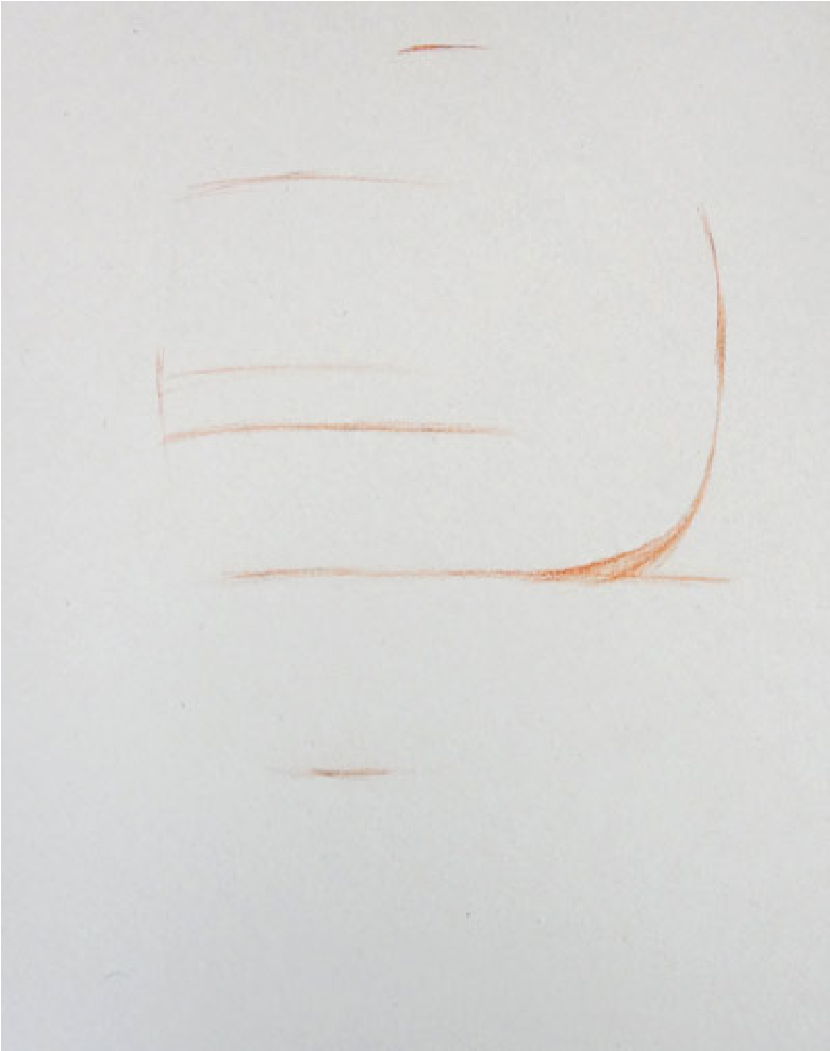
4. Base of the skull and edge of the cheekbone
Location the plane of the skull base will help us to connect the head, neck and shoulders correctly. This plane is on the same level as the base of the nose, which also corresponds to the bottom edge of the cheekbone.

Slide 15
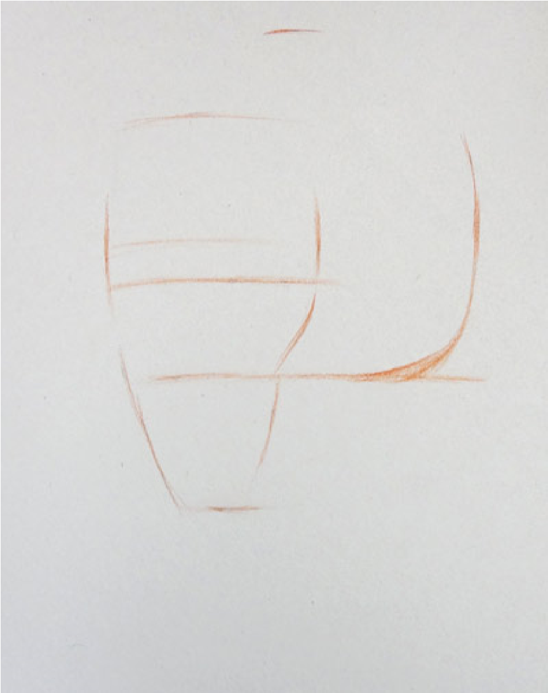
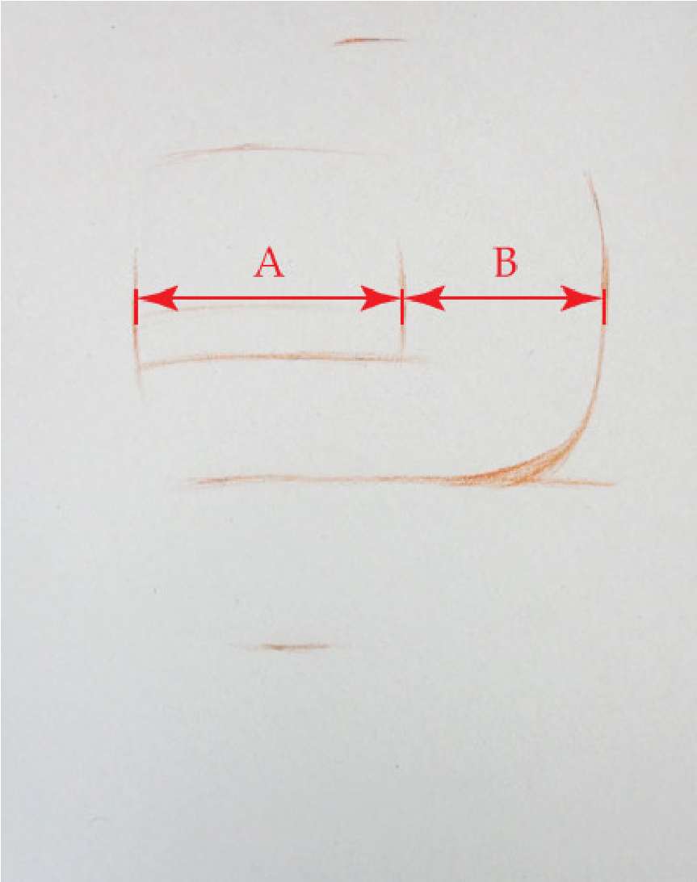
6. Locating the eyebrow
7. Defining contours of the face

Slide 16
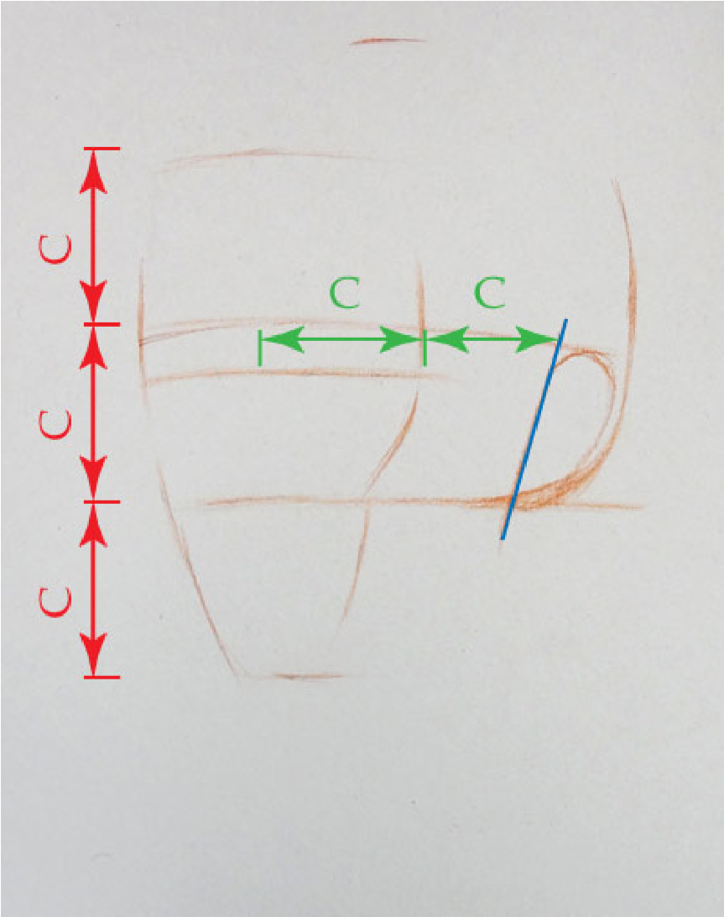
How to place the ear correctly The top of an ear is on the same level as the line of eyebrows.
The bottom edge of an ear is on the same level as the base of the nose

Slide 17
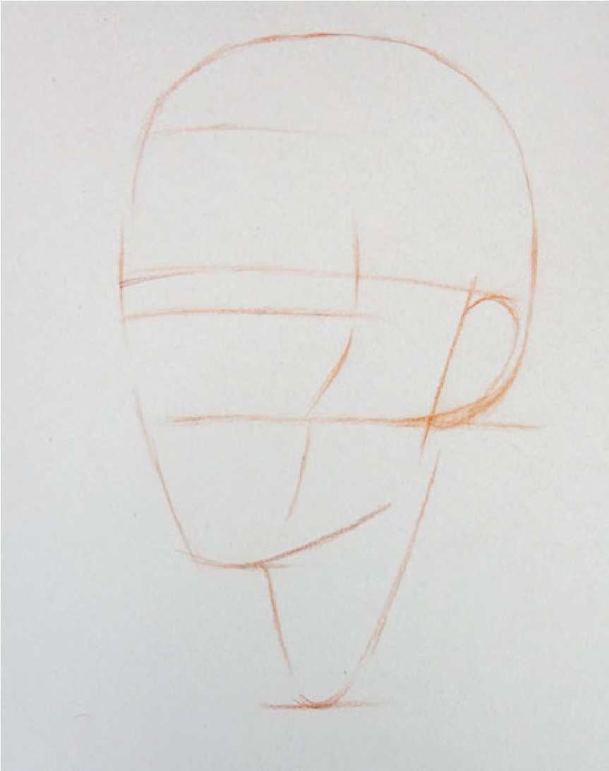
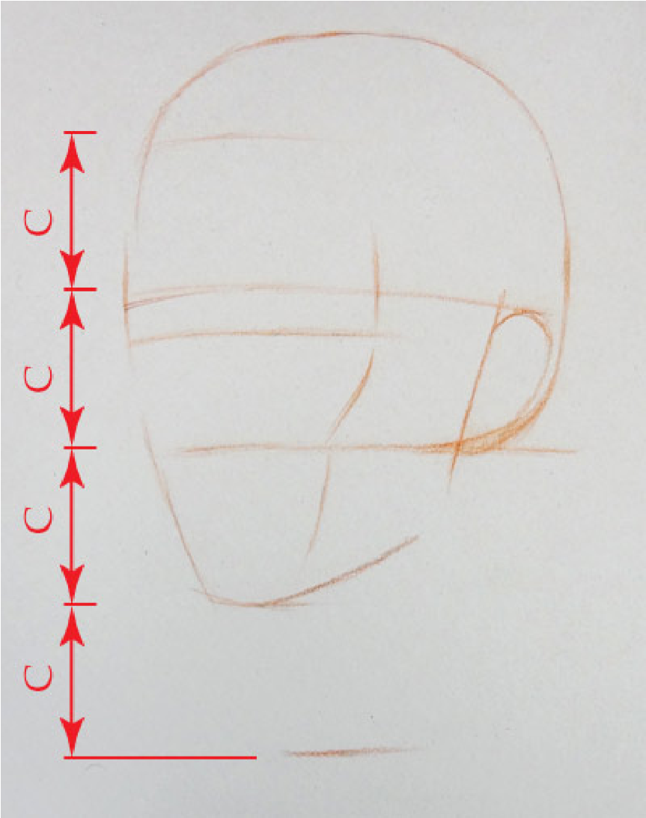
10. Placing the pit of the neck

Slide 18
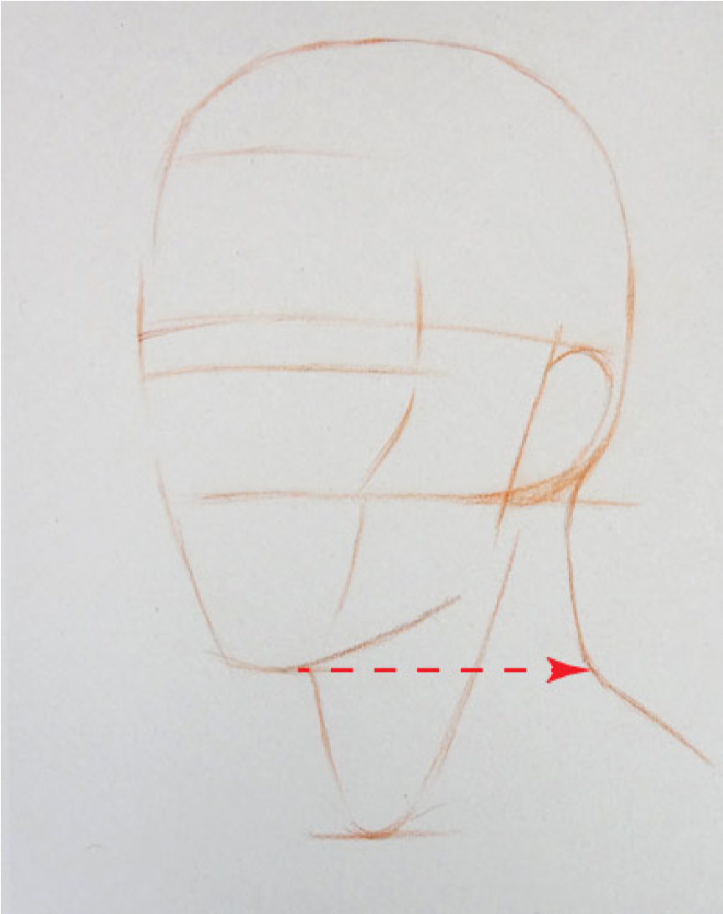
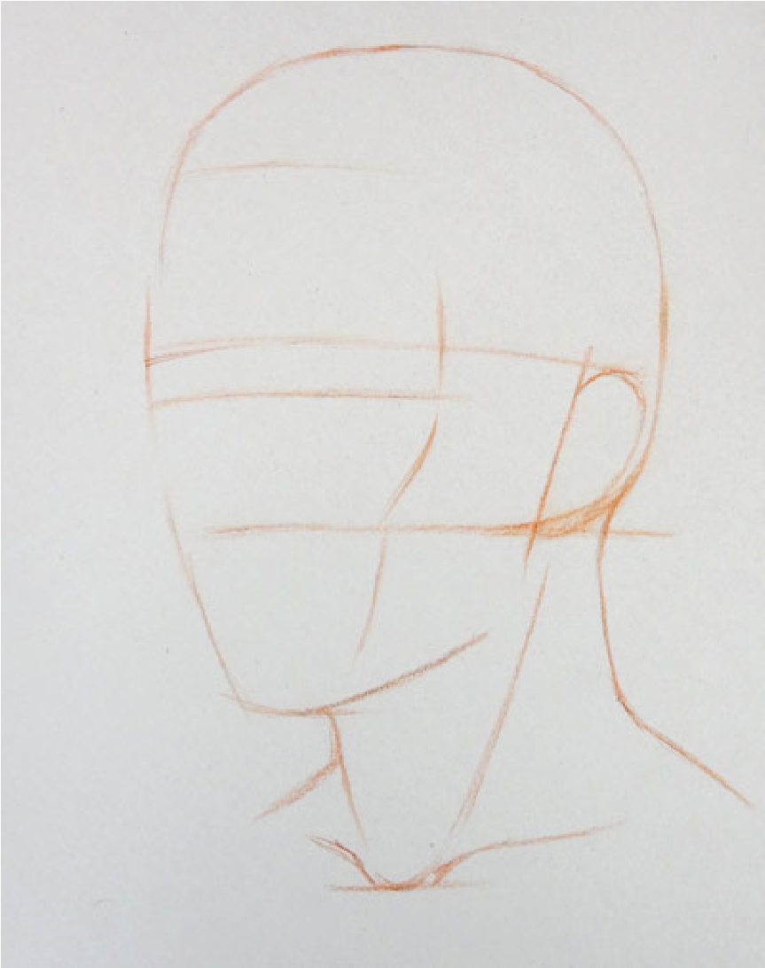
11. Outlines of the neck and collarbones

Slide 19
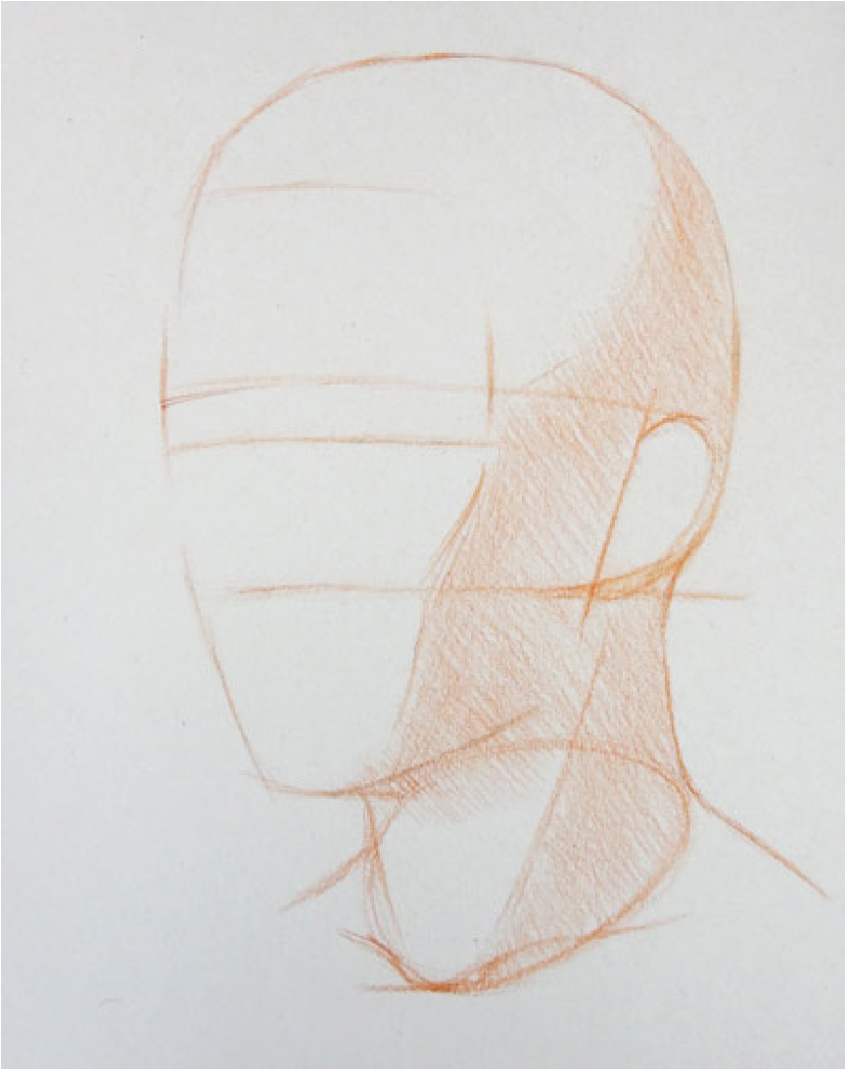
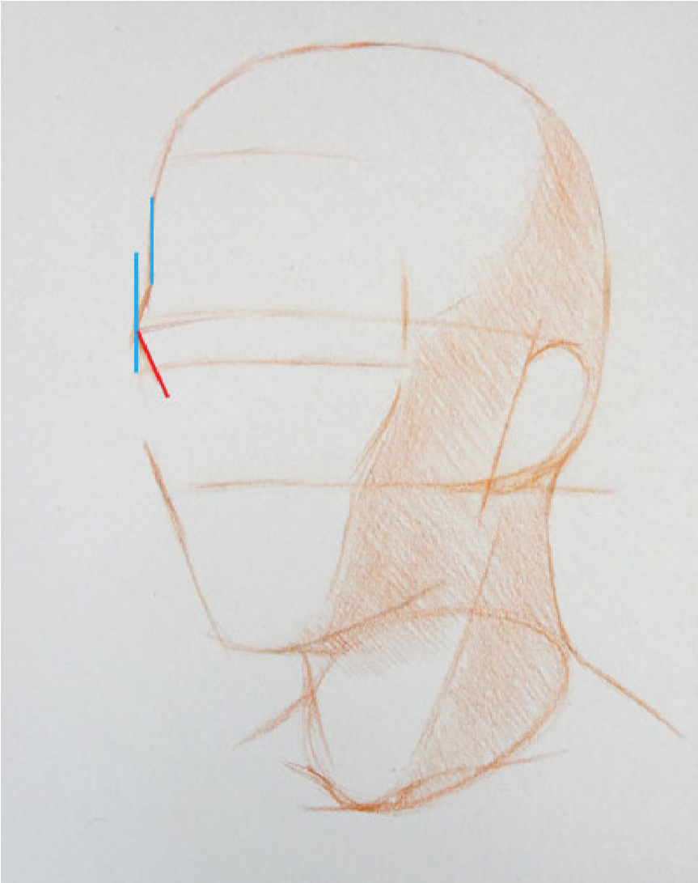
12. Rendering the main shades of the portrait

Slide 20
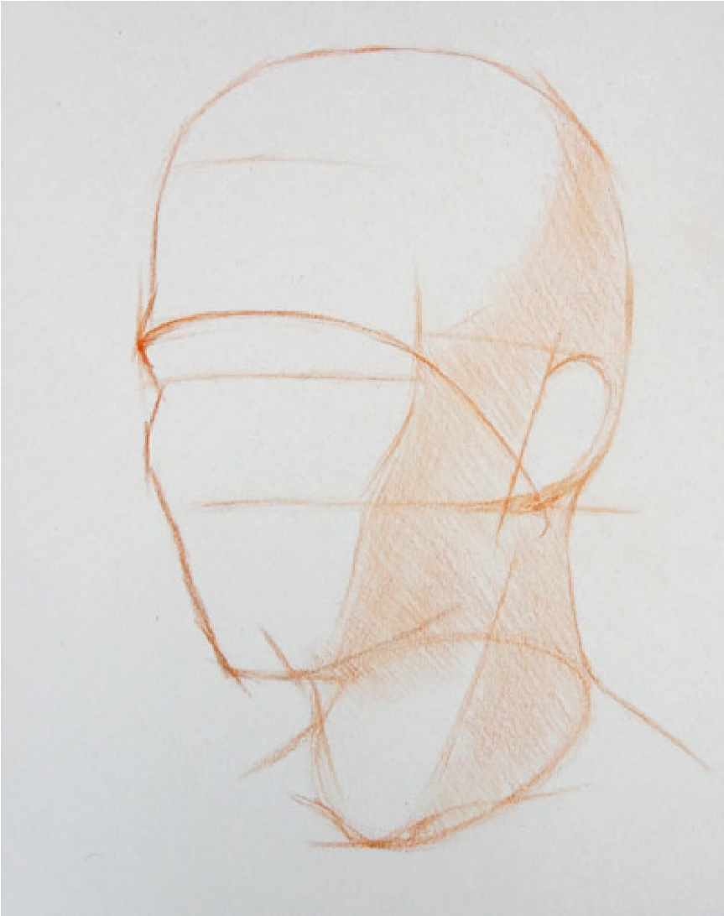
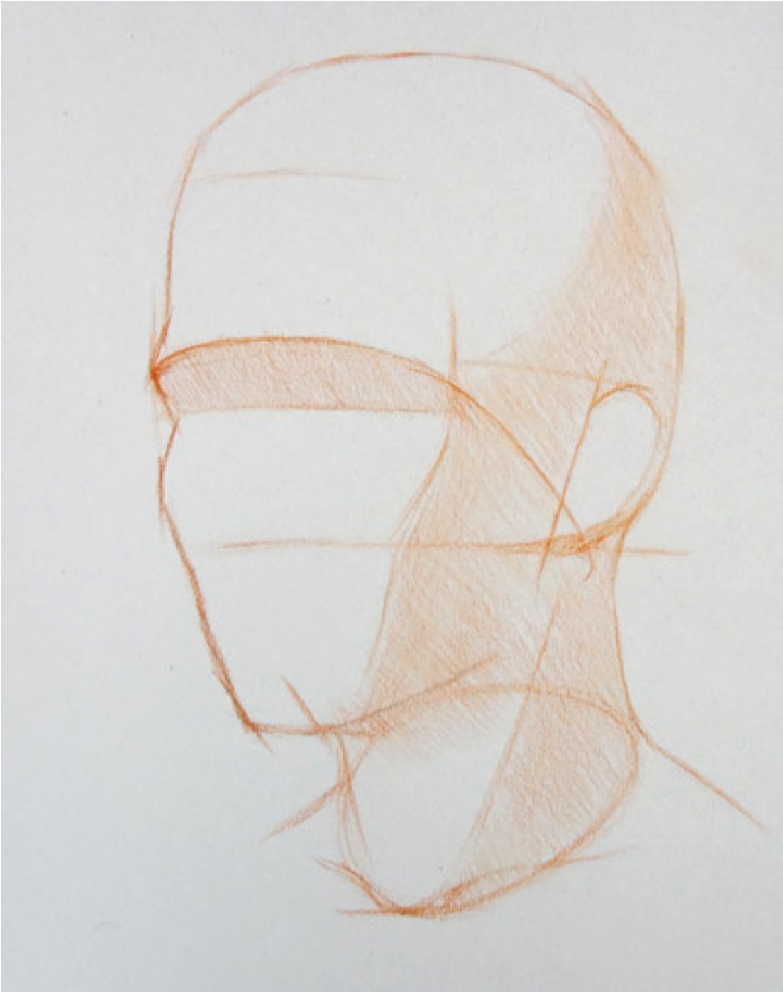
13. Indicating the plane under the eyebrows

Slide 21
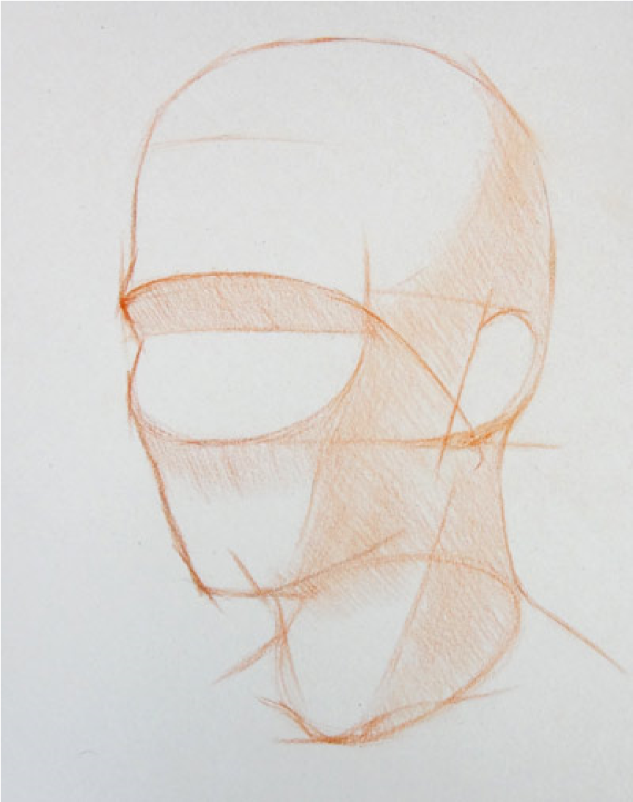
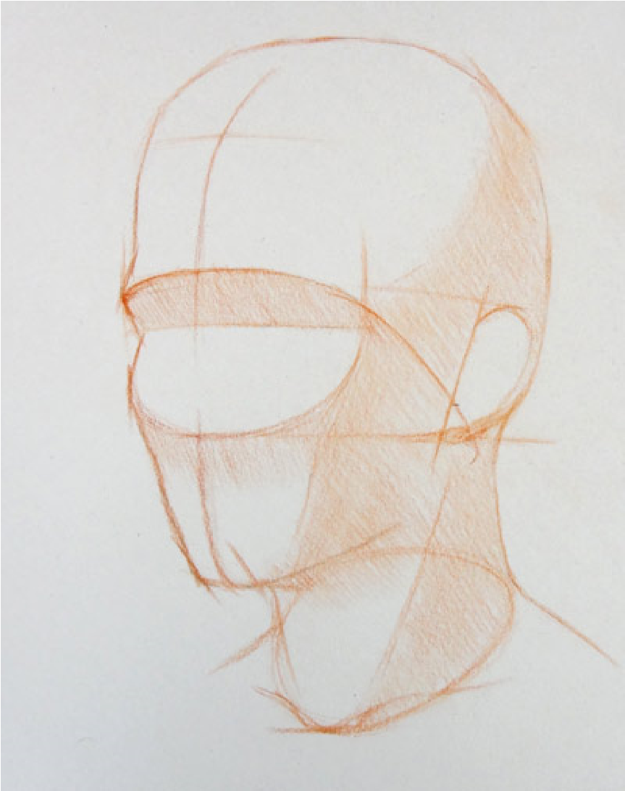
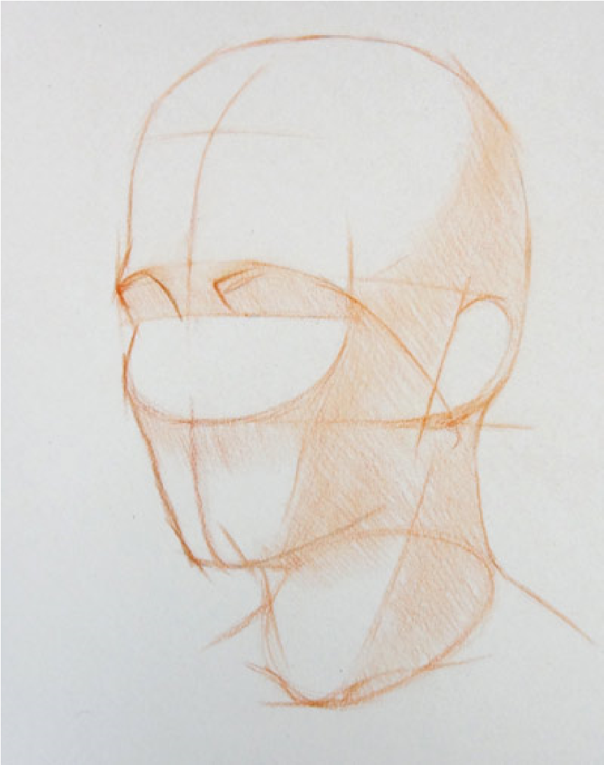
14. Drawing the central line of the face

Slide 22
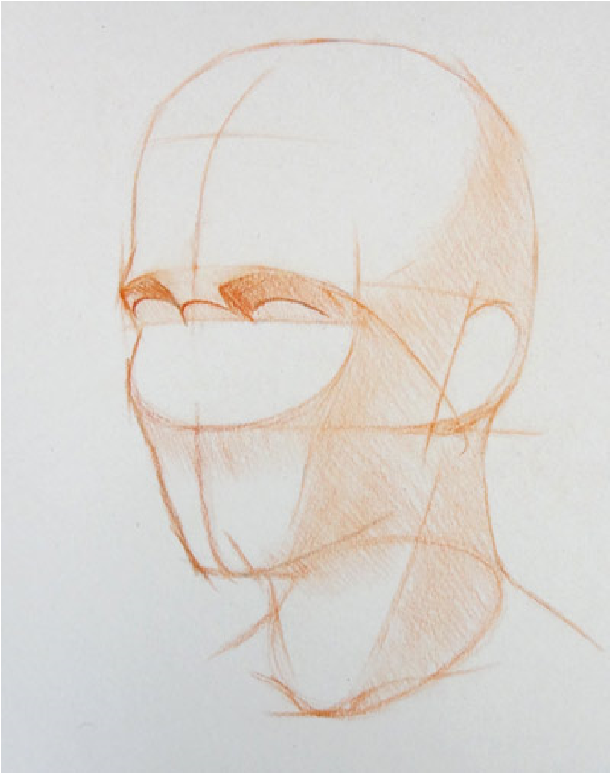
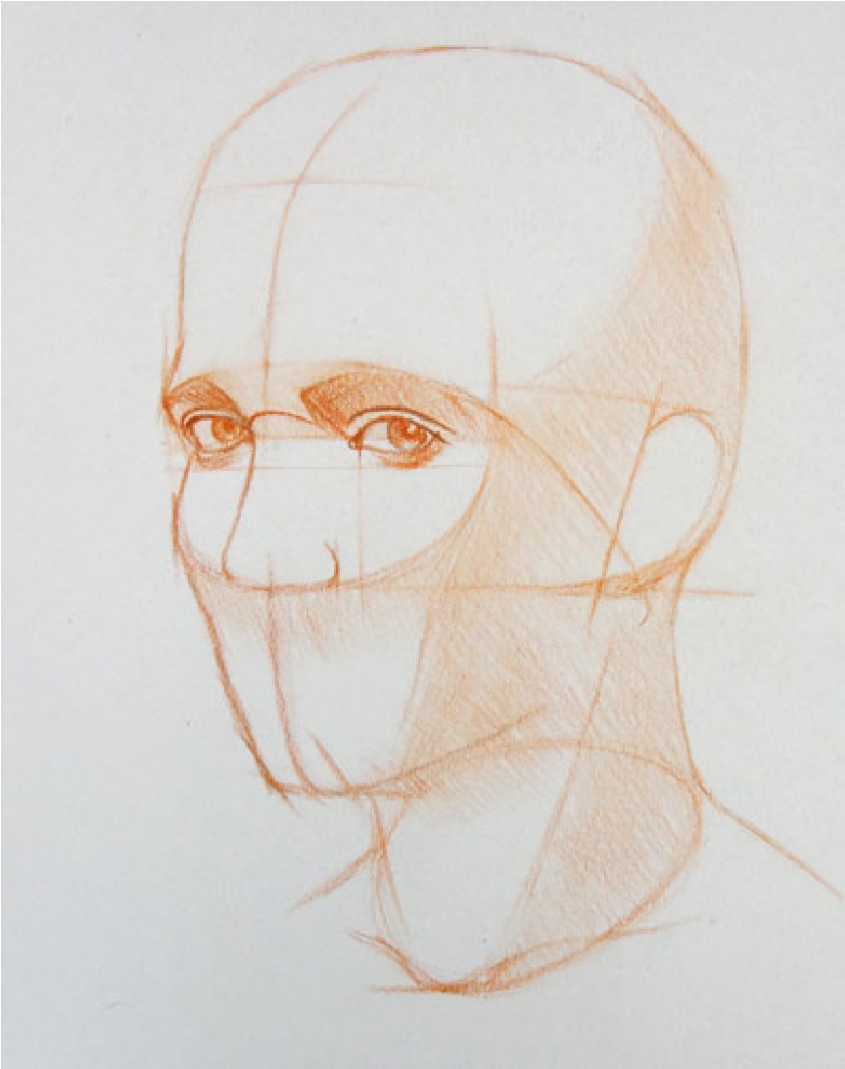
15. Marking Eyebrows . Eyelids and nose

Slide 23
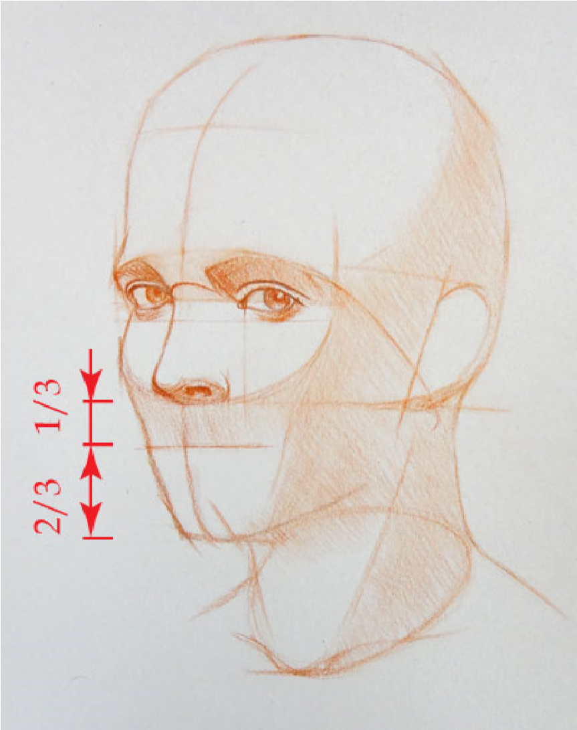
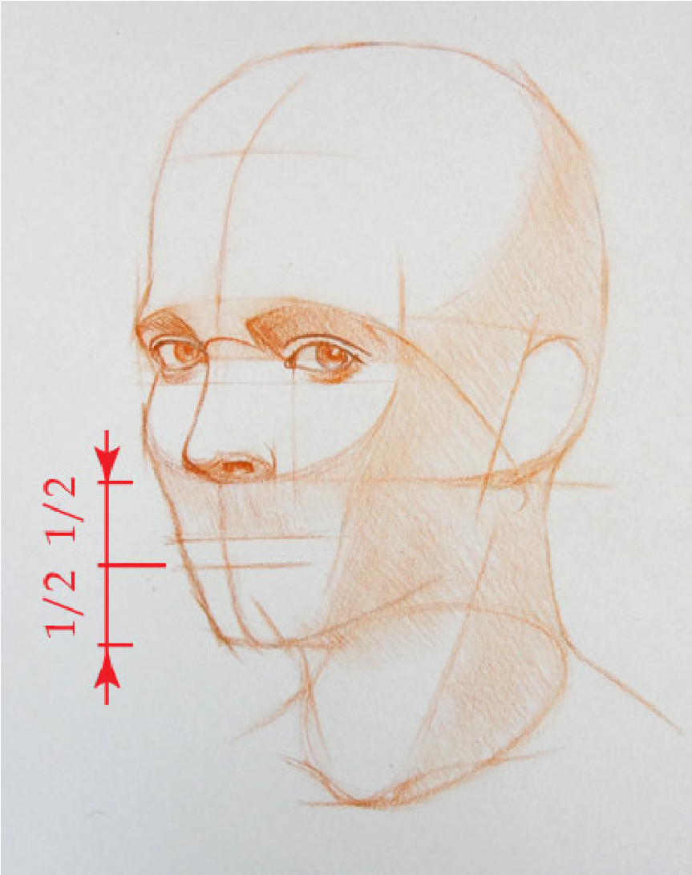
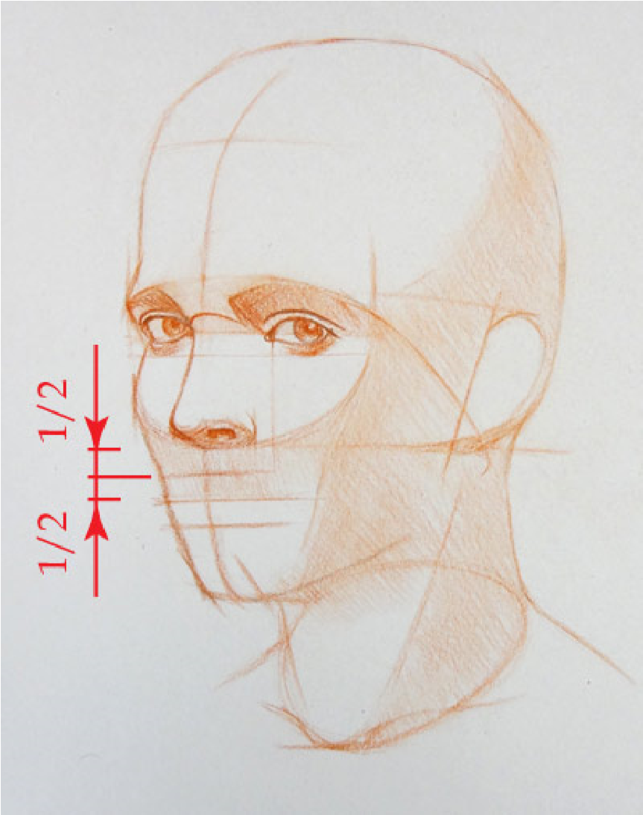
16. Placing Mouth

Slide 24
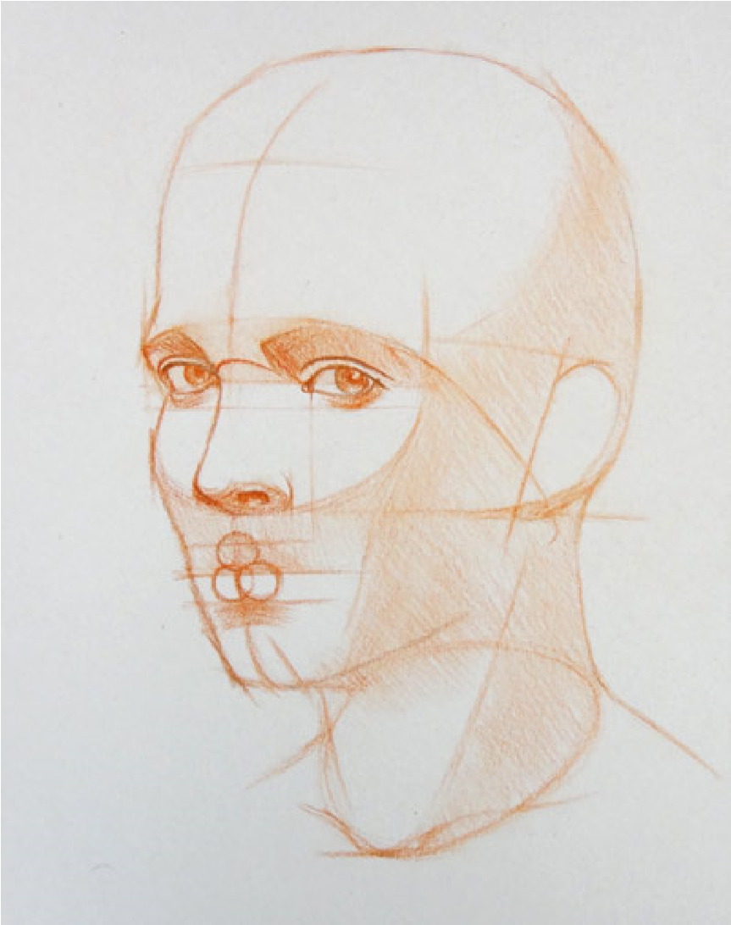
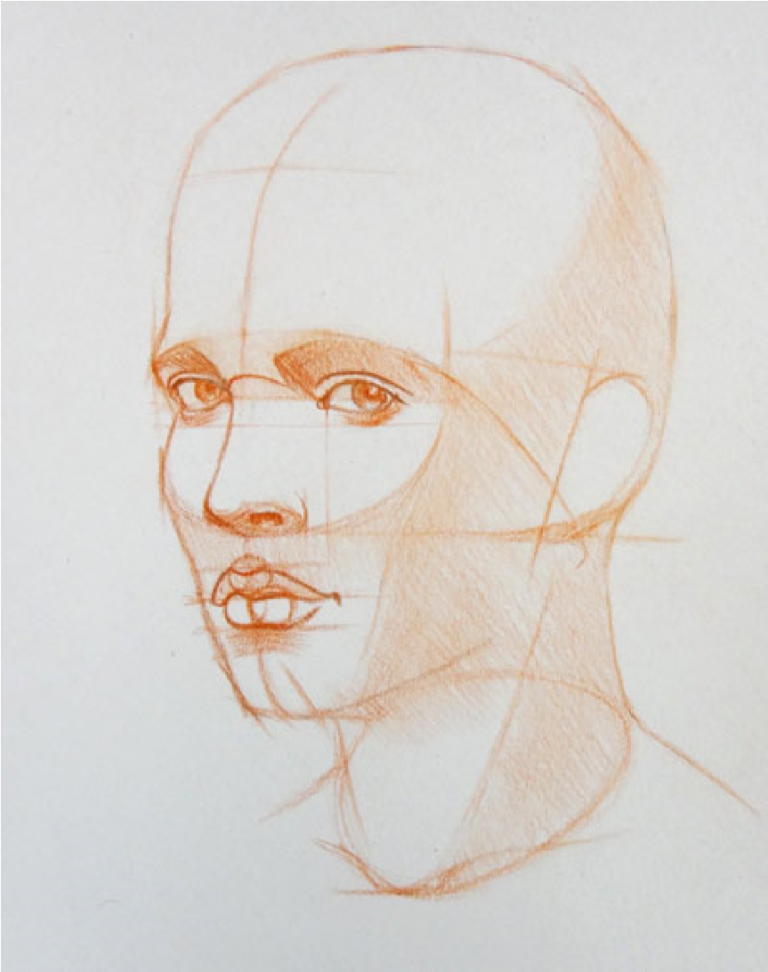
17. Drawing the mouth’s outlines

Slide 25
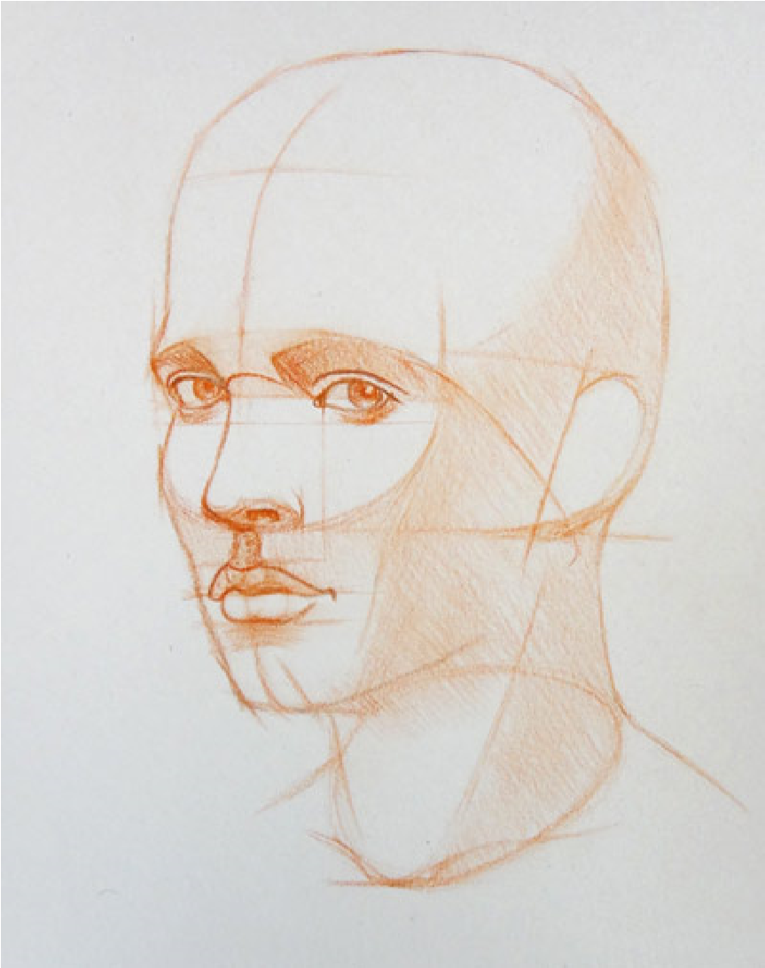
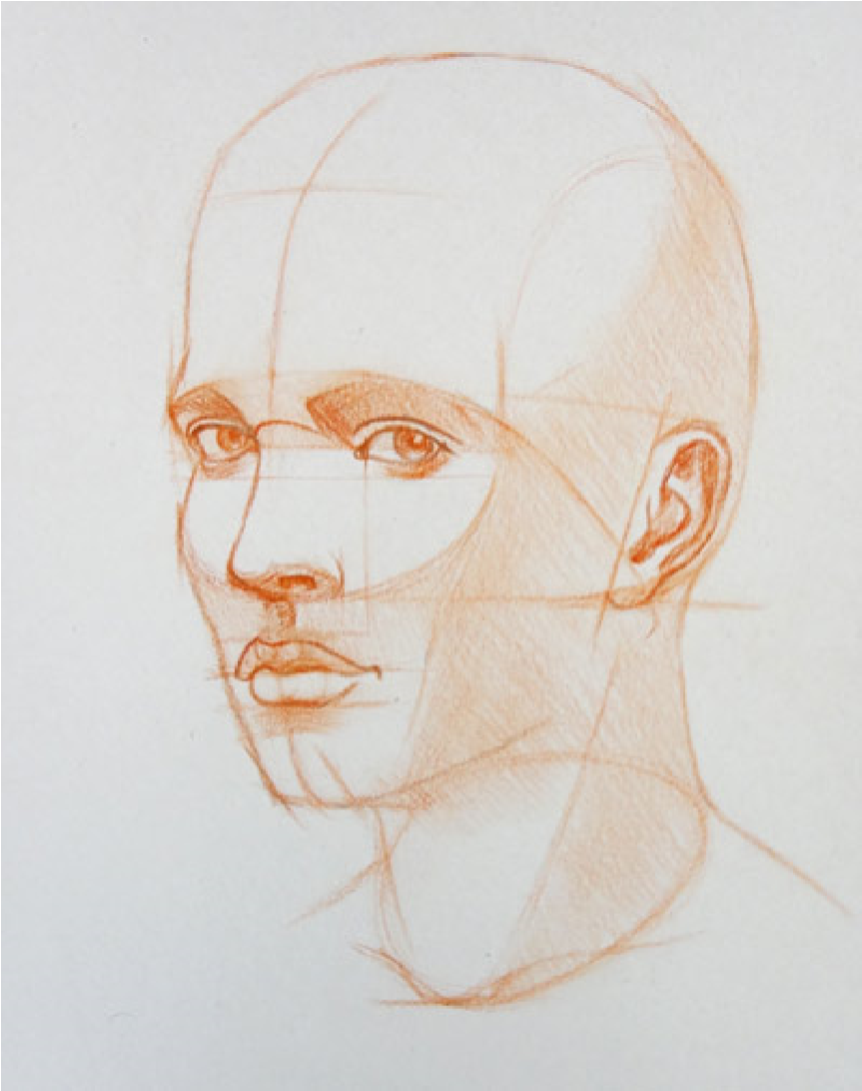
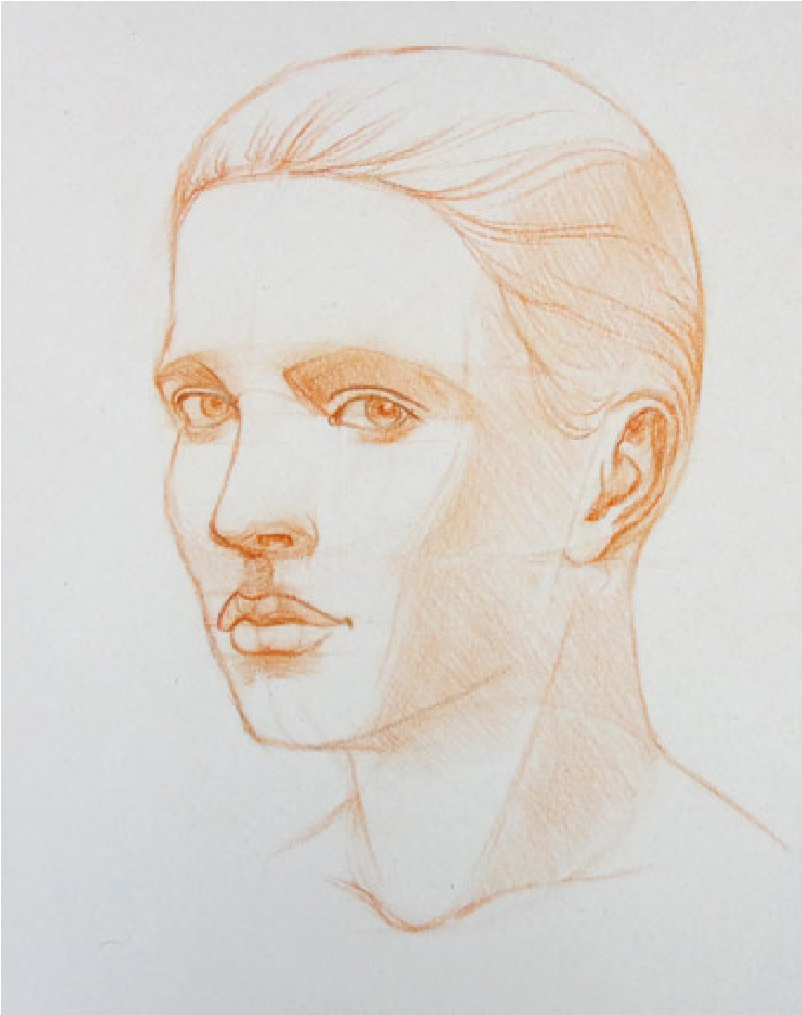
18. Defining the contours

Slide 26
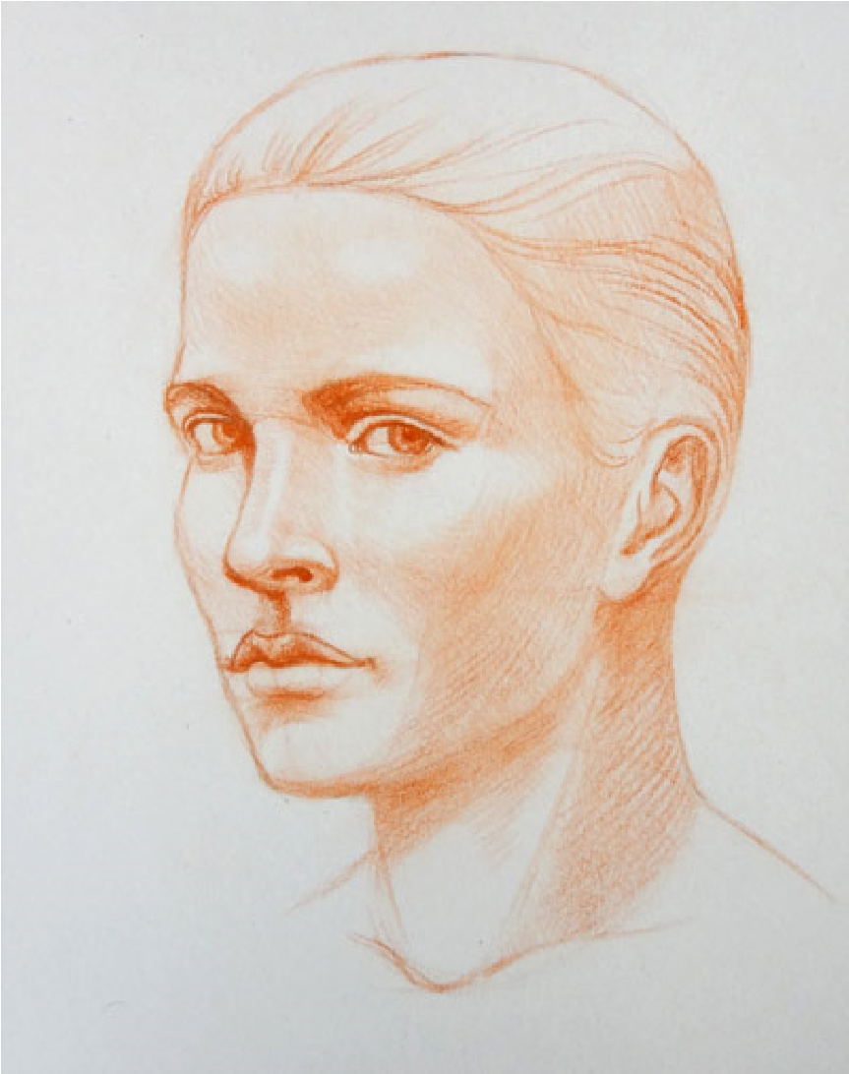
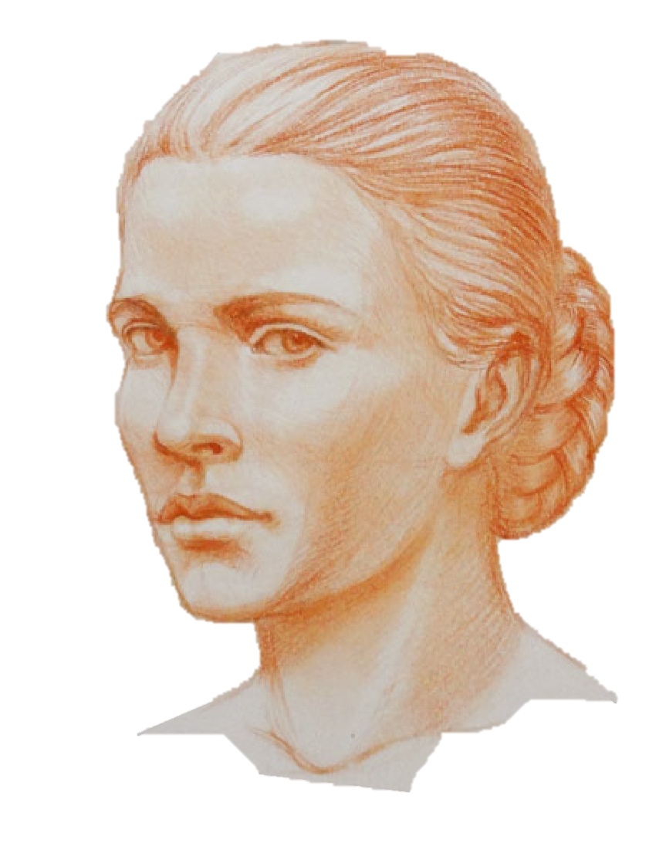
20. render tonal values

Slide 27
Conclusion
Practice makes a man perfect

Slide 28
Thank You

