Slide 1
Multimedia Systems And Design
Overview of Image as Multimedia Element

Slide 2
Creation of multimedia images
Images obviously play a very important role in multimedia products
Images may be photograph-like bitmaps, vector-based drawings, or 3D renderings
The type of still images created depends on the display resolution, and hardware and software capabilities.
Access to the right tools and right hardware for image development is important!
E.g., graphic designers like to have large, high-resolution monitors or multiple monitors

Slide 3
Types of Still Images
Still images are generated in two ways:
–
–
Bitmaps (or raster-based) . Vector-drawn graphics.

Slide 4
Images
Bitmaps may also be called “raster” images. Likewise, bitmap editors are sometimes called “painting” programs.
In computer graphics, a raster graphics image is a dot matrix data structure (representing a generally points of color, viewable via a monitor, paper, or other display medium..)
A raster is technically characterized by the width and height of the image in pixels
Vector editors are sometimes called “drawing” programs

Slide 5
Bitmaps VS Vector-Drawn
Bitmaps are used for photo-realistic images and for complex drawings requiring fine detail.
Vector-drawn objects are used for lines, boxes, circles, polygons and other graphic shapes that can be mathematically expressed in angles, coordinates, and distances.

Slide 6
Bitmaps VS Vector-Drawn
The appearance of both types of images depends on
Display Resolution
Capabilities of your computer’s graphics hardware and monitor.
Both types of images are stored in various file formats
Can be translated from one application to another or from one computer platform to another.

Slide 7
Bitmaps
•
Bitmap is derived from the words ‘bit’, which means the simplest element in which only two digits are used, and ‘map’, which is a two-dimensional matrix of these bits.
A bitmap is a data matrix describing the individual dots of an image that are the smallest elements (pixels) of resolution on a computer screen or printer
•

Slide 8
Pixels
1 pixel in a color monitor
Each pixel is actually composed of three dots a red, a blue and a green one.

Slide 9
Bitmaps
Bitmap is a data matrix that describes the characteristics of all the pixels making up an image
Here, each cube represents the data required to display a 4 × 4–pixel image (the face of the cube) at various color depths (with each cube extending behind the face indicating the number of bits— zeros or ones—

Slide 10
Bitmaps
Bitmaps are an image format suited for creation of:
–
–
–
Photo-realistic images. Complex drawings.
Images that require fine detail.
Bitmapped images are known as paint graphics.
Bitmapped images can have varying bit and color depths

Slide 11
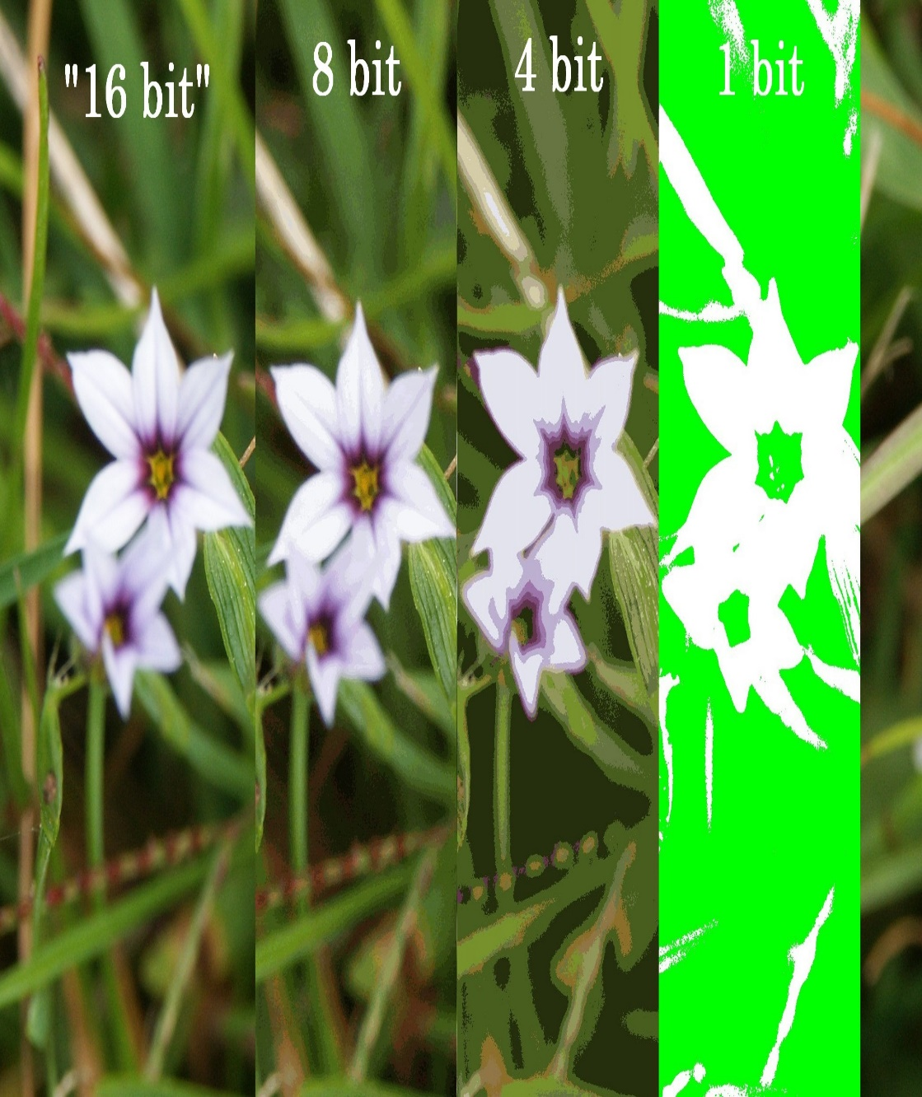
Related Terms for an Image
Bit depth - color information stored in an image.
The higher the bit depth of an image, the more colors it can store.
The simplest image, a 1 bit image, can only show two colors, black and white. That is because the 1 bit can only store one of two values, 0 (white) and 1 (black).
An 8 bit image can store 256 possible colors, while a 24 bit image can display over 16 million colors.
Bit depth increase with the increase in file size.

Slide 12
Bitmaps
More bits provide more color depth, hence more photo-realism;
but require more memory and processing power
Available binary Combinations for Describing a Color
Bitmaps are best for photo-realistic images or complex drawings requiring fine detail

Slide 13
Bitmaps
Bitmaps picture and their suitability of use:-
Use the native Microsoft bmp format as a raw image that will later be processed – faster to process.
Use JPEG, for photo sharing on the web because of its size and quality.
GIF is normally used for diagrams, buttons, etc., that have a small number of colours
It is also suitable for simple animation because it supports interlaced images.
– PNG is almost equal to gif except that it didn’t support the animation format.

Slide 14
Related Terms for an Image
Interlacing – referred to how the picture is created. These are images that are displayed by loading either odd or even lines first, and then loading the other lines on the next cycle.
Interlacing allows for a faster refresh rate by having less information during each scan at a lower cost.
a person who has partially received it sees a degraded copy of the entire image.
Interlacing is a form of incremental decoding, because the image can be loaded incrementally.
An illustration of Adam7 interlacing over a 16×16 image
For example: Interlaced GIF is a GIF image that seems to arrive on your display like an image coming through a slowly opening blind. A fuzzy outline of an image is gradually replaced by seven successive waves of bit streams that fill in the missing lines until the image arrives at its full resolution.

Slide 15
Bitmaps
Bitmaps can be inserted by:
Clip Art
–
–
–
–
Using clip art galleries. Using bitmap software.
Capturing and editing images. Scanning images.
Drawn
Scan
Capture

Slide 16
Bitmap Sources
Make a bitmap from scratch with a paint or drawing program.
Grab a bitmap from an active computer screen with a screen capture program, and then paste it into a paint program or your application.
Capture a bitmap from a photo or other artwork using a scanner to digitize the image.
Once made, a bitmap can be copied, altered, e-mailed, and otherwise used in many creative ways.

Slide 17
Awareness bout images download
You can also download an image bitmap from a web site
Legal rights protecting use of images from clip libraries fall into three basic groupings.
Public domain images
Royalty-free images
Rights-managed images

Slide 18
Vector Images
vector images are typically created and displayed within drawing programs.
Common vector images include 2- and 3-D architectural drawings, flow charts, logos and fonts.
They consist of lines, curves and shapes with editable attributes such as color or fill.
Because they are defined by mathematical equations, they are more easily transformed than raster images.
Unlike raster images, vectors are 'resolution independent': they can be reshaped or rescaled without losing quality.

Slide 19
Vector Images
Most multimedia authoring systems provide for use of vector-drawn objects such as:
– Lines, rectangles, ovals, polygons, and text.
Computer-aided design (CAD) programs have traditionally used vector-drawn object systems
Graphic artists designing for print media use vector-drawn objects.
Programs for 3-D animation also use vector- drawn graphics.

Slide 20
How Vector Drawing Works
A vector is a line that is described by the location of its two endpoints.
Vector drawing uses Cartesian coordinates where a pair of numbers describes a point in two-dimensional space:
– Horizontal and vertical lines (the x and y axes)
The numbers are always listed in the order x , y.
In three-dimensional space, a third dimension—depth— is described by a z axis (x , y , z).

Slide 21
Common uses for vector images
Vector images are commonplace.
cutting-edge magazine covers, interactive Web graphics they are very much the format of choice in contemporary design.
In certain specialist areas, computer-aided design for example, the vector format is the only choice.
There are many less specialized everyday uses of the vector format, where users may not even be aware they are creating vector images:
Drawing tools in Word, Excel, PowerPoint (e.g. lines, arrows, shapes)
Fonts - most fonts are vector fonts, where each character is scalable
Charts and graphs created in Excel, PowerPoint, etc

Slide 22
Example of Vector Image
<rect width="120" height="80" fill="rgb(255,51,0)" stroke="rgb(0,0,204)" stroke-width="4" />
Using fairly straightforward 'human readable' terms, this instructs the program displaying the image to draw a rectangle with a width of 120 pixels and a height of 80 pixels. It is filled with a shade of orange (as defined by the RGB color value of Red 255, Green 51, Blue 0), and is outlined with a blue stroke (R 0, G 0, B 204) that is 4 pixels wide

Slide 23
Example of Vector Image
If a vector image is resized, there will be no loss of quality.
This is because when resizing a vector what happens behind the scenes is a change to the mathematical instructions.
So if we resize our 120 by 80 pixel original by ten times to 1200 by 800, the sharpness of the original is retained because it is the Math in the code that has been adjusted rather than the physical image itself.
10x = 1200 x 800
1x = 120 x 80

Slide 24
Raster and vector images compared
Raster formats (bitmaps) | Vector formats (object-oriented)
Used for representation of continuous tones - suited to 'natural' photo-realistic imagery | Used for drawings and diagrams that can be described by mathematically defined shapes and attributes
Grid/matrix structure | Mathematical or textual description
Resolution dependent: scaling-up will diminish quality | Resolution independent: scaling-up is easy with no loss in quality
Most common capture type | Not normally used for capture, apart from some specialised mapping applications
Most common Web type | Less common Web type
Layering of images less common | Layering of images easy and common
Usually larger in file size | Usually smaller in file size
Usually quicker to display | Usually slower to display
Difficult to convert to a vector format | Easily and often converted to a raster format

Slide 25
Digital Camera Resolution
256x256 - Found on very cheap cameras, this resolution is so low that the picture quality is almost always unacceptable. This is 65,000 total pixels.
640x480 - This is the low end on most "real" cameras. This resolution is ideal for e-mailing pictures or posting pictures on a Web site.
1216x912 - This is a "megapixel" image size -- 1,109,000 total pixels -- good for printing pictures.
1600x1200 - With almost 2 million total pixels, this is "high resolution." You can print a 4x5 inch print taken at this resolution with the same quality that you would get from a photo lab.
2240x1680 - Found on 4 megapixel cameras -- the current standard -- this allows even larger printed photos, with good quality for prints up to 16x20 inches.
4064x2704 - A top-of-the-line digital camera with 11.1 megapixels takes pictures at this resolution. At this setting, you can create 13.5x9 inch prints with no loss of picture quality.

Slide 26
Graphic / Image Data Structures
Pixels -- picture elements in digital images
Volume element -- An image element in a three dimensional is called a voxel (volume element).
Image Resolution -- number of pixels in a digital image
Higher resolution always yields better quality
1024x768 pixels on a 15” monitor is better than 800x600 pixels

Slide 27
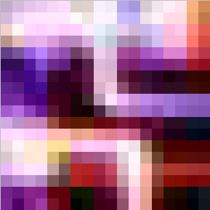
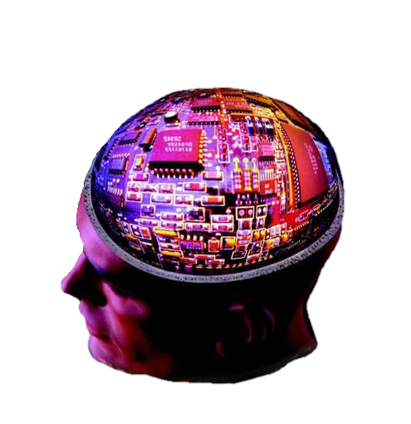
Zoom-in
Pixel

Slide 28
Why is a higher resolution better ?
When a 12x8 inch picture is formed by say, 600x400 pixels, it uses pixels of a certain size.
If the resolution increases, to about (for example) 1200x800, more pixels have to be squeezed in the 12x8 inch space. So the pixels used are smaller.
This allows more colors to be included in the image matrix, thereby creating a more realistic look.
The drawback is that this requires more memory.

