Slide 1
Endangerment and extinction
Genetic resources and conservation
BS Biotechnology (6th Semester)
University of Sargodha

Slide 2
Endanger and extinct species
Endangered species, any species that is at risk of extinction because of a sudden rapid decrease in its population or a loss of its critical habitat.
Threatened species, any species in danger of becoming endangered in the near future.
Rare species, any species that are limited in their distribution.
Extinct species, Any specie of animal or plant whose no more individuals are alive anywhere in the world- the specie has died out.

Slide 3
Causes of Extinction
Extinction is the disappearance of an entire specie.
If a specie dose not have the genetic traits to survive in its environment then the species will eventually become extinct.

Slide 4
Causes of endangerment and extinction
Rarity: When there are very few individual of the species left, there are less available mates. Animals can be rare if they have very specific food or nesting requirements, are sensitive to change, compete with other species, migrate or interfere with human activities in some way.
Inbreeding: When animals mate too much within their own group. The offspring become less able to survive and adapt in a healthy way.
Hybridization: When two animals from different closely related species mate, they might pass on genes that are less healthy. Like Mule (Mate of horse and donkey) or Quagga (mate of Horse and Zebra)
Loss of Habitat: When an animal’s habitat is destroyed and they have nowhere to live. Urbanization and deforestation are two major causes of habitat loss.

Slide 5
Causes of endangerment and extinction
Long term environmental trends: Gradual changes in the climate can also leads to the specie endangerment or extinction. Scientists think that dinosaurs became extinct because of a slow cooling of the earth.
Catastrophe: natural disasters like volcano eruption, tsunami, dramatic changes in climate can leads to habitat loss and specie death which will eventually decrease the number and abundance of species.
Reduction of mutualistic population: If two species are dependent on each other then the endangering/extinction of one also endangers/extinct the other.

Slide 6
Causes of endangerment and extinction
Competition: When a new specie is introduced to a habitat, then the stronger of the two species will be more likely to survive.
Predators: When the population of a species of predator in a habitat suddenly increase the population of their prey decreases.
Disease: If a particular sickness spreads quickly throughout a particular specie, then many may die before they can reproduce.
Hunting: Excessive Hunting of any specie can make it harder for the species to renew its number which will leads to specie endangerment/extinction.

Slide 7
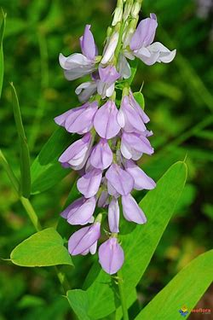
Importance of species
Species of all living organisms are very important because of their medicinal, ecological, agricultural and commercial value.
Medicine: Various species play an important role as source of drugs, which are critically important to treat several diseases. Like bacteria are an important source of antibiotics.
Similarly, various plant also act as source of drugs
like Metformin (used to treat diabetes) is derived
from French Lilac.

