Slide 1
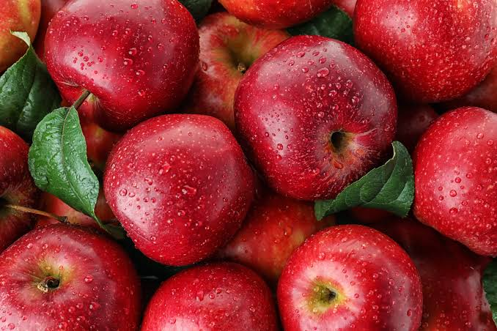
Production technology of apple

Slide 2
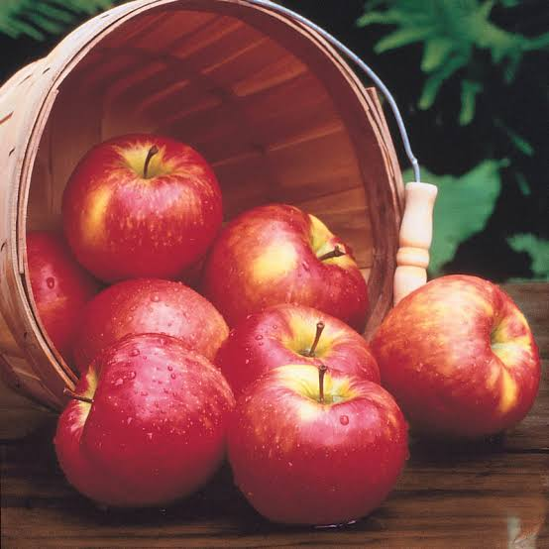
AREAS COVERED
Origin and history of apple
Botanical information
Cultivated varieties
Soil and climatic conditions
Propagation of apple
Cultural practices
Harvesting
Production and estimated yield
Post harvest handling and storage
Physiological disorders
Insect, pests and diseases
Useful by-products

Slide 3
Origin and history
Malus sieversii is a wild apple native to the mountains of Central Asia in southern Kazakhstan. DNA analysis has recently been shown to be the primary ancestor of most cultivars of domesticated apple (Malus pumila).
It was described as Pyrus sieversii in 1833 by Carl Friedrich von Ledebour, a German naturalist who saw them growing in the Altai mountain.
It is deciduous tree growing up to 5 to 12 meters, very similar in appearance to the domestic apple.
The centre of diversity of genus Malus is in eastern present day turkey. Apple was perhaps the earliest tree to be cultivated and its fruits have been improved through selection over thousands of years.

Slide 4
Origin and history
Alexander the Great is credited with finding dwarfed apples in Kazakhstan in 328 BCE.
Apple were introduced to the North America by Colonist in the 17th century and the first apple orchard on the North American continent was planted in Boston by Revered Willam Blaxton in 1625.
The only apple native to North America are crab apples, which were once called ‘common apple’.

Slide 5
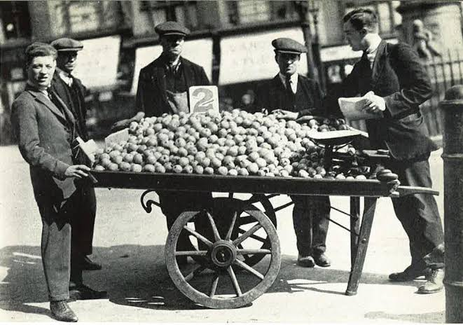
Origin and history
In Pakistan, its cultivation is limited and restricted to northern hilly tracts of Punjab, NWFP and Quetta region of Balochistan.
Apple cultivars are brought as seeds from Europe were spread along native american trade routes, as well as being cultivated on colonial farms.

Slide 6
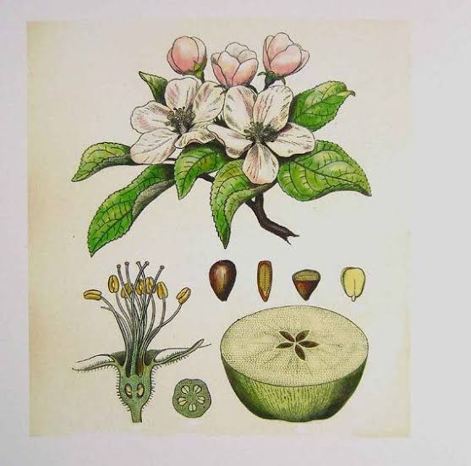
Botanical information
Kingdom : Plantae
Division : Magnoliophyta
Class : Magnoliopsida
Order : Rosales
Family : Rosaceae
Sub Family: Maloidae
Genus : Malus
Specie : Malus domestica

Slide 7
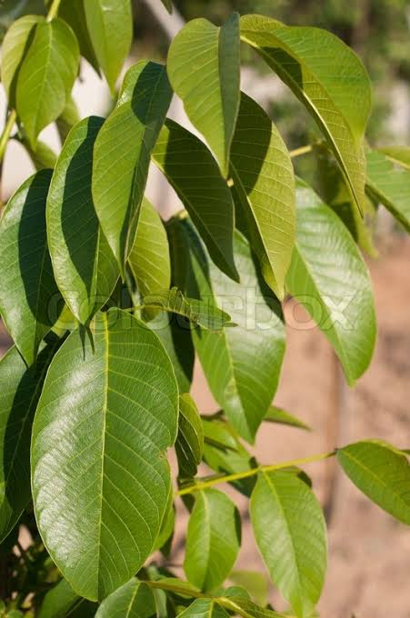
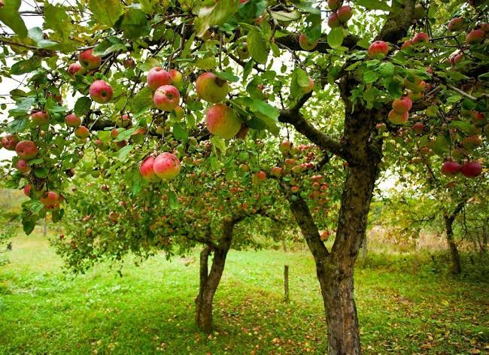
Botanical information
Tree: The apple is a deciduous tree standing 1.8 to 4.5 m tall in cultivation.
When cultivated, the size, shape and branch density are determined by rootstock and trimming method.
Leaves: The leaves are alternately arranged dark green colored simple ovals with serrated margins and slightly downy undersides.

Slide 8
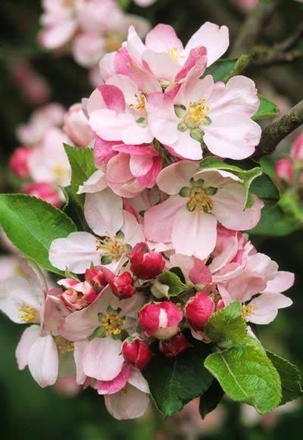
Botanical information
Apple blossom: the flower is perfect
with 5 petals, 5 sepals, 5 carpel with
two ovule each and 15-20 stamens.
Most apple blossom petals are pink
when they first bloom then they fade
to white as the season progresses.
All the flowers are self sterile and self pollination is impossible. The honey bee is the best pollinator of domestic apple

Slide 9
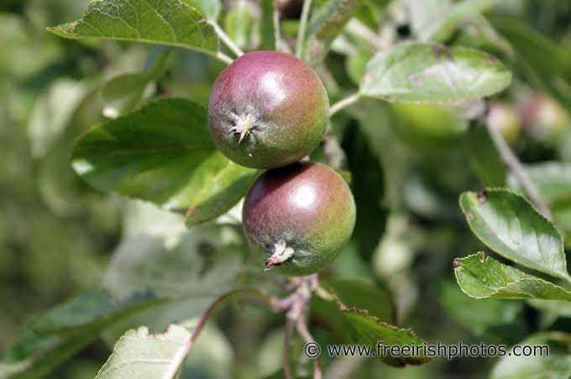
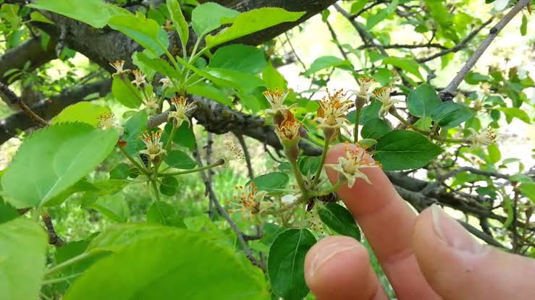
Botanical information
Pollination and fruit set:
when apple tree is ready to grow it produces flowers in winter
Some apple varieties can self pollinate but most varieties require cross pollination.
The outer part of the ovary develops into fleshy white part of the apple. The inner wall of the ovary becomes the apple core around the seeds.

Slide 10
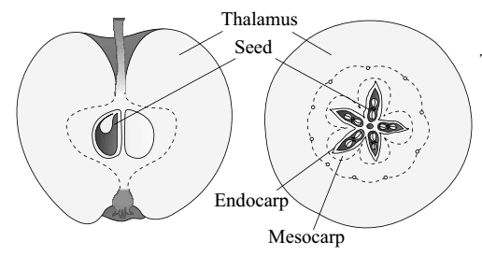
Botanical information
Apple: false fruit
The bulk of the fleshy edible portion is derived from the hypanthium or floral cup, not the ovary. Seeds are relatively small and black, and mildy poisonous.
When the other accessory floral parts contribute to the formation of fruit, then such fruits are called as false fruits or pseudo-carp.
In apple, the thalamus or receptacle grows around the pericarp ton produce the fleshy edible part. Hence, it is a false fruit.

Slide 11
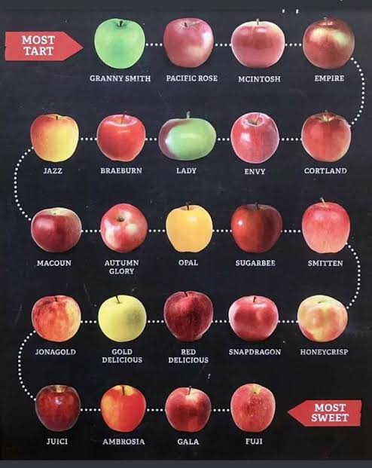
Cultivated varieties
There are more than 7500 known cultivars of apples. Different cultivars are available for temperate and sub-tropical regions.
Commercial popular apple cultivars are soft but crisp. Other desired qualities in modern commercial apple breeding are colorful skin, absence of russeting, ease of shipping, lengthy storage ability, high yield, disease resistance, long stem and popular flavor.
Different varieties of apple include red delicious, McIntosh, golden delicious, gala, granny smith, fuji, braeburn, pink lady, honey crisp, empire,

Slide 12
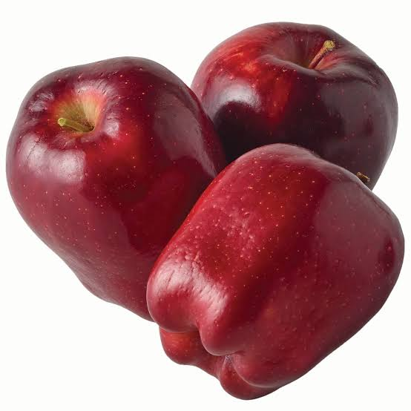
Cultivated varieties
Red delicious
A popular eating apple
Crispy, juicy taste, sweet flavor
Great for snacking
Fast growing apple tree
It has thick skin
Due its long storage life,
its selling can be carried
out of its season.

Slide 13
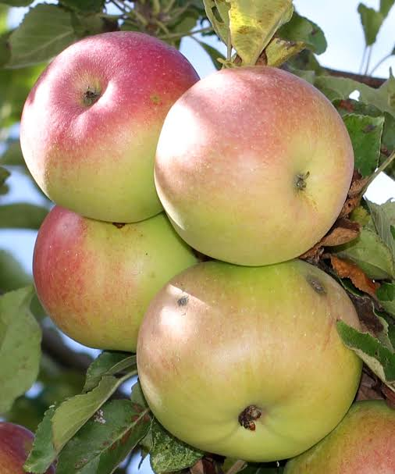
Cultivated varieties
McIntosh:
Fruit has red and green skin
Quickly produces apples
Easy to grow
Ideal for baking
A tart flavor and tender white flesh
With a soft skin and softer flesh, the McIntosh strikes a level balance between and acidic.

Slide 14
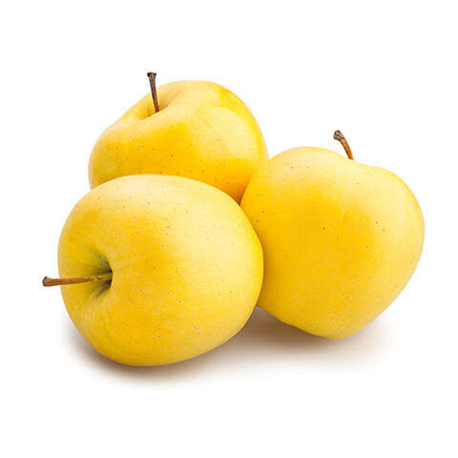
Cultivated varieties
Golden ( yellow) delicious:
Considered as all purpose apple
Mild and sweet
The flesh is juicy but taste wise is not all that different from the Red Delicious.
Amazingly sweet taste
Grows almost anywhere.

Slide 15
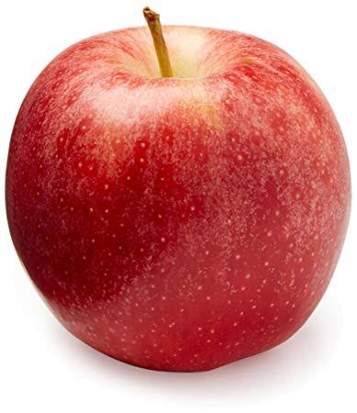
Cultivated varieties
Gala:
Native to new zeeland
It is cross between a kidd’s orange red ande a golden delicious apple
With pinkish orange striping over a gold base
Its skin is thin, concealing a crisp and juicy flesh that’s fragrant and fairy sweet
Long storage life
Fast growing apple tree

Slide 16
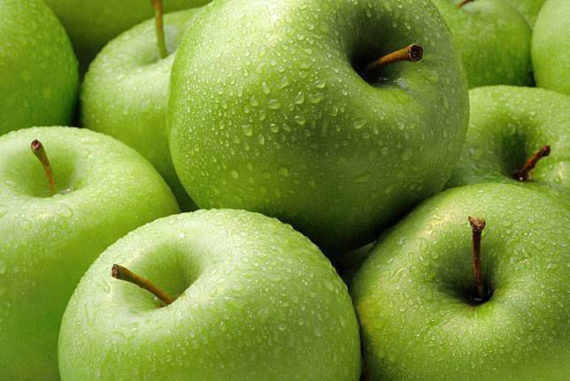
Cultivated varieties
Granny smith:
This white green apple boasts white, firm, juicy flesh that is sweet and tart at the same time
Fast growing apple tree
Delicious fruit
Great for snacking

Slide 17
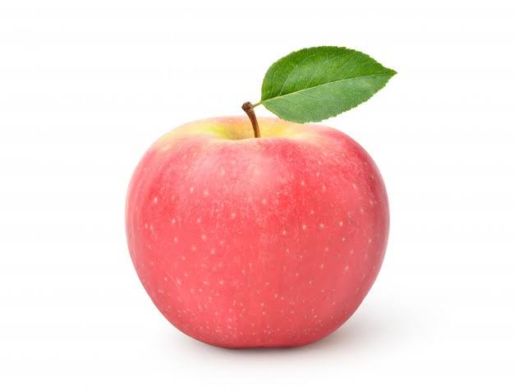
Cultivated varieties
Fuji:
Dense, crisp and generally regarded the sweetest of all varieties
Ripens quickly
Grows in many climates
Fast growing apple tree

Slide 18
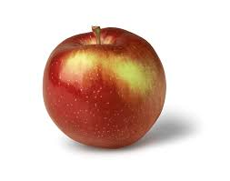
Cultivated varieties
Empire:
Red or green skinned
This juicy apple with a tart sweet flavor and creamy flesh is a cross between Red Delicious and McIntosh.

Slide 19
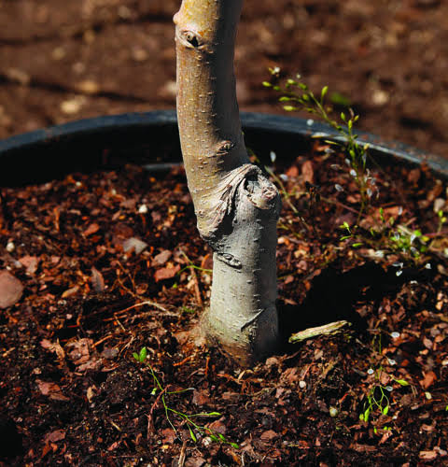
Soil and climatic condition
Soil:
Apple tree grows and bears fruit in wide range of soil but deep, well drained, fertile loam which permits free root development is more suitable.
Water logged soil should be avoided.
Hardpan soils are also undesirable, as are light, shallow, gravelly soils, which are not capable of retaining adequate moisture.

Slide 20
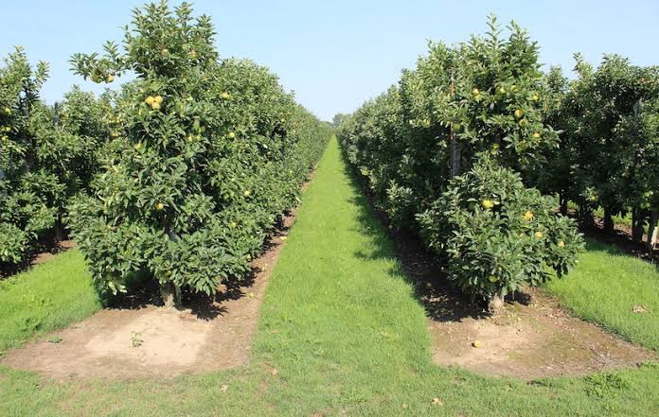
Soil and climatic conditions
Climate:
Apple need a cooler climate than most of the temperate fruit because it require chilling temperature in dormancy period.
Temperature of about -30 degree or rapid fluctuation in temperature is harmful.
Uniformly severe cold nights during the rest periods are useful.
Apple thrives usually at altitude of 1700-2500 m.

Slide 21
Soil and climatic conditions
Climate:
The quality of fruits grown at lower altitude are not good due to high summer temperature.
Localities having mean summer temperature up to 27 degree or lower are more considerable for the growth of apples.
750ppm rainfall is ideal for apple trees.
In Pakistan, northern hilly tracts receive most of their rain during the monsoon while the Quetta region usually faces shortage of irrigation water.
Late spring frosts and hail during the early stages of fruit development often damage apple crop in Murree Hills.
Continuous strong wind particularly during the blooming season is another hazard in apple culture.

Slide 22
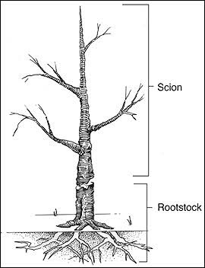
propagation
Raising of Rootstock:
Apple trees are budded on crab apple, on various East mailing types and on seedling of some commercial apple varieties. In the Murree Hills, crab apple is the only rootstock. Some other rootstock are used in Sariab, Quetta and Tarnab, Peshawar, including M-1, M-7 and M-9. M-1 is a very outstanding rootstock because of its good nursery performance. M-9 is the most growing stock in heavy soil and is dwarfing in nature.

Slide 23
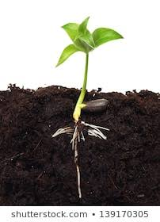
propagation
Through Seedling:
Crab apple is propagated through seed and stooling. To raise crab apple seedlings, the seeds are extracted in May-June and stored in a cool, dry place until December, when they are either sown directly in the sol or stratified in boxes.
In Murree, both stratification and direct sowing produce similar results. The seeds begin to germinate in March and are later transplanted to other beds, where they are ready for budding by the next summer.

Slide 24
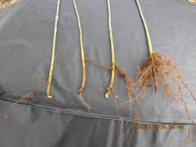
propagation
Through Stooling:
This is also called mound layering which is used for raising of rootstock. Two years old crab apple are cut back to ground level in the spring. Several shoots then emerge and when they are 10-15 cm tall, moist and friable soil is hilled up around them up to half he height of the shoots. This process is repeated 2 or 3 times until July, when the final height of the hill thus built up is 15-20 cm and shoots are 45 cm or more in length.
The un-rooted shoot and the parent stool are kept exposed to light during spring so that they develop new shoots then parent is again hilled up to encourage root development in these shoots.

Slide 25
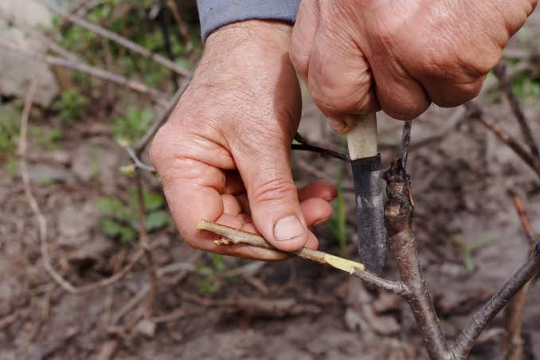
propagation
Raising of scion varieties:
Scion are propagated vegetatively by budding or grafting.
Cutting and layering are not suitable because they are difficult to establish on their own roots.
Budding is done during the active growth stage, while grafting is done dormancy in winter or early spring.
Some method of grafting of apples are whip, tongue grafting and cleft grafting. For budding, the ring or t-budding are of practiced.

Slide 26
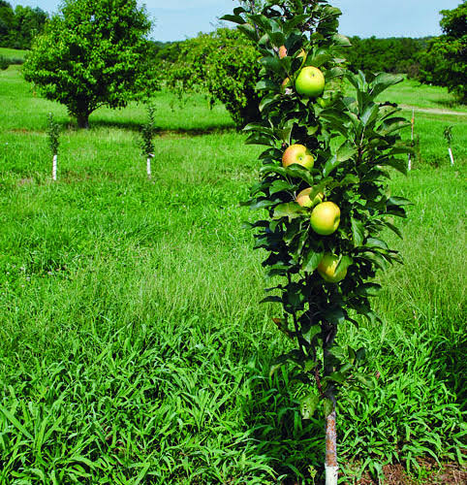
Cultural practices
Planting:
On sloping land, contour planting is done because it has advantages that soil
and rain water are conserved
which results in better tree growth
and production over a long period of time.

Slide 27
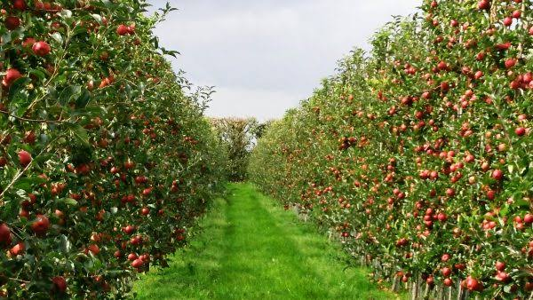
Cultural practices
On level land, square system is use for planting of apple trees. New plantation is done in early spring. The plant to plant distance should be 6-7 m.
wide spacing improves tree vigor and also promotes fruit color due to prolonged exposure to sunlight.
In hilly areas, sod helps to prevent soil erosion and in maintenance of organic matter.
In the Murree hills, trees are hoed under their canopy during early summer to eradicate weeds and grass and monsoon onward grass allowed to grow and mowed from time to time.

Slide 28
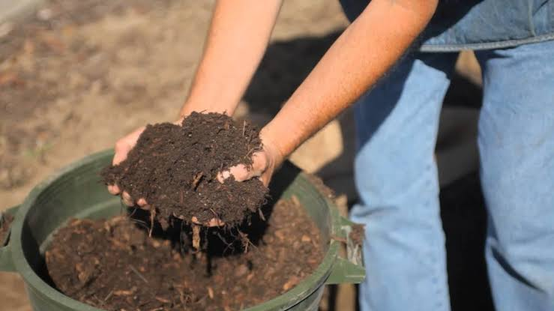
Cultural practices
Manuring:
It is an important cultural operation which is regularly performed in commercial orchards.
Three major elements nitrogen, phosphorus and potassium, are applied through fertilizers
Apple require high K levels, while the need of P is quite low.
Organic manure is more suitable than chemical fertilizers.

Slide 29
Cultural practices
For full grown apple tree, 80-100kg of well rotted FYM is applied in November before first snow.
For full bearing tree, fertilizer doses of
Ammonium sulphate 1.5-2 kg
Potassium sulphate 2 kg
Superphosphate 3 kg
are recommended. Nitrogen is applied in three doses; one soon after snow clearance and the other after fruit set.

Slide 30
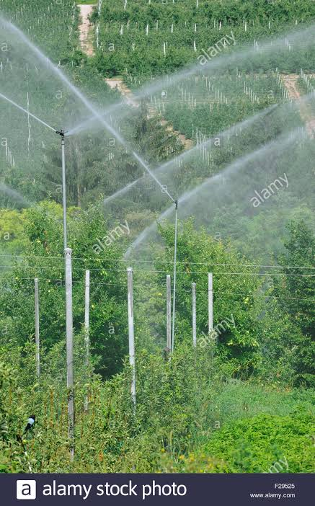
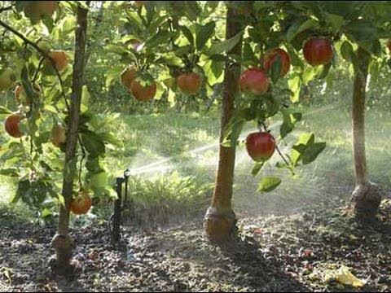
Cultural practices
Irrigation:
During blooming season, irrigation helps to increase fruit set and fruit development
In Murree hills, irrigation is done through rainfall except in the months of May-June. In these months, irrigation is supplied from springs.
In Quetta, there is no rainfall in summer and only 250 mm in winter. Water for irrigation is supplied through karez and springs.
At maturity, light irrigation should be applied. This helps the fruit attain timely ripening and full color development.

Slide 31
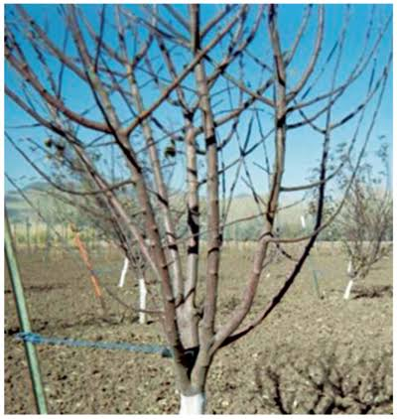
Cultural practices
Pruning and training:
Both young and bearing trees are pruned to increase orchard output, mostly during the dormant season. Training is done to maintain the shape of the tree and to expose the tree to the sunlight. Young trees are prune to train them to desirable shape so that limbs constituting the main framework are strong enough to bear heavy crop of fruit.
This can be helpful in managing spraying, thinning and picking of fruit. Old and undesirable trees are removed to maintain the tree in a vigorous condition. The kind and amount of pruning of tree will depend upon its age, original framework, growth characteristics and fruiting habit of variety.

Slide 32
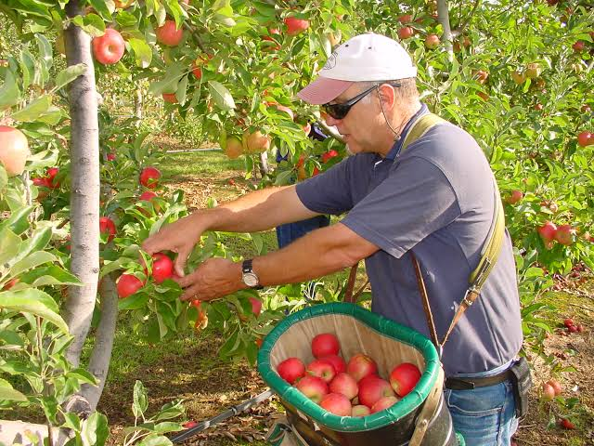
harvesting
Maturity:
Several methods are available for determining optimal harvest time. Days from full bloom is relatively constant from year to year and gives grower a rough estimate of picking date. Cultivars like gala mature early and Fuji very late.
Harvest method:
Apple must be picked by hands to avoid bruising of fresh market quality grade. Fruit must be picked carefully to avoid damaging the spur, where next season fruit will be borne.

Slide 33
Production and yield
Balochistan has largest area under apple production as nearly as one million tons of fruits are produced from 0.23 million hectares and production is 32.6%.
Province wise production of apple:
Year | Punjab | Sindh | KPK | Balochistan | Pakistan(000 tonnes)
2016-17 | 3.55 | 00.00 | 89.98 | 576.40 | 669.91
2017-18 | 3.60 | 00.00 | 69.30 | 576.40 | 649.40

Slide 34
Post harvest handling
Standard packing line operations are used for apple after harvest; hydro-cooling, washing, culling, waxing, sorting and packing. Apples are packed most often in 4/5 bushel boxes (40lb) but polyethylene bags are also popular for retail marketing. Quality grade is based on size and appearance of skin.
Storage
Controlled atmosphere (CA) storage has allowed the marketing of apples on a year round basis. The storage room temperature is altered to retard respiration by reducing oxygen to 2-3% and raising carbon dioxide to about 1%. More mature fruits are sold directly or placed in short term storage.

Slide 35
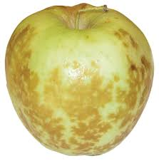
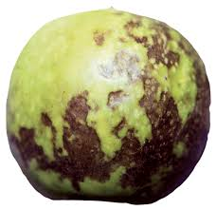
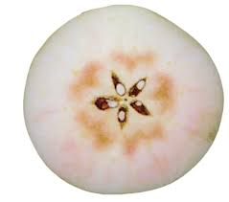
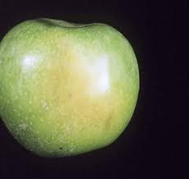
Physiological disorders
apples are affected by different physiological disorders such as:
Superficial scald
Senescent scald
Core fush
Internal breakdown
Braeburn browning
Water core

Slide 36
Insects pests and diseases
Leaves are damaged by insects
Apple trees are susceptible to number of fungal and bacterial diseases and insects pests. Nearly all commercial orchards pursue an aggressive program of chemical sprays to maintain high fruit quality, tree health and high yield.
Spraying of insects pests must never be done during flowering because it kills pollinators. White clover is a component of many grass seed mixes and many bees are poisoned by insecticides while visiting the flowers on the orchard floor after spraying.

Slide 37
Insects pests and disease
Among the most serious disease problems are the fire blight and Gynosporangium rust, apple scab, black spot.
The plum curculio is the most important insect pest. Others include apple maggot, codling moth
Apples are difficult to grow organically, though a few orchards have done so with commercial success, using disease resistant cultivars and the very best cultural control. Spray of light coating of kaolin clay is used as physical barrier to many pests and also helps to prevent apple sun scald.

Slide 38
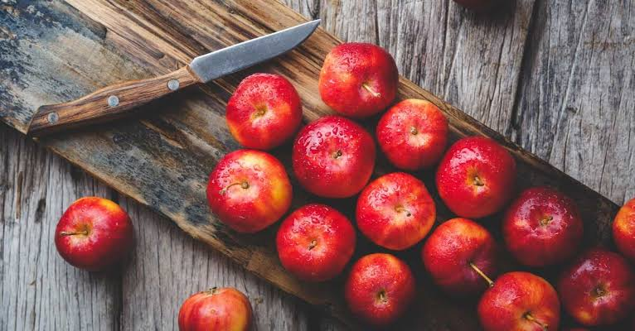
USEFUL BY- PRODUCTS
Apple jam is made from pulp and juice of the fruit.
Apple can also be used to make jelly
Apple pulp is manufactured by picking fresh fruit, which are clean, sound and properly matured.
Apple juice concentrate is produced by evaporating the fresh apple juice, which is extracted from farm fresh juicy apples.
Dried apple retain some chewiness and apple chips are crunchy and make for fine garnish on desserts and salads.
Apple cider vinegar is used in salad, food preservatives and chutneys.

Slide 39
