Slide 1
Growing media and mixes

Slide 2
Characteristics for Good Media:
The growth media should have the following characteristics for good results.
1. The growth medium must be sufficiently firm to hold the cutting in place during rooting. The volume must be fairly constant when it is dry or wet.
2. It must be sufficiently retentive of moisture so that frequency in watering can be minimized.
3. It must be porous so that excess of water can be drained out.
4. The media should be free from weed seeds, pathogens, termites, nematodes etc.
5. The media should be capable or suitable for getting sterilized without any illeffects.

Slide 3
Functions of Growing Media
1.Physical Support:
Young plants are fragile and must remain upright so that they can photosynthesize and grow.
2. Aeration:
Plant roots need a steady supply of oxygen to convert the photosynthate from the leaves into energy so that the roots can grow and take up water and mineral nutrients.
3. Water Supply:
Nursery plants use a tremendous amount of water for growth and development, and this water supply must be provided by the growing medium.
Supply of Mineral Nutrients:
Most of the essential mineral nutrients that nursery plants need for rapid growth must be obtained through the roots from the growing medium.

Slide 5
Growing medias:
Sand:
Sand is the result of weathering effect on parent rocks.
The usual size of sand is from 0.05 to 2.0 mm and is generally used in plant propagation media.
The sand used in plastering is very much suitable for rooting of cuttings.
The sand should be heated or fumigated before being used as media.
Generally sand does not contain any mineral nutrients and has no buffering capacity.
Peat:
Peat consists of the residues from a marsh swamp.
Vegetative peat moss is available but should be broken into fine parts before used in mixtures or as media. It contains some organic nitrogen and is favorable for newly rooted cuttings or germinated seeds.

Slide 6
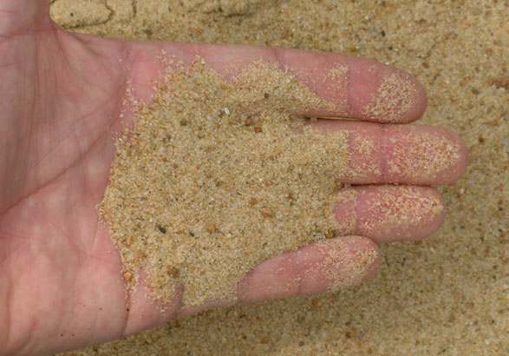
sand Peatmoss

Slide 7
Sphagnum Moss:
Sphagnum moss is the dehydrated remains of acid hog plants and has three genera, growing naturally in damp humid forest lands.
It is relatively sterile, light in weight and has a very high water holding capacity.
Normally, it absorbs and holds water 20 times to its weight.
Sphagnum is acidic in nature having pH about 3.5.
It is used for air layering in woody perennials like pomegranate and figs.

Slide 8
Sphagnum Moss:

Slide 9
Vermiculite and perlite:
Vermiculite:
This is the micaceous mineral which expands significantly when heated.
Chemically it is hydrated magnesium, aluminum, iron, silicate. When expanded it is very light in weight.
It is neutral in reaction and has good buffering properties.
It is insoluble in water
Perlite:
This is gray white material having volcanic origin. It is neutral.
It has no buffering reaction and it contains no mineral nutrients.

Slide 10
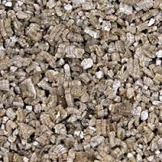
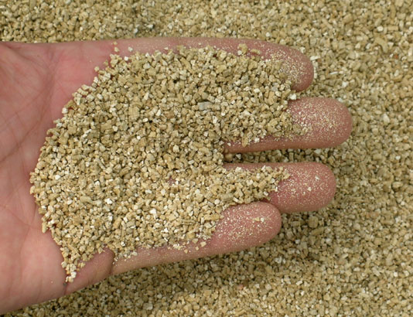
Perlite vermiculite

Slide 11
Pumice and compost:
Pumice is a very light weight volcanic rock that is used sometimes to increase aeration and drainage in potting mixes.
It is sometimes used in field plantings or in container cuttings.
Pumice has a fair water holding capacity. It is not heat treated and is not sterile.
Compost is made from a variety of locally available materials, usually a combination of ingredients that are high in nitrogen and carbon.
Compost holds water well and provides nutrient.
Compost can also provide natural protection against diseases of the seedlings and roots of plants due to beneficial organisms that live in well-made compost.

Slide 12
Leaf Mold and saw dust:
Leaf Mold:
It is prepared by using fallen leaves of various tree species available locally, e.g Oak, Silver oak, Maple, Azadirachta, Ficus, etc.
it is prepared by stacking a few layers of leaves then covering them with a thin layer of soil and cow dung slurry.
Some live culture of decomposing organisms is added to hasten the process of decomposition.
The medium is ready for use after about 12 to 18 months of decomposition.
Saw Dust: It is a byproduct or waste material from saw mills.
The quantity and quality depend on the parent wood material. It is mixed while preparation of media.

Slide 13
Comparison of Potting mix materials
Material | CationExchange | pH values | Sterile (y/n) | Water Holding Capacity | Weight | Cost
Soil | Poor | 4.5-6.0 | No | Poor | Heavy | Low
Sphagnum peat moss | Fair | 3.5-4.0 | Yes | High | Light weight | Medium
Bark | High | 4.0-5.0 | No | Medium | Medium to Heavy | Low
Sand | Poor | 4.5-6.0 | Yes | Poor | Heavy | Low
Pumice | Poor to Fair | 4.5-6.0 | No | Medium | Very Light weight | High
Perlite | None | 6.0-8.0 | Yes | Poor | Very Light weight | High
Vermiculite | High | 4.0-5.0 | Yes | Good | Very Light weight | High
Compost | High | 4.5-6.0 | No | good | Medium | Low

Slide 14
Different Media Combinations for Vegetable Nursery are as follows:
• Loamy soil + Sand + FYM + Vermicompost
• Loamy soil + Sand + FYM + Biofertilizers
• Loamy soil + Sand + Vermicompost + Biofertilizers
• Loamy soil + Sand + Vermicompost + Oil cakes + Biofertilizers
• Loamy soil + Sand + Compost + Biofertilizers
• Loamy soil + Sand + FYM + Oil cakes
• Loamy soil + Sand + FYM + Oil cakes + Biofertilizers
• Loamy soil + Sand + Leaf mould + Oil cakes

Slide 15
Mixing Media and Fertilizers
There are several methods for mixing the media together. A shovel could be used to manually stir the media, but it is extremely important that mixtures be uniform and consistent in quality so that plant growth results are also uniform.
A good system for mixing medium components in a nursery utilizes a rotary-type mixer, such as a cement mixer or a drum and paddle type mixer. There appears to be less breakage of the component particles when rotary-type mixers are used, but difficulties include loading the mixer and retrieving the mixture.

Slide 16
Conti….
Drum and paddle-type mixers can be used effectively if the mixing duration is carefully monitored.
Systems are now available that allow the components to be placed in large bins from which they drop onto conveyer belts in layers or directly into the mixer at the proper ratio.
Shredder-mixers are also used to prepare media.
Such a system can greatly reduce particle size and is unsatisfactory for blending fertilizers, especially controlled-release fertilizers, into the container medium.

Slide 17
Soil mixer

