Slide 1
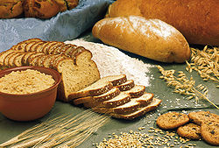
FST-309 Introduction to Cereal Technology 3(2-1)
1

Slide 2
Course contents
Theory
Cereal grains: importance, classification, production; Composition and nutrition of grains: carbohydrates, fats, proteins, minor constituents. Grain grades and grading; Technical aspects of cereals: storage: basic types, role of moisture; Processing - dry milling: cleaning, blending, tempering, conditioning. Grinding process: types of grinding machines; Sieving process: principles, types of sifters; Milling products: types, quality, treatment, rheology. Wet milling - production of starch, oil, protein; Rice: milling, processing, products; The role of cereals in health and disease; History of cereals in diet, Nutritional value of cereals, contribution of cereals and cereal products in diet, cereals in health and disease; Labeling and health claims; Consumer understanding; Future developments: fortification, genetic modifications, gene-nutrient interactions.
2

Slide 3
Practical
Grading of grains; Physical characteristics of cereal grains; Milling of wheat through different mills; Quality assessment of cereals; Rheological properties of dough; Cooking quality of rice; Pasting characteristics of rice flour.
3

Slide 4
Suggested readings
Hoseney, R.C. 1994. Principles of cereal science and technology. American Association of Cereal Chemists Inc, St. Paul, Minnesota, USA.
Karel, K. and G.P. Joseph. 2000. Handbook of cereal science and technology (2nd Ed.). Marcel Dekker, New York, NY, USA.
Kent, N.L. and A.D. Evers. 1994. Technology of cereals. Pergamon Press, Oxford, UK.
Wringley L., Corke H. and C.E Walker .2004. Encyclopedia of cereals grains. Taylor & Francis Ltd.
4

Slide 5
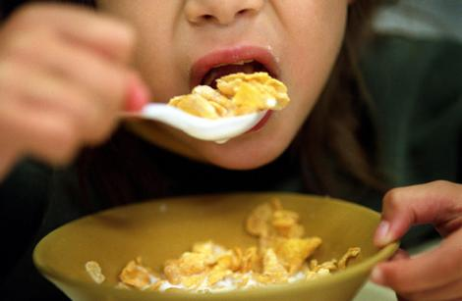
"To eat is a necessity, but to eat intelligently is an art"
5

Slide 6
Plants for Food
Approximately 350,000 plant species exist
195,000 are flowering plants
300 used for food
50 are actively cultivated for food around the world
World wide 17 different species supply most (90%) of our food
6

Slide 7
What are Cereals?
Cereals are grasses (members of the monocot family Poaceae, also known as Gramineae) cultivated for the edible components of their grain (botanically, a type of fruit called a caryopsis), composed of the endosperm, germ, and bran
Cereal grains are grown in greater quantities and provide more food energy worldwide than any other type of crop; they are therefore staple crops

Slide 8
In their natural form (as in whole grain), they are a rich source of vitamins, minerals, carbohydrates, fats, oils, and protein
However, when refined by the removal of the bran and germ, the remaining endosperm is mostly carbohydrate and lacks the majority of the other nutrients.
In some developing nations, grain in the form of rice, wheat, millet, or maize constitutes a majority of daily sustenance.
In developed nations, cereal consumption is moderate and varied but still substantial

Slide 9
Important sources of dietary protein, carbohydrates, the B complex of vitamins, vitamin E, iron, trace minerals, and fiber
The cereal grasses provide the grains that are the staple foods of most of the mankind
Cereals can be grown almost anywhere in the world
9

Slide 10
The 9 Main cereals are
Wheat
Rice
Maize/corn
Barley
Sorghum
Millet
Oat
Rye
Triticale
10

Slide 11
Wheat Triticum aestivum
Rice Oryza sativa
Corn Zea mays
Barley Hordeum vulgare
Millet Pennisetum typhodium
Sorghum Sorghum bicolor
Oat Avena sativa
Rye Secale cereale
Triticale Triticosecale ( man made)
11

Slide 12
The 9 Cereals
The 9 cereals provide 56% of the earth’s consumed energy and 50% of the protein consumed on earth
Wheat, corn and rice make up 75% of the world’s grain production
Wheat and rice are food staples, corn is a dominant source of livestock feed
Wheat, corn and rice are the most important cereals world wide
12

Slide 13
Characteristics of cereal grains
Good (cheap) source of nutrients
Relatively productive in term of land use
Wide rang of products can be prepared
Longer storage stability
13

Slide 14
World utilization of cereal grains
As food 66%
As feed 20%
Industrial 7%
Seed 7%
14

Slide 15
Utilization of cereal grains in Pakistan
Food 85%
Others 15%
Staple food
Cheapest and principle source of calories
More than 60% protein and calories derived from cereals
15

Slide 16
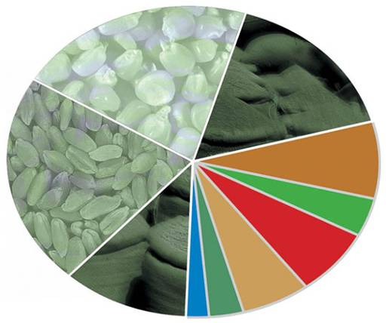
Contribution of cereals in global nutrition
Cereals 70%
Maize
22%
Rice
16%
Wheat
21%
8%
Animal & fish products
4%
Legumes, oilseeds
Others
11%
7%
6%
Roots & tubers
3%
Sugar
Fruits 2%
Other Vegetables & melons
16

Slide 17
Threats to global cereal production
The climatic changes
Diseases and insect pests
Land area decreasing and soil loss increasing
Biofuels are replacing food crops
Post harvest losses
Losses during storage
17

Slide 18
Grains supply chain
18

Slide 19
Cereal Grains and our health
Cereal-based foods may cause dietary problems (gluten intolerance)
Celiac disease, a condition caused by the ingestion of gluten proteins
Not a good sources of quality protein
19

