Slide 2
Genetic linkage and Crossing over

Slide 3
Is independent assortment always the case? No
Independent assortment states that during gamete formation, the two alleles for one gene assort or segregate independently of the alleles for other genes.
But if two genes are found on the same chromosome, they will not assort independently, and don’t follow Medelian inheritance patterns.
Genes that are inherited together are said to be “linked”

Slide 4
Genes located on different chromosomes are not linked. This allows independent assortment – in a di-hybrid cross the traits show the classic 9:3:3:1 inheritance pattern.
Genes that are located very close together on the same chromosome may show complete linkage.
They may be so close to each other that they cannot
be separated by recombination during meiosis.

Slide 5
Genes located far apart on the same chromosome typically show incomplete (partial) linkage because they are easily separated by recombination.

Slide 6
Genetic Linkage
It is the tendency of alleles that are located close together on a chromosome to be inherited together during meiosis.
Genes whose loci are nearer to each other are less likely to be separated on to different chromatids during chromosomal crossover, and are therefore said to be genetically linked.
In other words, the nearer two genes are on a chromosome, the lower is the chance of a swap occuring between them, and the more likely they are to be inherited together.

Slide 7
The discovery of genetic linkage
William Bateson and Reginald Punnett completed a study in1905 that determined the movement of alleles found on the same chromosome.
The study used sweet peas particularly flower colour and pollen shape, they followed inheritance pattern.
For flower colour purple is dominant over red, and for pollen shape long is dominant over round.

Slide 8
A cross was performed using a true breeding purple/long and red/round.
The F1 generation was 100% purple/long.
Crossing two individuals from F1 generation resulted in a F2 generation with four different phenotypes. (purple/long, purple/round, red/long, red/round).
The alleles that created these combinations did not follow the 9:3:3:1 pattern, but supported the idea that these alleles did not assort independently and therefore must be linked.

Slide 10
Why Linkage
Linkage refers to packaging genes onto chromosomes.
Chromosomes ( and therefore linkage ) are for organizing genes for their safe coordinated transmission from cell to cell ( parent to off-spring ).

Slide 11
Types of Linkage
Depending upon presence or absence of new combinations or non-parental combinations, linkage can be of two types:
Complete Linkage
Incomplete Linkage

Slide 12
Complete Linkage
If two or more characters are inherited together and consistently appear in two or more generations in their original or parental combinations, it is called complete linkage. These genes don’t produce non-parental combinations.
Genes showing complete linkage are closely located in the same chromosome.

Slide 13
Incomplete Linkage
Incomplete linkage is exhibited by those genes which produce some percentage of non-parental combinations.
Such genes are located distantly on the chromosome. It is due to accidental or occasional breakage of chromosomal segments during crossing over.

Slide 14
Complete v/s Incomplete Linkage
Complete Linkage
Incomplete Linkage

Slide 15
Significance of Linkage
It does not permit the breeders to bring the desirable characters in one variety. Fro this reason plant and animal breeders find it difficult to combine various characters.
Linkage reduces the chance of recombination of genes and thus helps to hold parental characteristics together. It thus helps organism to maintain its parental, racial and other characters.
Linked genes are not inherited together every time. Chromosomes exchange homologous genes during meiosis

Slide 16
Crossing over and inheritance of linked genes
Linked genes don’t always stay linked.
These linked groups can be separated by crossing over during prophase I of meiosis.

Slide 17
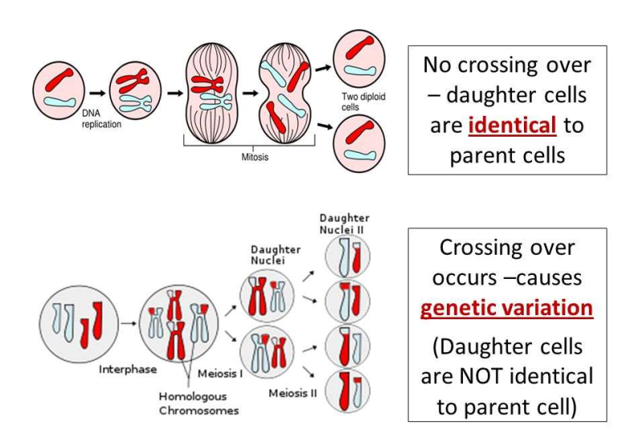

Slide 18
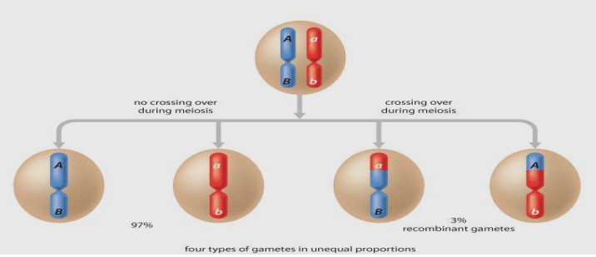
When crossing over occurs the genes that were previously linked become unlinked creating four different types of chromosomes (gametes).
The proportions are not equal because crossing over does not occur in every cell during meiosis.

Slide 19
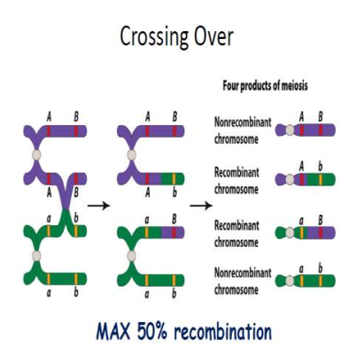
Crossing Over
A random exchange of DNA between two non-sister chromatids of homologous chromosomes.
Results in recombination of genetic material.

Slide 20
Prevalence of recombination is dependent on the distance between linked genes.

Slide 21
Factors affecting cross over
Sex: There is tendency of reduction of crossing over in male mammals.
Mutation: Mutation reduces crossing over.
Temperature: High and low temperature variations increase the percentage of crossing over in certain parts of the chromosome.
X-ray Effect: X-ray irradiations increase crossing over near centromere.
Age: Older age increase the rate of crossing over.

Slide 22
Significance of crossing over
Produces new combinations of traits.
Through crossing over segments of homologous chromosomes are interchanged and hence provide origin of new characters and genetic variations.
Crossing over plays a very important role in the field of breeding to improve the varieties of plants and animals.

Slide 23
Theories of crossing over
Following are theories about crossing over:
Contact First Theory:
According to this theory the inner two chromatids of the homologous chromosomes undergoing crossing over, first touch each other and then cross over. At the point of contact breakage occurs. The broken segments again unite to form new combinations.
The Breakage First Theory:
According to this theory the chromatids under-going crossing over, first of all break into two without any crossing over and after that the broken segments reunite to form the new combinations.

Slide 24
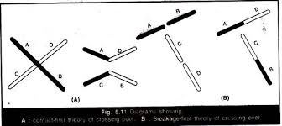

Slide 25
Types of crossing over
Single Crossing Over
Double Crossing Over
Multiple Crossing Over

Slide 26
Single Crossing over
In this type of crossing over, only one chiasma is formed( a chiasma is the point where two homologous non-sister chromatids exchange genetic material during the chromosomal cross over) all along the length of a chromosome pair.
Gametes formed by this type of crossing over are called single cross over gametes.

Slide 27
Double Crossing over
In this type two chiasmata are formed along the entire length of chromosome leading to breakage and rejoin of chromatids at two points. The gametes produced are called double cross over gametes.

Slide 28
Multiple crossing over
In this type more than two chiasmata are formed and thus crossing over occurs at more than two points on the same chromosome pair. It is a rare phenomenon.

Slide 30
Difference between linkage and crossing over
Linkage
It is tendency of genes on a chromosome to remain together and passed as such in next generation.
It brings more parental types.
Strength of linkage between two genes increases if they are closely placed on a chromosome.
It helps to maintain a newly improved variety.

Slide 31
Crossing Over
It is exchange of genes or chromosomal parts to break established linkage and formation of new linkage.
It produces recombination.
Frequency of crossing over between two genes decreases if they are closely placed.
It is the source of variation for producing new varieties.

Slide 32
In genetic recombination by crossing over, what is the difference between parental gametes and recombinant gametes?
Parental gametes are the gametes that maintain the original linkage of genes (alleles) in the chromosome.
Recombinant gametes are those in which the original linkage is undone due to exchange of chromosomal pieces via crossing over during meiosis.

