Slide 1
GIT CONTRAST STUDY
DR NAZISH HAMEED

Slide 21
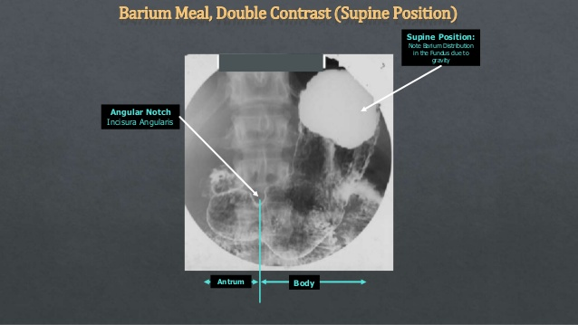

Slide 22
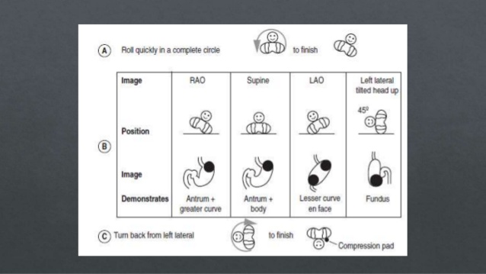

Slide 23
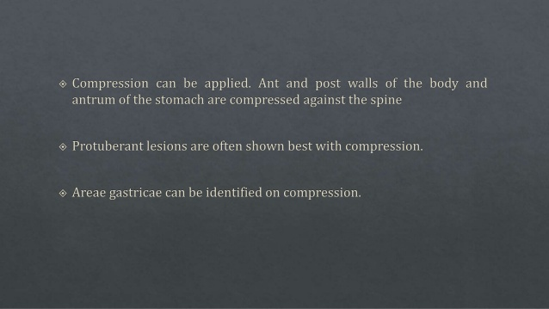

Slide 46
