Slide 1
DAS
Management of New-born Calf
Introduction to Animal Husbandry
2020
Notes:
Experimental—deceleration, disability, supine, mice
Theory—mites, honeybees, identity, probit
Lifespan—primates, etc
Human—self reinforcing, wasp, NBA
Thank
Background
Invasive/Greece/Hawaii
CDFA Medfly panel
Aging research
LBAM
Workshop
Zalom et al
Retreat/Workshop
LMAM see that little changes
New day in science/policy

Slide 2
At Birth
Breathing
Yes or no
If not then artificial breathing
Cleaning
Natural orifices
Necessary during winter
Disinfection of naval cord
Any disinfectant (tincture of Iodine)
Cut 1-1.5 inches from the body, again apply the antiseptic
Notes:
Experimental—deceleration, disability, supine, mice
Theory—mites, honeybees, identity, probit
Lifespan—primates, etc
Human—self reinforcing, wasp, NBA
Thank
Background
Invasive/Greece/Hawaii
CDFA Medfly panel
Aging research
LBAM
Workshop
Zalom et al
Retreat/Workshop
LMAM see that little changes
New day in science/policy

Slide 3
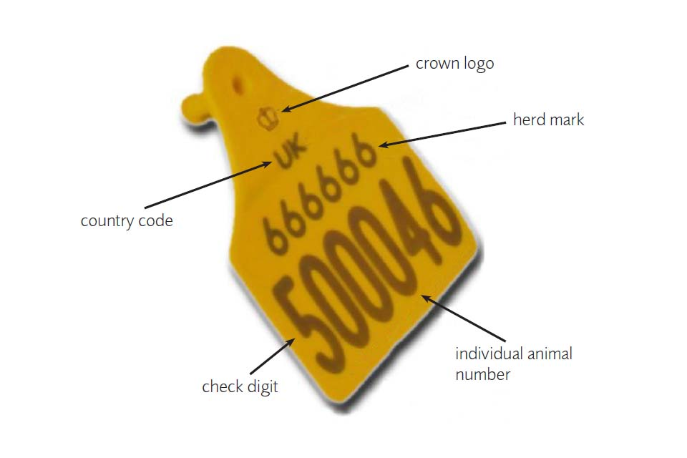
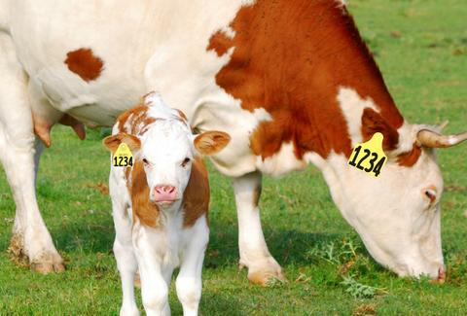
Conti…
Weighing and marking
Before separation from the dam
Tattooing, Ear tagging, Around the neck
Notes:
Experimental—deceleration, disability, supine, mice
Theory—mites, honeybees, identity, probit
Lifespan—primates, etc
Human—self reinforcing, wasp, NBA
Thank
Background
Invasive/Greece/Hawaii
CDFA Medfly panel
Aging research
LBAM
Workshop
Zalom et al
Retreat/Workshop
LMAM see that little changes
New day in science/policy

Slide 4
Conti…
Feeding colostrum (First milk)
Within first hour
Whole, Skimmed, Limited milk and milk replacer
Dehorning
Three to 10 days of age
Calf Feeding Schedules
Notes:
Experimental—deceleration, disability, supine, mice
Theory—mites, honeybees, identity, probit
Lifespan—primates, etc
Human—self reinforcing, wasp, NBA
Thank
Background
Invasive/Greece/Hawaii
CDFA Medfly panel
Aging research
LBAM
Workshop
Zalom et al
Retreat/Workshop
LMAM see that little changes
New day in science/policy

Slide 5
Colostrum
It is the normal physiological secretions of mammary glands of class mammalian just after parturition to fourth day of milking
Benefits
Immunity
Rich source of energy
Nutritious (More fat, proteins, minerals and vitamins)
Remove meconium (the dark green substance forming the first faeces of a newborn infant.)
Notes:
Experimental—deceleration, disability, supine, mice
Theory—mites, honeybees, identity, probit
Lifespan—primates, etc
Human—self reinforcing, wasp, NBA
Thank
Background
Invasive/Greece/Hawaii
CDFA Medfly panel
Aging research
LBAM
Workshop
Zalom et al
Retreat/Workshop
LMAM see that little changes
New day in science/policy

Slide 6
Weaning and Benefits
Take away from dam on first day
Cessation of milk feeding
Benefits
Easy management
Milk can be fed according to requirement
Avoid under or over feeding
Clean milk
Actual milk production record
No teat wound
Notes:
Experimental—deceleration, disability, supine, mice
Theory—mites, honeybees, identity, probit
Lifespan—primates, etc
Human—self reinforcing, wasp, NBA
Thank
Background
Invasive/Greece/Hawaii
CDFA Medfly panel
Aging research
LBAM
Workshop
Zalom et al
Retreat/Workshop
LMAM see that little changes
New day in science/policy

Slide 7
Dehorning
Process of removing or preventing the growth of horns
Why?
Improve the appearance
Reduce injuries
Increase feeder space
Improve the value
Two methods
non-invasive
invasive
Notes:
involving the introduction of instruments or other objects into the body or body cavities.

Slide 8
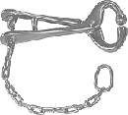
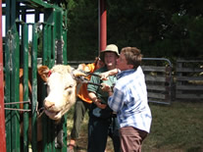
Restraint
Very important
Remember safety
Restrain head
Notes:
Experimental—deceleration, disability, supine, mice
Theory—mites, honeybees, identity, probit
Lifespan—primates, etc
Human—self reinforcing, wasp, NBA
Thank
Background
Invasive/Greece/Hawaii
CDFA Medfly panel
Aging research
LBAM
Workshop
Zalom et al
Retreat/Workshop
LMAM see that little changes
New day in science/policy

Slide 9
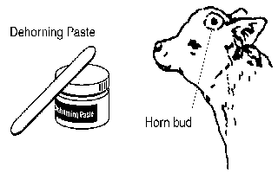
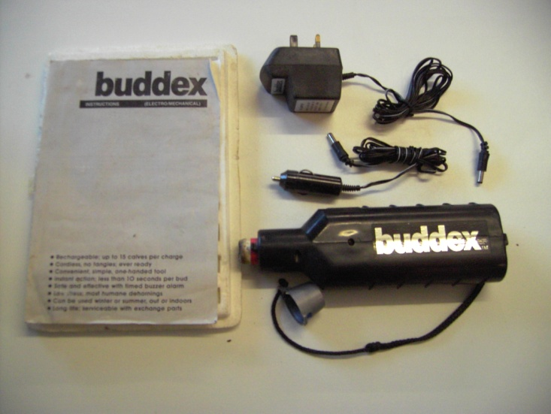
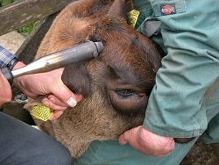
Non-Invasive
Bloodless
Young animals
Types
Chemical paste
Hot iron
Notes:
Experimental—deceleration, disability, supine, mice
Theory—mites, honeybees, identity, probit
Lifespan—primates, etc
Human—self reinforcing, wasp, NBA
Thank
Background
Invasive/Greece/Hawaii
CDFA Medfly panel
Aging research
LBAM
Workshop
Zalom et al
Retreat/Workshop
LMAM see that little changes
New day in science/policy

Slide 10
Disadvantages
Animal need time to set back due to stress
Cost and labor
Death, due to bleeding
Disease spreading
Breed ID
Notes:
Experimental—deceleration, disability, supine, mice
Theory—mites, honeybees, identity, probit
Lifespan—primates, etc
Human—self reinforcing, wasp, NBA
Thank
Background
Invasive/Greece/Hawaii
CDFA Medfly panel
Aging research
LBAM
Workshop
Zalom et al
Retreat/Workshop
LMAM see that little changes
New day in science/policy

Slide 11
Feeding schedule for Calf
Week of age | Whole milk | Legume hay | Calf starter
4 to 7th day | 10% of body weight | ad libitum | ad libitum
2-8th week | 10% of body weight | ad lib. | ad lib.
9th week | 10% of body weight – 2 kg | ad lib. | ad lib.
10th week | 10% of body weight – 4 kg | ad lib. | ad lib.
Notes:
Experimental—deceleration, disability, supine, mice
Theory—mites, honeybees, identity, probit
Lifespan—primates, etc
Human—self reinforcing, wasp, NBA
Thank
Background
Invasive/Greece/Hawaii
CDFA Medfly panel
Aging research
LBAM
Workshop
Zalom et al
Retreat/Workshop
LMAM see that little changes
New day in science/policy

