Slide 1
Frequency Distribution BS Education-V Teaching Mathematics (EDU-511)
Department of Education University of Sargodha

Slide 2
Frequency Distribution Razia Irshad (BEUF18M041) Teaching Of Mathematics (EDU-511) BS Education Sem-5th Department Of Education University Of Sargodha 40100, Pakistan 21st October 2020

Slide 3
Definition
Frequency Distribution:
The conversion of ungrouped data into grouped data so that the frequencies of different groups can be visualized is called frequency distribution.
Frequency
The number of value that accurs in a group of a deta is called its frequency. eg. In the above given examples,
The frequency of (11-40) is 5.
The frequency of (41-70) is 7.
The frequency of (71-80) is 8.

Slide 4
Class Limit's
Upper Clas Limit:
The greatest value of a class interval is called the upper class limit, e.g. in the class interval (41-70), 70 is the upper class limit.
Lower Class Limit:
The smallest value of a class interval is called the lower class limit, e.g. in the class interval (71-100), 71 is the lower class limit.
Class Intervals:
Each group of a deta is Also known as the class interval. For example, (11-40), (41-70) and (71-100) are class interval. Each interval represent all the value of a group.

Slide 5
Size Of The Class Interval:
The number of values in a class interval is called its size or length.
For example, the size or length of class interval (11-40), is 30 that can be checked by counting. It can also be calculated by subtracting the lowest value of the deta from greatest value and divide the result by the class of number interval as shown below:

Slide 6
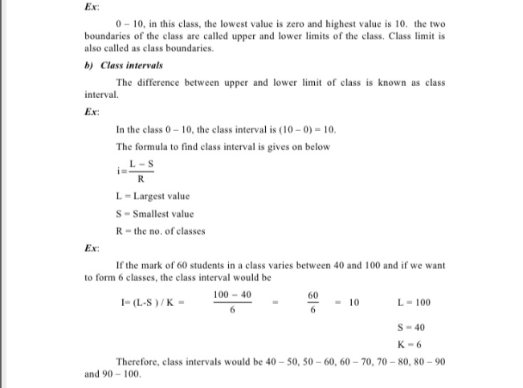

Slide 7
MCQ'S
(1)In the class interval (12-53), the upper class limit is:
(a)6 (b)12 (c)53✔️
(2) in the class interval (7-15), the lower ckass limit is:
(a)6 (b)7 (c)15✔️
(3) in a grouped data, greatest value=21, lowest value =3, and number of interval=3, then the size of the classis is:
(a)3 (b)6 (c)18✔️

