Slide 1
Integument and appendages
Dr. M. Asam Riaz
Assistant Professor
Entomology, College of Agriculture, University of Sargodha, Sargodha, Pakistan

Slide 2
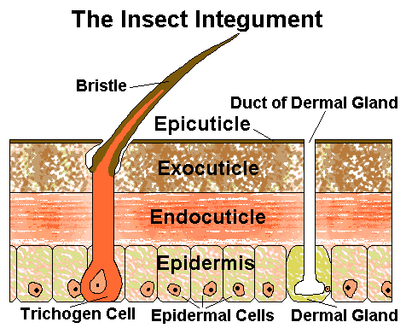
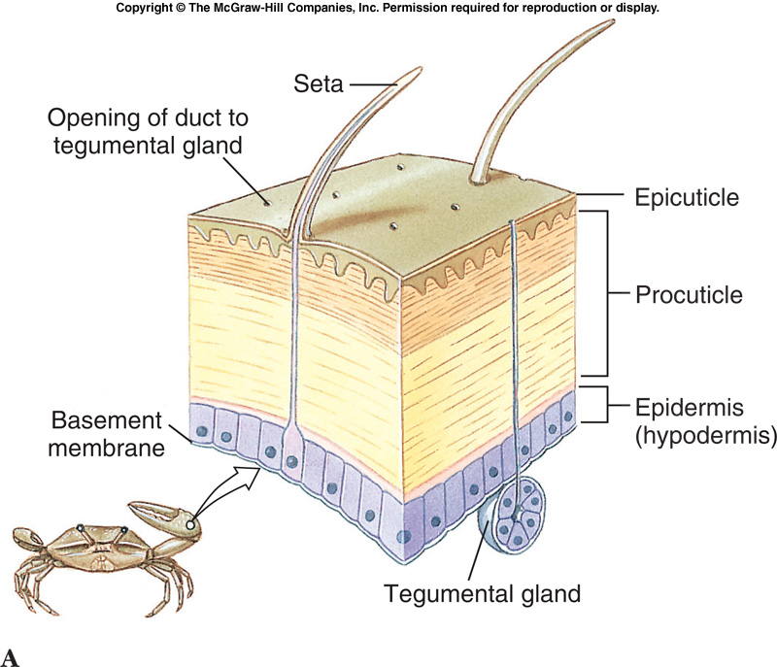
Difference between insects and other arthropods integument

Slide 3
Movie before lecture
https://www.youtube.com/watch?v=fZkNlvKdK3g
https://www.youtube.com/watch?v=BXpwhUCDzc8

Slide 4
What is integument
The integument is the protective outer covering of the body
It is the outer layer of the insect, comprising the
epidermis
cuticle
Basement membrane

Slide 5
Epidermis
It is the outer cell layer of the insect. It is one cell thick, but the cell densities and cell depth changes during development.
This specialized regions are known as plasma membrane plaques and they are the sites of secretion of the outer epicuticle and of chitin fibers.
the epidermal cells form pore canal of the cuticle

Slide 6
Epidermis
All epidermal cells are glandular in the sense.
They secret cuticle and the enzyme concerned in its production and its digestion at the time of molting.
Some epidermal cells have additional specialized glandular functions.
Trichogen, tormogen cells, dermal gland cells

Slide 7
Basal lamina/Basement membrane
The epidermal cells stand on a basal lamina or basement membrane.
The primary components of it are
fibrous protein,
collagen,
glycoprotein and
glycosaminoglycans.
The basal lamina acts as a molecular sieve.
It forms a sheet where muscles are attached.
It may be produced by the epidermal cells, but plasmatocytes also contribute to it.

Slide 8
Basic structure of cuticle
It is differentiated into two main regions:
1- Inner region Pocuticle, characterized by the presence of chitin and forming the block of the cuticle. (200 micrometer)
2- Outer thin epicuticel, which don’t contain chitin.(1-4 micrometer)

Slide 9
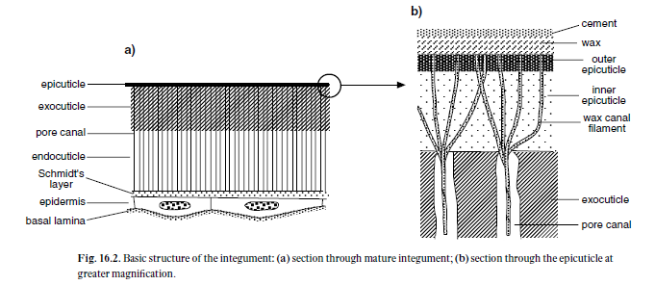

Slide 10
Epicuticle
Made up of several layers
Inner epicuticle
Outer epicuticle
Wax
Cement

Slide 11
Inner epicuticle
Thickest layer of 0.5 to 2micron
Immediately outside the procuticle
Chemically complex and consists of tanned lipoprotein
It contains phenolic substances and phenoloxidase (perform tanning)
Outer epicuticle (also called cuticulin due to its material)
Thin layer of 15nm
It has highly polymerized lipid and protein
First-formed layer at each molt and protect procuticle from molting enzymes.
inextensible

Slide 12
3- Wax layer
Present outside of epicuticle
Variable thickness
Water proofing the cuticle
Synthesized by oenocytes
Contain different compounds
hydrocarbons with odd number of carbon atoms,
90% wax,
aliphatic alcohols with even number of carbon atoms (12 to 34),
fatty acids
Honey bees produce wax. Wax is secreted by epidermal cells on the ventral surface of abdominal segments 4 to 7.
Notes:
The glands of worker bees convert the sugar contents of honey into wax, which oozes through the bee’s small pores to produce tiny flakes of wax on their abdomens. Workers chew these pieces of wax until they become soft and moldable, and then add the chewed wax to the honeycomb construction.
The hexagonal cells of the honeycomb are used to house larvae and other brood, as well as to store honey, nectar and pollen. When beekeepers extract honey from hives, the comb is easily left intact, though beekeepers sell honey comb as well.

Slide 13
Wax is used by honey bees to protect themselves against water loss through the integument and in the construction of combs. The major fractions of the cuticular wax were analyzed by gas-liquid chromatography and were shown to be qualitatively similar to those of comb wax (Blomquist et al. 1980). However, the composition of the cuticular wax of the honey bee is quantitatively different from that of the comb wax.

Slide 14
The major component of the cuticular lipids is hydrocarbon, which comprises 58% of this wax.
In contrast, hydrocarbon comprises only 13-17% of the comb wax, and monoester is the largest component (Tulloch 1971). Comb wax is produced by four pairs of glands within the abdomen while cuticular wax is likely produced by epidermal cells of the integument

Slide 15
4- Cement layer
Very thin layer outside most of the wax
Consisting of mucopolysaccharide associated with lipids
Protect underlying wax
Not produced by all insects (e.g., honey bee)
It is secreted by gland cell.

Slide 16
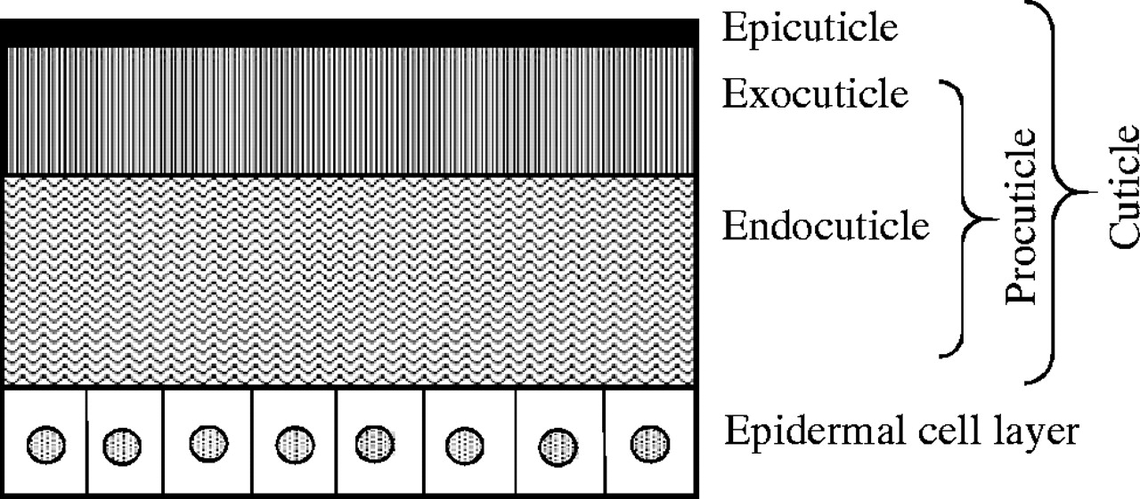

Slide 17
Procuticle
Chitin commonly comprising 20-50% of insect dry weight.
Cuticle bound to protein.
the outer part become hard and rigid to form exocuticle,
the inner undifferentiated part is called endocuticle.
Between of the two there maybe a region of hardened, but not fully darkened cuticle (which contain stain) is called mesocuticle.

Slide 18
What is Chitin?
Chitin is a polysaccharide made up largely of N-acetylglucosamine residues.
The sugar residues are linked by 1-4 β linkage,
Adjacent chitin chains are held together by hydrogen bonds to form microfibrils.

Slide 19
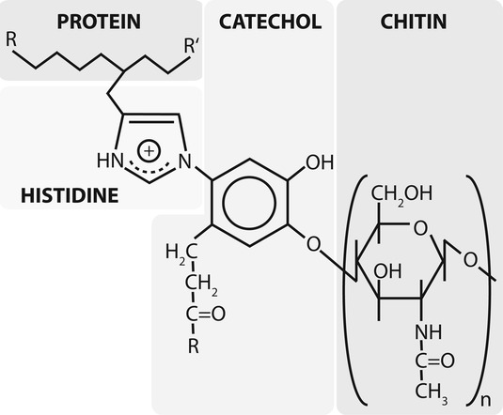
Chemical structure of poly-N-acetyl-d-Glucosamine (chitin) linked to proteins in insect cuticles through catecholamines and histidine moieties (modified after Schaefer et al. 1987)

Slide 20
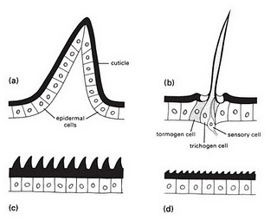
Cuticular appendages and processes
Seta (Macrotrichia)
Microtrichia
Fig. 2 The four basic types of cuticular protuberances: (a) a multicellular spine; (b) a seta, or trichoid sensillum; (c) acanthae; and (d) microtrichia.

Slide 21
Cuticular Appendages are |  | Cuticular processes are
Outgrowths |  | Outgrowths
Connected with cuticle with membranous joints. |  | Connected with cuticle rigidly. No membranous joints.
They arise from epidermis cells. |  | Don’t arise from epidermis
Unicellular appendages | Multicellular appendages | Cuticular processes are either: Microtrichia Spines
Involves a single epidermal cell | Involves more than one epidermal cells
Setae (Macrotrichia) | Multicellular appendages are either: Spines B) Spur

Slide 22
Cuticular Appendages are |  | Cuticular processes are
Known as hairs | Spines: Immoveable appendages, present on tibia. | Microtrichia: fixed hairs, hair like structure present on wings of Mecoptera and Diptera
Arise from a cup like pit which is known as alveolus | Spur: Moveable appendages, present at the end of tibia.
Alveolus: Cavity at the base of setae | ………………………… | Spines: Thorn like structure, harder than microtrichia
Setae is a hollow structure and develop from trichogen cells | ………………………….
Cuticular membrane is produced by tormogen cells | ………………………….. | ……………………………..
Imp. in systematics particularly [thysanura, diptera, lepidoptera, diplura(larvae)] | …………………………. | ……………………………
Arrangement of setae is known as chaetotaxy

Slide 23
Function of Exoskeleton
Inhibits water loss from body
Prevents damage by chemicals and injury
Protects against infection
Provide shape and structure
Muscles attachement for locomotion
Innerlining of trachea, foregut and hindgut

Slide 24
Cuticular extensions
Insects are well endowed with cuticular extensions, varying from fine and hair-like to robust and spine-like. Four basic types of protuberance , all with sclerotized cuticle, can be recognized on morphological, functional, and developmental grounds:
1. Spines are multicellular with undifferentiated epidermal cells.
2. Setae, also called hairs, macrotrichia, or trichoid sensilla, are multicellular with specialized cells;

Slide 25
3. Acanthae are unicellular in origin.
4. microtrichia are subcellular, with several to many extensions per cell

Slide 26
Cuticular extensions Con…
Setae sense much of the insect’s tactile environment. Large setae may be called bristles or chaetae, with the most modified being scales, the flattened setae found on butterflies and moths (Lepidoptera) and sporadically elsewhere. Three separate cells form each seta, one for hair formation (trichogen cell), one for socket formation (tormogen cell), and one sensory cell (Fig. 4.1).

Slide 27
Cuticular extensions Con…
There is no such cellular differentiation in multicellular spines, unicellular acanthae, and subcellular microtrichia. The functions of these types of protuberances are diverse and sometimes debatable, but their sensory function appears limited. The production of pattern, including color, may be significant for some of the microscopic projections. Spines are immovable, but if they are articulated, then they are called spurs. Both spines and spurs may bear unicellular or subcellular processes

Slide 28
Fig. 2 The four basic types of cuticular protuberances: (a) a multicellular spine; (b) a seta, or trichoid sensillum; (c) acanthae; and (d) microtrichia.

Slide 29
Movie before lecture
https://www.youtube.com/watch?v=fZkNlvKdK3g
https://www.youtube.com/watch?v=BXpwhUCDzc8

Slide 30
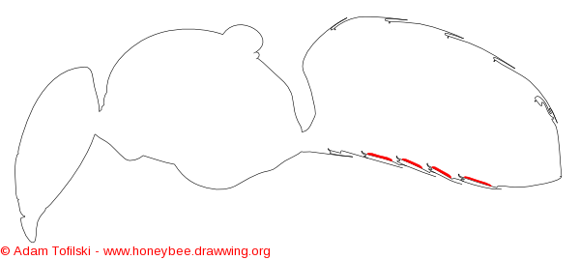
Wax gland (4 to 7 sternites)

Slide 31
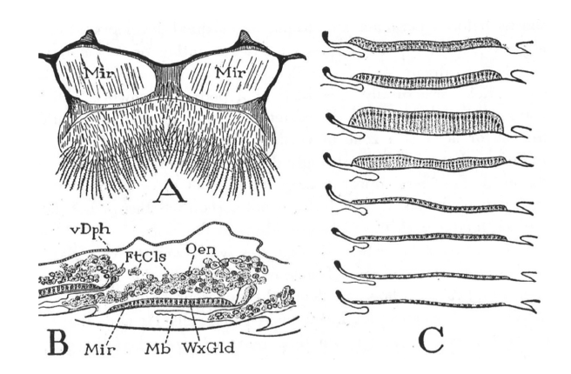
Figure 1.- The Wax Glands: A = Sternum of segment VI of worker, ventral, showing polished “mirrors” beneath wax glands, B = lengthwise section through two wax glands with overlying masses of fat cells and oenocytes. C = stages in the development and regression of a wax gland. Mir = mirror, WxGld = wax gland, FtCls = fat cells, Oen = oenocytes, vDph = ventral diaphragm, Mb = intersegmental membrane. (Snodgrass 1956).
Notes:
https://www.beeculture.com/a-closer-look-beeswax-wax-glands/

