Slide 1
Recording field research observations
For recording field research observations, preparation of data book is essential where
a) field data (coded)
b) decoded raw data and
c) final data will be there.
These data ultimately will be processed and analyses later on according to designs of the experiments
Without data- book the experiments can not move single step further
This book is actually the key book for research activates

Slide 2
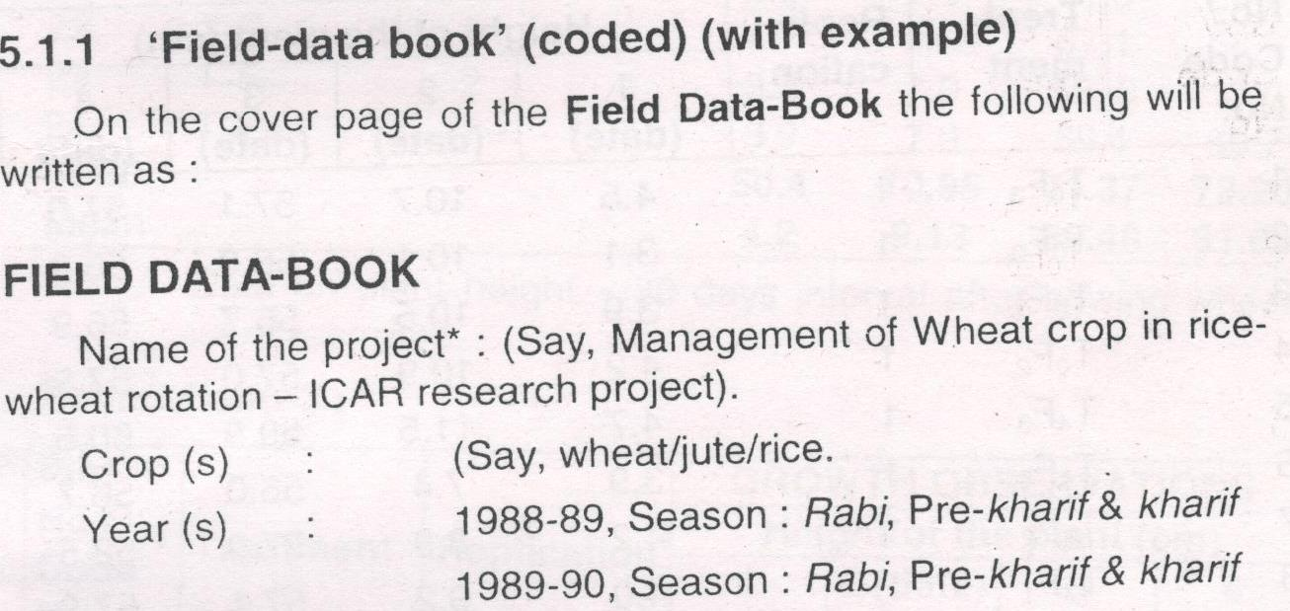

Slide 8
Terms used in fields experiments
Fields layout
Randomization
Replication
Layout fitting
Pegging/Sticking
Recording observation
Field data book
Tag/tagging
Brown paper

Slide 9
Field research observation for growth characters of crops
Height of crops at different intervals
Number of leaves/nodes/leaves per square
Number of total tillers per square at different stages
Number of branches per plant
Number of leaves per plant
Effective tillers/sq.meter
Stem girth( stem diameter) of plant
Length and depth of roots per plant
Number of roots per plants
Number of tubers per Square meter
Weight of tuber per square meter

Slide 10
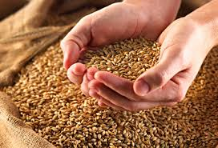
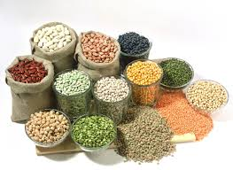
Recording observation for yield/ component of yield
Yield component
Effective tillers
Number of grains per plant
Grain Weight
Plant population
Number of branches per plants
Number of pods per branches
Number of seed per pods
1000 seed weight

Slide 11
Numbers of final effective tillers
Number of grains per plant/tiller
Number of seeds/plant
Number of pods or siliqua per plan
Seed weight
Straw/ Stover or stick yield per plot
grain/ or seed or fibre yield
Weight of individual corm in unit area
Display all these characters in data-book (example)
Number of seeds per pod

Slide 12
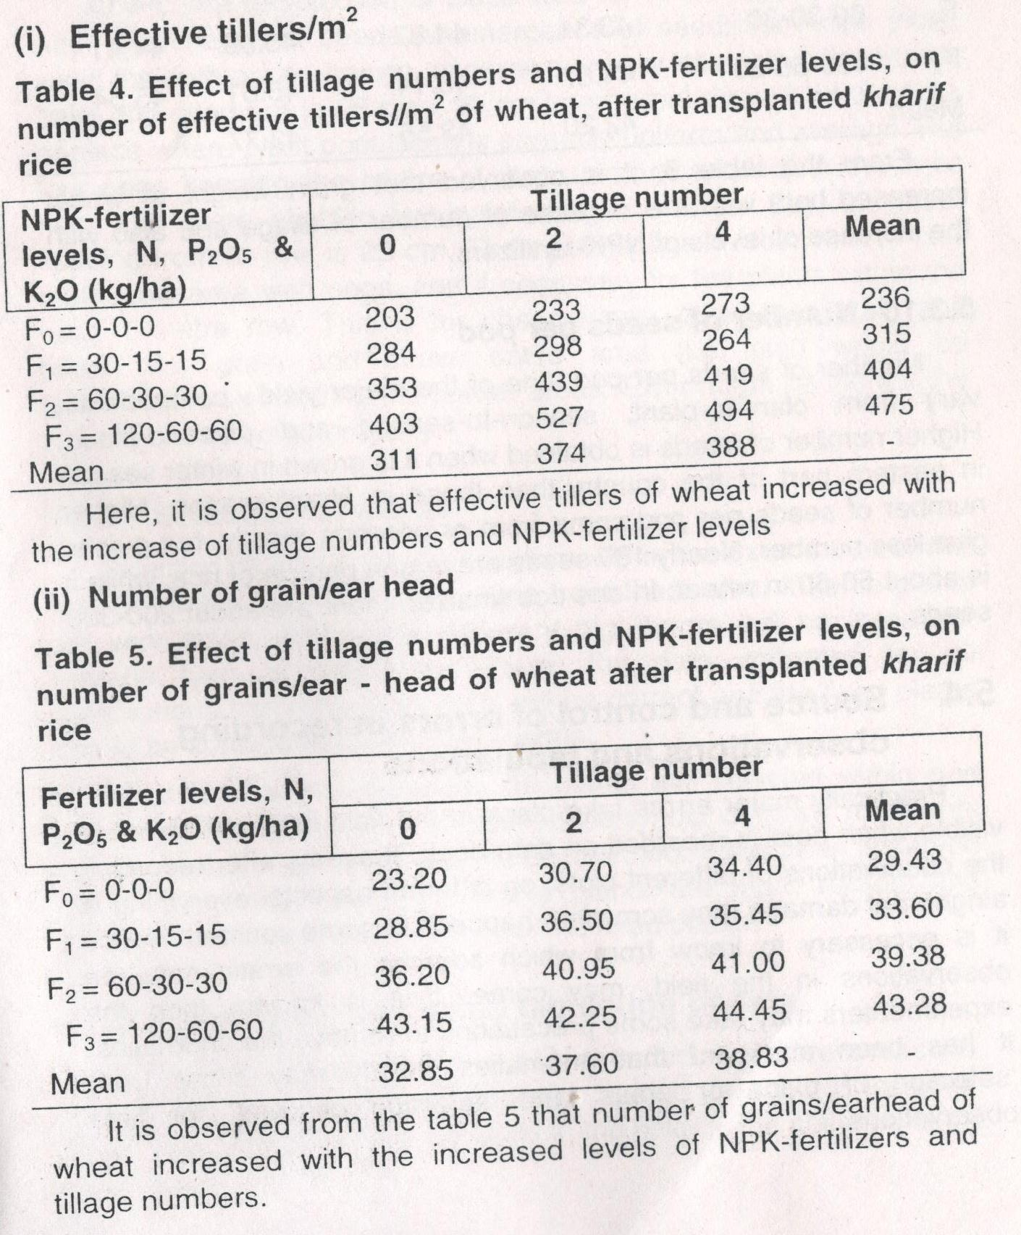

Slide 13
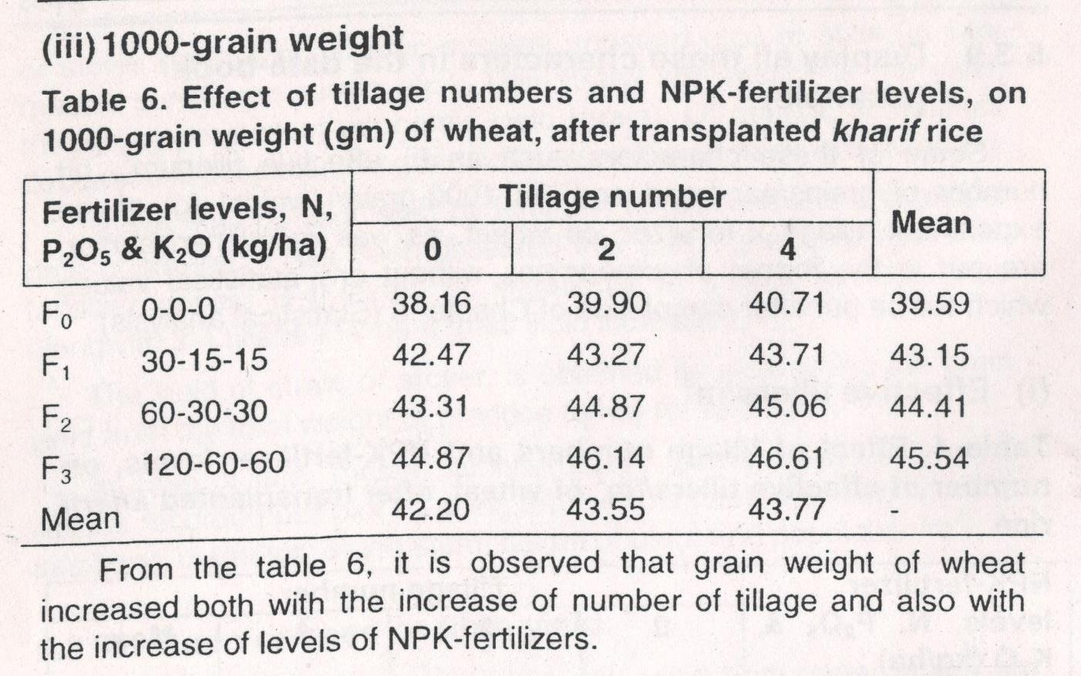

Slide 14
Source and control of error in recording observations and tabulation
Selection of place
Selection of plants
Coding/ decoding and tabulation of data
Decoding
Tabulation of data

