Slide 1
Screen Printing

Slide 2
What is screen printing?
Screen printing is the process of transferring a stencilled design onto a flat surface using a mesh screen, ink and a squeegee
Fabric and paper are the most commonly screen-printed surfaces, but with specialised inks it’s also possible to print onto wood, metal, plastic, and even glass
The basic method involves creating a stencil on a fine mesh screen, and then pushing ink (or paint, in the case of artwork and posters) through to create an imprint of your design on the surface beneath.
The process is sometimes called 'silk screening' or 'silk screen printing' and while the actual printing process is always fairly similar, the way the stencil is created can vary, depending on the materials used. Different stencilling techniques include:
Using masking tape or vinyl to cover the desired areas of the screen.
Painting the stencil onto the mesh using 'screen blockers' such as glue.
Using a light-sensitive emulsion to create a stencil, which is then developed in a similar way to a photograph

Slide 3
Why is screen printing used?
One of the reasons that the screen printing technique is so widely used is because it produces vivid colours, even on darker fabrics
Designs use one shade of ink, or several. In the case of multicoloured items, the colours must be applied in individual layers, using separate stencils for each ink.
The technique is also favoured because it allows the printer to easily reproduce a design multiple times. Because the same stencil can be used to replicate a design again and again
For creating large batches of custom clothing
Even with the complexity, the colors are more intense than digital printing

Slide 4
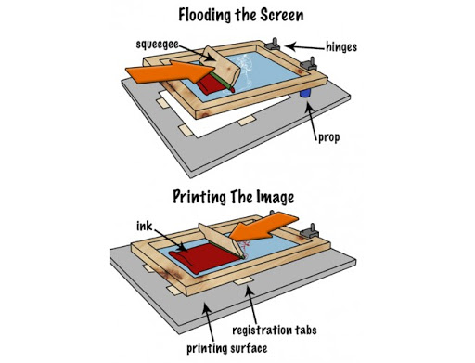
Screen printing

Slide 5
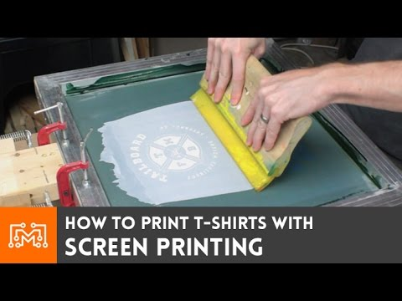
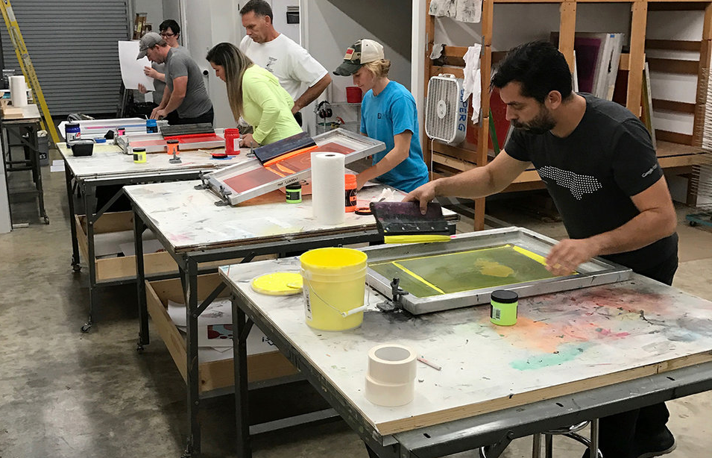
SCREEN PRINTING PRESS
We can screen print with just a mesh screen and a squeegee,
But mostly we prefer to use a press, because it print lots of items more efficiently.
Why we prefer it , because the press holds the screen in place between prints which makes it easier to swap out the paper or clothing that is being printed.
There are three types of press: manual, semi-automatic, and automatic.
In Manual press, they are operated by hand, they require human labor.

Slide 6
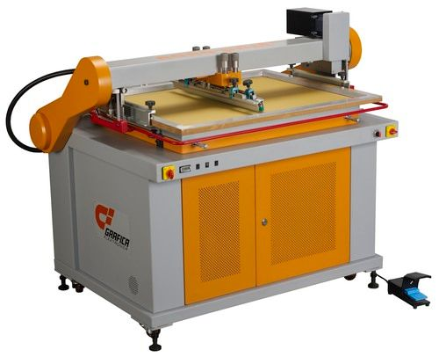
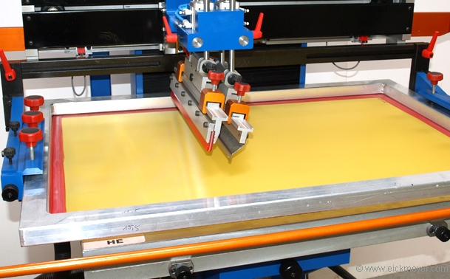
Semi-automatic presses are partially mechanised, but still require human input to swap over the items being pressed, while

Slide 7
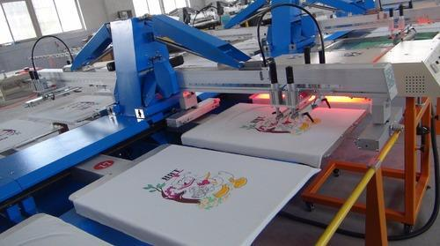
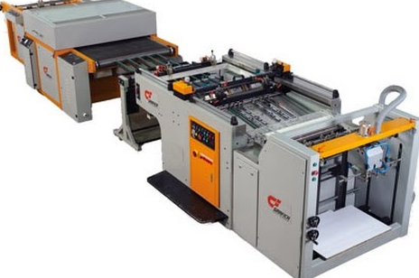
automatic presses are completely automated and require little to no input.

Slide 8
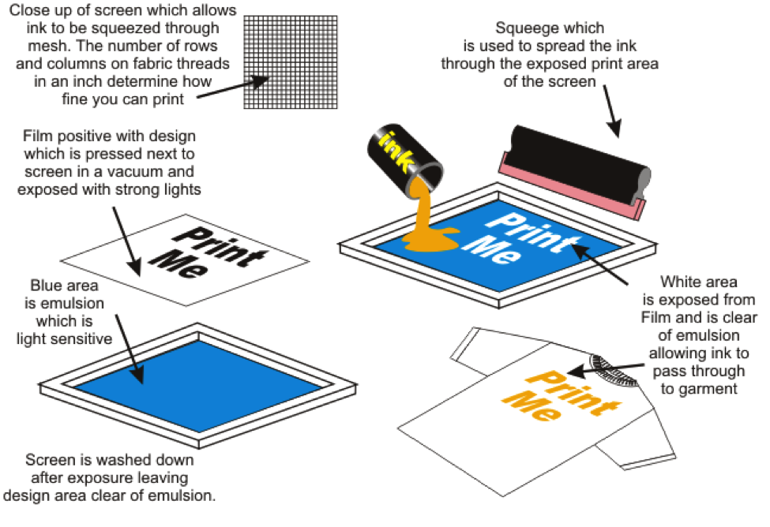
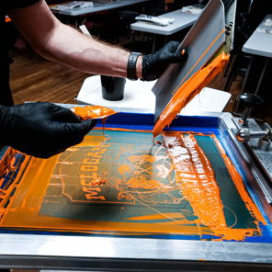
The inks
paint is pushed through the mesh screen and onto the item being printed,
a printer may use glittery inks
, texturised inks
, or puff inks (which expand to create a raised surface)
to create a unique look or feel.
The printer will also take into account the type of fabric being screen printed.

Slide 9
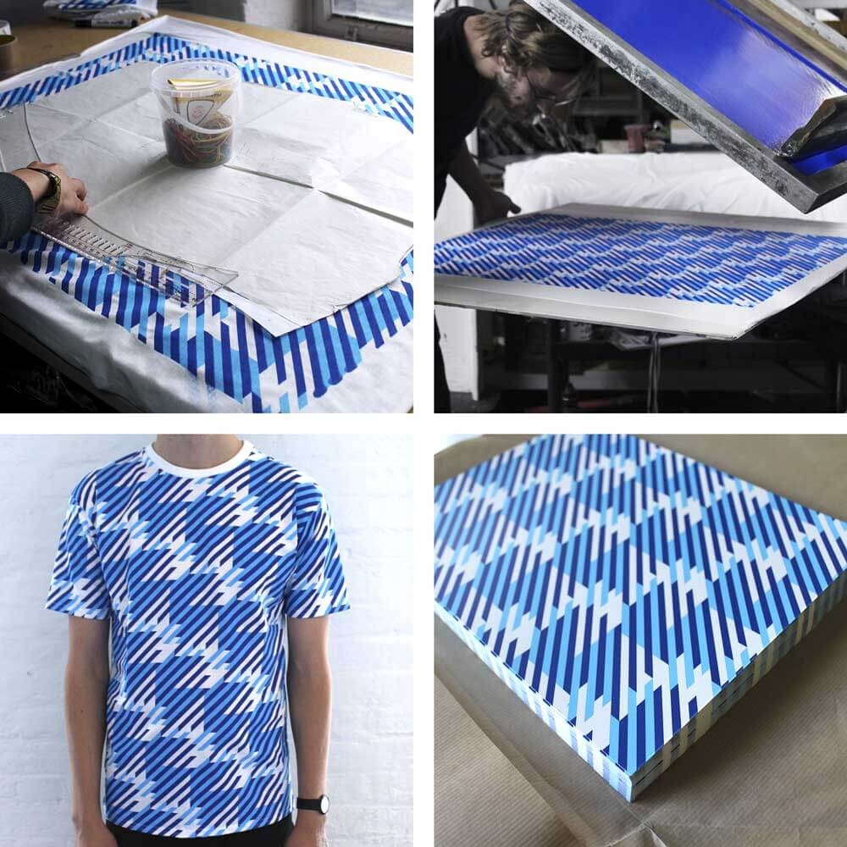
Will screen printing ink wash out?
If a garment has been properly screen using a heat-treated washable ink, then the design shouldn’t wash out.
the manufacturer's guidelines should be followed.
The correct drying temperature and time vary according to the type of ink and the fabric used.
so the printer needs to follow the instructions to create a long-lasting, washable item.

Slide 10
Process
There are different methods of screen printing, but they all involve the same basic technique.
The form of printing we'll talk about below is the custom method that uses a special light-reactive emulsion to create a custom stencil; this tends to be the most popular type of commercial printing, as it can be used to make intricate stencils

Slide 11
Steps of process
Step 1- To start, the printer takes the design they want to create on the finished product, and prints it out onto a transparent acetate film. This will be used to create the stencil.
Step 2- Next, the printer will choose a mesh screen to suit the complexity of the design, and the texture of the fabric being printed. The mesh screen is then coated with a layer of light-reactive emulsion, which will harden when developed under bright light.

Slide 12
Steps of process
Step 3- The acetate sheet featuring the design is then laid onto the emulsion-coated screen, and the whole thing is exposed to a very bright light. The light hardens the emulsion, so the parts of the screen which are covered by the design remain in liquid form.
If the final design is going to include more than one colour, then a separate screen must be used to apply each layer of ink. To create multi-coloured products, the printer must use his skill to design each stencil, and line them up perfectly to ensure the final design is seamless.
Step 4- After the screen has been exposed for a set time, the areas of the screen not covered by the design will have turned hard. Any unhardened emulsion is then carefully rinsed away. This leaves a clear imprint of the design on the screen for the ink to pass through.
The screen is then dried, and the printer will make any necessary touch-ups or corrections to make the imprint as accurate as possible to the original design. The stencil is now ready to be used.

Slide 13
Steps of process
Step 5- The screen is then placed on the printing press. The item or garment being printed is laid down flat onto the printing board, underneath the screen.
There are a number of different presses, including manual and automatic styles, but most modern commercial printers will use an automatic rotary carousel printer, as this allows several different screens to work at once. For multicoloured prints, this sort of printer can also be used to apply the separate colour layers in quick succession.
Step 6- The screen is lowered down onto the printing board. Ink is added to the top end of the screen, and a squeegee is used to pull the ink along the full length of the screen. This presses the ink through the open areas of the stencil, imprinting the design on the product underneath.
If the printer is creating multiple items, then the screen is raised and a new garment is placed onto the printing board. The process is then repeated.
Once all the items have been printed and the stencil has served its purpose, the emulsion is removed using a special washing fluid so the mesh can be reused to create new stencils.

Slide 14
Steps of process
Step 7- The printed product then passes through a dryer, which 'cures' the ink and creates a smooth, colourfast finish. The final product will be checked and washed thoroughly to remove any residue, before being passed on to its new owner.

Slide 15
History
Ancient art form
Printing patterns onto fabrics
Firstly, it was pioneered in China around 950 AD
Japanese artisans:
adopted after centuries. They transfer the pattern by using stiff brush to push ink through ma mesh screen from human hair

Slide 16
History
18th century :
it arrived in Europe. It was slow to catch on as fabric printing method was of high cost because of high rates of silk mesh. After Silk Road, imported silk became affordable making silk printing a popular and profitable way to print fabric.
20th century:
Photo sensitized emulsion was created by printers which allowed artisans to make complex designs easily.
Serigraphy:
It was named as serigraphy by printers and artisans as they began experimenting with it.

Slide 17
History
Fine arts :
Eduardo paolozzi and Andy Warhol
Marilyn diptych is best example of screen printing by Andy Warhol.
Now a days :
Used as artistic medium
Commercial printing process
Custom clothing

