Slide 1
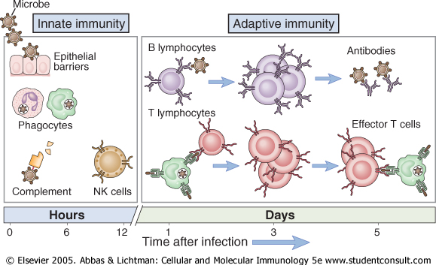

Slide 6
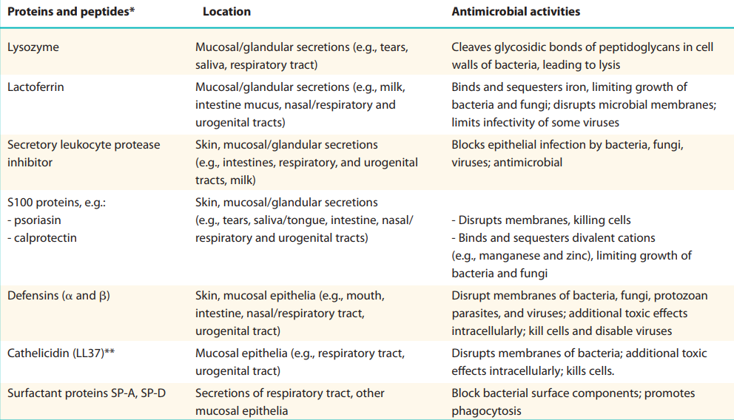

Slide 8
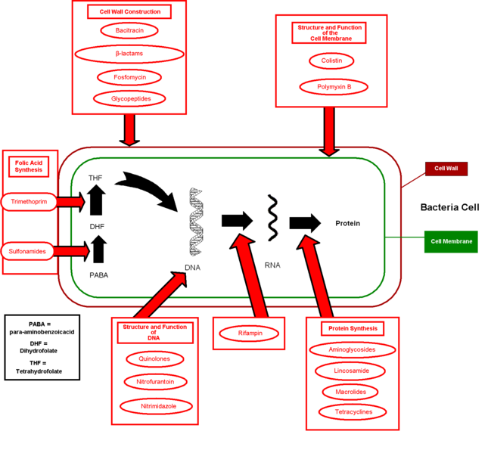
sites of antiobiotic action
Notes:
This diagram shows the various targets of antibiotics on the structure and functions carried out by bacteria. The beta-lactams group of antibiotics, which I will talk more about shortly, has an effect on the construction of cell walls by many different types of bacteria.

Slide 9
Antibiotics: modes of resistance

Slide 11
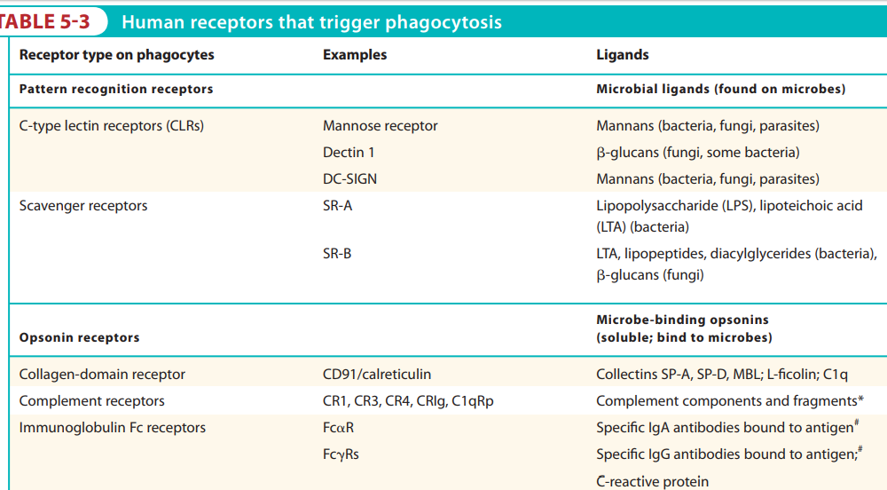

Slide 13
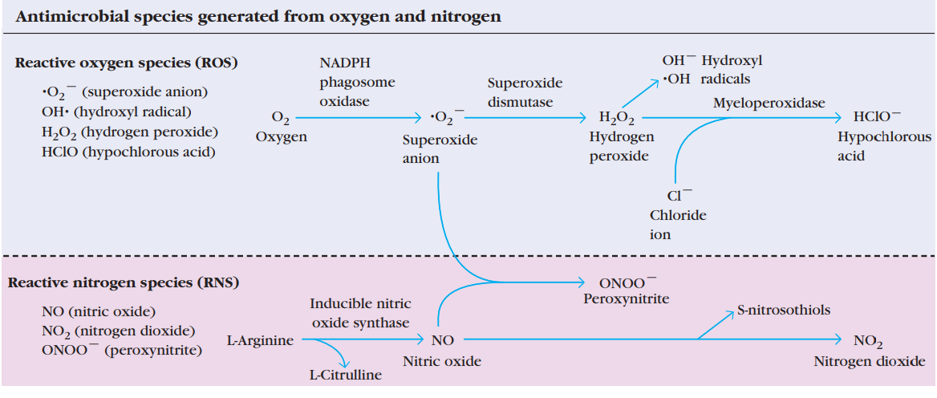

Slide 14
