Slide 1
MEASURES OF DISEASE FREQUENCY AND DISEASE BURDEN
Medical Geography

Slide 2
Introduction
Certain aspects of health and disease patterns can be calculated and quantified for research and other purposes.
These methods are very useful since they help in understanding the difference in the distribution of diseases and many more outcomes.
The main objective behind such studies is to measure disease occurrence and make comparisons between population groups.

Slide 3
Major health outcomes
Examples of health outcomes measured in health studies include:
1. Morbidity
2. Mortality
3. Infectious disease incidence
4. Birth defects
5. Disability
6. Injuries
7. Vaccine efficacy
8. Utilization of hospital services

Slide 4
Measures of disease frequency
Measures of disease frequency are used to describe how common an illness (or other health event) is with reference to the size of the population (the population at risk) and a measure of time. Measures of disease frequency include:
a) Prevalence
b) Incidence
c) Calculation of person-time at risk
d) Issues in defining the population at risk
e) The relationships between incidence and prevalence
f) Commonly used measures of disease frequency

Slide 5
Main measures of disease frequency
There are two main measures of disease frequency:

Slide 6
1. Prevalence
Prevalence measures the proportion of individuals in a defined population that have a disease or other health outcomes of interest at a specified point in time (point prevalence) or during a specified period of time (period prevalence).

Slide 7
Example of calculating prevalence rate
Of 10,000 female residents in town A on 1st January 2006, 1,000 have hypertension.
The prevalence of hypertension among women in town A on this date is calculated as:
1,000/10,000 = 0.1 or 10%

Slide 8
Contd:
Prevalence is a useful measure for quantifying the burden of disease in a population at a given point in time
Calculating prevalence of various conditions across different geographical areas or amongst different sub-groups of the population and then examining prevalence of other potential risk factors can be of particular use when planning health services
Prevalence is not a useful measure for establishing the determinants of disease in a population

Slide 9
2.Incidence
In contrast to prevalence, incidence is a measure of the number of new cases of a disease (or other health outcome of interest) that develops in a population at risk during a specified time period.
Incidence in epidemiology is a measure of the probability of occurrence of a given medical condition in a population within a specified period of time. Although sometimes loosely expressed simply as the number of new cases during some time period
There are two main measures of incidence:

Slide 10
Contd.

Slide 11
Incidence Risk
Risk is the proportion of individuals in a population (initially free of disease) who develop the disease within a specified time interval. Incidence risk is expressed as a percentage (or if small as per 1000 persons).

Slide 12
Contd:
The incidence risk assumes that the entire population at risk at the beginning of the study period has been followed for the specified time period for the development of the outcome under investigation. However, in a cohort study participants may be lost during follow-up. For example, some participants may:
Develop the outcome under investigation
Refuse to continue to participate in the study
Migrate
Die
Enter the study some time after it starts

Slide 13
Incidence Rate
Incidence rates also measure the frequency of new cases of disease in a population. However, incidence rates take into account the sum of the time that each person remained under observation and at risk of developing the outcome under investigation.

Slide 14
The relationship between prevalence and incidence
Incidence should not be confused with prevalence which is the proportion of cases in the population at a given time rather than rate of occurrence of new cases.
Thus, incidence conveys information about the risk of contracting the disease, whereas prevalence indicates how widespread the disease is.
Prevalence is considered more useful measure for calculating the disease burden of non-communicable diseases. While as Incidence rate is more useful for studying the communicable or infectious diseases
The proportion of the population that has a disease at a point in time (prevalence) and the rate of occurrence of new disease during a period of time (incidence) are closely related.
Prevalence depends on:
1. The incidence rate (r)
2. The duration of disease (T)

Slide 15
Contd.
For example, if the incidence of a disease is low but the duration of disease (i.e. until recovery or death) is long, the prevalence will be high relative to the incidence. For example diseases like leprosy or tuberculosis tend to persist for a longer duration, from months to years, hence the prevalence (old and new cases) would be longer than the incidence.
Conversely, if the incidence of a disease is high and the duration of the disease is short, the prevalence will be low relative to the incidence [1]. For example, acute conditions like diarrhoea have a relatively short duration (a few days).
A change in the duration of a disease, for example the development of a new treatment which prevents death but does not result in a cure will lead to an increase in prevalence. Fatal diseases or diseases from which a rapid recovery is common have a low prevalence, whereas diseases with a low incidence may have a high prevalence if they are incurable but rarely fatal and have a long duration.

Slide 16
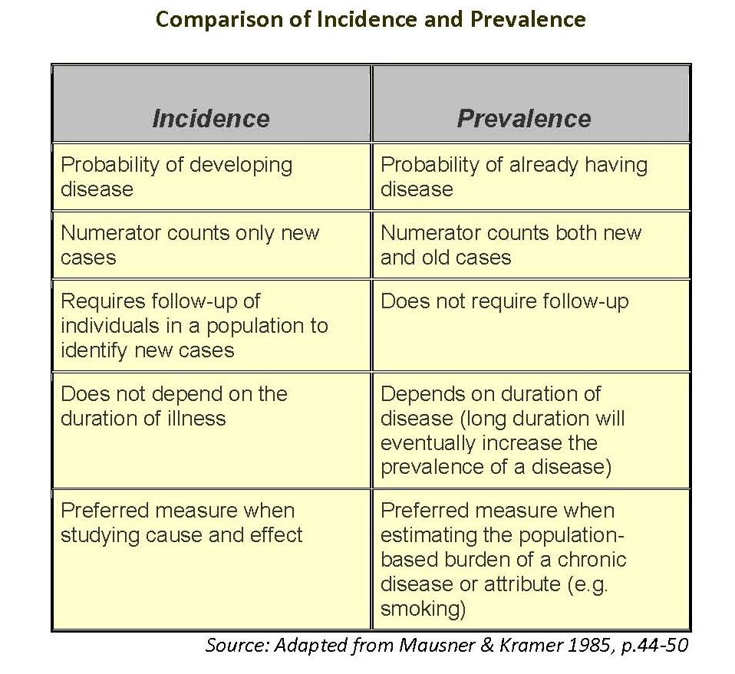

Slide 18
Other commonly used measures of disease frequency

Slide 19
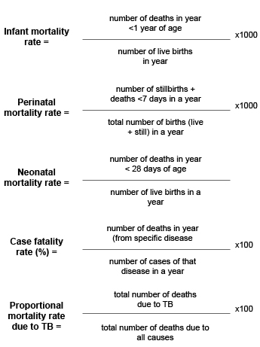

Slide 20
Useful links for further study
https://www.vetmed.umn.edu/sites/vetmed.umn.edu/files/shmp_2016l17.50_comparing_incident_vs_rate-science_page.pdf
https://www.britannica.com/science/incidence-epidemiology
http://sphweb.bumc.bu.edu/otlt/MPH-Modules/EP/EP713_DiseaseFrequency/EP713_DiseaseFrequency4.html
https://www.cdc.gov/csels/dsepd/ss1978/lesson3/section2.html
https://www.eupati.eu/pharmacoepidemiology/epidemiologic-concepts-incidence-and-prevalence/

