Slide 1
HORT 308
MEDICINAL AND AROMATIC PLANTS

Slide 2
Arjun

Slide 3
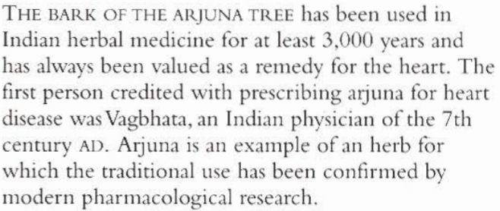
B.N.Terminelia arjuna Family:Combretaceae

Slide 4
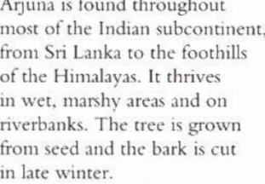
Habitat and Cultivation

Slide 5
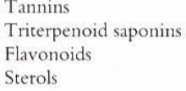
Key Constituents

Slide 6
Key Actions

Slide 7
Research
Through research in India since 1930 it has been proved Arjun as
Cardiac Tonic
Reduce blood Cholesterol

Slide 8
Traditional and Current uses
Traditional Heart remedy
Leaf juice for earache
Decoction for Diarrhea and Dysentery
For Poisoning and Scorpion sting
Modern heart remedy

Slide 9
Parts Used
Bark
Leaves

Slide 10
Key preparations
Infusion
Decoction
Tincture
Powder

Slide 11
Ginger

Slide 12
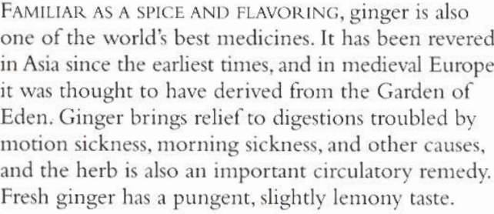
B.N. Zjngiber officinal Family:Zingibereacea

Slide 13
Habitat and Cultivation
Native to Asia
Grown in throughout the tropics, It needs plenty of water ,fertile soil and shady places

Slide 14
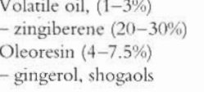
Key Constituents

Slide 15
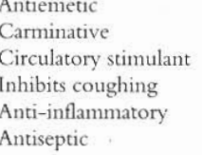
Key Actions

Slide 16
Research
Antiemetic (Motion sickness and post operative Nausea proved better than conventional medicine in London 1990)
Antiseptic

Slide 17
Traditional and Current uses
Digestive Problems (Indigestion, Colic ,Gas, intestinal infections)
Circulatory Problems(Stimulate blood flow to surface specially to hands and feet)
Increase sweating and reduce body temperature in fever
Respiratory conditions(Cough, cold and flu etc.)

Slide 18
Parts Used
Rhizomes (Fresh and dried)

Slide 19
Key Preparations
Infusion
Essential oil
Tincture
Capsules

Slide 20
Precautions
Do not use essential oil internally.
Do not ginger medicine when suffering from peptic ulcer

Slide 21
Making Herbal Remdies

Slide 22
Infusions

Slide 23
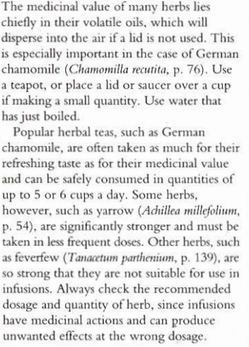

Slide 24
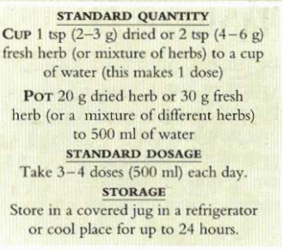

Slide 25
Decoctions

Slide 26
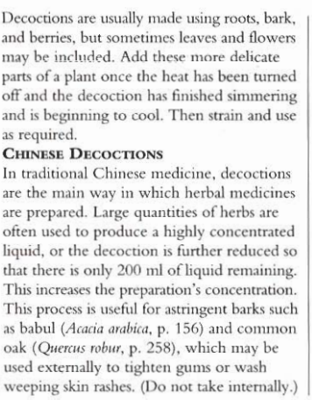

Slide 27
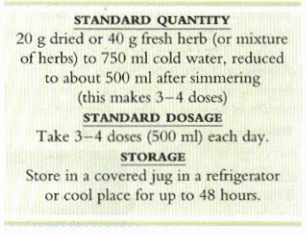

Slide 28
Tinctures

Slide 29
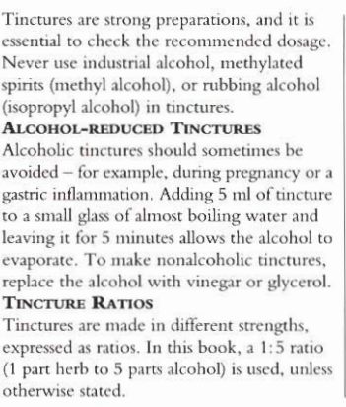

Slide 30
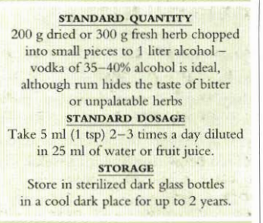

Slide 31
Capsules and Powders

Slide 32
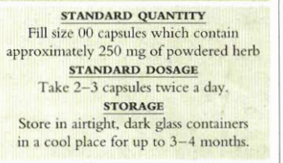

Slide 33
Tonic Wines

Slide 34
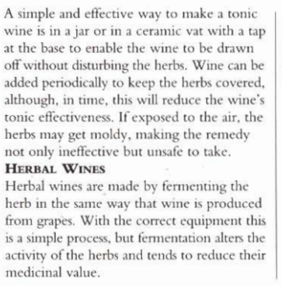

Slide 35
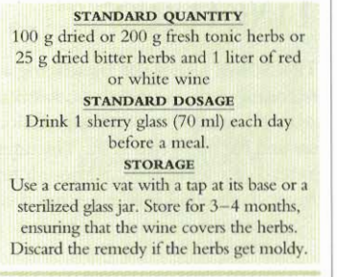

Slide 36
Syrups

Slide 37
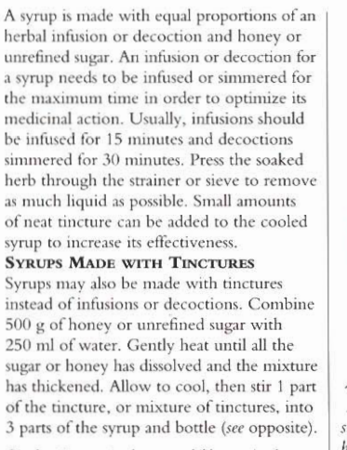

Slide 38
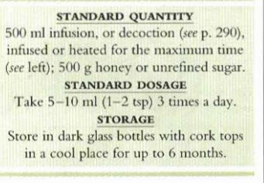

Slide 39
Infused Oils

Slide 40
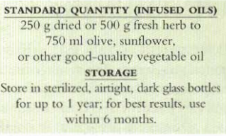

Slide 41
Ointments

Slide 42
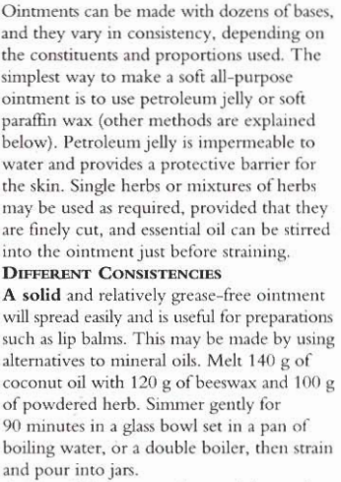

Slide 43
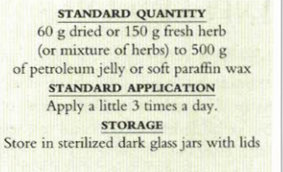

Slide 44
Poultices

Slide 45
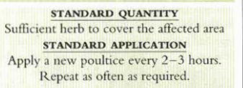

Slide 46
Creams

Slide 47
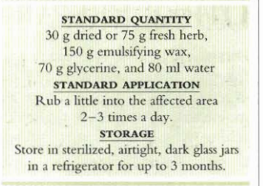

Slide 48
Compresses and Lotions

Slide 49
