Slide 1
LAYOUT AND STYLE, SELF DOCUMENTING CODE

Slide 2
Contents
Introduction
Layout Techniques
Commenting Techniques
Key Points

Slide 3
Introduction
This topic turns to an aesthetic aspect of computer programming: the layout of program source code.
The layout don’t affect execution speed, memory use, or other aspects of a program that are visible from outside the program.
It affect how easy it is to understand the code, review it, and revise it months after you write it.
It also affect how easy it is for others to read, understand, and modify your code.

Slide 4
Introduction

Slide 5
Introduction
The routine in the previous slide is syntactically correct.
It’s thoroughly commented and has good variable names and clear logic.
What the routine doesn’t have is good layout.

Slide 6
Introduction

Slide 7
Introduction
The routine has become much more readable, and the effort that has been put into documentation and good variable names is now evident.
The variable names and comments are same in both examples, but the layout was so poor in the earlier one that they weren’t helpful.

Slide 8
Layout Techniques
A good layout can be achieved using these simple techniques
White space
Grouping
Blank lines
Indentation
Parentheses

Slide 9
Layout Techniques
Whitespace
Usewhitespacetoenhancereadability.
White space, including spaces, tabs, line breaks, and blank lines, is the main tool available to you for showing a program’s structure.
You wouldn’t think of writing a book with no spaces between words, no paragraph breaks, and no divisions into chapters.
Breaking a book into chapters, paragraphs, and sentences shows a reader how to mentally organize a topic.

Slide 10
Layout Techniques
The information contained in a program is denser than the information contained in most books.
Whereas you might read and understand a page of a book in a minute or two, most programmers can’t read and understand a program listing in that time.
A program should give more organizational clues than a book, not fewer.

Slide 11
Layout Techniques
Grouping
White space helps in grouping, making sure that related statements are grouped together.
In writing, thoughts are grouped into paragraphs.
A well-written paragraph contains only sentences that relate to a particular thought.
It shouldn’t contain extraneous sentences.
Similarly, a paragraph of code should contain statements that accomplish a single task and that are related to each other.

Slide 12
Layout Techniques
Blank lines
Just as it’s important to group related statements, it’s important to separate unrelated statements from each other.
The start of a new paragraph in English is identified with indentation or a blank line.
The start of a new paragraph of code should be identified with a blank line.
Using blank lines is a way to indicate how a program is organized.
You can use them to divide groups of related statements into paragraphs, to separate routines from one another, and to highlight comments.

Slide 13
Layout Techniques
Indentation
Use indentation to show the logical structure of a program.
As a rule, you should indent statements under the statement to which they are logically subordinate.
Indentation has been shown to be correlated with increased programmer comprehension.
Studies show that programmers scored 20 to 30 percent higher on a test of comprehension when programs had a two-to-four-spaces indentation scheme than they did when programs had no indentation at all.

Slide 14
Layout Techniques
Parentheses
Use more parentheses than you think you need.
Use parentheses to clarify expressions that involve more than two terms.
They may not be needed, but they add clarity and they don’t cost you anything.

Slide 15
Layout Techniques
For example, how are the following expressions evaluated?
C++ version: 12 + 4 % 3 * 7 / 8
Microsoft Visual Basic version: 12 + 4 mod 3 * 7 / 8
Even experienced programmers don’t answer confidently, and that’s why you should use parentheses whenever there’s any doubt about how an expression is evaluated.

Slide 16
Commenting Techniques
Commenting can be done by several different techniques depending on the level to which the comments apply. These levels are
Class
Routine
Paragraph
Individual line.

Slide 17
Commenting Techniques (Individual Lines)
In good code, the need to comment individual lines of code is rare.
Here are two possible reasons a line of code would need a comment:
The single line is complicated enough to need an explanation.
The single line once had an error, and you want a record of the error.

Slide 18
Commenting Techniques (Individual Lines)
Endline comments are usually used for commenting individual statements.
Endline comments are comments that appear at the ends of lines of code.
Endline comments tend to be cryptic.
The right side of the line usually doesn’t offer much room, and the desire to keep the comment on one line means that the comment must be short.
Work then goes into making the line as short as possible instead of as clear as possible.

Slide 19
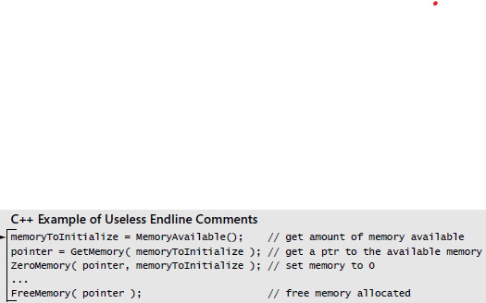
Commenting Techniques (Individual Lines)
In addition to this practical problem, endline comments pose several conceptual problems.
Here’s an example of a set of endline comments:

Slide 20
Commenting Techniques (Individual Lines)
First problem is that it’s hard to write a meaningful comment for one line of code.
Most endline comments just repeat the line of code, which hurts more than it helps.
Consider another example

Slide 21
Commenting Techniques (Individual Lines)
If an endline comment is intended to apply to more than one line of code, the formatting doesn’t show which lines the comment applies to.
Even though the content of this particular comment is fine, its placement isn’t.
You have to read the comment and the code to know whether the comment applies to a specific statement or to the entire loop.

Slide 22
Commenting Techniques (Paragraphs)
Most comments in a well-documented program are one-sentence or two-sentence comments that describe paragraphs of code:
Java Example of a Good Comment for a Paragraph of Code
// swap the roots
oldRoot = root[0];
root[0] = root[1];
root[1] = oldRoot;

Slide 23
Commenting Techniques (Paragraphs)
The comment doesn’t repeat the code, it describes the code’s intent.
Such comments are relatively easy to maintain.
Even if you find an error in the way the roots are swapped, for example, the comment won’t need to be changed.
While writing a comment for a code paragraph, it should be written at the level of intent, means it must describe the purpose of the block of code that follows the comment.
Comments that aren’t written at the level of intent are harder to maintain.

Slide 24
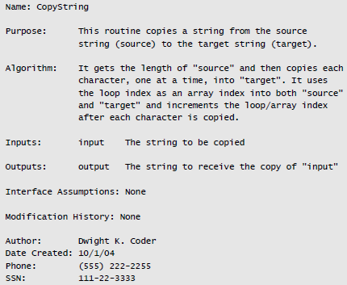
Commenting Techniques (Routines)
Consider the following routine header

Slide 25
Commenting Techniques (Routines)
CopyString is presumably a trivial routine probably fewer than five lines of code.
The comment is totally out of proportion to the scale of the routine.
Another problem with heavy routine headers is that they discourage good factoring of the code, the overhead to create a new routine is so high that programmers will tend to err on the side of creating fewer routines, not more.
Coding conventions should encourage good practices; heavy routine headers do the opposite.

Slide 26
Commenting Techniques (Routines)
Some guidelines for commenting routines are
Keep comments close to the code they describe
Describe each routine in one or two sentences at the top of the routine
Document interface assumptions
Comment on the routine’s limitations
Document the routine’s global effects

Slide 27
Commenting Techniques (Classes)
For each class, use a block comment to describe general attributes of the class:
Describe the design approach to the class
Overview comments that provide information that can’t readily be reverse-engineered from coding details are especially useful.
Describe the class’s design philosophy, overall design approach, design alternatives that were considered and discarded, and so on.
Notes:
Factory method, observer, singleton

Slide 28
Commenting Techniques (Classes)
Describe limitations, usage assumptions, and so on
Similar to routines, be sure to describe any limitations imposed by the class’s design.
Also describe assumptions about input and output data, error-handling responsibilities, global effects, sources of algorithms, and so on.

Slide 29
Commenting Techniques (Classes)
Comment the class interface
Can another programmer understand how to use a class without looking at the class’s implementation? If not, class encapsulation is seriously at risk.
The class’s interface should contain all the information anyone needs to use the class.
The Javadoc convention is to require, at a minimum, documentation for each parameter and each return value .
This should be done for all exposed routines of each class.

Slide 30
Commenting Techniques (Classes)
Don’t document implementation details in the class interface
A cardinal rule of encapsulation is that you expose information only on a need-to-know basis: if there is any question about whether information needs to be exposed, the default is to keep it hidden.
Consequently, class interface files should contain information needed to use the class but not information needed to implement or maintain the inner workings of the class.

Slide 31
Key Points
The first priority of visual layout is to illuminate the logical organization of the code. Criteria used to assess whether that priority is achieved include accuracy, consistency, readability, and maintainability.
Looking good is secondary to the other criteria—a distant second. If the other criteria are met and the underlying code is good, however, the layout will look fine.

Slide 32
Key Points
The question of whether to comment is a legitimate one. Done poorly, commenting is a waste of time and sometimes harmful. Done well, commenting is worthwhile.
The source code should contain most of the critical information about the program. As long as the program is running, the source code is more likely than any other resource to be kept current, and it’s useful to have important information bundled with the code.
Comments should say things about the code that the code can’t say about itself at the summary level or the intent level.

Slide 33
Readings
[Chapter 31,32] Code Complete: A Practical Handbook of Software Construction by Steve McConnell, Microsoft Press; 2nd Edition (July 7, 2004). ISBN-10: 0735619670

