Slide 2
Each organization's specific environment is unique and changes with conditions e.g Rolex and Timex
Organizations exist to meet the needs of customers. It's the customer or client who absorbs the organization's output.
Organization's suppliers provide materials and equipment. The term suppliers also includes providers of financial and labor inputs. Stockholders, banks, insurance companies, pension funds, and other similar organizations are needed to ensure a continuous supply of money. Labor unions, colleges and universities, occupational associations, trade schools, and local labor markets are sources of employees. When the sources of employees dry up, it can constrain managers' decisions and actions.

Slide 3
All organizations have one or more competitors. Managers cannot afford to ignore the competition. When they do, they pay dearly. Now, with digital cable, DVD players and VCRs, and even the World Wide Web, customers have a much broader choice of what to watch. As technological capabilities continue to expand, the number of viewing options will provide even more competition for the broadcast networks. The Internet is also having an impact on whom an organization's competitors are because it has virtually eliminated the geographic boundaries.
Managers must recognize the special-interest groups that attempt to influence the actions of organizations. For instance, PETA's (People for the Ethical Treatment of Animals) pressure on McDonald's Corporation over its handling of animals during the slaughter process led McDonald's to stop buying beef from one of its suppliers until it met McDonald's standards for processing cattle. As social and political attitudes change, so too does the power of pressure groups.

Slide 4
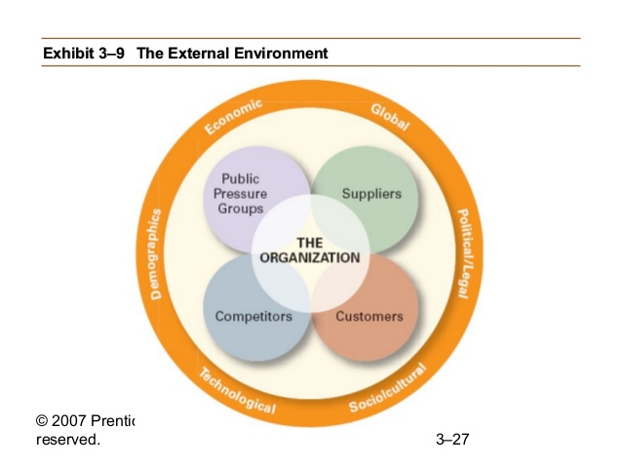

Slide 6
