Slide 1
Natural Approach
5180351
5180368
5180383

Slide 2
Natural Approach
History and Background
Objectives
Theories
Learner and Teacher’s roles
Advantages and Disadvantages

Slide 3
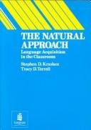
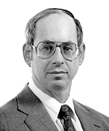
History and Background
It was developed and published as a book by Mr. Stephen Krashen and Mrs. Tracy Terrell in 1983.
Mr. Stephen Krashen is a famous linguist. He is currently a professor at University of Southern California.
Mrs. Tracy Terrell is an educational theorist and a professor at University of California.

Slide 4
History and Background
The publication of this book, “The Natural Approach”, made a wide impact globally.
Natural Approach believes that adults can still acquire second languages. The ability of language acquisition does not disappear as we grow up.

Slide 5
History and Background
Adults have the LAD. Adults also acquire language by following the principles of Universal Grammar.
The different between adult and children acquisition skill is that adults have two things to follow when they learn foreign language: Acquisition and learning. But, children only acquire the languages.

Slide 6
History and Background
In the book, Mr. Krashen and Mrs. Terrell consider their approach as a traditional method.

Slide 7
Objectives
To help adults in learning the foreign language naturally.
The learner will be able to pick up the grammar by themselves when they are ready.

Slide 8
Theories
The Acquisition-Learning hypothesis –
is the most basic steps of all in the Krashen’s theory
It’s the most well known among linguists and language practitioners.
The learner has two ways of learning the second language, which are the acquired system and the learned system.
The monitor hypothesis
when the learner can check and correct language output.

Slide 9
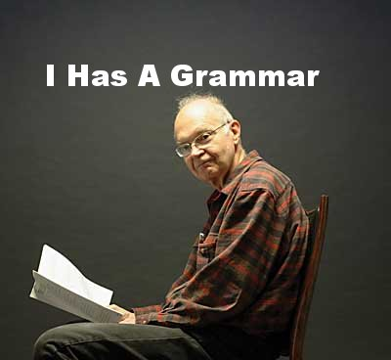
Theories
The Natural Order hypothesis
When people acquire language by using grammatical structures in a predictable order.
The input hypothesis
The acquisition of languages are in a predictable order. Everybody have the same steps of learning acquisition.

Slide 10
Theories
The Affective Filter hypothesis
When the learner’s emotional state can act as a filter that can prevent input from reaching the learner’s language acquisition device.
Filter is up = Negative emotional factors and they won’t acquire language.
Filter is down = Learner will learn better.

Slide 11
Roles of Teacher and Learner
Teacher:
Act as an authority in the class
Imitate the first language learning process
Creatively instruct students to do activities that benefit the language learning.
Student:
Responds to the teacher by physical action
Interact to teacher and other students

Slide 12
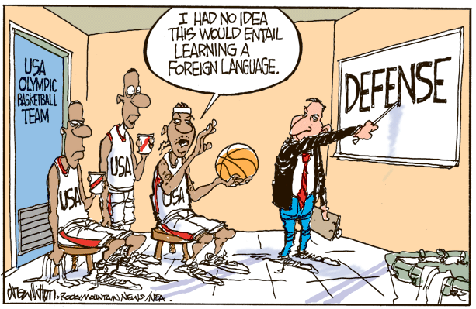
In Class Activities
For beginners:
Pointing, handing objects, writing or drawing , standing, walking, sitting down
For advanced learners:
Like listening n reading tasks that learners order pictures, follow written instruction or maps.

Slide 13
Advantages & Disadvantages
Advantages
This method is very easy
Reliable as it’s widely used
There’s no grammar instruction in this method
Disadvantages
It takes long time and learner can do only elementary things
It does not suit for those who do not have much time
The method rarely concerns about correctness

Slide 14
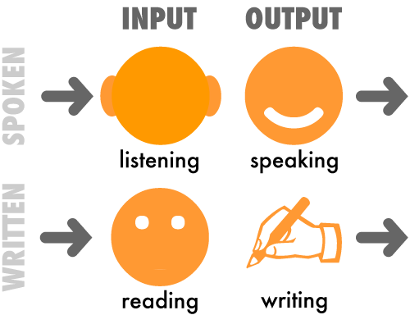
Techniques involved
Using inputs like pictures, objects
Mime
Body language
Audiovisual aids
Memorizing

Slide 15
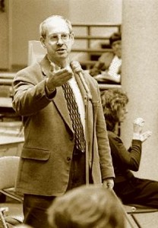
Thank You for Your Attention

