Slide 1
Lecture
Spearman Rank order correlation

Slide 2
Introduction
Charles Edward spearman (born Sep 10, 1863) in London & (died Sep 17, 1945) who theorized that general test.
The spearman’s rank order correlation coefficient, In short spearmen’s correlation is a statistical procedure that is designed to measure the relationship between two variables.
The parametric equivalent to this correlation is pearson product –moment correlation.

Slide 3
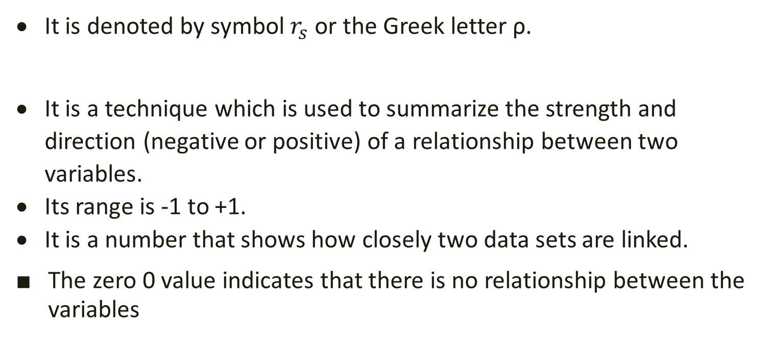
It is denoted by symbol $r_{s}$ or the Greek letter ρ.
It is a technique which is used to summarize the strength and direction (negative or positive) of a relationship between two variables.
Its range is -1 to +1.
It is a number that shows how closely two data sets are linked.
The zero 0 value indicates that there is no relationship between the variables

Slide 4
Assumptions
You need two variables that are either ordinal, interval, or ratio.
Linearly related
Spearman's correlation determines the strength and direction of the Monotonic relationship between your two variables.

Slide 5
Monotonic relationship
A monotonic relationship is a relationship that does one of the following:
As the value of one variable increases ,so does the value of other variable.
As the value of one variable increases ,the other variable decreases.

Slide 6
procedure
1. Hypothesis
2. level of significance

Slide 7
Test statistic
or

Slide 8
calculation
two conditions
when ranks are Given
when ranks are not Given

Slide 9
Decision Rule
critical region:
$\left|r_{s}\right| ≥ {r_{s}}_{\frac{α}{2}}$ (n-2)
If $r_{s}$ calculated is greater than or equal to ${r_{s}}_{α/2}$ with n-2 degree of freedom then we reject our null hypothesis and conclude that there is significant correlation between the variable.

Slide 10
When ranks are Given

Slide 11
Examples 1. when ranks are given

Slide 12
Test statistic
or

Slide 13
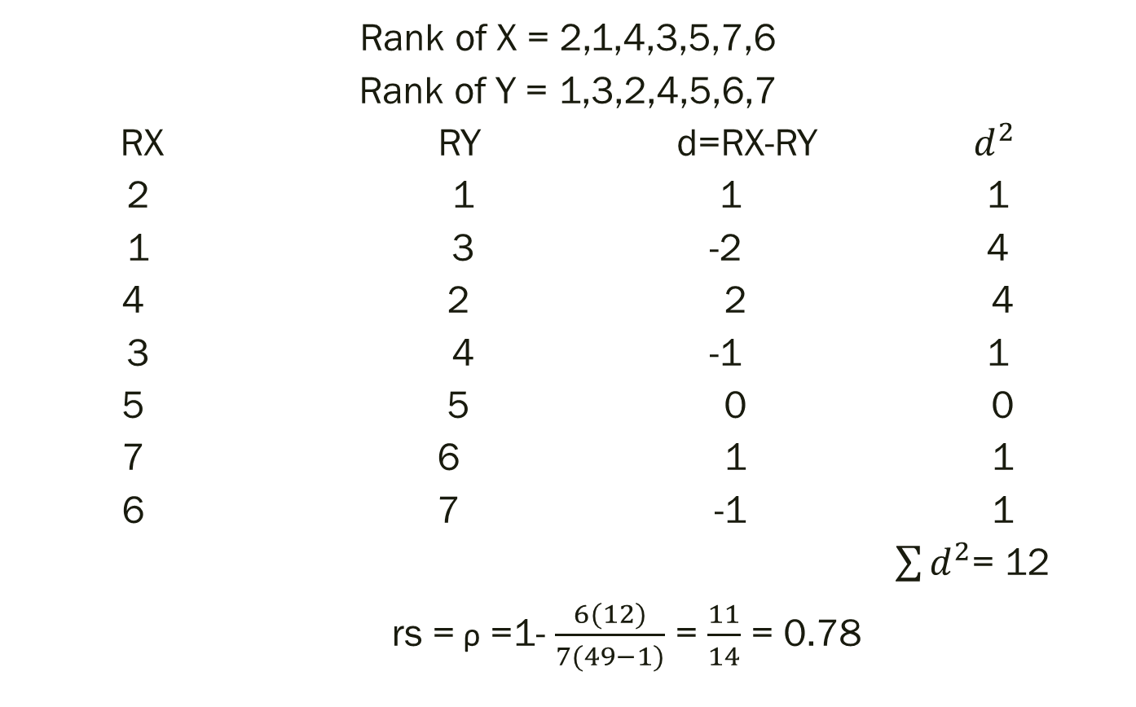
Rank of X = 2,1,4,3,5,7,6
Rank of Y = 1,3,2,4,5,6,7
RX RY d=RX-RY $d^{2}$
2 1 1 1
1 3 -2 4
4 2 2 4
3 4 -1 1
5 5 0 0
7 6 1 1
6 7 -1 1
$\sum{d^{2}}$= 12
rs = ρ =1- $\frac{6(12)}{7(49−1)}$ = $\frac{11}{14}$ = 0.78

Slide 14

Conclusion
if $\left|r_{s}\right| ≥ {r_{s}}_{\frac{α}{2}}$ (n-2) then reject the null hypothesis
As n=6 and $r_{s}$=.78
and $\frac{α}{2}$=0.025
So ${r_{s}}_{\frac{α}{2}}$ (n-2) =.9000
So

Slide 15
When ranks are not given

Slide 16
Test statistic
or

Slide 17

When Ranks are not Given
X Y RX RY d $d^{2}$
35 30 3 5 -2 4
23 33 5 3 2 4
47 45 1 2 -1 1
17 23 6 6 0 0
10 8 7 8 1 1
43 49 2 1 1 1
9 12 8 7 1 1
6 4 9 9 0 0
25 31 4 4 0 0
$\sum{d^{2}}=12$
$r_{s}$= ρ =1-$\frac{{6d}^{2}}{n(n−1)}$ = 1-$\frac{6(12)}{9(81−1)}$ = .9

Slide 18
Conclusion
As rs =.9 So variables are Strongly related and there is positive relationship between the two variables

